Slide 1
January 29, 2026 | 12:00 a.m. – 1:30 p.m. CT
A Healthy Union: How States and Regions Can Lead on Environmental Health and Climate Change
Notes:
[Meghan]

Slide 2


WEBINAR RECORDING
The webinar is being recorded, and you will receive an email when the recording and the slides are posted to the Network website.​
Q & A
Feel free to use the Q&A function throughout the webinar if you have questions, and we will try to get to as many of your questions as possible.
Notes:
[Meghan]

Slide 3

Betsy Lawton, J.D. Deputy Director, Climate and Health Network for Public Health Law

Slide 4
About the Network for Public Health Law
The Network advances health equity and improves health outcomes by providing guidance on the effective use of laws and policies. ​
We work with:
We provide:
Public health officials and practitioners
Policymakers
Attorneys
Community and Advocacy Organizations
Research and analysis​
Strategic consultation and guidance​
Knowledge-building and training

Slide 5


Jill Krueger, J.D. Director, Climate and Health Network for Public Health Law
Susan Kaplan J.D. Environmental Health Lawyer, Professor, and Writer

Slide 6
Federal Retreat on Climate Action
Jill Krueger, J.D. Director, Climate and Health Network for Public Health Law

Slide 7
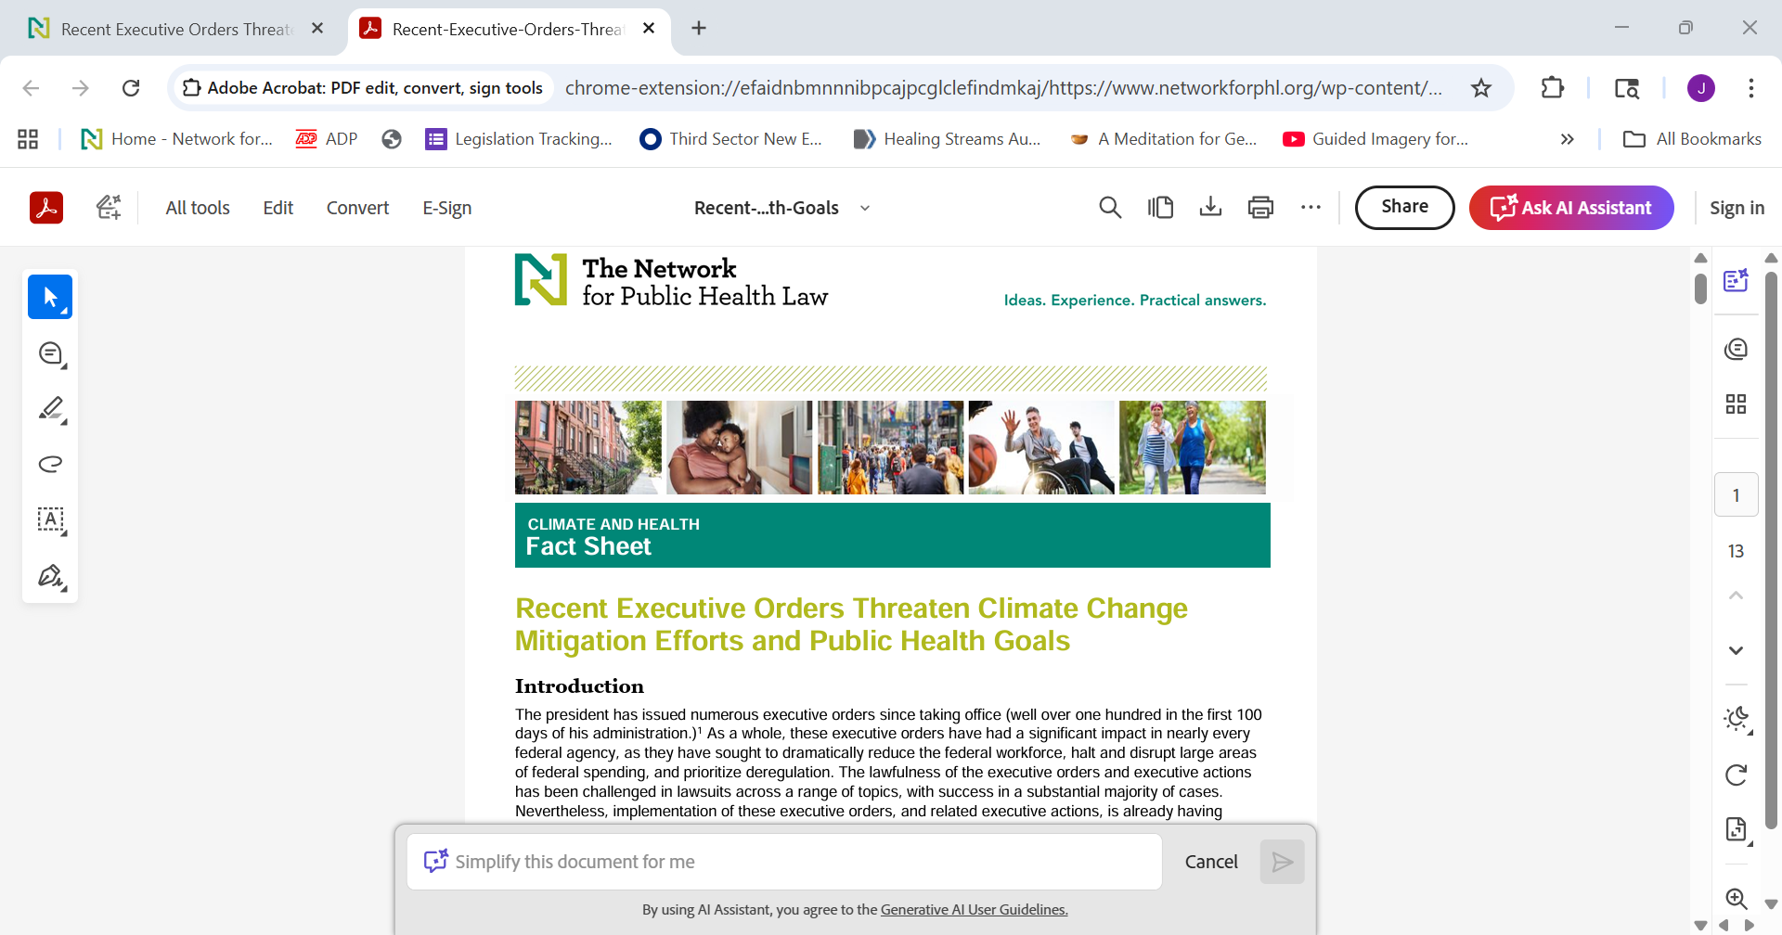
Executive Orders Related to Climate Change in 2025
Increase Production and Distribution of Fossil Fuels
End Environmental Justice Efforts
Assess Federal Role in Emergency Preparedness
Rescind Regulations
Reduce Funding and Staffing
Limit Protections of Public Lands to Extract Resources

Slide 8
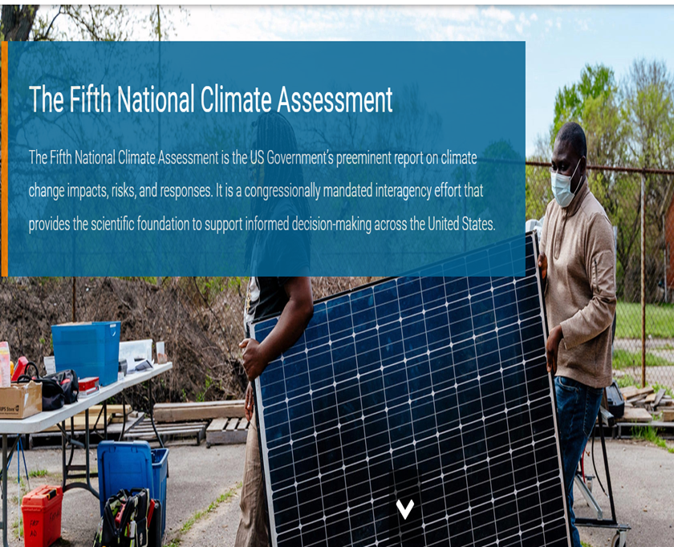
National Climate Assessment
The National Climate Assessment is an authoritative report to inform decision-makers and the public about climate risks
Required under the Global Change Research Act of 1990
Fifth National Climate Assessment released in 2025
Authors for 6th National Climate Assessment dismissed

Slide 9
One Big Beautiful Bill Act
Terminates financial incentives for renewable energy and energy efficiency, such as rooftop solar, heat pumps, and upgraded insulation
Ends electric vehicle tax credit
Repeals statutory authority and claws back unobligated funds for the Greenhouse Gas Reduction Fund. Status of previously obligated funds is still in litigation
However, it is worth noting that a proposal to strip states of authority to regulate the environmental and health impacts of data centers for 10 years was not included in the final version of the Act

Slide 10
Repeal of Endangerment Finding
2009 Finding by the EPA that 6 greenhouse gases emitted by motor vehicles threaten public health and welfare, which activated regulatory authority under the Clean Air Act
EPA has proposed rescinding the endangerment finding, based in part on a “critical review” of climate science
EPA also now argues that the Clean Air Act does not provide authority to regulate greenhouse gases
NASEM report issued in September found that:
EPA’s 2009 finding that human-caused emissions of greenhouse gases adversely affect human health and welfare was accurate, has stood the test of time, and is now reinforced by even stronger evidence.
A final rule is currently under review at the Office of Information and Regulatory Affairs

Slide 11
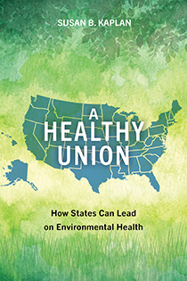
A Healthy Union: How States and Regions Can Lead on Environmental Health and Climate Change
Network for public health law
Presenter: susan kaplan
January 29, 2026

Slide 12
The 1920s: The split starts
Environmental movement
Natural resources conservation Improved sanitation in cities
During the Progressive era, conservationists successfully pushed for the federal government to increase its role in managing natural resources. Sanitary efforts were based in cities and more diffuse.

Slide 13
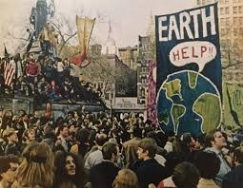
1970s: The environmental movement grows
Congress passes laws including the Clean Air Act, Clean Water Act, and hazardous waste laws, and establishes the U.S. Environmental Protection Agency. Public health fails to develop a similar, broad-based movement.
Photo: Zinn Education Project

Slide 14

Consolidation at environmental agencies
When the EPA was established, programs at federal health agencies that addressed areas like air and drinking water quality were moved to EPA.
The consolidation was meant to strengthen environmental health protection. Instead, it reduced attention to the public health aspects of environmental issues.
This pattern was replicated in states.

Slide 15
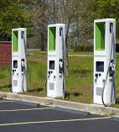
States move to the forefront
California was the only recipient of a waiver under the Clean Air Act that allows it to set motor vehicle emission standards more protective than federal standards. Seventeen states and D.C. have adopted California’s standards.
Photo of EV charging infrastructure: CalMatters

Slide 16
State best practice: California air monitoring law – and additional states

Slide 17

California’s Community Air Protection Program (AB 617)
Particular vulnerability to pollution:
Pregnant women
Children
Environmental Justice communities
Those with pre-existing illness
Elderly
Photo: CDC

Slide 18
Cal EnviroScreen 4.0 indicators

Slide 19
AB 617 requirements
Environmental Justice communities are exposed to more air pollution. The law (enacted in 2017) requires the state to:
develop a strategy to reduce air pollution in highly impacted areas
increase local air quality monitoring in these locations
select locations for emission reduction plans
support these communities with funds and technical assistance
convene community steering committees and consult with them on planning and implementation

Slide 20
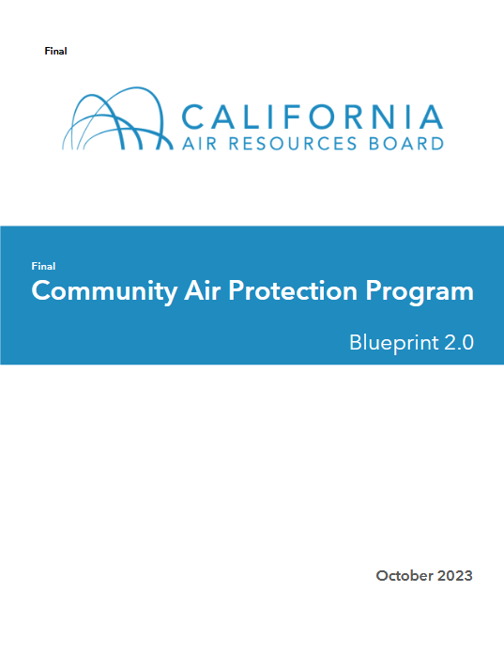
Challenges and successes
Community groups often felt state staff didn’t treat them as equal partners.
Lack of involvement of planning agencies
But a huge shift: “a bold new approach”; local air monitoring and community involvement “transformative”; published two Blueprints

Slide 21
Lessons learned for other states
-Structure so that community steering committees are equal partners with state staff.
-Make use of frequent (typically monthly) meetings and professional facilitators who are “flexible and skillful” at managing the meetings and their inevitable conflicts. “Invest in process.” (Jonathan London)
-Involve zoning and planning agencies; increase focus on land use through partnerships with cities and counties.
-Involve additional state agencies that impact air pollution.

Slide 22

Additional local air monitoring programs
Examples:
New Hampshire allows PurpleAir owners to register their monitors with the state. Owners get maintenance assistance and their data is shared with the public network.
Missouri operates “special purpose monitors” to identify current issues or trends in air pollution.
Photo: The Appalachian Voices – installation of air monitor in Kentucky

Slide 23
State best practice: Collaboration across agencies

Slide 24
The traditional “siloed” approach
The transportation department focuses on building roads and other infrastructure.
The agriculture department focuses on growing food.
Are they also thinking about health impacts of their actions?

Slide 25
Health in All Policies: Tennessee Livability Collaborative
Tennessee Livability Collaborative:
Staff of 24 state agencies, departments and commissions meet bi-monthly to learn about each other’s initiatives.
Benefits:
Reduce duplication. For example, TN collaborative developed a set of livability indicators with East Tennessee State University’s Center for Rural Health Research, which merged its own health care access indicators project with the collaborative to eliminate duplication.
Increase efficiency, innovation, health benefits.

Slide 26
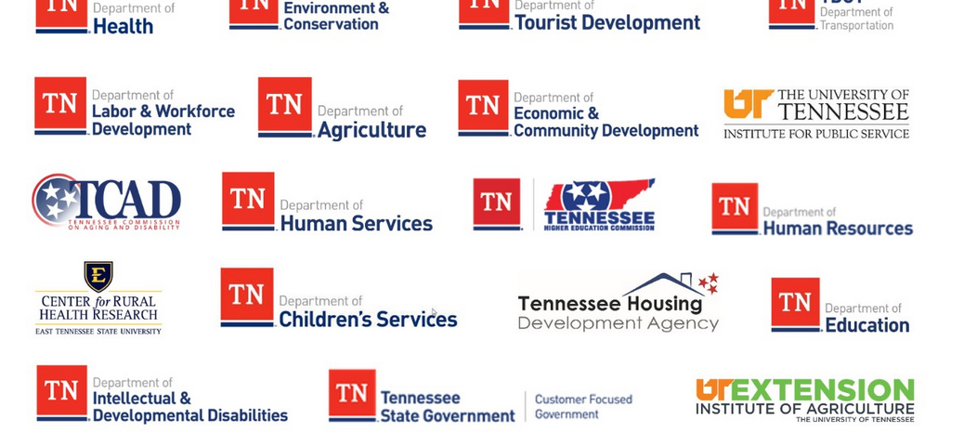

Slide 27

HiAP in Colorado and its municipalities
Initiated by state’s Office of Health Equity
Goals: improve public health and reduce health disparities
Successes include innovative cross-sector activities and strategies like data sharing.
Keys to success include developing relationships; explaining to non-health agency staff why they should participate; agency support for innovative approaches.

Slide 28
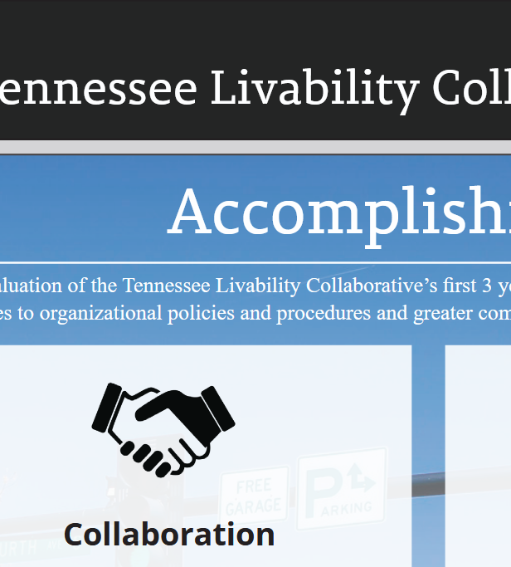
Lessons learned for other states
HiAP efforts can take many different forms and use a variety of terms.
Important to:
educate agency staff about distinction between direct health care and population health
include people who are systems and policy thinkers
demonstrate to staff that it is worthwhile AND not extra work
be creative where lack of dedicated funding/person
share data

Slide 29
State best practice: Regional efforts to address climate change

Slide 30
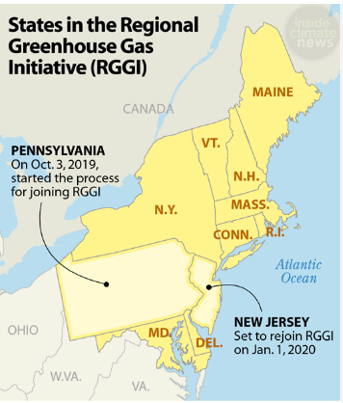
Regional Greenhouse Gas Initiative (RGGI)
An overall cap on industrial CO2 emissions is set; each participant can buy and sell within their allowance. Funds from sales go to participating states, which invest them to support clean energy.
Graphic: Inside Climate News

Slide 31
RGGI successes
The large number of participating states helped prevent “leakage,” or states buying less expensive but likely dirtier energy (like from coal plants) from non-RGGI states.
Auctions of allowances raised money to support more clean energy options.
Reduced CO2 emissions. Made dirtier energy more expensive and supported development of clean energy.
A co-benefit: reduced air pollution like PM

Slide 32

How RGGI states collaborate
States develop Model Rule that provides framework. Each state then enacts its own law governing its participation.
Professional staff manages RGGI, Inc., a 501(c)(3) non-profit organization.
Board of directors – the energy and environmental heads of each member state – makes regulatory decisions. They review the Model Rule every few years and make changes such as lowering the emissions cap.

Slide 33
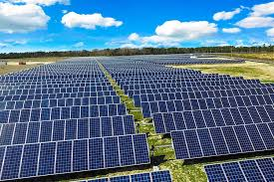
RGGI keys to success
Close working relationship of state environmental and energy agencies
Working relationships across states from previous initiatives
Political and technical flexibility to meet needs of states
Efficiencies: With numerous states, drew on broader array of policy experts, etc. and reduced start-up costs Photo: MIT News

Slide 34
Southeast Regional Partnership for Planning and Sustainability (SERPPAS)
An “unconventional” partnership of federal and state military, environmental and natural resources agencies and more in the Southeast.
Parties achieve their goals by working together, not opposing each other.
Example: the “woodpecker wars” at Fort Bragg

Slide 35
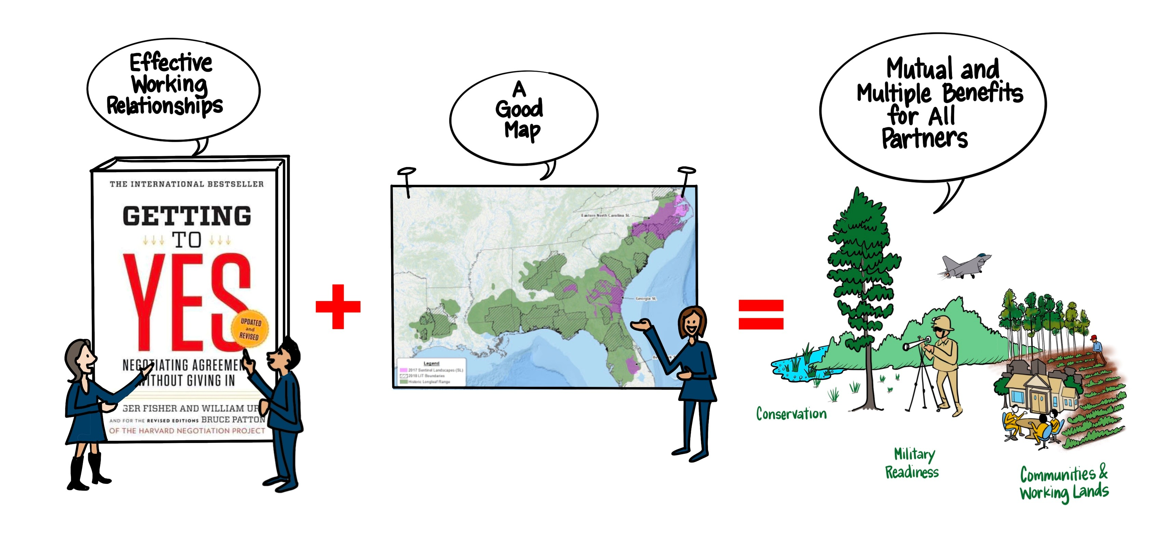
SERPPAS keys to success
Forum’s structure based on “Getting to Yes.”
Unconventional partnerships based on trust. Woodpeckers require zones of forest; partner The Nature Conservancy identified parcels between military bases, purchased and protected them along with the Army and U.S. Fish and Wildlife Service.
Graphic: Wittmann Studios

Slide 36
How SERPPAS partners collaborate
Support efforts through development of GIS tool that integrates federal, military, and state data.
Prioritize in-person meetings and networking to help build trust.
SERPPAS structure
Principals: senior leaders of participating state and federal agencies. Identify SERPPAS priorities, develop strategies to implement them, provide overall leadership.
Steering committee: senior staff of participating state and federal agencies. Lead development of projects and communicate about SERPPAS within their own agencies.
Working groups: Identify shared objectives. Each has a leader from an agency or other partner.

Slide 37
Benefits of a regional approach
-Build on shared regional characteristics; can be more place-specific than federal approach.
-Pollution doesn’t stop at the state line; regional approaches can more effectively protect environmental health.
RGGI: The more members, the less “leakage”
-Share – and increase access to – expertise and resources.
-Can lead to more effective decision making on complex issues with multiple components.
SERPPAS overlap of military, environmental, etc. goals AND benefits

Slide 38
Advocating for environmental health policies

Slide 39
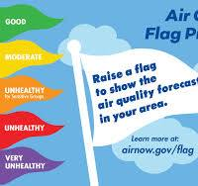
Solutions to expand environmental health policies
1. Increase environmental health education
2. Carry out expansive economic analyses
3. Expand government-university-industry partnerships
4. Take local action
Graphic: Utah Asthma Program

Slide 40

Solutions, cont’d
5. End state pre-emption of local policymaking
6. Increase agency collaboration
7. Expand policy surveillance and legal epidemiology
8. Re-fund decimated state public health agencies
Image: Wiley

Slide 41
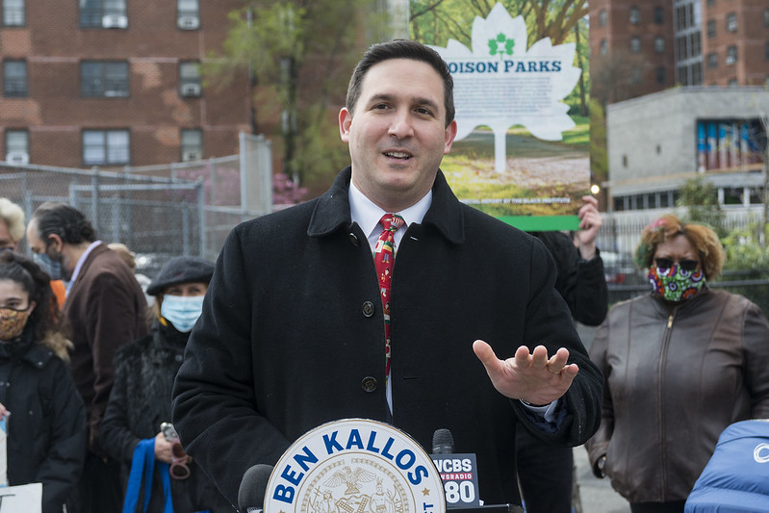
Advocacy steps
-Research policies
-Build a coalition
-Identify a champion
-Garner media and public attention
Photo of Councilor Ben Kallos: New York City Council

Slide 42


A Healthy Union
Susan B. Kaplan
Use discount code UNION to save 20%
www.islandpress.org/books/ healthy-union

Slide 43

QUESTIONS?
Notes:
[Meghan]

Slide 44
Thank You

Slide 45

Connect With Us
Request Assistance Contact one of our team leads or visit our website to request a consultation.
Explore our resources Search our fact sheets, surveys and issue briefs.
Get our newsletters Sign up to receive our biweekly Network Report and quarterly Judicial Trends in Public Health.
Attend our events Join us at our bi-annual conference, or monthly for one of our webinars.

Slide 46








Our Leadership Team
Quang “Q” Dang, J.D. Executive Director qdang@networkforphl.org
Darlene Huang Briggs, J.D., M.P.H. Deputy Director, Special Projects, Public Health Authority and Modernization dhbriggs@networkforphl.org
Allison N. Winnike, J.D. Director, Western Region, Emergency Preparedness and Response, Vaccines, Immunizations awinnike@networkforphl.org
Jill Krueger, J.D. Director, Climate and Health jkrueger@networkforphl.org
Kathleen Hoke, J.D. Director, Eastern Region, Reproductive and Maternal Health, Food Security khoke@networkforphl.org
April Shaw, J.D. Ph.D. Deputy Director, Health Equity, Racial Equity, Mental Health, Community Connectedness ashaw@networkforphl.org
Stephen Murphy, J.D. Director, Mid-States Region, Data Modernization, Data Sharing and Privacy smurphy@networkforphl.org
Corey Davis, J.D., M.S.P.H. Director, Harm Reduction cdavis@networkforphl.org

Slide 47
Network attorneys can provide consultation and guidance to:
Identify the ways in which laws and policies may or may not impact a particular project or community; or the potential impact on different populations within a community.
Provide examples of and compare public health laws or policy strategies from other jurisdictions.
Analyze the legal authority to implement a policy or law, or reforms.
Apply equity tools to laws and policies.
TELL US WHAT YOU’RE WORKING ON.
WE’RE READY TO HELP.
REQUEST A CONSULTATION

Slide 48

Disclaimer The Network for Public Health Law promotes public health and health equity through non-partisan educational resources and technical assistance. The materials provided are provided solely for educational purposes and do not constitute legal advice. The Network’s provision of these materials does not create an attorney-client relationship with you or any other person and is subject to the Network’s Disclaimer.
networkforphl.org

