Slide 1
February 19, 2026 | 11:00 a.m. – 12:30 p.m. CT
Beyond Borders: Global Legal Innovations for Countering “Parental Rights” and “Prenatal Personhood” in the U.S. Abortion Context
Notes:
[Meghan]

Slide 2


WEBINAR RECORDING
The webinar is being recorded, and you will receive an email when the recording and the slides are posted to the Network website.​
Q & A
Feel free to use the Q&A function throughout the webinar if you have questions, and we will try to get to as many of your questions as possible.
Notes:
[Meghan]

Slide 3

Kathi Hoke, J.D. Director, Network for Public Health Law—Eastern Region
MODERATOR
Beyond Borders: Global Legal Innovations for Countering “Parental Rights” and “Prenatal Personhood” in the U.S. Abortion Context February 19, 2026 | 11:00 a.m. – 12:30 p.m. CT

Slide 4
About the Network for Public Health Law
The Network advances health equity and improves health outcomes by providing guidance on the effective use of laws and policies. ​
We work with:
We provide:
Public health officials and practitioners
Policymakers
Attorneys
Community and Advocacy Organizations
Research and analysis​
Strategic consultation and guidance​
Knowledge-building and training

Slide 5




Jennifer Driver, M.P.H. Senior Director of Reproductive Rights, State Innovation Exchange
Dana Repka, LL.M. Research Associate University of Toronto Faculty of Law
SPEAKERS
Wendy Heipt, J.D. Senior Reproductive Justice Counsel Legal Voice
Rebecca Reingold, J.D. Associate Director O’Neill Institute for National and Global Health Law

Slide 6


Young People’s Abortion Decision-Making in the U.S.
Jennifer Driver
Senior Director, Reproductive Rights
State Innovation Exchange & SiX Action
jennifer@stateinnovation.org
Notes:
This resource is a five-part comparative report series examining how abortion is regulated globally and what that means for the United States.
Each report focuses on a major structural battleground in abortion law: countering prenatal personhood, removing criminal law from abortion regulation, limiting parental involvement mandates for young people, regulating religious refusals, and treating abortion as health care rather than as a moral or criminal exception.
Across all five topics, the reports synthesize international human rights standards, global public health guidance, and the jurisprudence and legislation of selected countries. They then situate the United States within that broader global context and reflect on implications for state-level policymaking.
The unifying theme is abortion exceptionalism. Abortion is health care, yet it is regulated unlike any other essential medical service. While exceptionalism exists in many countries, the United States represents an extreme example, both before and after Dobbs.
The purpose of this series is not to be exhaustive. It is to expand our legal imagination. It highlights concrete policy models and arguments from around the world that demonstrate abortion can be regulated in ways that respect autonomy, dignity, and public health.
At a time when state legislatures are the primary arena for reproductive rights in the U.S., comparative law becomes a practical tool for innovation, resistance, and reform.

Slide 7




Abortion as Health Care Report
Critiques of Abortion Criminalization
Regulation of Religious Refusals for Abortion Care
Regulation of Abortion Decision-Making Among Young People
Policy Considerations
Notes:
This resource is a five-part comparative report series examining how abortion is regulated globally and what that means for the United States.
Each report focuses on a major structural battleground in abortion law: countering prenatal personhood, removing criminal law from abortion regulation, limiting parental involvement mandates for young people, regulating religious refusals, and treating abortion as health care rather than as a moral or criminal exception.
Across all five topics, the reports synthesize international human rights standards, global public health guidance, and the jurisprudence and legislation of selected countries. They then situate the United States within that broader global context and reflect on implications for state-level policymaking.
The unifying theme is abortion exceptionalism. Abortion is health care, yet it is regulated unlike any other essential medical service. While exceptionalism exists in many countries, the United States represents an extreme example, both before and after Dobbs.
The purpose of this series is not to be exhaustive. It is to expand our legal imagination. It highlights concrete policy models and arguments from around the world that demonstrate abortion can be regulated in ways that respect autonomy, dignity, and public health.
At a time when state legislatures are the primary arena for reproductive rights in the U.S., comparative law becomes a practical tool for innovation, resistance, and reform.

Slide 8
The barriers adults face when seeking abortion care are magnified for minors
Travel costs: gas, flights, hotels, food, childcare
Missing school or work
Cost of abortion care if they cannot use insurance
Immigration status and photo ID requirements
Delays + Intimidation
Youth who also often experience additional challenges;
Emotional abuse, physical abuse and family violence,
Immigration Detention/Foster Care/Child Protective Services involvement,
Orphan de facto: parents are deceased, missing, or incarcerated
Notes:
When we talk about young people’s access to health care, we are really talking about power.
Who gets to decide? Who gets to be trusted? Who gets to keep their medical information private?
In the United States, we are witnessing a deliberate rollback of young people’s autonomy in health care, particularly in sexual and reproductive health.
The Beyond Borders report gives us a powerful comparative lens to understand just how out of step the U.S. has become.

Slide 9
Youth remain a primary target of anti-abortion extremists
Texas: A lawsuit was brought against the TItle X family planning program under the claim that Texas’s parental involvement law precedes it. Conservative judges have upheld the claim, cutting off birth control, STI testing & treatment and other care for minors in the state.
Florida: The attorney general intervened in a judicial bypass case and a court effectively stopped judicial bypass in Florida immediately.
Nevada: A parental involvement law was allowed to take effect after being enjoined for 20 years after the Dobbs decision.
State lawmakers are fighting to protect youth. In 2025, Connecticut’s Public Act No. 25-28 passed to give young people an affirmative right to pregnancy related care.
Notes:
When we talk about young people’s access to health care, we are really talking about power.
Who gets to decide? Who gets to be trusted? Who gets to keep their medical information private?
In the United States, we are witnessing a deliberate rollback of young people’s autonomy in health care, particularly in sexual and reproductive health.
The Beyond Borders report gives us a powerful comparative lens to understand just how out of step the U.S. has become.

Slide 10

Repeal mandatory parental involvement laws
Strengthen confidentiality protections
Align with evolving capacity standards
Notes:
Policy change is possible at the state level.
States can repeal or reform parental involvement requirements.
They can codify confidentiality protections.
They can shift from rigid age cutoffs to individualized capacity assessments.
These are not radical ideas globally. They are standard practice elsewhere.

Slide 11
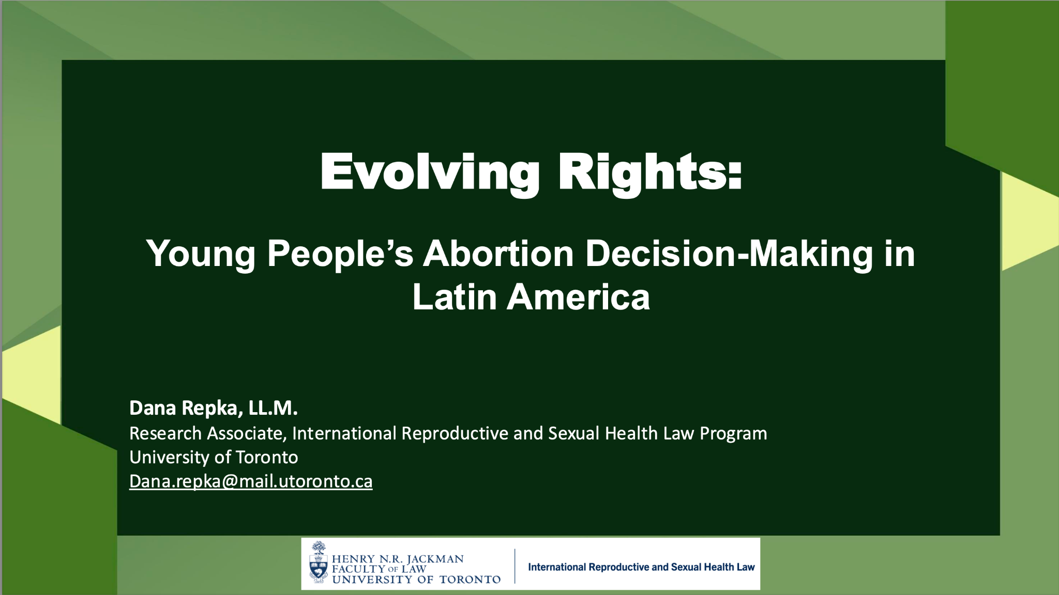
Young People’s Abortion Decision-Making in Latin America
Dana Repka
Research Associate
International Reproductive and Sexual Health Law Program
University of Toronto
dana.repka@mail.utoronto.ca

Slide 12
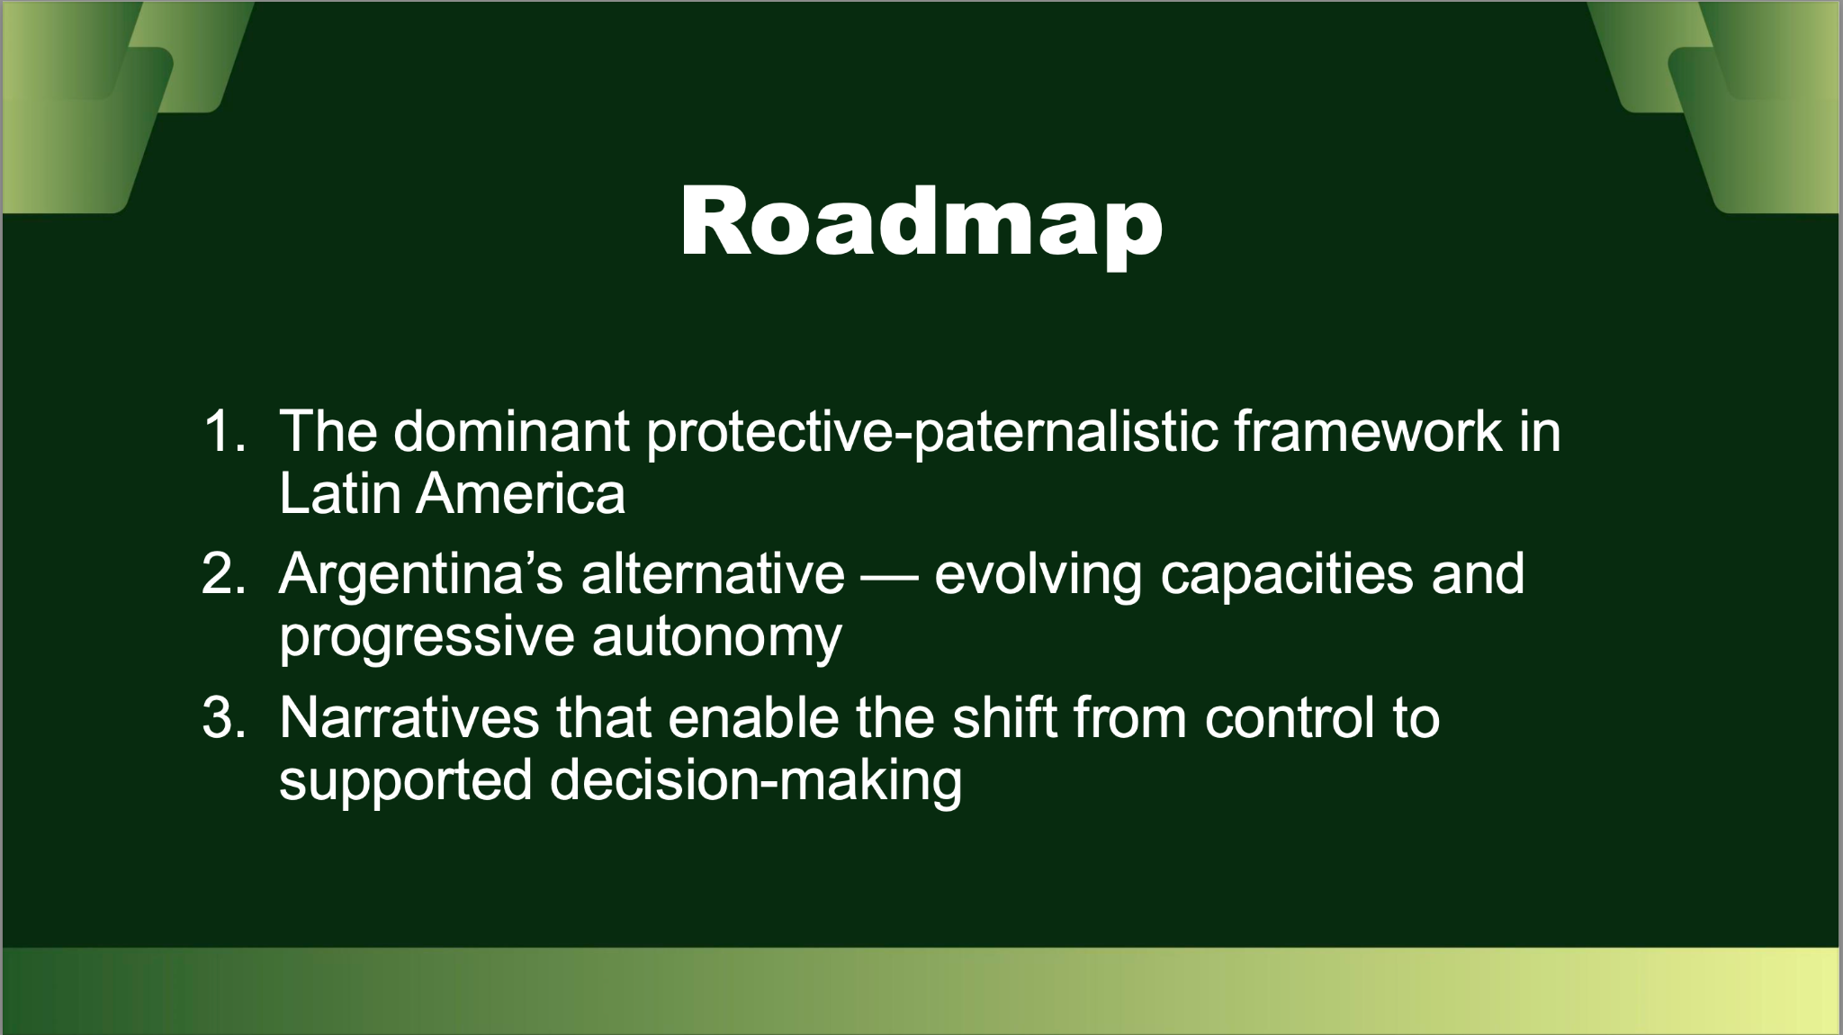
Young People’s Abortion Decision-Making in Latin America
Dana Repka
Research Associate
International Reproductive and Sexual Health Law Program
University of Toronto
dana.repka@mail.utoronto.ca

Slide 13
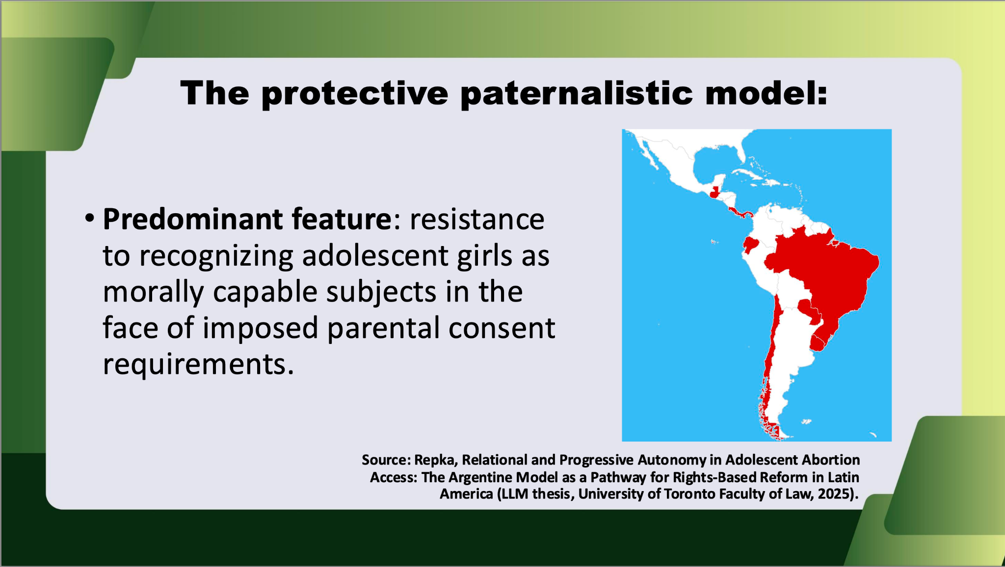
Young People’s Abortion Decision-Making in Latin America
Dana Repka
Research Associate
International Reproductive and Sexual Health Law Program
University of Toronto
dana.repka@mail.utoronto.ca

Slide 14
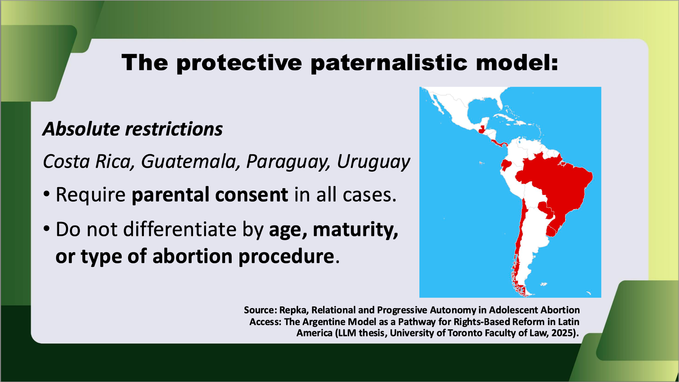
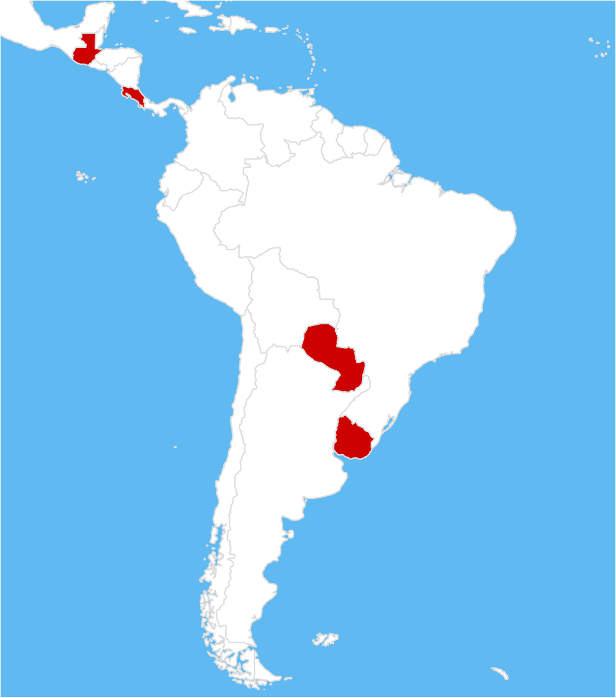
Young People’s Abortion Decision-Making in Latin America
Dana Repka
Research Associate
International Reproductive and Sexual Health Law Program
University of Toronto
dana.repka@mail.utoronto.ca

Slide 15
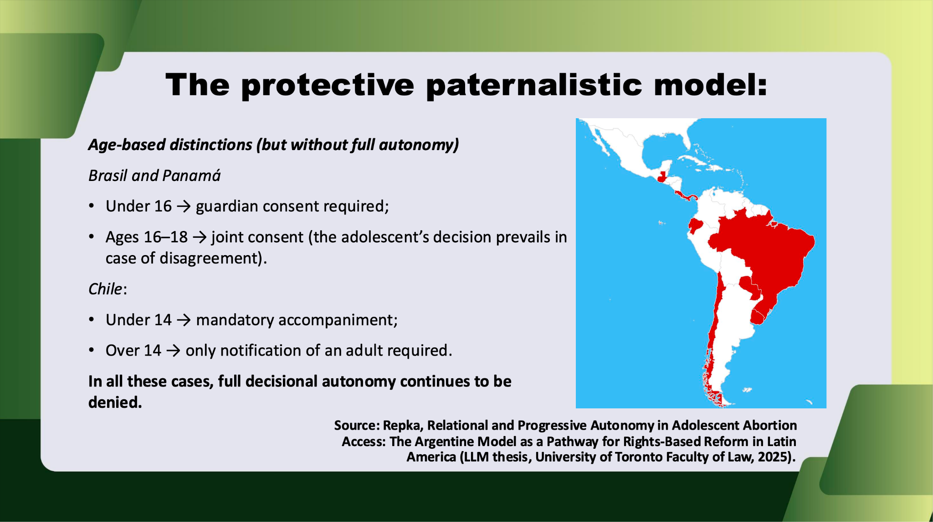
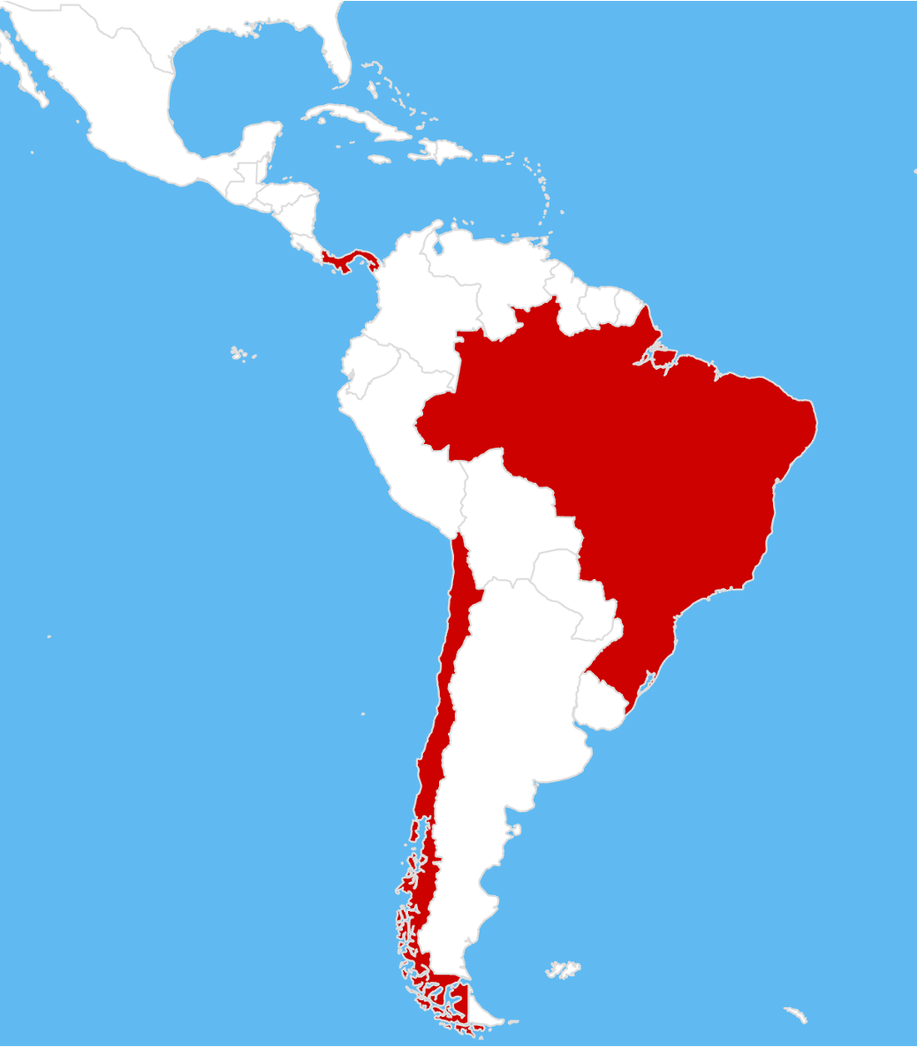
Young People’s Abortion Decision-Making in Latin America
Dana Repka
Research Associate
International Reproductive and Sexual Health Law Program
University of Toronto
dana.repka@mail.utoronto.ca

Slide 16
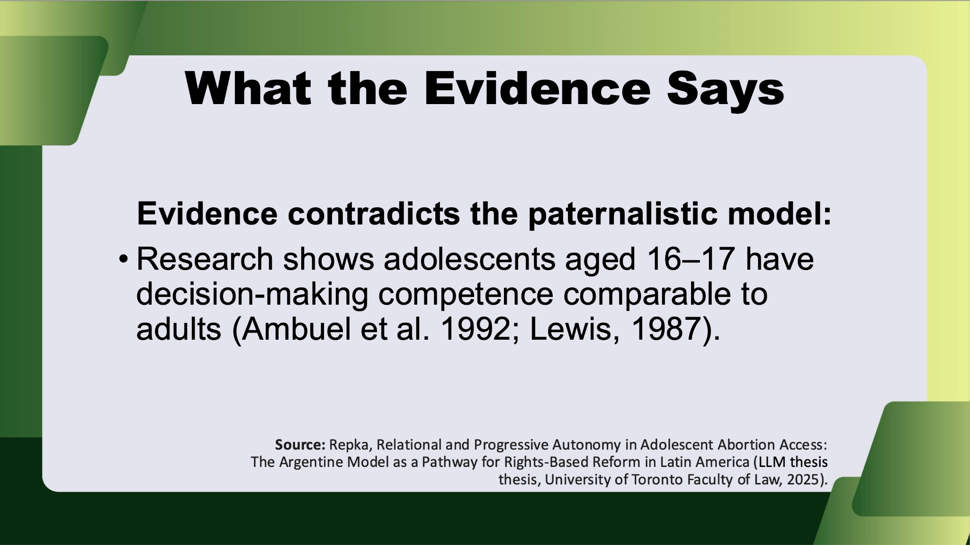
Young People’s Abortion Decision-Making in Latin America
Dana Repka
Research Associate
International Reproductive and Sexual Health Law Program
University of Toronto
dana.repka@mail.utoronto.ca

Slide 17
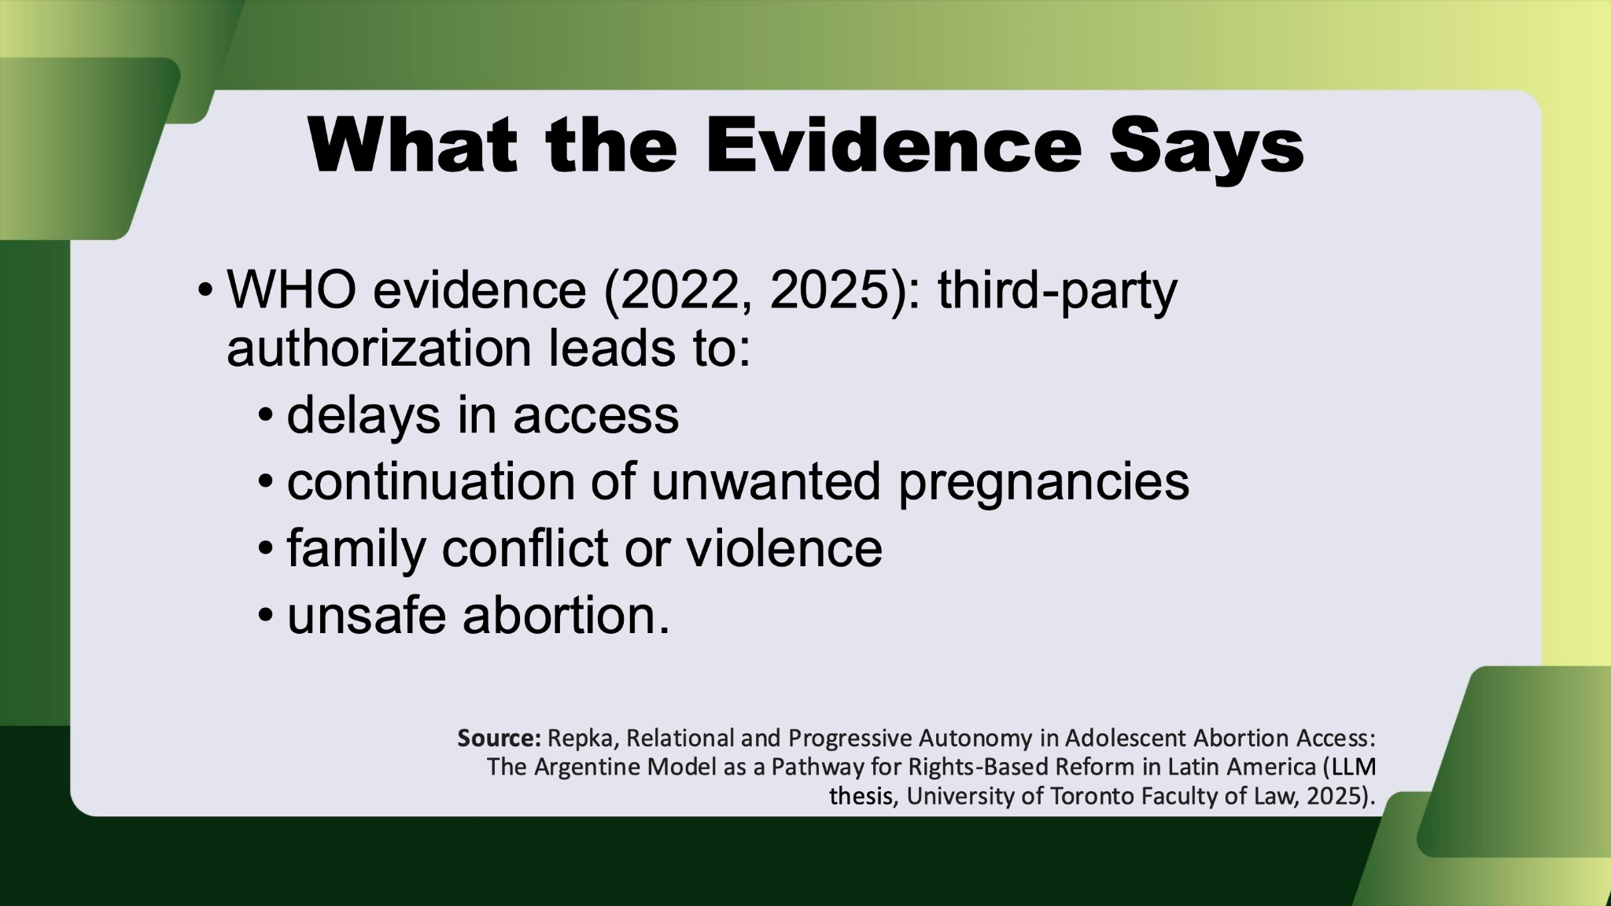
Young People’s Abortion Decision-Making in Latin America
Dana Repka
Research Associate
International Reproductive and Sexual Health Law Program
University of Toronto
dana.repka@mail.utoronto.ca

Slide 18
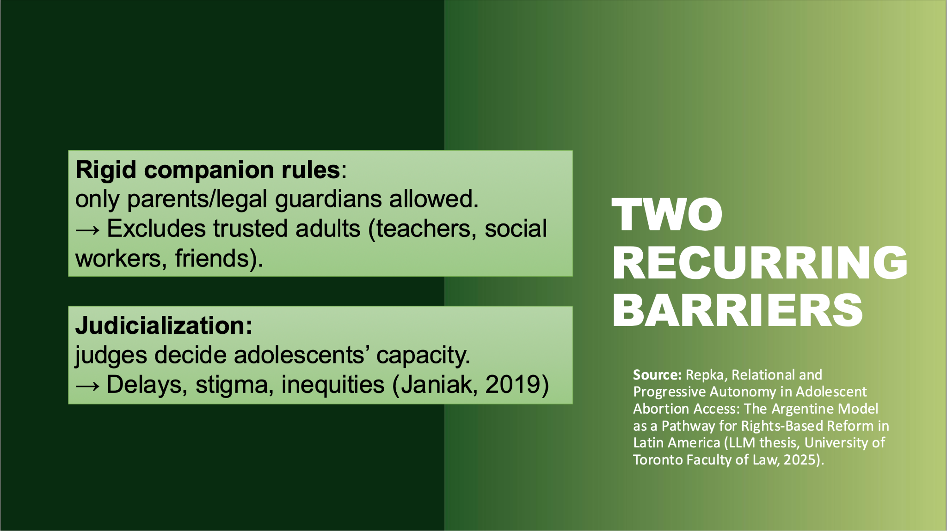
Young People’s Abortion Decision-Making in Latin America
Dana Repka
Research Associate
International Reproductive and Sexual Health Law Program
University of Toronto
dana.repka@mail.utoronto.ca

Slide 19
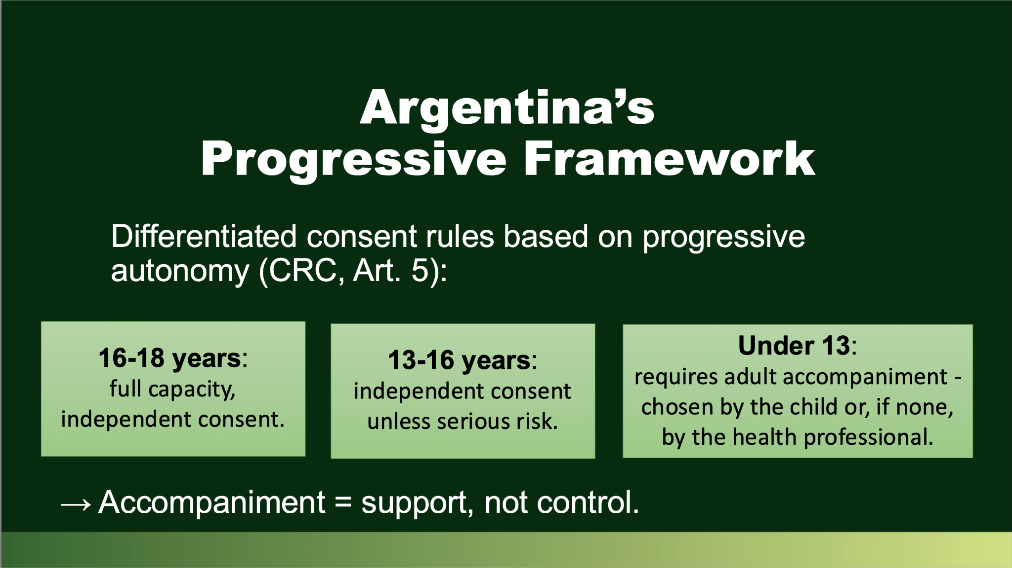
Young People’s Abortion Decision-Making in Latin America
Dana Repka
Research Associate
International Reproductive and Sexual Health Law Program
University of Toronto
dana.repka@mail.utoronto.ca

Slide 20
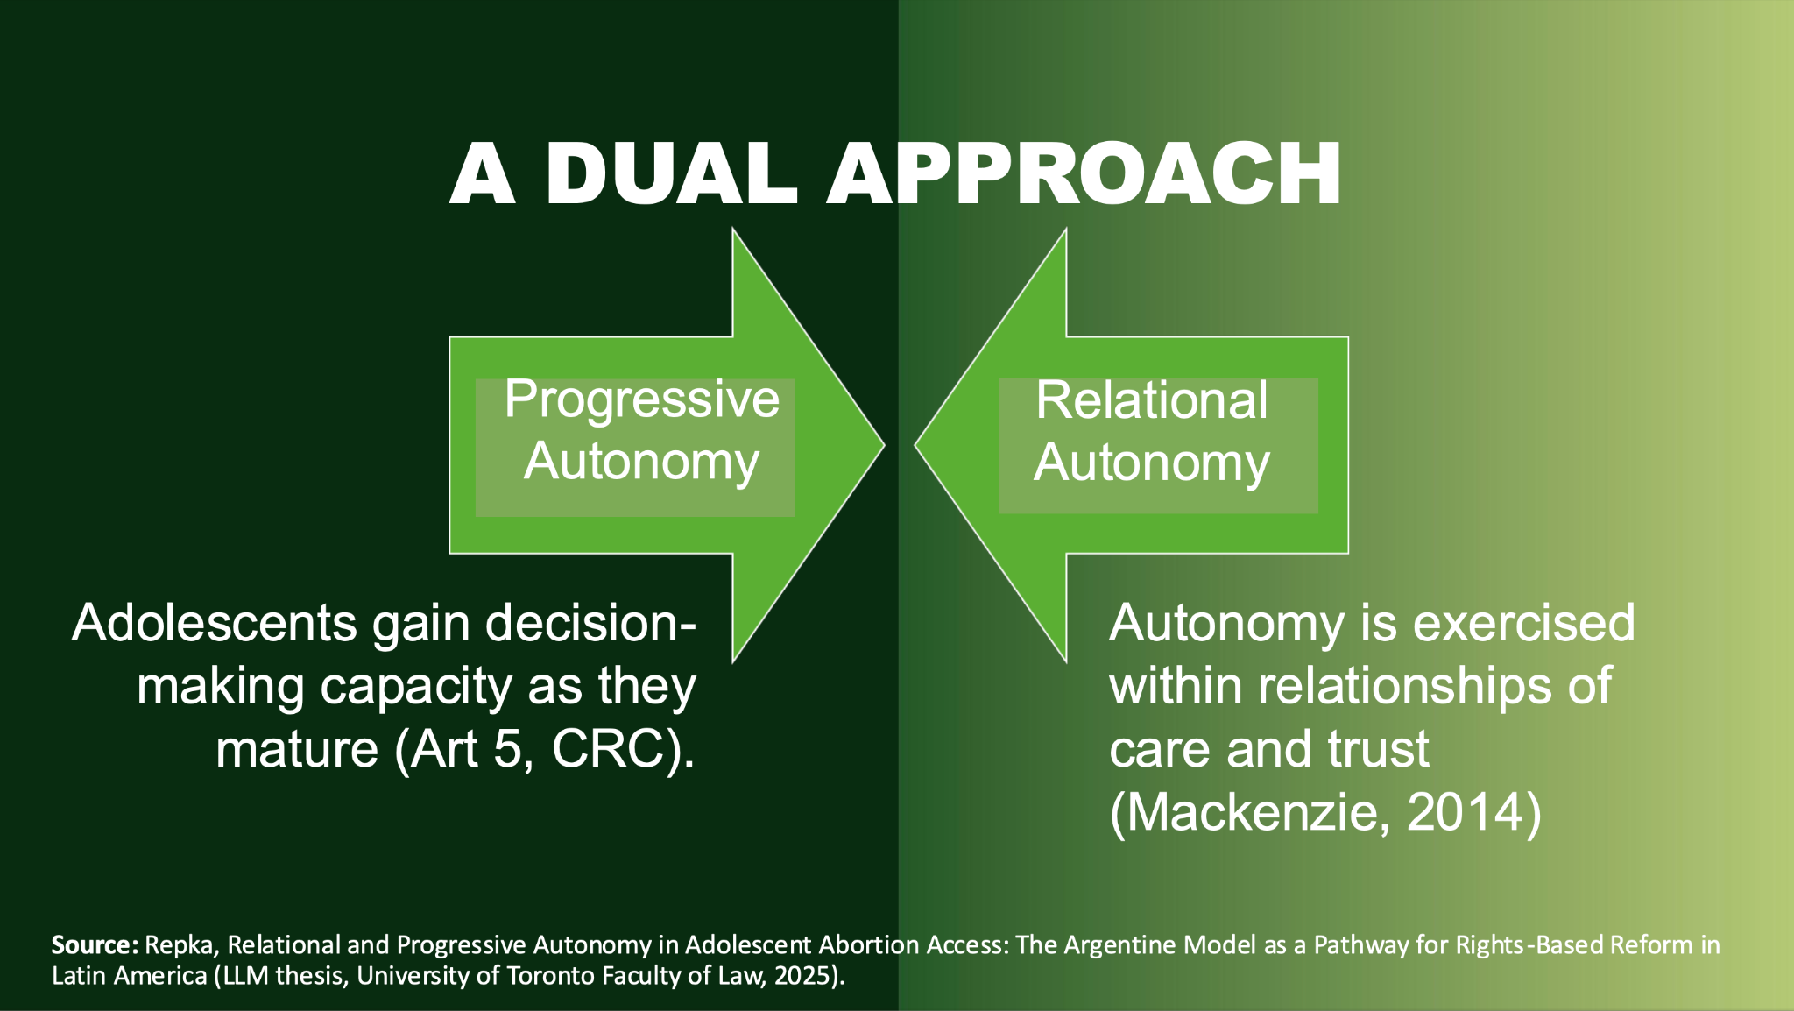
Young People’s Abortion Decision-Making in Latin America
Dana Repka
Research Associate
International Reproductive and Sexual Health Law Program
University of Toronto
dana.repka@mail.utoronto.ca

Slide 21
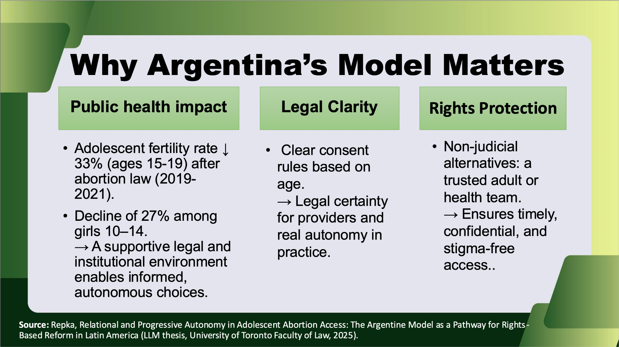
Young People’s Abortion Decision-Making in Latin America
Dana Repka
Research Associate
International Reproductive and Sexual Health Law Program
University of Toronto
dana.repka@mail.utoronto.ca

Slide 22
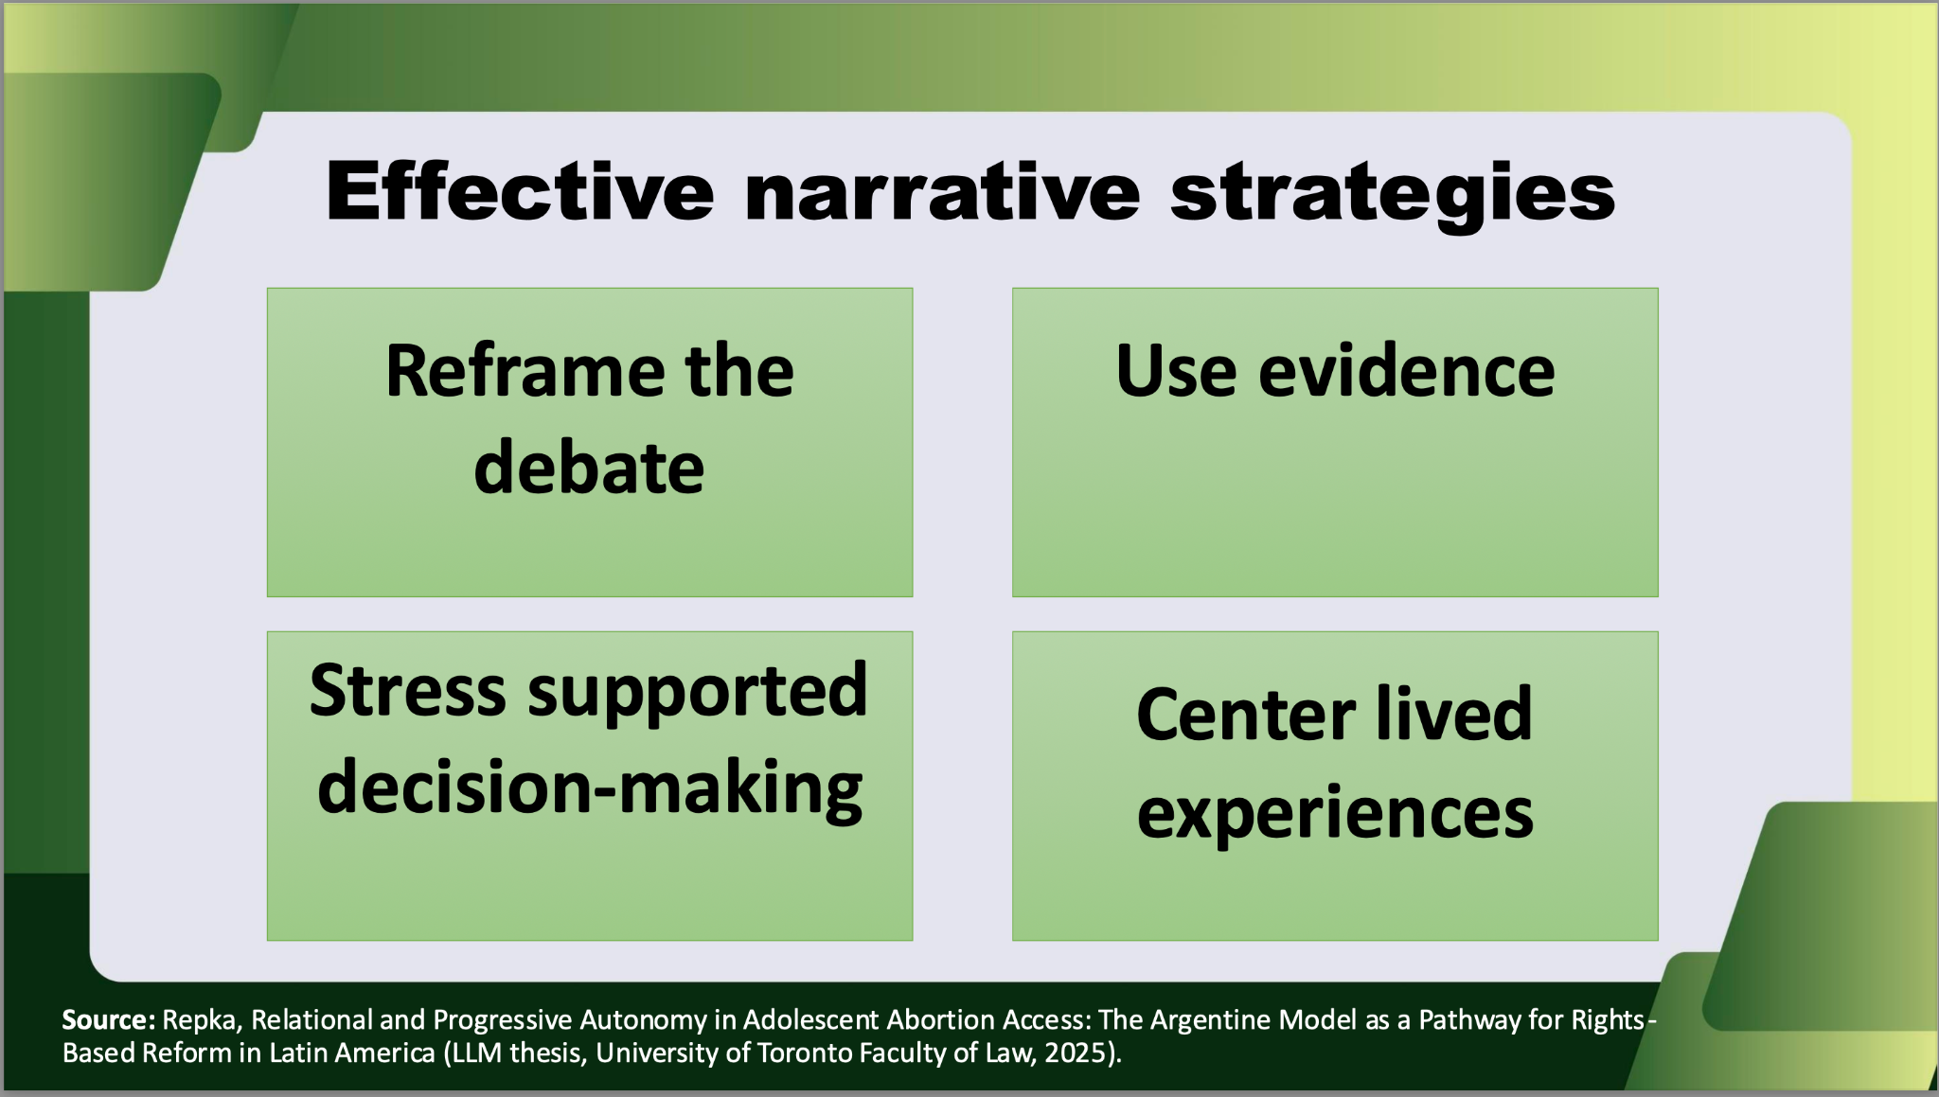
Young People’s Abortion Decision-Making in Latin America
Dana Repka
Research Associate
International Reproductive and Sexual Health Law Program
University of Toronto
dana.repka@mail.utoronto.ca

Slide 23

Young People’s Abortion Decision-Making in Latin America
Dana Repka
Research Associate
International Reproductive and Sexual Health Law Program
University of Toronto
dana.repka@mail.utoronto.ca

Slide 24

Legal Fetal Personhood in the U.S.
Wendy Heipt
Senior Reproductive Rights Counsel
Legal Voice
wheipt@legalvoice.org

Slide 25
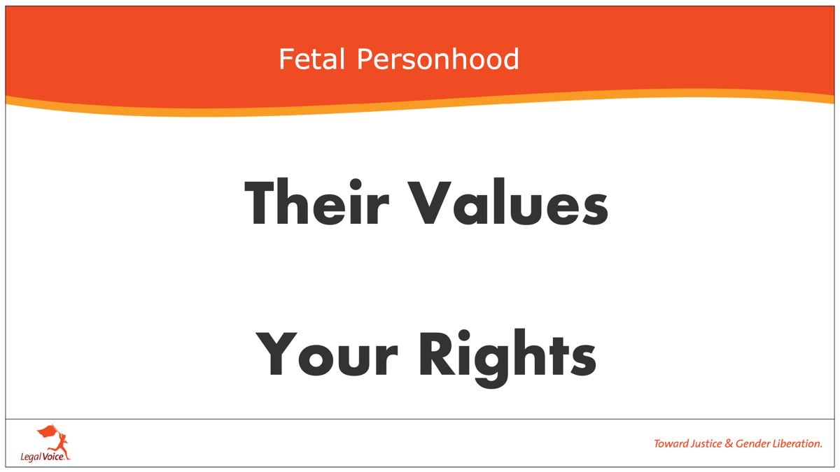

Slide 26
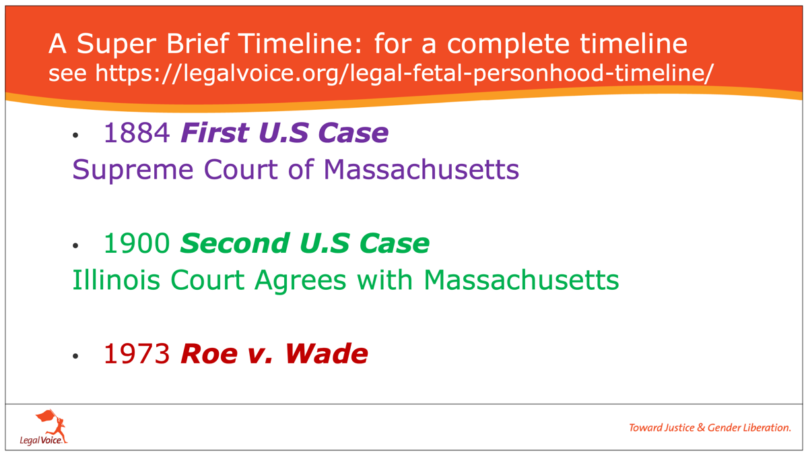

Slide 27
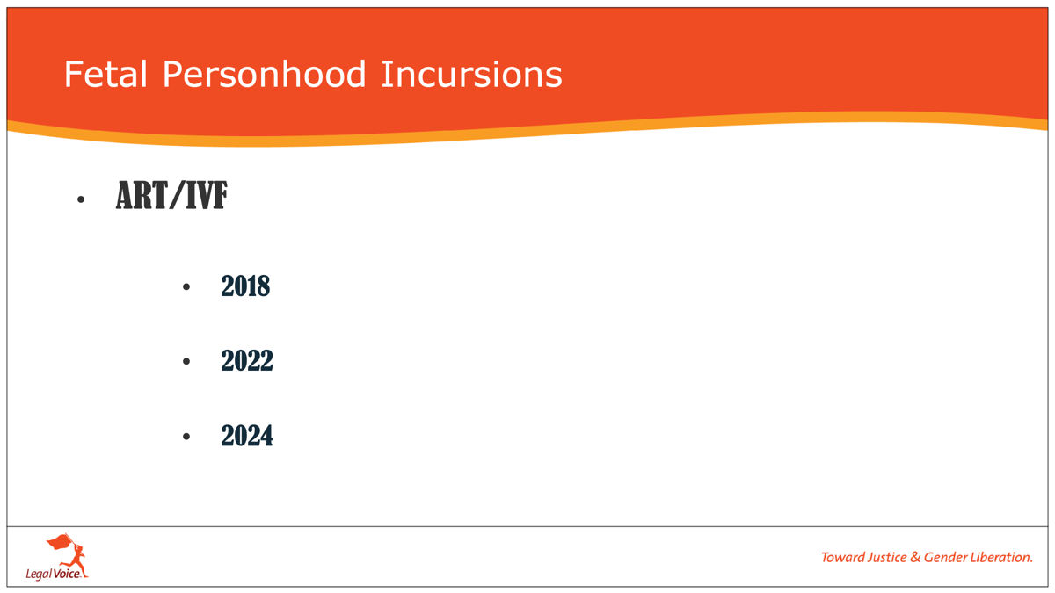

Slide 28
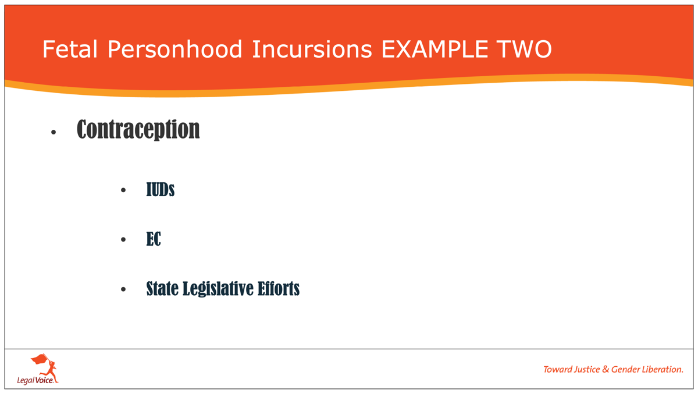

Slide 29
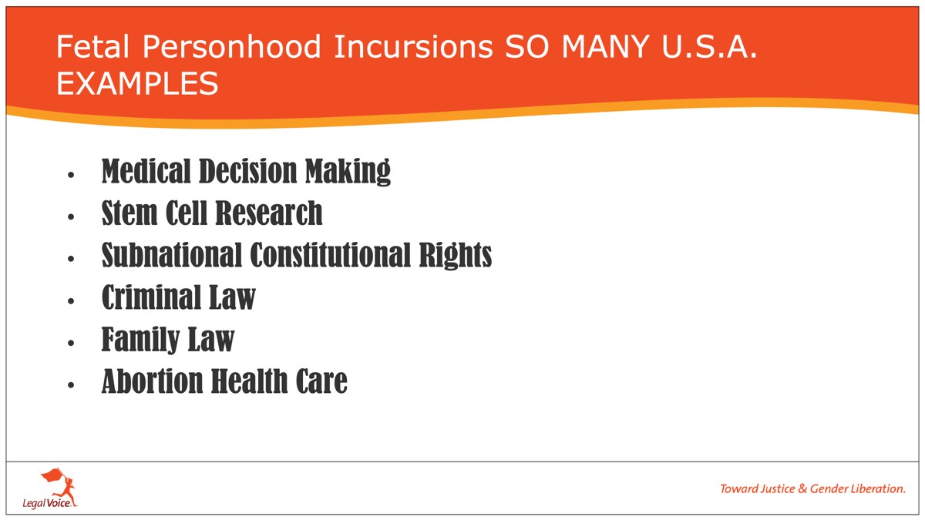

Slide 30
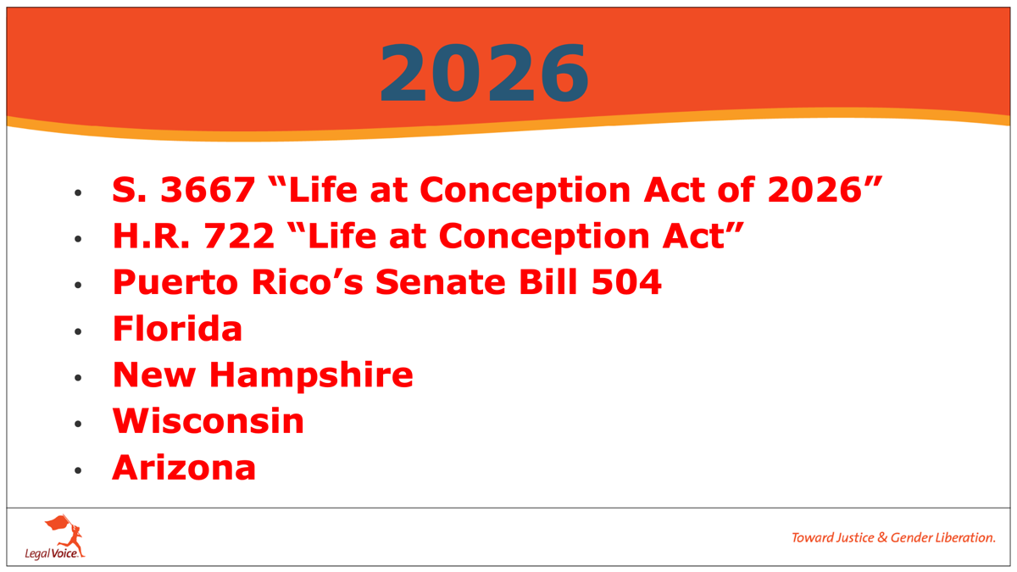

Slide 31
Prenatal Personhood in Latin America
Rebecca Reingold
Associate Director
O’Neill Institute for National and Global Health Law
Georgetown University Law Center
rr951@georgetown.edu

Slide 32
Role of judges
International law
Comparative law
Status of prenatal life
Rights violations
Not the role of the court to determine when life begins, noting that it can be evaluated from “biological, medical, ethical, moral, philosophical, and religious perspectives…”
“regulatory trends in international law do not lead to the conclusion that the embryo should be treated in the same way as a person, or that it has a right to life.”
“a legitimate interest in protecting prenatal life is recognized, but this interest is distinguished from the right to life.”
“it is not applicable to grant the status of person to the embryo.”
Ban constitutes an excessive and arbitrary interference with both individuals’ and couples’ rights to personal integrity, personal freedom, and private and family life.

Slide 33
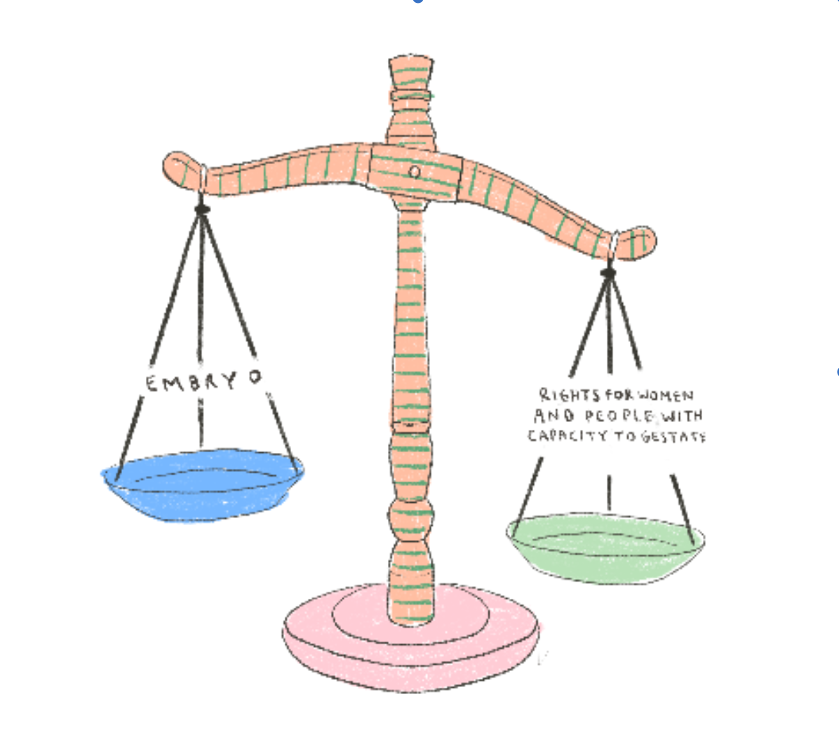
According to Mexico’s federal Supreme Court, prenatal personhood:
Alters the cultural and social meaning of rights and contributes to building a social imaginary that is adverse to the exercise of pregnant people’s rights;
Increases stigma for those who seek these health care services;
Generates a false fear in health personnel;
Causes inequality in the provision of health services among pregnant people;
Among other constitutionally unacceptable consequences.
GIRE, Step by Step: Mexico’s Supreme Court Rulings on Abortion

Slide 34


vs.
President Michelle Bachelet
EC approval (2001)
Supreme Decree No. 48 (2007)
Law 20.418 (2010)
Constitutional Court of Chile
Case N° 591 (2007)
Case Nº 740 (2008)
Case Nº 1588 (2010)

Slide 35

BEYOND BORDERS:
Bringing Abortion Law and Policy Experiences from Around the World to the U.S.
If you are interested in learning more, please email us at:
reproductiverights@stateinnovation.org

Slide 36
Jennifer Driver jennifer@stateinnovation.org Senior Director, Reproductive Rights, State Innovation Exchange & SiX Action | Dana Repka dana.repka@mail.utoronto.ca Research Associate, International Reproductive and Sexual Health Law Program, University of Toronto | Wendy Heipt wheipt@legalvoice.org Senior Reproductive Rights Counsel, Legal Voice | Rebecca Reingold rr951@georgetown.edu Associate Director, O’Neill Institute for National and Global Health Law, Georgetown University Law Center

Slide 37

QUESTIONS?
Notes:
[Meghan]

Slide 38
Thank You

Slide 39

Connect With Us
Request Assistance Contact one of our team leads or visit our website to request a consultation.
Explore our resources Search our fact sheets, surveys and issue briefs.
Get our newsletters Sign up to receive our biweekly Network Report and quarterly Judicial Trends in Public Health.
Attend our events Join us at our bi-annual conference, or monthly for one of our webinars.

Slide 40








Our Leadership Team
Quang “Q” Dang, J.D. Executive Director qdang@networkforphl.org
Darlene Huang Briggs, J.D., M.P.H. Deputy Director, Special Projects, Public Health Authority and Modernization dhbriggs@networkforphl.org
Allison N. Winnike, J.D. Director, Western Region, Emergency Preparedness and Response, Vaccines, and Infectious Diseases awinnike@networkforphl.org
Jill Krueger, J.D. Director, Climate and Health jkrueger@networkforphl.org
Kathleen Hoke, J.D. Director, Eastern Region, Reproductive and Maternal Health, Food Security khoke@networkforphl.org
April Shaw, J.D. Ph.D. Deputy Director, Health Equity, Racial Equity, Mental Health, Community Connectedness ashaw@networkforphl.org
Stephen Murphy, J.D. Director, Mid-States Region, Data Modernization, Data Sharing and Privacy smurphy@networkforphl.org
Corey Davis, J.D., M.S.P.H. Director, Harm Reduction cdavis@networkforphl.org

Slide 41
Network attorneys can provide consultation and guidance to:
Identify the ways in which laws and policies may or may not impact a particular project or community; or the potential impact on different populations within a community.
Provide examples of and compare public health laws or policy strategies from other jurisdictions.
Analyze the legal authority to implement a policy or law, or reforms.
Apply equity tools to laws and policies.
TELL US WHAT YOU’RE WORKING ON.
WE’RE READY TO HELP.
REQUEST A CONSULTATION

Slide 42

Disclaimer The Network for Public Health Law promotes public health and health equity through non-partisan educational resources and technical assistance. The materials provided are provided solely for educational purposes and do not constitute legal advice. The Network’s provision of these materials does not create an attorney-client relationship with you or any other person and is subject to the Network’s Disclaimer.
networkforphl.org

