Slide 1
November 20, 2025 | 12:00 p.m. – 1:00 p.m. CT
Counting Everyone, Counting Correctly: Case Studies in Data Disaggregation, Inclusive Data Visualization, and Reducing Misclassification of American Indian and Alaska Native Populations
Notes:
[Meghan]

Slide 2


WEBINAR RECORDING
The webinar is being recorded, and you will receive an email when the recording and the slides are posted to the Network website.​
Q & A
Feel free to use the Q&A function throughout the webinar if you have questions, and we will try to get to as many of your questions as possible.
Notes:
[Meghan]

Slide 3

Meghan Mead, J.D.
Deputy Director, Network for Public Health Law—Mid-States Region

Slide 4

Disclaimer
The Network for Public Health Law promotes public health and health equity through non-partisan educational resources and technical assistance. The materials provided are provided solely for educational purposes and do not constitute legal advice. The Network’s provision of these materials does not create an attorney-client relationship with you or any other person and is subject to the Network’s Disclaimer.
networkforphl.org
County Everyone, Counting Correctly| November 20, 2025 | 12:00 p.m. – 1:00 p.m. CT

Slide 5

Connect With Us
Request legal technical Assistance
Contact one of our team leads or visit our website to request legal technical and policy assistance.
Explore our resources
Search our fact sheets, surveys and issue briefs.
Get our newsletters
Sign up to receive our biweekly Network Report and quarterly Judicial Trends in Public Health.
Attend our events
Join us at our bi-annual conference, or monthly for one of our webinars.

Slide 6



Brian Hui, Ph.D.
Staff Analyst, Center for Health Equity, Los Angeles County Department of Public Health
Jamie Piatt, M.P>H
Epidemiologist/Evaluator
Southern Plains Tribal Health Board
Shannan Piccolo, J.D., C.P.H.
Senior Attorney, Network for Public Health Law—Mid-States Region
County Everyone, Counting Correctly| November 20, 2025 | 12:00 p.m. – 1:00 p.m. CT

Slide 7
Learning Objectives
​
Obtain an understanding of the foundations of data disaggregation and how it can promote health equity.​
​
Learn about the challenges associated with aggregated race and ethnicity data and its impacts.​
Obtain strategies for more inclusive data collection, tabulation, and visualization.​
​
Learn about the impact of racial misclassification on marginalized populations and American Indian and Alaska Native data accuracy and reporting. ​
Notes:
[Meghan]

Slide 8
Foundations of Data Disaggregation
Shannan Piccolo
Senior Attorney, Network for Public Health Law—Mid-States Region

Slide 9
Legal Authority for Public Health Data Collection
• State, territorial, and local health departments
• Tribal sovereignty
• Health care providers duty to report
• Federal government supports and collects data
• Office of Management and Budget’s race and ethnicity categories
  -Directive No. 15
  -Baseline standard
County Everyone, Counting Correctly| November 20, 2025 | 12:00 p.m. – 1:00 p.m. CT

Slide 10
Current Law Permits Collection of Race and Ethnicity Data
Federal and state laws and tribal sovereignty allow for collection of race and ethnicity in public health data sets
HIPAA is not a legal barrier to data collection
Office of the National Coordinator for Health Information Technology’s information blocking rule and guidance encourage public health data collection
County Everyone, Counting Correctly| November 20, 2025 | 12:00 p.m. – 1:00 p.m. CT

Slide 11
Non-legal Barriers to Collection of Race and Ethnicity Data in Public Health
  Patient hesitance to report
  Data reporters not collecting and/or providing
  Technical limitations
  Insufficient guidance, requirements, or standards for data collection
  Limited resources at public health departments
  Methodology
County Everyone, Counting Correctly| November 20, 2025 | 12:00 p.m. – 1:00 p.m. CT

Slide 12
Data Disaggregation
Definition: Breakdown and categorization of large sets of data by certain data elements such as race and ethnicity.
Reveals Inequities: Uncovers disparities masked by board racial or ethnic groupings.
More Complete Data: Addressing data gaps resulting incomplete and inaccurate collection of race and ethnicity data.
Improves Action: Guides more targeted and effective policies and interventions.
Promotes Inclusion: Ensures small or marginalized groups are visible and accurately counted.
Builds Trust: Strengthens transparency and community confidence in public health data.
County Everyone, Counting Correctly| November 20, 2025 | 12:00 p.m. – 1:00 p.m. CT

Slide 13
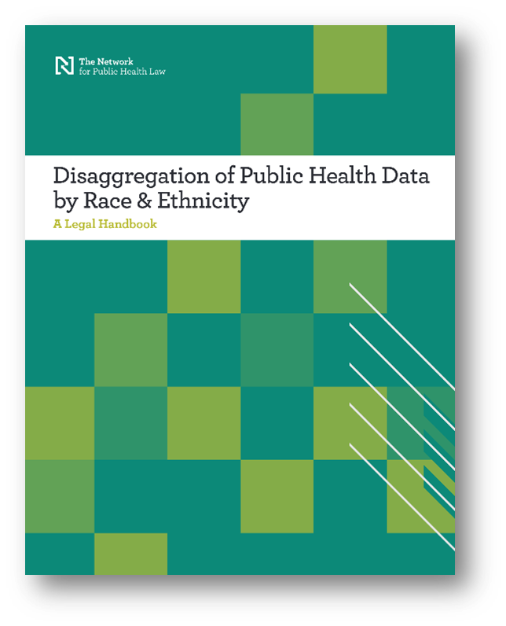
Role of Law in Collecting and Disseminating Public Health Data Disaggregated by Race and Ethnicity.
Not intended to be legal advice. Please make sure to always consult your attorney regarding the specifics of your proposed data-sharing project.

Slide 14


Racial Misclassification and the Impact on Data Integrity
Oral Health Patient Record Mapping Project
Presented by Jamie Piatt, MPH

Slide 15
Racial Misclassification
A Major Issue with American Indian/Alaska Native Data
What is racial misclassification?
Incorrect recording of an individual’s race or ethnicity
Usually is in one direction

Slide 16
Ways Racial Misclassification Can Occur
Collection of data- i.e. medical records, vital statistics data, criminal justice data, etc
Analyses of data
Reporting of data

Slide 17
Impact of Racial Misclassification
In Oklahoma, between 20%-40% of American Indians were racially misclassified in mortality records*
This trend is seen nation-wide**
Dougherty, T. et.al. Racial Misclassification in Mortality Records Among American Indians/Alaska Natives in Oklahoma from 1991-2015. https://pmc.ncbi.nlm.nih.gov/articles/PMC6690744/#ref-list1
**Arias, PhD., et al. The Validity of Race and Hispanic-origin Reporting on Death Certificates in the United States: An Update. U.S. Department of Health and Human Services. Centers for Disease Control and Prevention. National Center for Health Statistics. August, 2016. Detailed Mortality Statistics (ICD-10) (OK2SHARE) (state.ok.us)

Slide 18
How to Address Racial Misclassification?
First, understand that it is present
Link data
State the issue when reporting data
Getting to the core of the issue

Slide 19
Why Oral Health Medicaid Data?
Oral Health CMS Data
“Othering”
Oklahoma’s Medicaid data from the state itself, was disaggregated.

Slide 20
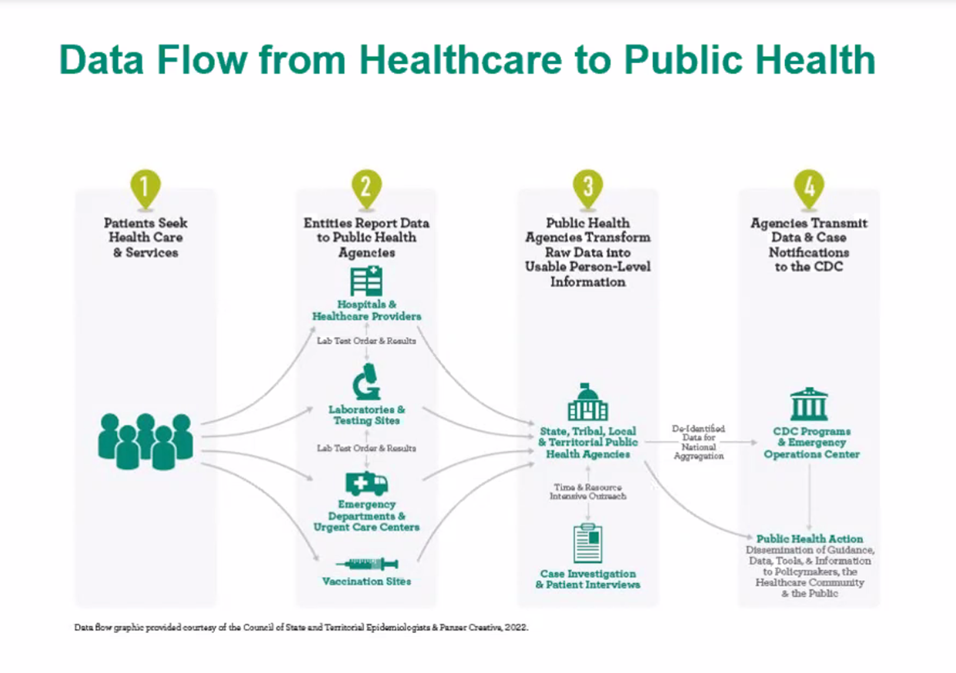
Framework Model

Slide 21
RMAG Mapping Work
OKHCA Oral Health Data Flow
  Patient
  SoonerCare Portal
  Clinics
  OKHCA
  Reports

Slide 22
Rough First Sketch

Slide 23
Second Sketch

Slide 24
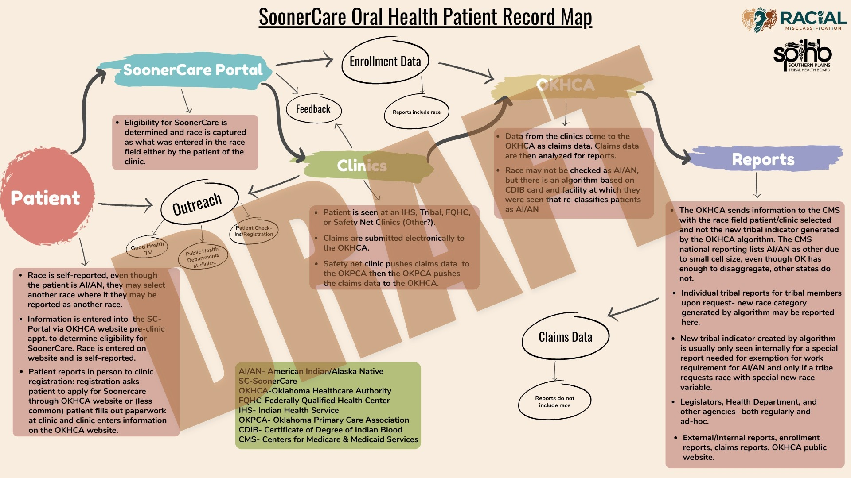
Draft

Slide 25
Discussion
Insights
Member data vs claims data
CMS questions

Slide 26
Thank You!

Slide 27


Rethinking Race/Ethnicity Visualization
Brian Hui, PhD
Center for Health Equity
Los Angeles County
Department of Public Health

Slide 28
Race/Ethnicity Data Visualization
What is Inclusive Data
Why Inclusive Data Matters
Inclusive Race/Ethnicity Visualization and How It Works
Examples

Slide 29
Race/Ethnicity Data Visualization
Presenting data by race/ethnicity can illuminate disparities that could reveal structural inequities, differential exposure to health risks, or uneven access to services
However…
Figure 1. Los Angeles County Population Estimates by Race/Ethnicity, 2020 (Mutually Exclusive and Exhaustive Approach)

Slide 30
Race/Ethnicity Data Visualization
Presenting data by race/ethnicity can illuminate disparities that could reveal structural inequities, differential exposure to health risks, or uneven access to services
However…
  Broad umbrella categories can mask meaningful differences in diverse jurisdictions
Figure 1. Los Angeles County Population Estimates by Race/Ethnicity, 2020 (Mutually Exclusive and Exhaustive Approach)

Slide 31
Race/Ethnicity Data Visualization
Presenting data by race/ethnicity can illuminate disparities that could reveal structural inequities, differential exposure to health risks, or uneven access to services
However…
  Broad umbrella categories can mask meaningful differences in diverse jurisdictions
  People who identify with more than one race are often grouped into “Multiracial” or “Other”
Figure 1. Los Angeles County Population Estimates by Race/Ethnicity, 2020 (Mutually Exclusive and Exhaustive Approach)

Slide 32
Race/Ethnicity Data Visualization
Presenting data by race/ethnicity can illuminate disparities that could reveal structural inequities, differential exposure to health risks, or uneven access to services
However…
  Broad umbrella categories can mask meaningful differences in diverse jurisdictions
  People who identify with more than one race are often grouped into “Multiracial” or “Other”
  Smaller/more multiracial communities face erasure
Figure 1. Los Angeles County Population Estimates by Race/Ethnicity, 2020 (Mutually Exclusive and Exhaustive Approach)

Slide 33
Race/Ethnicity Data Visualization
Presenting data by race/ethnicity can illuminate disparities that could reveal structural inequities, differential exposure to health risks, or uneven access to services
However…
  Broad umbrella categories can mask meaningful differences in diverse jurisdictions
  People who identify with more than one race are often grouped into “Multiracial” or “Other”
  Smaller/more multiracial communities face erasure
  Externally imposed group definitions create both ethical and practical problems
Figure 1. Los Angeles County Population Estimates by Race/Ethnicity, 2020 (Mutually Exclusive and Exhaustive Approach)

Slide 34

Race/Ethnicity Data Visualization
Beyond highlighting health disparities, these practices influence who appears in public health data products and who may be left out.
Figure 1. Los Angeles County Population Estimates by Race/Ethnicity, 2020 (Mutually Exclusive and Exhaustive Approach)

Slide 35
What Is Inclusive Data?
“Inclusive data” refers to data collection, analysis, and presentation practices that recognize and reflect the full identities of individuals and communities.
  Granular disaggregated categories
  Accurate and relevant groupings
  Inclusion of multiracial population in each group they identify with, rather than forcing them into a single category

Slide 36
Race/Ethnicity Data Tabulation
Mutually Exclusive and Exhaustive (MEE) Approach:
  [Race/ethnicity] is based on a mutually exclusive and exhaustive sequential grouping where persons are classified first as whether they are “Latino/Hispanic” if their ethnicity is Latino/Hispanic, regardless of any information on race Next, if not “Latino/Hispanic,” and identifying as more than one race (except not counting “Other”) they are classified as “Multirace”; then finally if not “Multirace,” they are classified as a single race (e.g., Non-Hispanic White, Non-Hispanic Black, etc.).
Inclusive Any-Mention Approach:
  Race is based on a race being noted alone, in combination with any other race, or in combination with Latino/Hispanic ethnicity. With this approach the groupings are not mutually exclusive—meaning persons identifying with more than one race and/or ethnicity would be included multiple times in such tables.
California State Health Assessment Core Module 2025 Update

Slide 37
Why Inclusive Data Matters
LA County (and the United States) is becoming more multiracial
Differences within racial groups can be important to understand
Groups with small populations face erasure
Our reports must keep pace with the norms of how the public understands racial, ethnic, and multiracial/intersectional identities. Presenting data in ways that align with how communities understand themselves helps maintain clarity, relevance, and public trust.

Slide 38
Why NOT Inclusive Data?
Totalization and rates
Data consistency and quality
MEE is easier

Slide 39
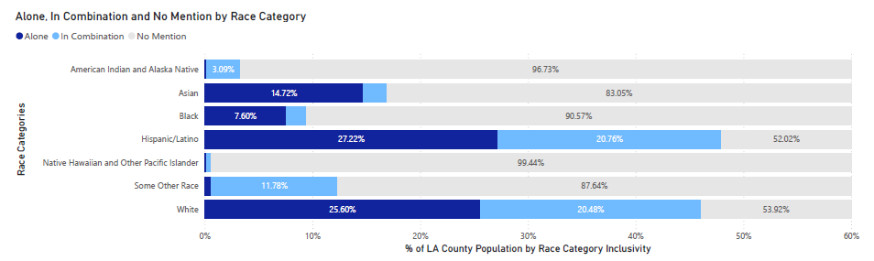
Inclusive Race/Ethnicity Data Visualization
In this inclusive race/ethnicity visualization, each bar represents one group and shows the proportion of people who identify:
with that group alone
with that group in combination with one or more others
and the portion of the population who do not identify with that group

Slide 40
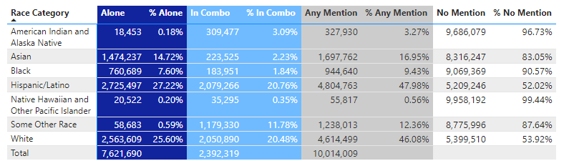
Inclusive Race/Ethnicity Data Visualization
Totals to 100%
Allows for rates and comparison
Facilitates another dimension of intragroup comparison
Includes any mention of group membership in group totals

Slide 41
Example: Deaths of Despair
Table 1: Changes in mortality rates 2013-1999, ages 45-54 (2013 mortality rates)
 | All cause mortality
White non-Hispanics (WNH) | 33.9 (415.4)
Black non-Hispanics | -214.8 (581.9)
Hispanics | -63.6 (269.6)
**Case A, Deaton A. Rising morbidity and mortality in midlife among white non-Hispanic Americans in the 21st century. Proc Natl Acad Sci USA 2015; 112: 15078–83.

Slide 42
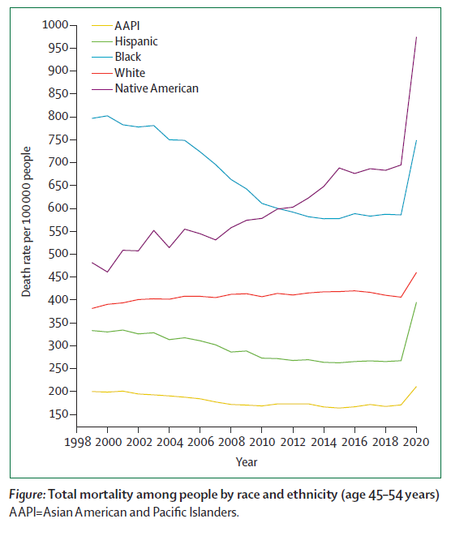





Example: Deaths of Despair
**Case A, Deaton A. Rising morbidity and mortality in midlife among white non-Hispanic Americans in the 21st century. Proc Natl Acad Sci USA 2015; 112: 15078–83.

Slide 43
Example: Deaths of Despair
**Case A, Deaton A. Rising morbidity and mortality in midlife among white non-Hispanic Americans in the 21st century. Proc Natl Acad Sci USA 2015; 112: 15078–83.
Friedman, J., Hansen, H., & Gone, J. P. (2023). Deaths of despair and Indigenous data genocide. The Lancet, 401(10379), 874-876.

Slide 44
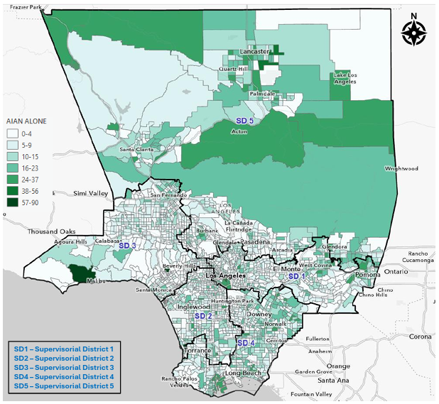
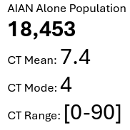
Example: AIAN MEE/Any Distribution

Slide 45
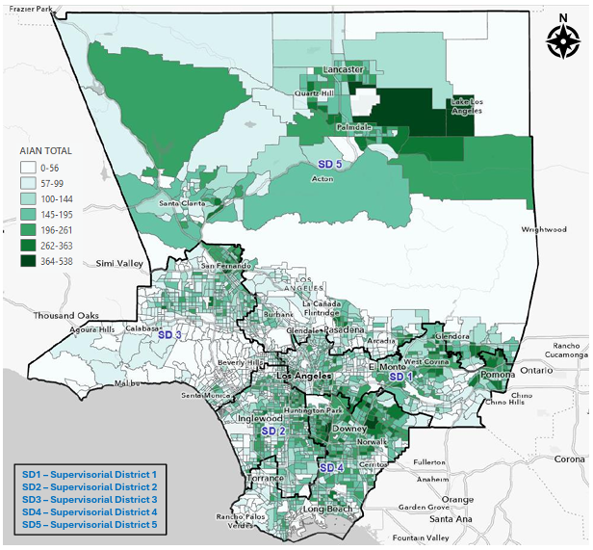
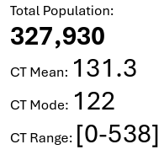
Example: AIAN MEE/Any Distribution

Slide 46
Example: AIAN MEE/Any Distribution

Slide 47
Thank you
Brian Hui, PhD
bhui@ph.lacounty.gov
Center for Health Equity
Los Angeles County
Department of Public Health

Slide 48

QUESTIONS?
Notes:
[Meghan]

Slide 49
Thank You

Slide 50
The Network advances health equity and improves health outcomes by providing guidance on the effective use of laws and policies. ​

Slide 51
Network attorneys can provide consultation and guidance to:
Identify the ways in which laws and policies may or may not impact a particular project or community; or the potential impact on different populations within a community.
Provide examples of and compare public health laws or policy strategies from other jurisdictions.
Analyze the legal authority to implement a policy or law, or reforms.
Apply equity tools to laws and policies.
TELL US WHAT YOU’RE WORKING ON.
WE’RE READY TO HELP.
Request a Consultation

