Slide 1
Public Health Under the New Administration:
Examining State and Local Authority to Regulate Raw Milk, Water Fluoridation, and School Entry Vaccines
April 17, 2025 | 12 – 1:30 p.m. CT

Slide 2

Moderator
Kathleen Hoke, J.D.
Director, Network for Public Health Law, Eastern Region; Professor and Director, Legal Resource Center for Public Health Policy, University of Maryland Carey School of Law

Slide 3
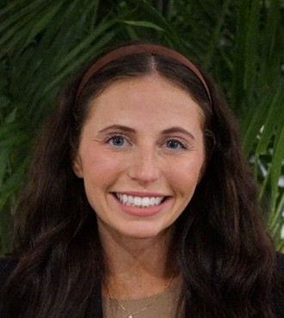


Presenters
Anna Kate Cagle J.D./M.P.H. Dual-degree candidate, University of Maryland Francis King Carey School of Law and John Hopkins Bloomberg School of Public Health
Madison Harden-Stein, Third-year law student, University of Maryland Francis King Carey School of Law
Lauren Gammer, J.D./M.P.H. Dual-degree candidate, University of Maryland Francis King Carey School of Law and Johns Hopkins Bloomberg School of Public Health

Slide 4
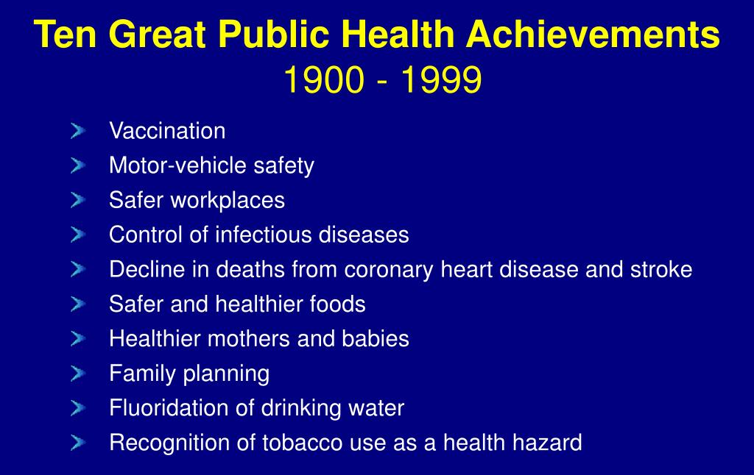
Setting the Table
Why Vaccination, Water Fluoridation, and Raw Milk?
Notes:
Plus, role for federal and state regulatory action

Slide 5

Federal Regulation Basics
Administrative Procedure Act
Framework for agency action by regulation
(or adjudication)
Requires notice (publish proposed rule/repeal) and comment period
  Allows stakeholders to submit data, analysis, and arguments in support of or in opposition to proposed rule: public docket serves as record for review of agency decisions
  Agency must consider public feedback, should be reflected in preamble to final rule
Establishes standard of review on challenge to agency action: arbitrary and capricious
Exceptions where procedures would be impractical or undesirable
Notes:
APA does NOT apply to Executive Orders

Slide 6
Some Acronyms!
APA: Administrative Procedure Act
HHS: Department of Health and Human Services
FDA: Food and Drug Administration
CDC: Centers for Disease Control and Prevention
PHS: U.S. Public Health Service
ACIP: Advisory Committee on Immunization Practices*
EPA: Environmental Protection Agency
Notes:
Madison will note that ACIP’s rescheduled meeting was held yesterday and today. The agenda does not reveal action directly relevant to our discussion.

Slide 7
School Entry Vaccines
Madison Harden-Stein

Slide 8
School-Entry Vaccinations
Roadmap
Why are childhood vaccinations and school-entry requirements important to public health?
Federal Role in School-Entry Vaccine Requirements
  National Child Vaccine Injury Act (NCVIA)
  Advisory Committee on Immunization Practices (ACIP)
State and Local Government’s Role in School-Entry Vaccine Requirements
Potential Federal Action and Opportunities for States to Respond

Slide 9

Childhood Immunization
Decreases childhood illness and death
Most effective way to prevent the spread of infectious disease across the population
  Diphtheria has been nearly eliminated
  Chickenpox infections dropped from 10,000 to 1,400 hospitalizations annually, and causes 90% fewer deaths

Slide 10
School-Entry Vaccine Requirements
To attend school, students must have received certain age-appropriate vaccinations against specific diseases (varies by state).
Schools play a vital role in maintaining high immunization rates and preventing the spread of disease.
Began as early as 1800s, with smallpox outbreaks
  Necessary measure as education became compulsory, school days lengthened, and more children attended school.

Slide 11

Federal Government’s Role:
National Childhood Vaccine Injury Act (NCVIA)
Passed in 1986
Response to increasing litigation against vaccine manufacturers
  Without NCVIA, vaccine shortages and decreased vaccination rates
The NCVIA establishes:
  National Vaccine Injury Compensation Program
  Liability protections for manufacturers
  Research and guideline requirements
  Reporting and safety measures

Slide 12
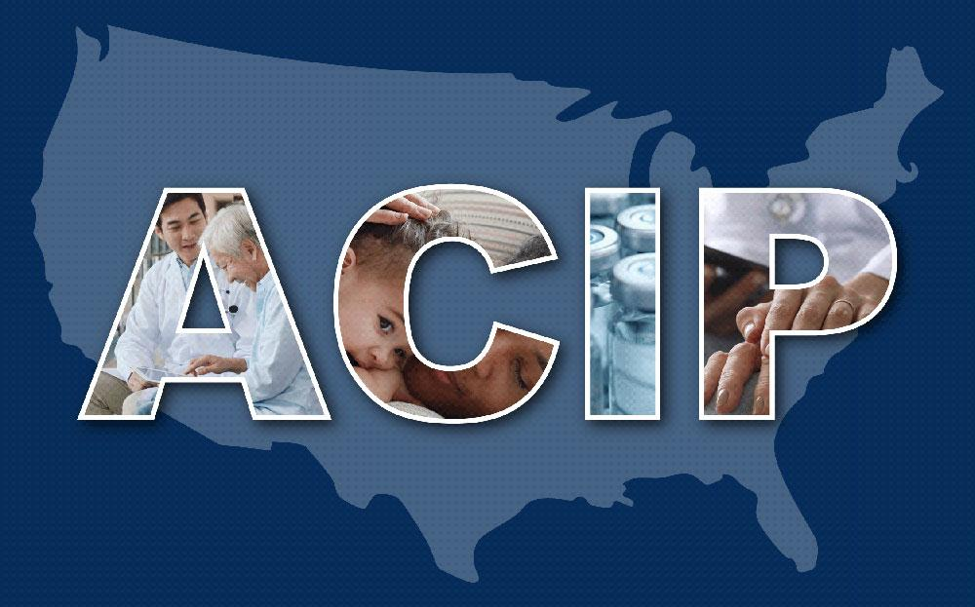
Federal Government’s Role:
Advisory Committee on Immunization
Practices (ACIP)
Federal advisory body that provides vaccine use recommendations
Maintains and updates immunization schedules
Focus is on preventing the spread of vaccine-preventable infectious diseases
3 meetings/year to review scientific data, discuss prevalent infectious disease issues, and vote on vaccine recommendations
Source: https://www.cdc.gov/acip/index.html

Slide 13
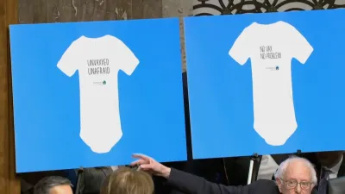
Federal Action Impacting School-Entry Vaccines
Robert F. Kennedy, Jr., the current Secretary of Health and Human Services (HHS), has supported anti-vaccination rhetoric in the past and in his current role.
The administration is downplaying the current measles outbreak and openly questioning the safety of
vaccines.
Source: https://www.nbcdfw.com/news/national-international/are-you-supportive-of-these-onesies-sanders-grills-rfk-jr-on-anti-vaccine-apparel/3753608/

Slide 14
Federal Action Impacting School-Entry Vaccines
ACIP’s first meeting of 2025, which was scheduled for 2/26-2/28, was postponed to 4/15-4/16.
COVID-19 Executive Order prohibits schools from including COVID-19 vaccines as a school-entry requirement.

Slide 15
State Government’s Role
Ultimately a state power
All 50 states and D.C. impose school-entry vaccine requirements for childcare, and 49 states have requirements for pre-K to 12th grade entry
  DTaP, Polio, MMR, Varicella, TdaP vaccines required in 49 states
  States vary on requiring the Hepatitis A, Hepatitis B, Influenza, PCV, Hib, and Meningococcal vaccines.

Slide 16
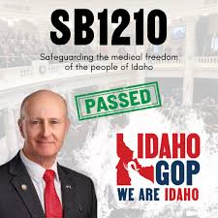
State Government’s Role: Idaho
On April 9, 2025, Idaho became the first state to prohibit vaccine mandates for school-entry (“Idaho Medical Freedom Act,” Senate Bill 1210).
Daycare facilities may still be permitted to require vaccines for entry.
Takes effect on July 1, 2025.
Source: https://www.instagram.com/idahorepublicanparty/p/DIC0a-HNp9S/it-took-some-twists-and-turns-but-the-medical-freedom-act-passed-the-legislature/

Slide 17
State Government’s Role: Vaccine Requirement Exemptions
States also have the authority to allow or limit exemptions to their school-entry vaccine requirements.
Exemptions include:
  Medical Exemptions
    Likely constitutionally required
  Religious Exemptions
  Personal Belief/Philosophical Exemptions

Slide 18
State Government’s Role: Vaccine Requirement Exemptions - State Interest in Public Health
A few states do not have or have removed the ability to exempt due to religion or personal beliefs because of the prevalence of infectious disease.
Spillane v. Lamont (Connecticut, 2024)
Royce v. Bonta (California, 2024)
Miller v. McDonald (New York, 2025)
West Virginia Parents for Religious Freedom v. Christiansen (West Virginia, 2024)
  W.V. legislature also recently voted against a bill that would have added religious exemptions.

Slide 19
Opportunities for State Governments to Respond
States may maintain current school-entry vaccine requirements
State laws may include enforcement mechanisms to ensure compliance
States may respond to infectious disease outbreaks by limiting exemptions
  Exercise the state interest in public health

Slide 20
Opportunities for State/Local Governments to Respond
Local officials may respond to infectious disease outbreaks by temporarily prohibiting children from attending school if they are unvaccinated
  Example: Rockland County, NY’s “Exclusion Orders” (2019)
States may establish an ACIP-like entity for vaccine evaluation and recommendation
  Collaboration with multiple states and research organizations; looking to international models

Slide 21
Water Fluoridation
Lauren Gammer

Slide 22
Water Fluoridation
Roadmap
General Overview
Federal laws and guidance that govern water fluoridation
  EPA
  PHS
State and Local Government’s Role in Water Fluoridation
Food & Water Watch, Inc. v. EPA (N.D. Cal, 2024)
Potential Federal Action and Opportunities for States to Respond

Slide 23
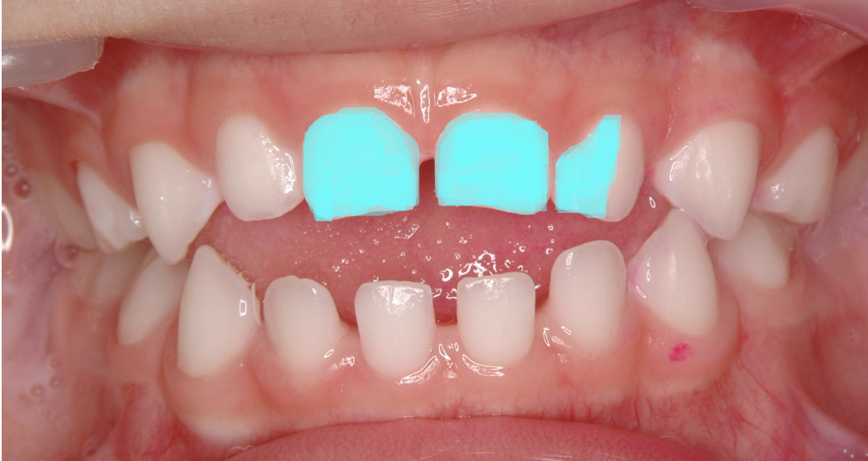
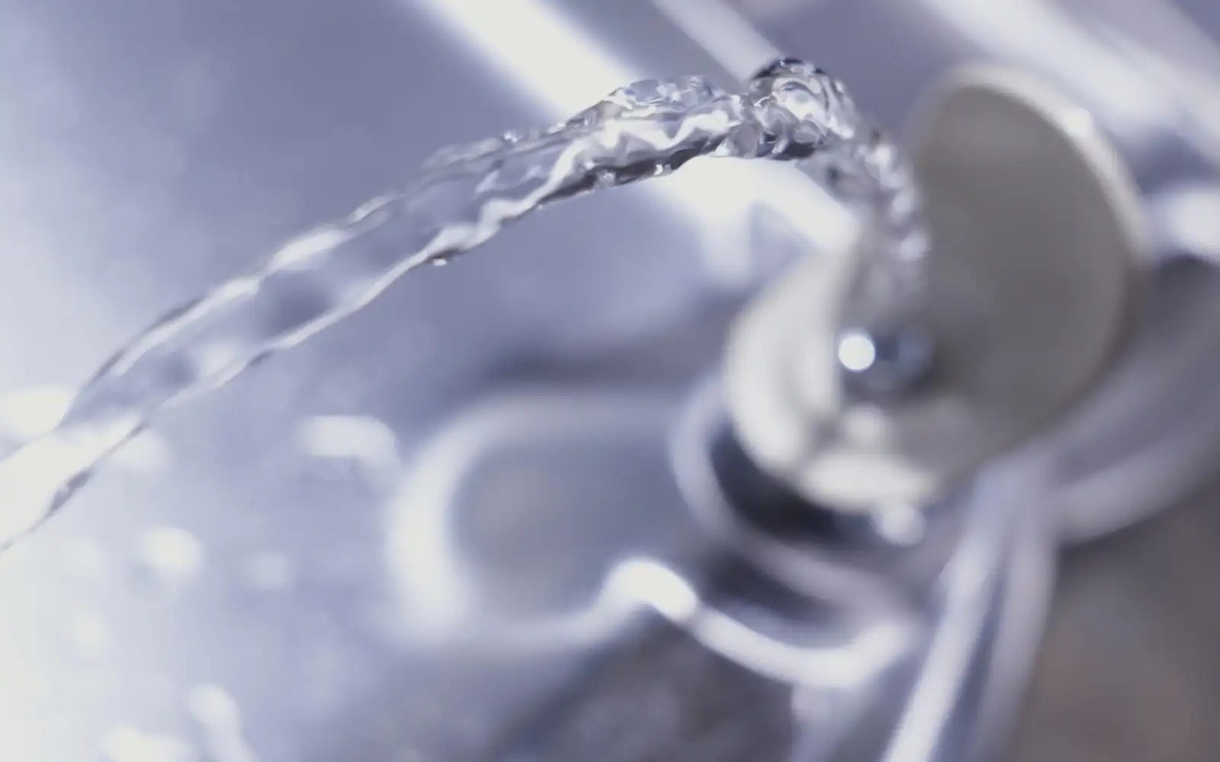
Water Fluoridation - General Overview
Many well-established benefits, virtually no risk
  Prevents at least 25% ​​of cavities
  Children in fluoridated communities have 2.5 fewer decayed teeth, on average
  Economic savings in dental costs
    Approximately $6.5 billion
  Cessation of community water fluoridation leads to increases in cavities and Medicaid costs
Notes:
https://media.freemalaysiatoday.com/wp-content/uploads/2025/03/47e07b04-fluoride-ap-290325.webp
https://commons.wikimedia.org/wiki/File:Case111.jpg

Slide 24

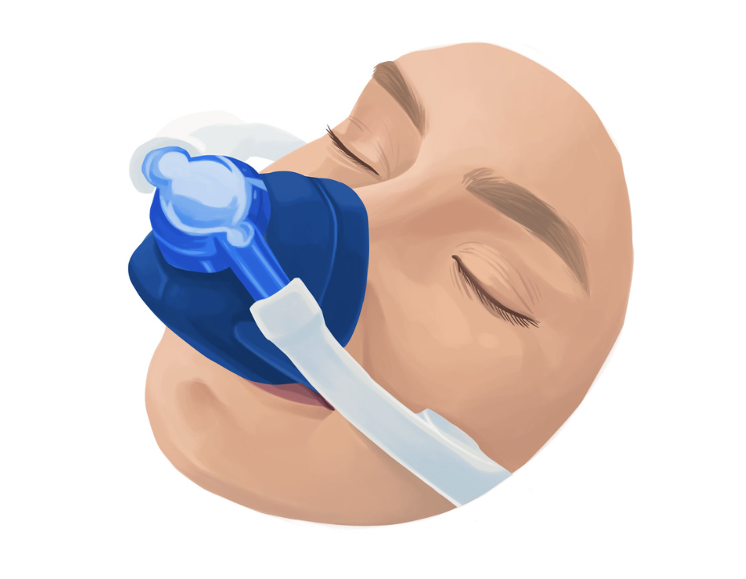
Negative Outcomes of Past Cessation Attempts
Cessation of community water fluoridation leads to increases in cavities and Medicaid costs, even in modern conditions
Calgary, Canada (2011)
Juneau, Alaska (2007)
Increased number of children requiring IV antibiotics or operative dental care under anesthesia
Notes:
https://www.flickr.com/photos/dental-photos/50729730291/in/photostream/
https://www.flickr.com/photos/dental-photos/50729730231/in/photostream/

Slide 25

Health Equity Considerations
Oral health disparities by income
Children of low income aged 2-5 years suffer from cavities by nearly three times more (18% vs. 7%)
Notes:
https://openclipart.org/detail/298398/cavity#google_vignette

Slide 26
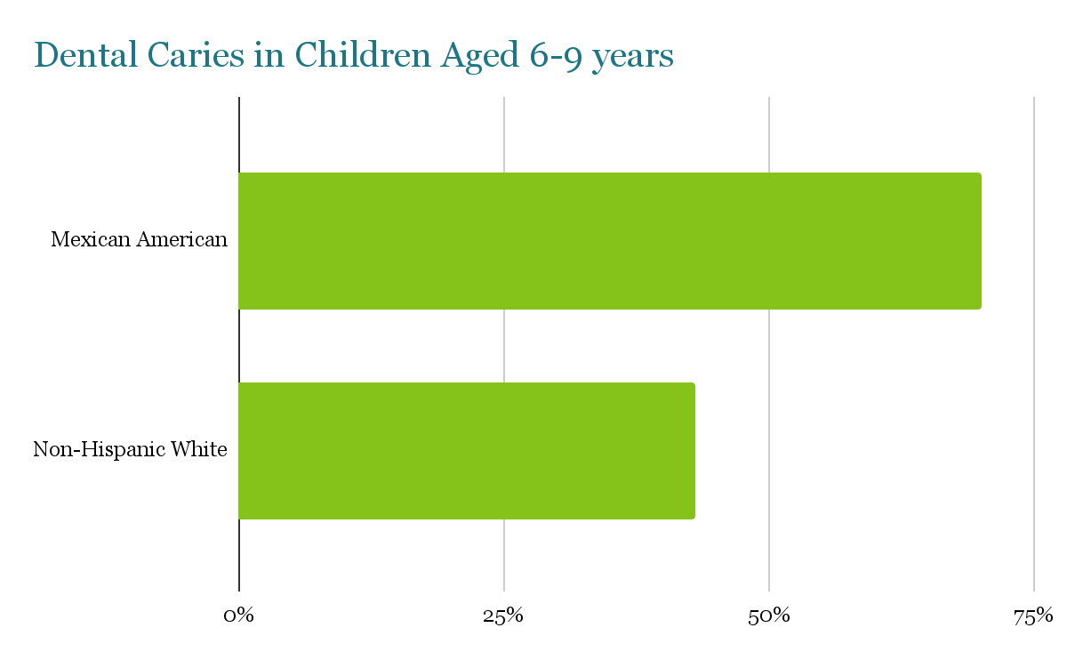
Health Equity Considerations
Oral health disparities by race/ethnicity
Source: https://www.cdc.gov/oral-health/health-equity/index.html
70%
43%

Slide 27
Health Equity Considerations
Oral health disparities by access to dental care
  Nearly 25 million Americans live in “dental deserts”
    Rural populations
    Racially segregated populations
  Uninsured
  Only one third of dentists treat patients on Medicaid
  Nearly 30% of counties where over half of residents live in a dental shortage also do not have water fluoridation

Slide 28


Federal Government’s Role in Fluoride Regulation
EPA and PHS
Notes:
https://upload.wikimedia.org/wikipedia/commons/a/ac/United_States_Public_Health_Service_%28seal%29.svg
https://www.google.com/url?sa=i&url=https%3A%2F%2Fen.wikipedia.org%2Fwiki%2FUnited_States_Environmental_Protection_Agency&psig=AOvVaw3ZxEI-QcKbgU3rmlds8fUb&ust=1744290162728000&source=images&cd=vfe&opi=89978449&ved=0CBQQjRxqFwoTCOCmu6-By4wDFQAAAAAdAAAAABAE
https://upload.wikimedia.org/wikipedia/commons/thumb/6/6f/Seal_of_the_United_States_Environmental_Protection_Agency.svg/640px-Seal_of_the_United_States_Environmental_Protection_Agency.svg.png

Slide 29
EPA - Fluoridation
Safe Drinking Water Act
Zero enforcement actions for fluoride violations
EPA National Fluoride Standards (Last affirmed 2024)
Primary Standard | Secondary Standard
4.0 mg/L Legally enforceable | 2.0 mg/L Requires notice when exceeded

Slide 30
PHS - Fluoridation
0.7 mg/L
2015 Amended PHS Guidance - optimal concentration for water fluoridation
  Subject to substantial notice and comment period
  Addressed concerns related to water fluoridation
Not legally binding

Slide 31
State and Local Government’s Role in Water Fluoridation
Water fluoridation is required by 14 states and others at the local level (e.g., by ordinance or public health regulation)
Some expressly refer to PHS guidance or EPA standards in state statutes/codes

Slide 32
State and Local Government’s Role in Water Fluoridation
Legislative challenges to water fluoridation
  Utah completely prohibits fluoridation at state or local level
  Others have not yet succeeded
    Arkansas
    Kentucky
    Texas
    Louisiana
    Massachusetts
    New Hampshire
    Georgia (2024)

Slide 33
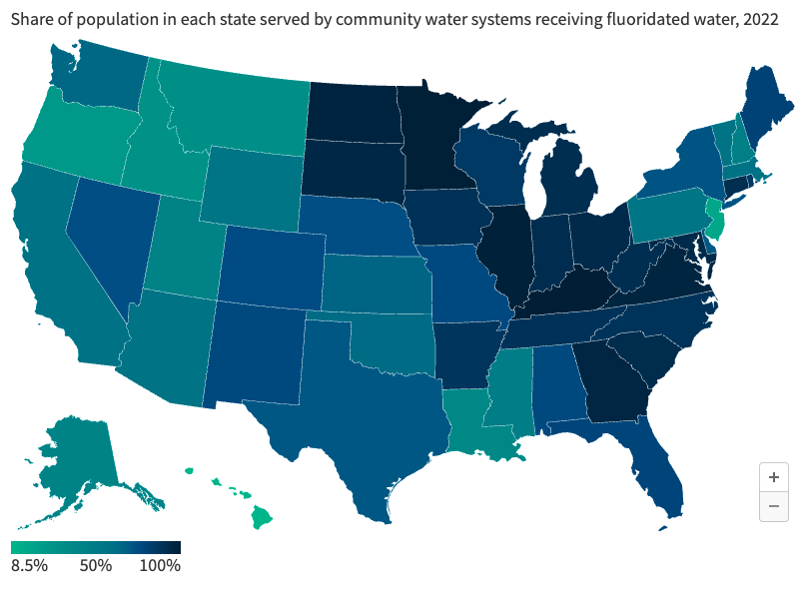
State and Local Government’s Role in Water Fluoridation
Share of population in each state served by community water systems receiving fluoridated water, 2022
Source: https://www.kff.org/other/issue-brief/water-fluoridation-in-the-u-s-the-federal-role-in-policy-and-practice/#:~:text=As%20of%202022%2C%20the%20CDC,of%20the%20U.S.%20population%20overall.

Slide 34
Federal Litigation Challenging EPA Standards
Food & Water Watch, Inc. v. EPA
Plaintiffs: Group of advocacy organizations and individuals opposed to water fluoridation sued the EPA
Relevant Law: Toxic Substances Control Act (TSCA)
District court heavily relied on draft National Toxicology Program (NTP) Monograph, which the National Academies has found to be scientifically deficient

Slide 35
NTP Monograph
Found with “moderate confidence” that fluoride exposures at 1.5 mg/L are “consistently associated” with lower IQ in children
  Concentration is more than twice the PHS Guidance —0.8 mg/L difference
  Did not find causation
Children’s IQ studies were performed in China, Mexico, Canada, India, and Iran
  Importantly, no studies were conducted the United States
Not all studies measured fluoride in drinking water
  Some measured fluoride in urine (child or maternal) and serum

Slide 36
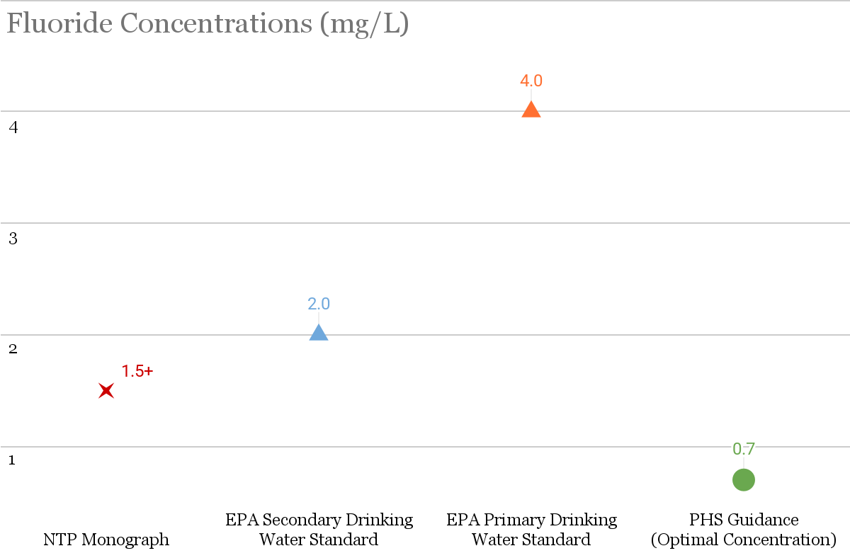

Slide 37
NTP Monograph
“It is important to note that there were insufficient data to determine if the low fluoride level of 0.7 mg/L currently recommended for U.S. community water supplies has a negative effect on children’s IQ. The NTP found no evidence that fluoride exposure had adverse effects on adult cognition.” - National Toxicology Program
“This Monograph and Addendum do not address whether the sole exposure to fluoride added to drinking water in some countries (i.e., fluoridation, at 0.7 mg/L in the United States and Canada) is associated with a measurable effect on IQ.” - National Toxicology Program

Slide 38
Potential Federal Action - EPA
EPA could amend the primary standard, lowering the permissible level of fluoride in drinking water from 4.0 mg/L to 0 mg/L or some miniscule level
  Would be incredibly difficult for the agency to achieve due to Administrative Procedure Act
  April 7, 2025 - EPA Administrator Zeldin indicated intent to “expeditiously review” new science, specifically the NTP Monograph

Slide 39
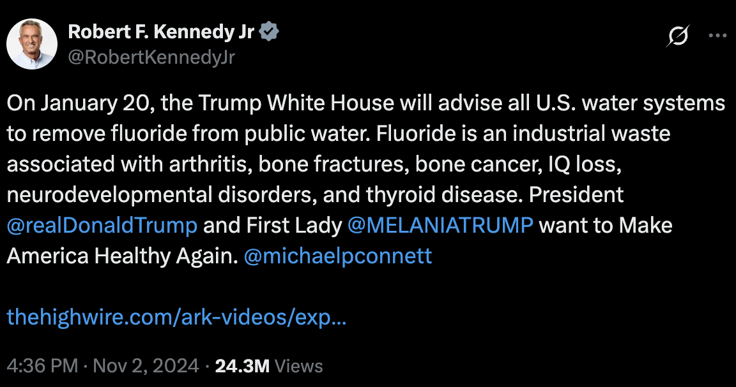
Potential Federal Action - PHS
PHS could issue new Fluoride guidance
April 7, 2025 - HHS Secretary Kennedy publicly announced plans to direct the CDC to stop recommending water fluoridation
Notes:
https://x.com/robertkennedyjr/status/1852812012478398923?s=46

Slide 40
Opportunities for States to Respond
State and local governments can take preventive action to:
  (1) determine whether their statutes/codes explicitly reference PHS’s guidance or the EPA’s standards for drinking water quality and, if yes,
  (2) amend these laws/regulations to include the specified optimal concentration of 0.7 mg/L;
  (3) build in systems for review of the standard

Slide 41
Raw Milk
Anna Kate Cagle

Slide 42
Raw Milk
Roadmap
What is Raw Milk?
History and public health impact of dairy pasteurization
Rise in popularity of Raw Milk
State and Federal Regulation of Raw Milk
Potential Federal Action and Opportunities for States to Respond

Slide 43

What is Raw Milk?
Raw Milk = Unpasteurized Milk
The only difference between pasteurized and unpasteurized milk → Salmonella, Listeria, E. coli, and more
Source: https://www.pexels.com/photo/woman-milking-cow-15835847/

Slide 44
Pasteurization
Pasteurization is the process of heating a liquid to a high temperature for a short amount of time to kill harmful organisms
Pasteurization was invented in 1864
U.S. cities, states, and the federal government adopted pasteurization standards throughout the 1900s
Public Health Benefits: Reductions in…
  Foodborne illness attributed to dairy consumption
  Infectious diseases (Tuberculosis, Typhoid Fever, etc.)
  Infant mortality rate

Slide 45

Raw Milk on the Rise
Weekly raw milk sales increased between
21 and 65 percent in 2023
Why?
  Unfounded health claims by influencers, celebrities, politicians, political commentators, and health professionals
  Food Freedom Movement
  Distrust in the government and food industry
Source: https://tenor.com/view/hi-gwyneth-paltrow-hello-hey-there-greetings-gif-16222314

Slide 46
Regulatory Landscape of Raw Milk
Current Federal Regulation
Authority to regulate interstate commerce
  Commerce Clause
Congress
  The Public Health Service Act
  The Food, Drug, and Cosmetic Act
FDA
  Prohibits the interstate sale of raw milk
Notes:
Discuss what fda is doing now

Slide 47
Regulatory Landscape of Raw Milk
Current State Regulation
Authority to regulate intrastate commerce
  10th amendment
5 categories of state laws
 | Retail | Direct- to-consumer | Pet consumption | Herd share | Sale prohibited for human consumption
Number of states | 16 | 36 | 11 | 14 | 8

Slide 48
Regulatory Landscape of Raw Milk
Potential Federal Regulation
“The FDA’s war on public health is about to end…[including] its aggressive suppression of…raw milk.”
-Robert F. Kennedy Jr.

Slide 49
Regulatory Landscape of Raw Milk
Potential Federal Regulation
Legalize the interstate sale of raw milk
  Congress could legalize interstate sale of raw milk, or
  FDA could repeal its ban
    Could be challenged under the Administrative Procedure Act (APA)
Draft national raw milk standards
  Potential “Raw Milk Advisor:” Mark McAfee
    (1) raw milk can be sold in retail stores, direct-to-consumer, herd shares, etc.,
    (2) risk mitigating training for farmers,
    (3) monthly pathogen testing,
    (4) raw milk should be chilled < 40 degrees Fahrenheit within one hour of milking,
    (5) herds free from Tuberculosis, Brucellosis, and Johnes, and
    (6) raw milk must not commingle with milk from other farms.

Slide 50
Regulatory Landscape of Raw Milk
Potential Federal Regulation
Encourage or incentivize states to legalize raw milk and adopt national standards
  Voluntary adoption of standards, or
  Offer conditional federal funds to incentivize state legalization and adoption of national standards
    Conditional fund limitations established in South Dakota v. Dole, 483 U.S. 203 (1987) and NFIB v. Sebelius, 567 U.S. 519 (2012):
Clear notice of condition and consequences
Conditions are related to the program or activity
Condition must not be coercive
Condition must not violate an independent constitutional bar

Slide 51
Regulatory Landscape of Raw Milk
Opportunities for States to Respond
States may continue to regulate the intrastate sale of raw milk, so long as they are not preempted
States may legalize and regulate raw milk in a manner that minimizes consumer risk
  Proposed national standards +
    No retail sale
    Warning label requirements
    Permit requirements
States may adjust language in raw milk laws to proactively account for the legalization of the interstate sale of raw milk

Slide 52

Q&A

Slide 53
Thank you for attending.
You will receive an email notification when the slides and recording of today’s webinar have been posted on the Network website.
53

Slide 54
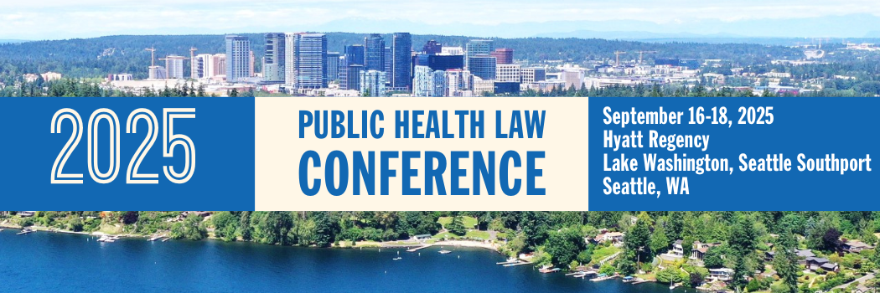
More than 40 sessions examining core issues for
healthier, stronger, and more equitable communities.
networkforphl.org/2025PHLC | #PHLC2025

Slide 55
About the Network
The Network for Public Health Law provides visionary leadership in the use of law to protect, promote and improve health and advance health equity.
We work with:
Public health officials and practitioners
Policymakers
Attorneys
Community and Advocacy Organizations
We provide:
Research and analysis
Strategic consultation and guidance
Knowledge-building and training

