Slide 1
Potential Changes in Federal Cannabis Policy and the Anticipated Public Health Impacts
December 12, 2024 | 12:00 – 1:00pm CT

Slide 2


Presenters
Mathew Swinburne
Senior Advisor, Eastern Region, Network for Public Health Law and
George Townsend
Staff Attorney, Legal Resource Center for Public Health Law-Cannabis

Slide 3
Potential Changes in Federal Cannabis Policy and the Anticipated Public Health Impacts
Mathew Swinburne, Network for Public Health Law and the Legal Resource Center for Public Health Policy
George Townsend, Legal Resource Center for Public Health Policy
December 12, 2024

Slide 4
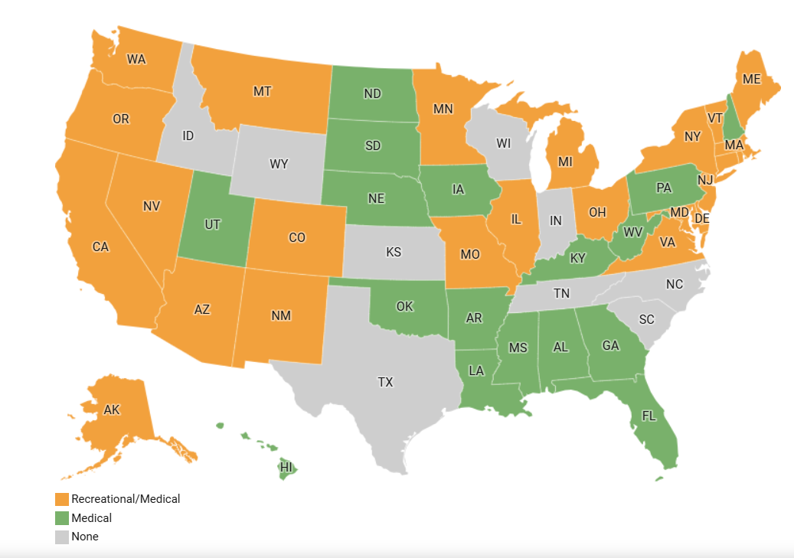
The majority of Americans live in a state that has legalized cannabis.

Slide 5
Federal Cannabis Rescheduling Process

Slide 6
What Is Rescheduling?
Controlled Substances Act of 1970
  "Schedules" drugs based on potential for abuse, "currently accepted medical use," and risk of dependence.
    Cannabis is a Schedule I drug.
      Other Schedule I drugs include heroin, LSD, mescaline, peyote, and psilocybin.
    Several medications containing synthetic cannabinoids are scheduled differently:
      Forms of dronabinol are in Schedules II (Syndros) and III (Marinol).

Slide 7
Federal Rescheduling & Public Health
Controlled Substances Act includes a process for the DEA and the FDA to move substances from one schedule to another.
  The Drug Enforcement Administration is currently in the process of considering a rescheduling of cannabis from Schedule I to Schedule III.
How cannabis is scheduled has significant implications for the availability of cannabis to researchers, how medications derived from cannabis or synthesized to imitate cannabis can be prescribed.
  As will be discussed, rescheduling does not legalize recreational use and would not mirror the medical availability of state medical cannabis programs.
  The biggest public health impact would likely be the availability of researchers to access cannabis for studies and to develop THC-based medications.

Slide 8

2023-24 Rescheduling Process
Aug. 2023: FDA sent recommendation to DEA that cannabis be moved to Sch. III.
May 2024: DOJ published a Notice of Proposed Rulemaking to reschedule cannabis.
May-July 2024: Over 40,000 public comments submitted to the DEA.
December 2, 2024: Initial hearing.
Link to public comments: https://www.regulations.gov/docket/DEA-2024-0059/comments

Slide 9
About the DEA Hearings
The DEA has granted a hearing on the record in response to the proposed rescheduling. An initial procedural hearing was held December 2, with a substantive hearing to occur from January through March 2025.
An administrative hearing is an opportunity for select parties to present evidence for or against the proposed change.
  The agency responsible for the proposed rule change (here, the DEA) serves as the party in favor of the proposed rule.
  The purpose of the hearing is to develop a record of evidence for a presiding officer to submit to the DEA Administrator, along with recommended findings of fact, recommended conclusions of law, and a recommended decision regarding whether the evidence presented meets the legal requirements for moving a substance from Schedule I to Schedule III.

Slide 10
What Would Change at Schedule III
Schedule III drugs may be prescribed by a registered health care provider.
  Prescribed medications must be approved pursuant to the Food, Drug, and Cosmetics Act.
Schedule III drugs are not subject to the CSA’s manufacturing quota limits.
  Schedule III drugs are easier to obtain and use for clinical trials, leading to more research.
BUT:
Recreational use of Schedule III drugs is still illegal.
Medical use of Schedule III drugs outside of the FDCA approval process is still illegal.
  Cannabis plant products would not be approved under the FDCA process.
  The products sold in state licensed dispensaries would also fall outside the legal FDCA market.

Slide 11
Federal Cannabis Descheduling

Slide 12
What Is Descheduling?
Descheduling cannabis would be removing the substance from the Controlled Substances Act framework altogether and regulating it separately.
Descheduling would allow for cannabis products to be sold without having to be formulated as a prescription medication.
Descheduling would create the opportunity for regulation consistent with current state market models.
Descheduling would put cannabis in a similar position to alcohol and tobacco; not scheduled by the CSA but still regulated through other legislation.
Several bills to deschedule cannabis have been proposed in recent years; none have passed both chambers of Congress.

Slide 13
Federal Cannabis Regulation Models
If Congress chose to deschedule cannabis, it would need to decide whether cannabis would be regulated on the federal level, or if states would be free to maintain their own regulatory standards.
Federal law can preempt local laws; if the federal government chooses to impose its own regulations, states cannot impose contradictory restrictions.
  However, federal legislation can sanction state regulations that differ from national standards, so long as it is explicit in the statutory language.

Slide 14
Benefits of a National Cannabis Market
Descheduling would allow for the standardization of regulations across the country, and for greater collaboration between federal and state enforcement mechanisms.
Creation of an interstate cannabis market would allow for cannabis production to occur in states that are environmentally better suited for cannabis agriculture.
  This could help reduce the enormous environmental impact of indoor cannabis cultivation, which is often practiced in colder, darker parts of the country.

Slide 15
Downsides to a National Cannabis Market
Standardization across states may disrupt some of the regulatory requirements preferred by state governments.
  While some states would see their regulatory standards raised, others may see them lowered by national rulemaking.
A larger, nationwide market will be more difficult for small businesses to enter and compete in, undermining state-level social equity goals. It would be harder for state governments to direct the profits of cannabis sales towards their states' affected communities.

Slide 16
Addressing the Explosion of Intoxicating Hemp-Derived Products

Slide 17
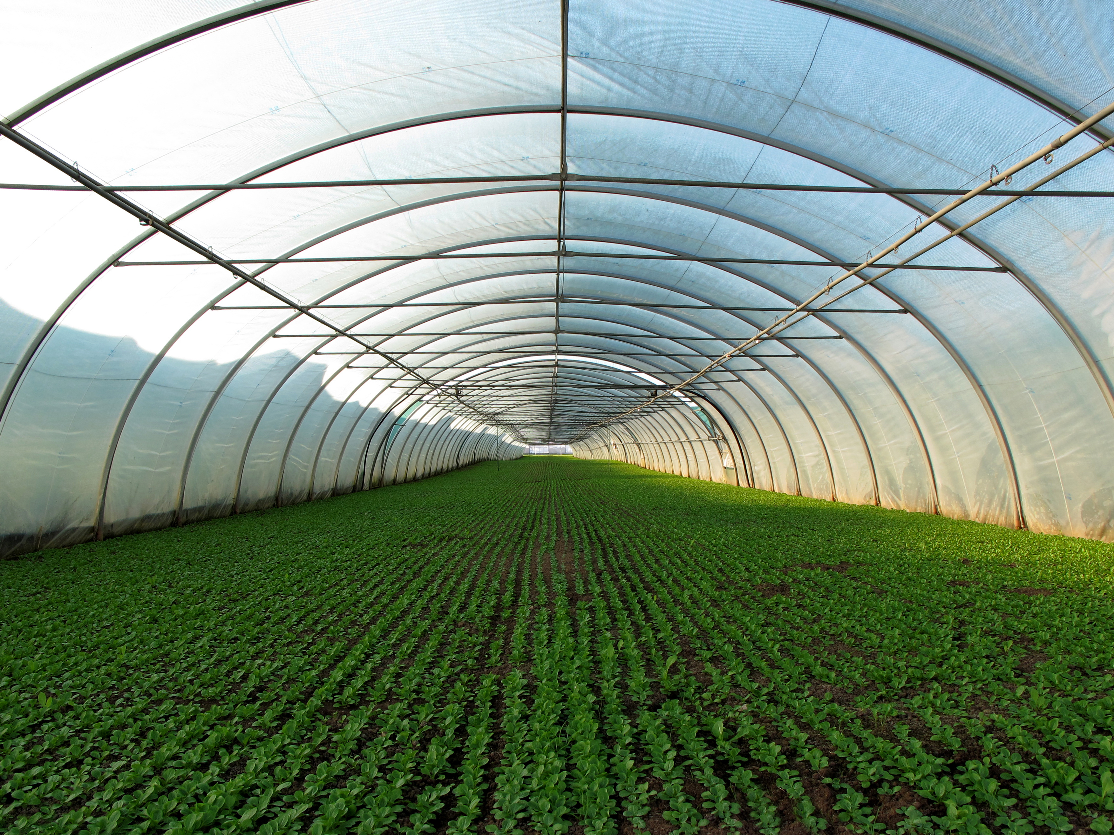
The Hemp Plant Legalized
2018 Agriculture Bill
Legalized hemp as an agricultural product (low potency cannabis).
Removed hemp from the Controlled Substance Act (no longer Schedule I substance).
No longer restricted to research.
Permitted in interstate commerce.
States could develop their own hemp cultivation programs or utilize the USDA system (most states have chosen to develop their own programs).
Retained the FDA’s authority to regulate the products derived from hemp.

Slide 18

Hemp Defined
The plant Cannabis sativa L. and any part of that plant, including the seeds thereof and all derivatives, extracts, cannabinoids, isomers, acids, salts, and salts of isomers, whether growing or not, with a delta-9 tetrahydrocannabinol concentration of not more than 0.3 percent on a dry weight basis.
50 grams x 0.3%=150mg D9 THC

Slide 19
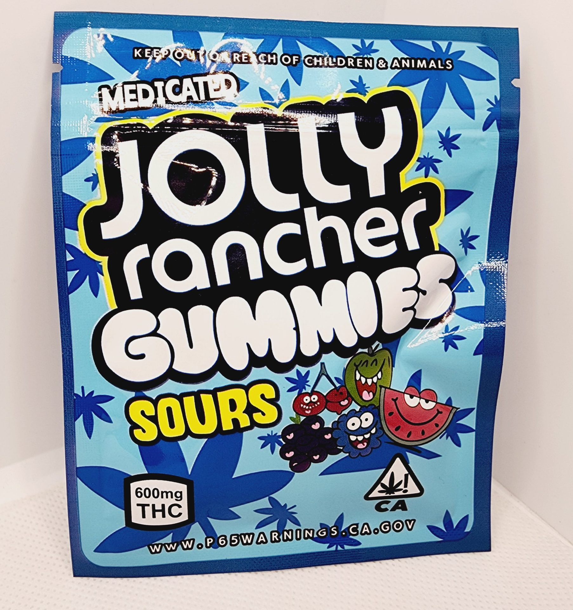
Bad at Math and Bad at Science
There are several forms or isomers of THC (delta-8 THC & delta-10 THC) that are not addressed by Farm Bill.
Federal government (FDA) has done little to regulate these products.
Hemp products present the same challenges as licensed cannabis products but are often not subject to the same safety measures.
Sold at locations throughout the country which are often open to children (gas stations, corner stores, smoke shops . . . )
Hemp market valued at approximately $30 billion.

Slide 20
Federal Response
FDA Consumer Update: 5 Things to Know about Delta-8 Tetrahydrocannabinol – Delta-8 THC (Dec. 2021)
Delta-8 THC products have not been evaluated or approved by the FDA for safe use and may be marketed in ways that put the public health at risk.
The FDA has received adverse event reports involving delta-8 THC-containing products.
Delta-8 THC has psychoactive and intoxicating effects.
Delta-8 THC products often involve use of potentially harmful chemicals to create the concentrations of delta-8 THC claimed in the marketplace.
Delta-8 THC products should be kept out of the reach of children and pets.

Slide 21
Warning Letters
FDA in conjunction with the Federal Trade Commission have issued dozens of warning letters to hemp companies.
Unfair and deceptive marketing practices: marketing intoxicating products that look like snack foods often consumed by children
Unapproved new drug: based on diagnosis, cure, mitigation, treatment, or prevention of disease claims.
  “Delta-8 THC can be used to suppress the immune response in your body. If a patient is suffering from autoimmune diseases, Delta-8 THC will offer some relief and support. Some of these diseases include lupus, HIV/AIDS, and multiple sclerosis.”
Misbranded drugs: inadequate directions for safe use.
Adulterated food:
  No food additive regulation authorizes the use of Delta-8 THC.
  Use of unauthorized food additive has adulterated the food products.

Slide 22
State Response
In the void of federal policy, states have attempted to regulate the public health risks associated with intoxicating hemp-derived products.
Approaches vary greatly between jurisdictions.
  New York: created a separate licensing system that places public health restrictions on licensed businesses (age restriction, packaging restrictions, labeling, testing, . . . ).
  Oregon: no license, but product limitations (delta-9 THC limits, age restrictions, prohibitions on adding THC isomers).
  Maryland: attempted to prohibit the sale of intoxicating hemp-derived products outside of a licensed cannabis dispensary.
State attempts to regulate or prohibit the sale of intoxicating hemp products are often challenged in court by the hemp industry.
  Ex. Maryland is currently litigating a challenge to its hemp restrictions.
Resolution of the public health challenge of intoxicating hemp-derived products will be resolved on a state-by-state basis or through some federal action.

Slide 23

Federal Farm Bill – Prohibition of Intoxicating Products
Congress is currently trying to draft a new Farm Bill.
  The 2018 Farm Bill Expired in September of this year.
In the debates surrounding this massive bill, amendments have been introduced to address intoxicating hemp products.
  Defines hemp as only including naturally occurring, naturally derived, and nonintoxicating cannabinoids.
      This would ban delta-8 THC and delta-10 THC products.
Unlikely that the Farm Bill will be passed soon and may not keep this hemp amendment.

Slide 24
Regulation Rather than Prohibition
Cannabinoid Safety and Regulation Act
  Allows intoxicating products (delta-8, delta-9, delta-10).
  Federal age restriction of 21.
  Labeling requirements and warnings on packaging.
  Cannot be packaged or advertised in a manner attractive to children.
  Prohibit products with alcohol, tobacco, or nicotine.
  Requires hemp companies to register with FDA.
  Requires FDA to create detailed safety regulations.
  Allow state to tax and ban products.
  Unlikely to pass this Congressional session. Will have to be introduced again in 2025.

Slide 25

Questions?
25

Slide 26
Thank you for attending.
You will receive an email notification when the slides and recording of today’s webinar have been posted on the Network website.
26

Slide 27

More than 40 sessions examining core issues for
healthier, stronger, and more equitable communities.
networkforphl.org/2025PHLC | #PHLC2025

