Slide 1

Navigating Public Health and Democracy After the Election
November 21, 2024 | 1:30 – 3:00pm CT

Slide 2

Moderator
Darlene Huang Briggs, J.D., M.P.H., Deputy Director, Act for Public Health Initiative, Network for Public Health Law

Slide 3



Presenters
Gnora Mahs
Health & Democracy Coalitions Advisor, Institute for Responsive Government
Spring Schmidt
Executive Director, Missouri Center for Public Health Excellence; Director of the Office of Public Health Practice, St. Louis University College for Public Health and Social Justice
Ashish Sinha
Chief of Staff, Institute for Responsive Government

Slide 4

Agenda
  Important Acknowledgments
  Public Health Authority and Advocacy
  Health and Democracy
  From the Trenches in Missouri
  Post-Election Democracy Landscape
  Q & A
This Photo by Unknown Author is licensed under CC BY-SA

Slide 5

The Fine Print
The Network promotes public health and health equity through non-partisan educational resources and technical assistance. Any materials provided in this presentation are intended solely for educational purposes and do not constitute legal advice. The Network’s provision of these materials does not create an attorney-client relationship with you or any other person and is subject to the Network’s Disclaimer.
For legal advice, attendees should consult with their own counsel.

Slide 6


Slide 7


Slide 8
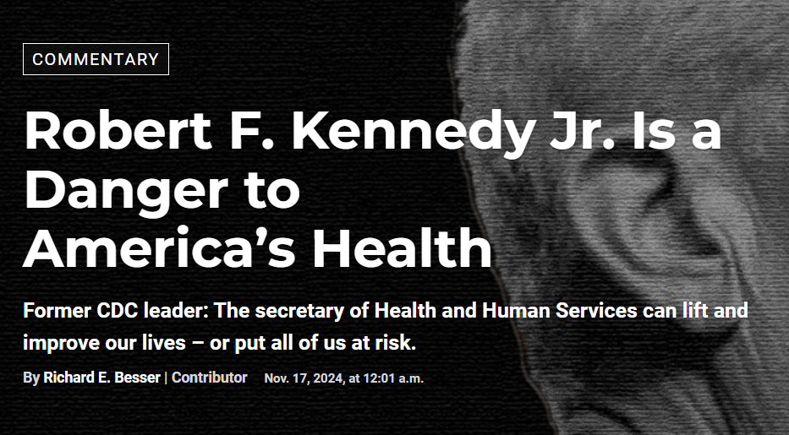




Slide 9


Source: https://library.into-action.us/collection/act-for-public-health

Slide 10


https://www.changelabsolutions.org/news/making-case-public-health-framing-and-language-recommendations

Slide 11










Health law partners addressing challenges to
public health authority and infrastructure.
Perhaps more than at any other time in its history, public health is being directly and significantly impacted by how laws and policies are being implemented—or weakened.

Slide 12





The Tension: Shared Powers and Separation of Powers
Federal
State and Territorial
Municipal
County
Tribal
  Health departments sit within the executive branch, which implements public health laws
  The legislative branch passes laws establishing and shaping public health authority
  The judicial branch interprets laws in ways that shape public health authority
For more information: Structure of Government, Public Health Law Academy

Slide 13
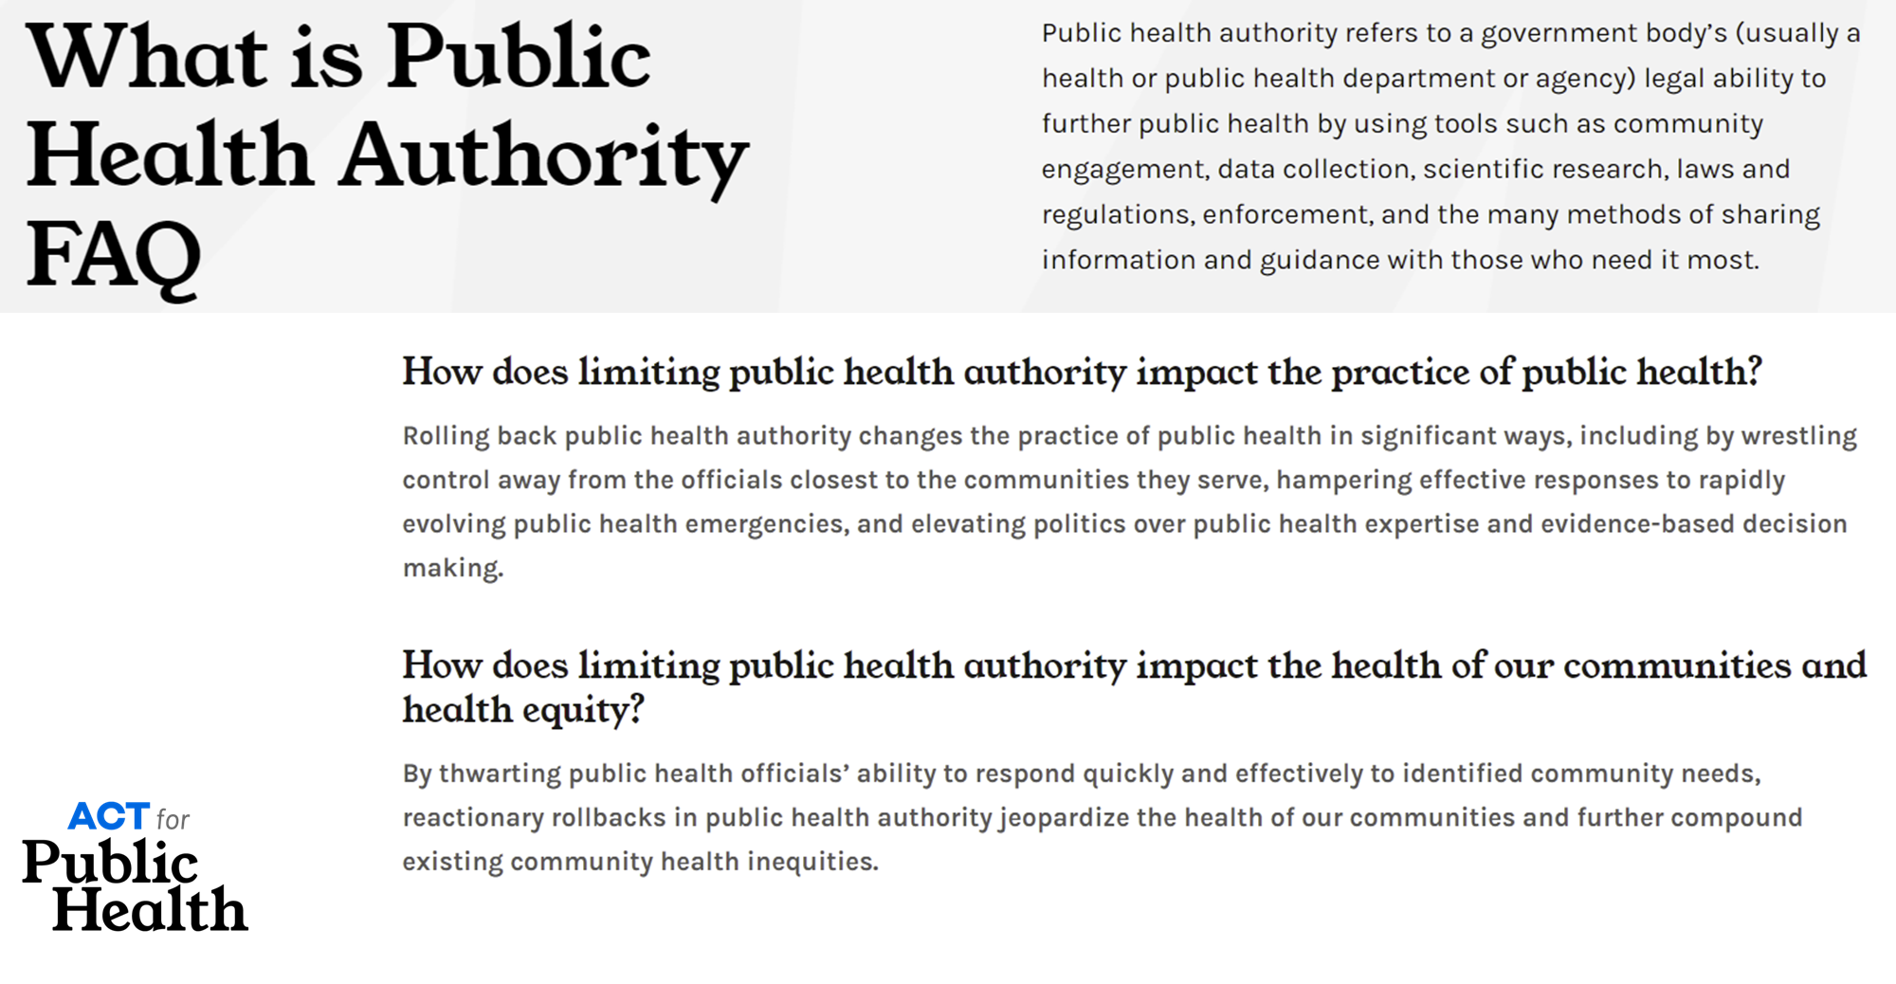
https://actforpublichealth.org/public-health-authority/

Slide 14


Coordinated COVID backlash
Themes
Prohibitions on public health interventions
Shifts in authority
Limitations on public health orders
Elevation of individual freedoms over the common good

Slide 15
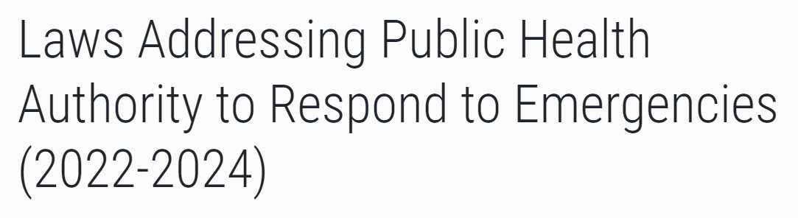
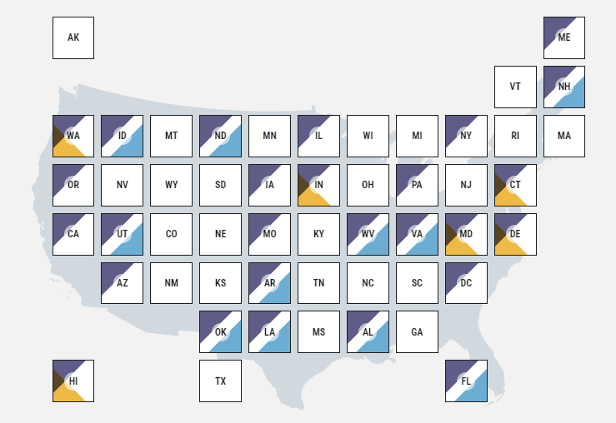
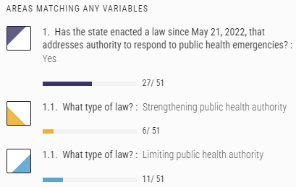
https://lawatlas.org/datasets/laws-addressing-public-health-authority-to-respond-to-emergencies

Slide 16
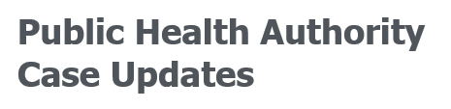
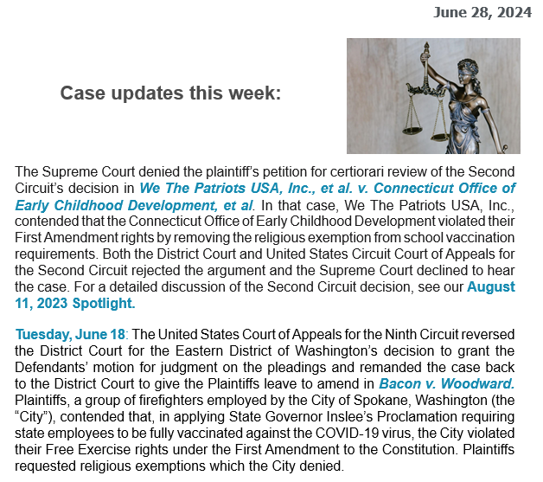

Slide 17
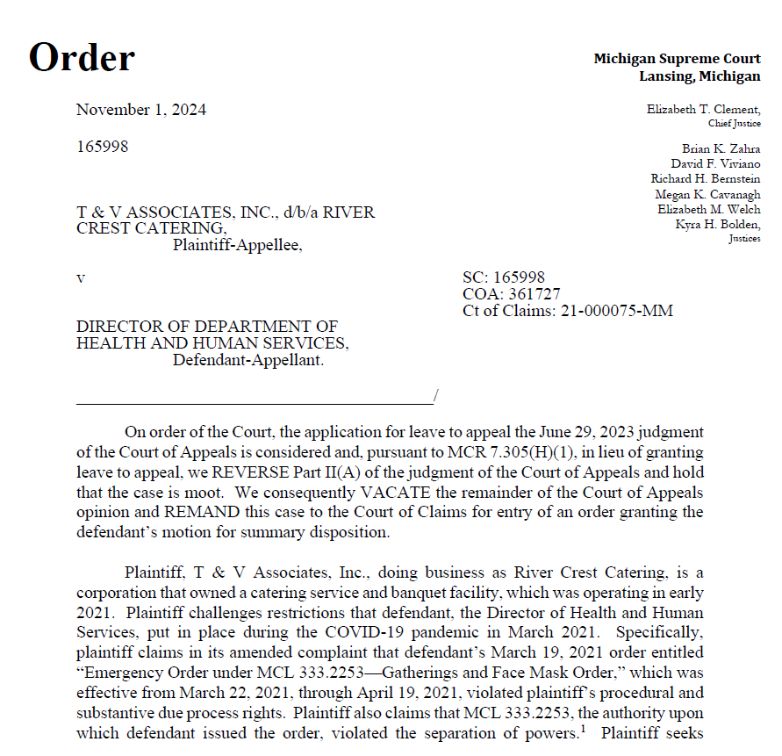
Judicial Influence Over Public Health
In some states, courts have restricted health departments’ authority to protect public health in their communities.
E.g., T&V Associates v. Director of Health and Human Services
Michigan Dep’t of Health and Human Services issued emergency order limiting gatherings at food services establishments
Business challenged provision of Michigan Public Health Code underlying emergency order, MCL 333.2253, and Michigan Court of Appeals found provision to be invalid
Michigan Supreme Court REVERSED, finding the case moot

Slide 18

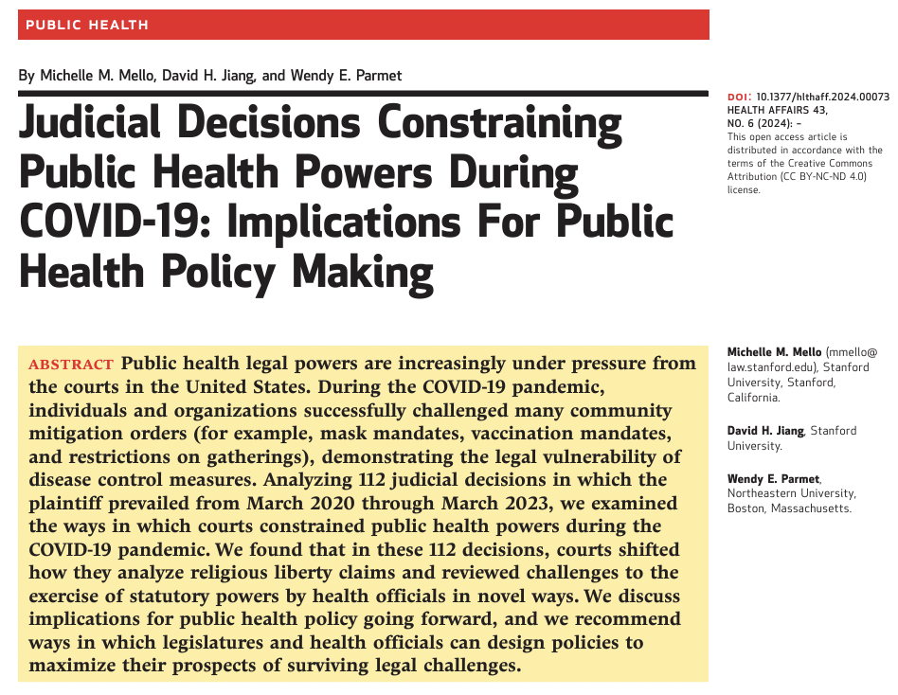
Early Warning System
This Photo by Unknown Author is licensed under CC BY-SA
Mello, Jiang and Parmet

Slide 19
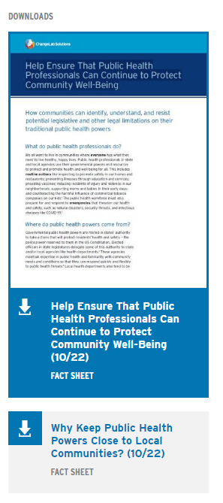
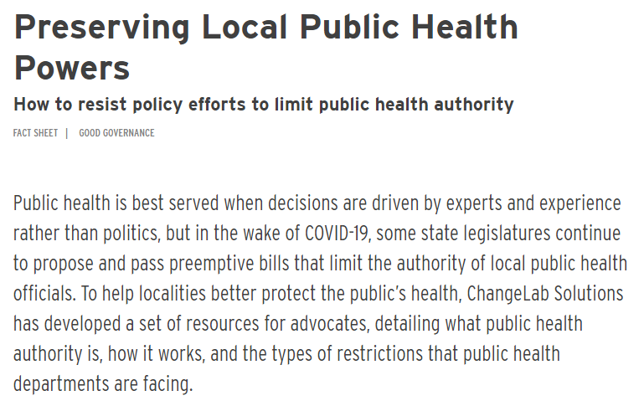
https://www.changelabsolutions.org/product/preserving-local-public-health-powers

Slide 20
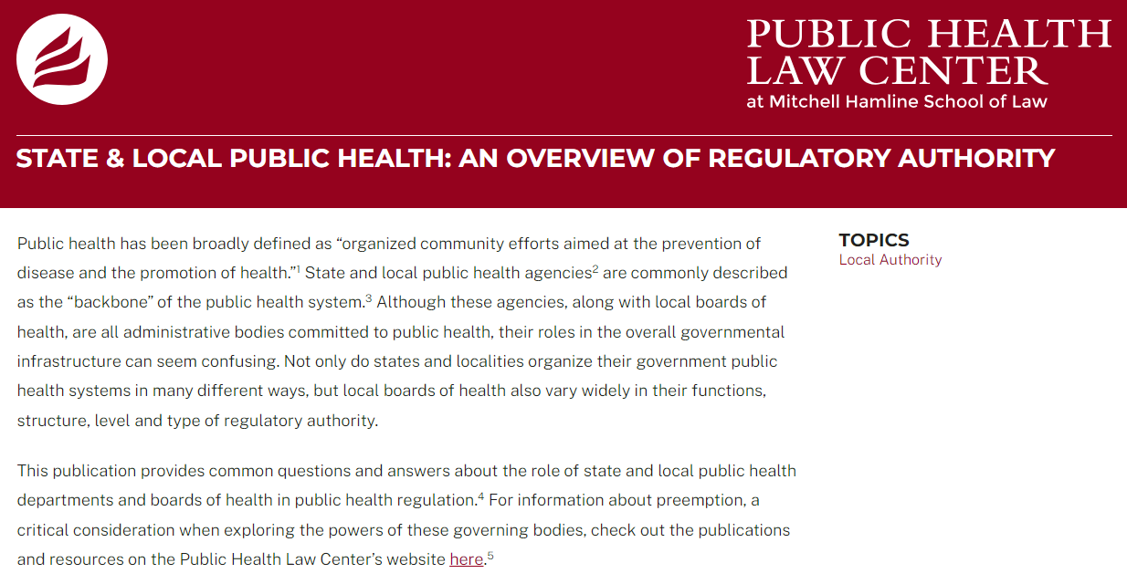
https://www.publichealthlawcenter.org/resources/state-local-public-health-overview-regulatory-authority

Slide 21

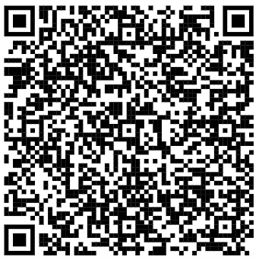
Toward a Coordinated Response
Funding
Workforce
Public Health Interventions and Emergency Orders
Health Equity
Governance
Infrastructure
More Effective and Equitable Public Health System

Slide 22
Central Question
What laws, policies, and governance structures are needed to ensure that public health officials and staff can serve the public’s health effectively and equitably, in ways responsive to community priorities? Authority to…
  Respond nimbly to public health emergencies;
  Provide stable, day-to-day public health services to all; and
  Facilitate upstream activities that improve public health

Slide 23
Visit the Act for Public Health Website
actforpublichealth.org
Join the Framework conversation: https://forms.office.com/Pages/ResponsePage.aspx?id=wJZZqgTyV0y6tPSZL236khzDI-FBsV1At7RDKi0bkGVUODcxTU9QN01BRVVRV1Y0MjA1QzJKUUNOUC4u

Slide 24
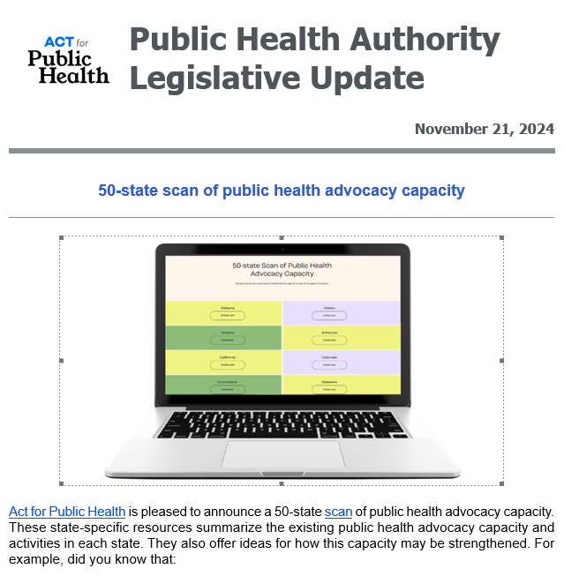
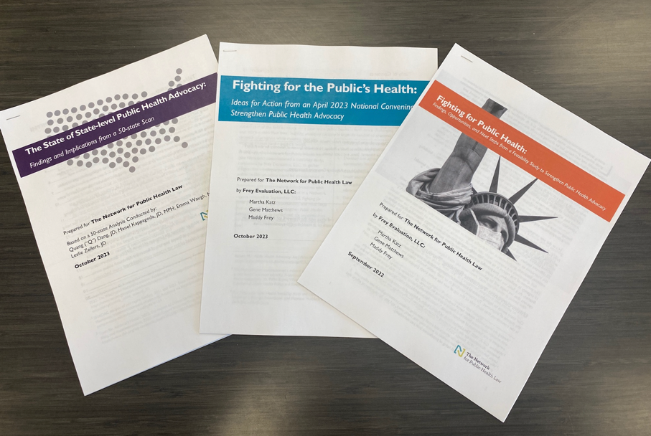
Fighting for the Public’s Health

Slide 25
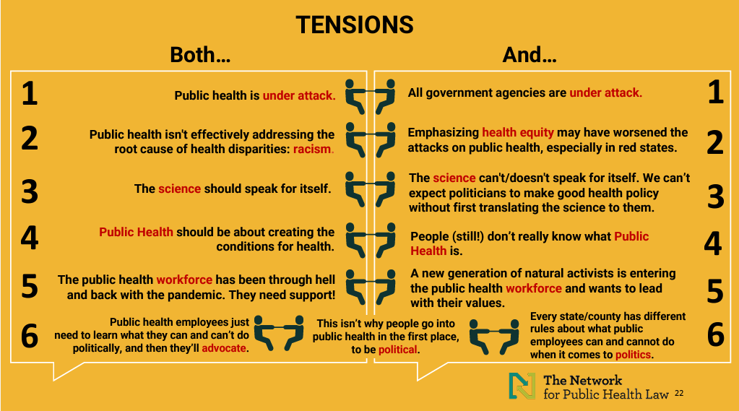

Slide 26
Findings & Opportunities
1
PH’s role and value is often misunderstood
Elevate public health’s value proposition
2
PH is often reluctant to rely on lobbying and advocacy
Encourage strategic advocacy and lobbying
3
Counter challenges to public health authority
Challenges to PH authority make advocacy more difficult and essential
Fight for health equity
4
Health equity is fundamental and requires nuanced communication
5
Tap the strengths of supportive allies
Public health allies remain untapped resources
6
The PH workforce is underfunded
Support the public health workforce

Slide 27
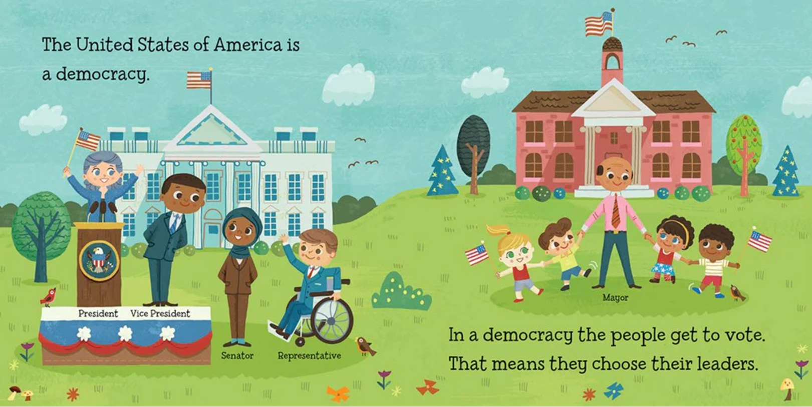
27
Baby Loves Political Science: Democracy! by Ruth Spiro

Slide 28




Health & Democracy: The Case for Public Health
Gnora Mahs, DrPH
Health & Democracy Coalitions Advisor

Slide 29


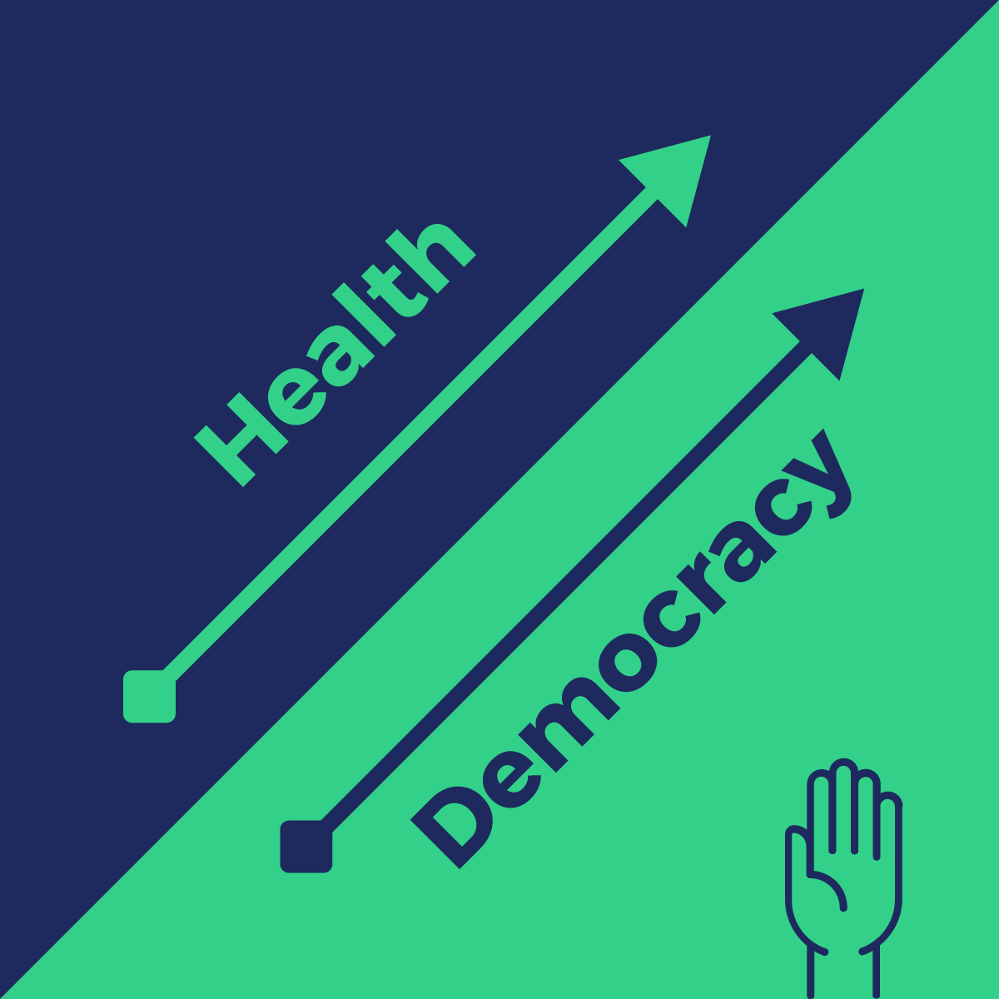
Health is always on the ballot
Public Safety & Violence prevention
Health care access
Early childhood investments
Climate resiliency
Pandemic & infectious disease prevention
Maternal and Infant Health
Reproductive Health
Public Health Authority
Housing, water, food, education, transportation, civil rights…………

Slide 30




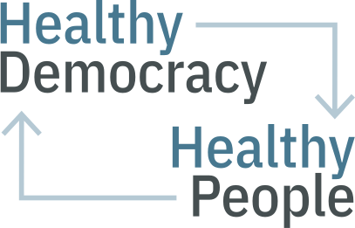








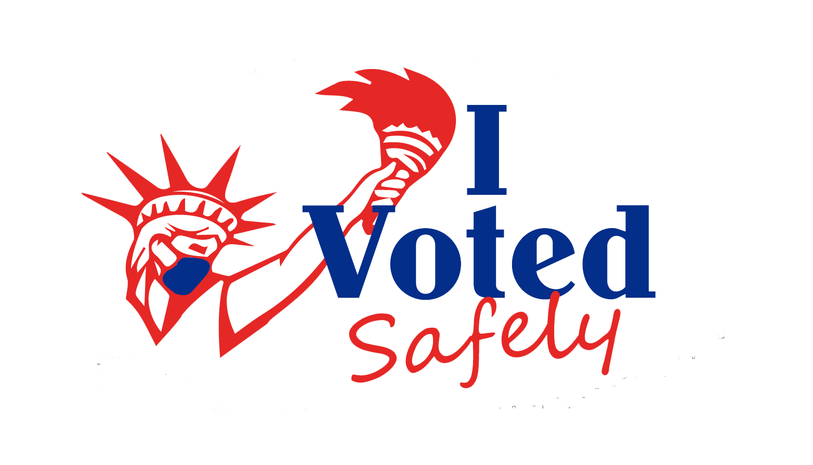



2020 Brought Public Health and Elections Together

Slide 31


How is Democracy Related to Health?

Slide 32
Health and democracy are Interdependent
Higher civic and voter participation
More power to influence policy
Healthy Democracy Healthy People
Better health outcomes
Notes:
health and democracy as interdependent which is confirmed by research. The short answer is that higher civic voter participation is correlated with better health outcomes for people and communities, and lower civic participation is correlated with worse health outcomes. One rationale for how voting is tied to health is through the understanding of power being a root cause for influencing policy that can advance health and racial equity.

Slide 33
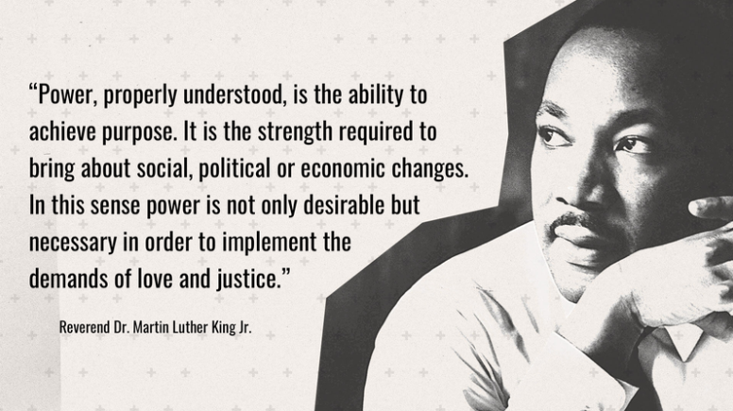
Notes:
A great definition of power comes from MLK Jr. “Power, properly understood, is the ability to achieve purpose. It is the strength required to bring about social, political, or economic changes. In this sense power is not only desirable but necessary in order to implement the demands of love and justice.” In this sense we can see civic and voter participation being key to building collective power across and with our communities.

Slide 34
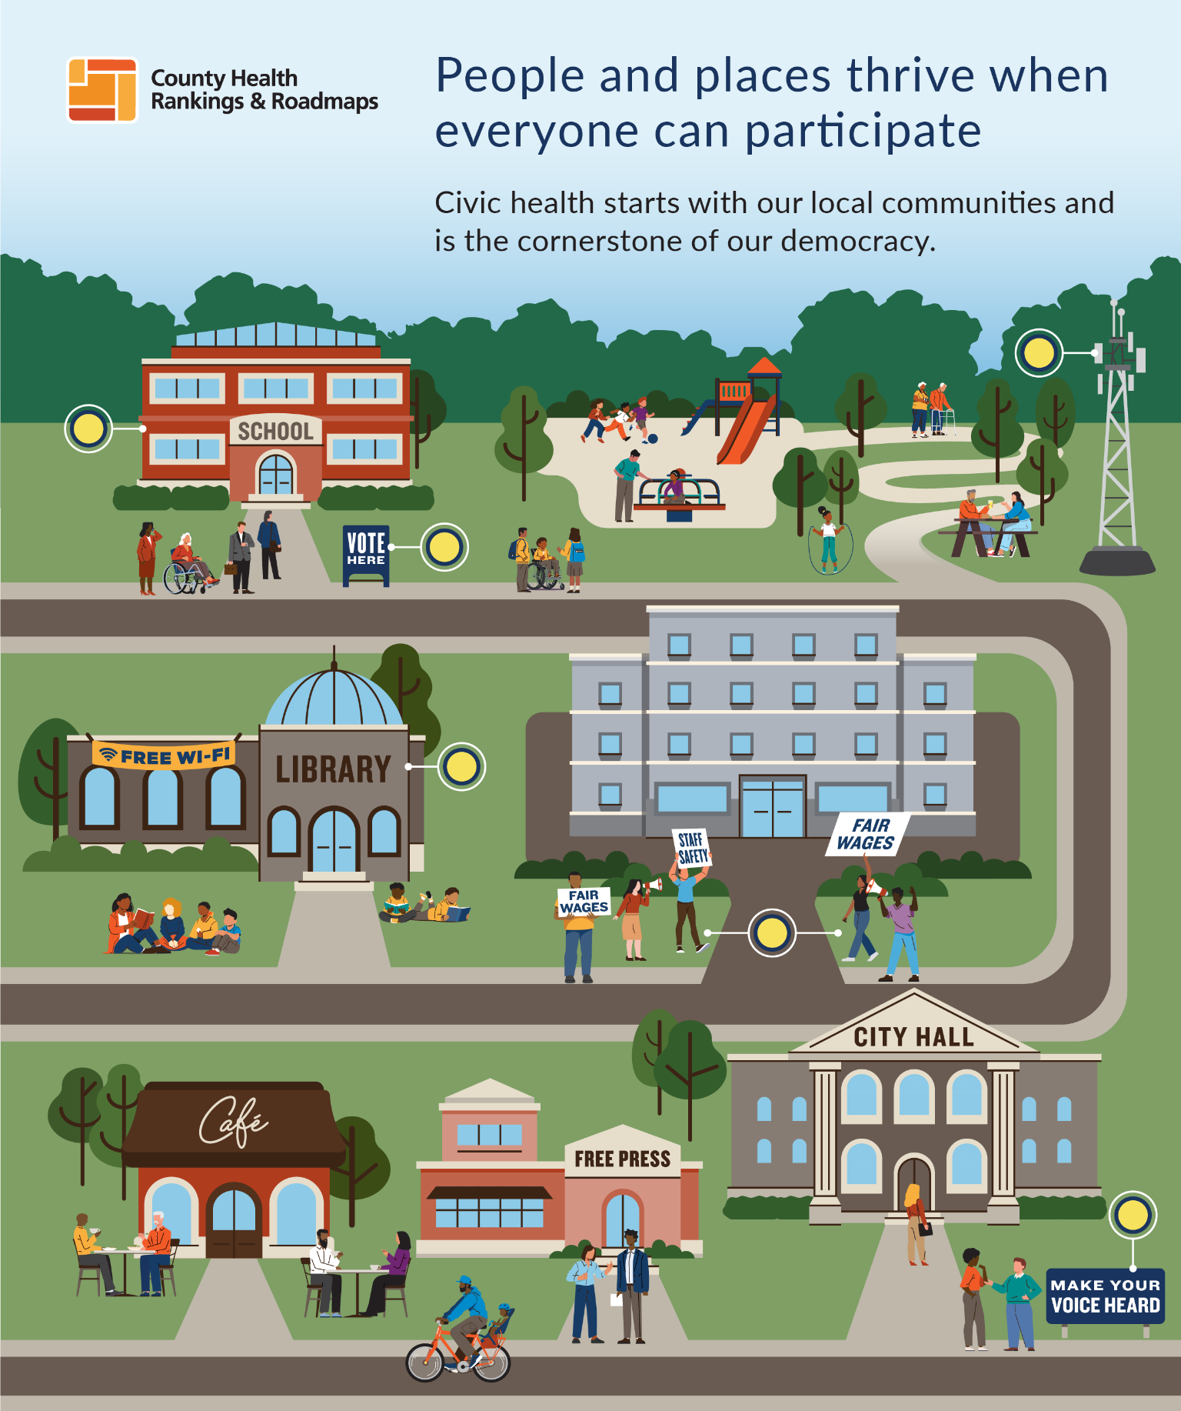
Notes:
One way power manifests is through civic and voter participation. in a democracy, we can directly influence policies when we vote on ballot measures like funding for parks, education, transportation, etc. We also vote for elected officials who are tasked with representing our interests in the policymaking process. Therefore, whose interests are reflected in these policy decisions is often tied to voting and the policies that either enable or hinder community members to participate. Communities with more power, through voting, can advocate for healthier conditions.
Historical and contemporary research confirms that when we have higher rates of civic and voter participation communities are healthier.

Slide 35
Health and democracy are Interdependent
Higher civic and voter participation
More power to influence policy
Healthy Democracy Healthy People
Better health outcomes
Notes:
Thus, healthy communities are also more likely to have higher voter participation, making this a continuous and virtuous cycle. We also know the opposite is true, where communities with less civic and voter participation, often due to governing structures that make it harder to participate, have less power to influence which reinforces worse health outcomes because the policies do not reflect the needs of the communities. Thus this feedback loop reinforces health inequities.

Slide 36
History: Expansion of Electoral Power Improves Health
Expansion of Voting Access | Health Improvement
Women’s Suffrage | Child mortality rates declined
Civil Rights Movement | More inclusive policies in education, housing, economic opportunity, and health care including Medicare and Medicaid
Voting Rights Act of 1965 | Reductions in Black infant deaths in Southern counties subject to preclearance
All steps forward were contested “continuous struggle for power…”
Notes:
We have historical examples of how collective power has made our democracy more inclusive and led to positive community health outcomes
Whenever we have expanded the electorate or worked to ensure our democracy is more inclusive, we have seen improvements to health and the social determinants. For example, when women gained the right to vote they were able to use their influence to ensure legislative bodies were more responsive to women’s concerns making investments to improve maternal and child health. Studies show that child mortality rates declined.
All of these steps are examples of steps forward. But we know the each step has been met with contention– we cannot sit out and achieve our aims and we have a constant continuous struggle for power.

Slide 37

Health & Democracy Index
Compares 12 public health indicators and voter turnout to the restrictiveness of voting policies in each state.
States with more voting access and greater civic participation have better health outcomes
https://democracyindex.hdhp.us/

Slide 38

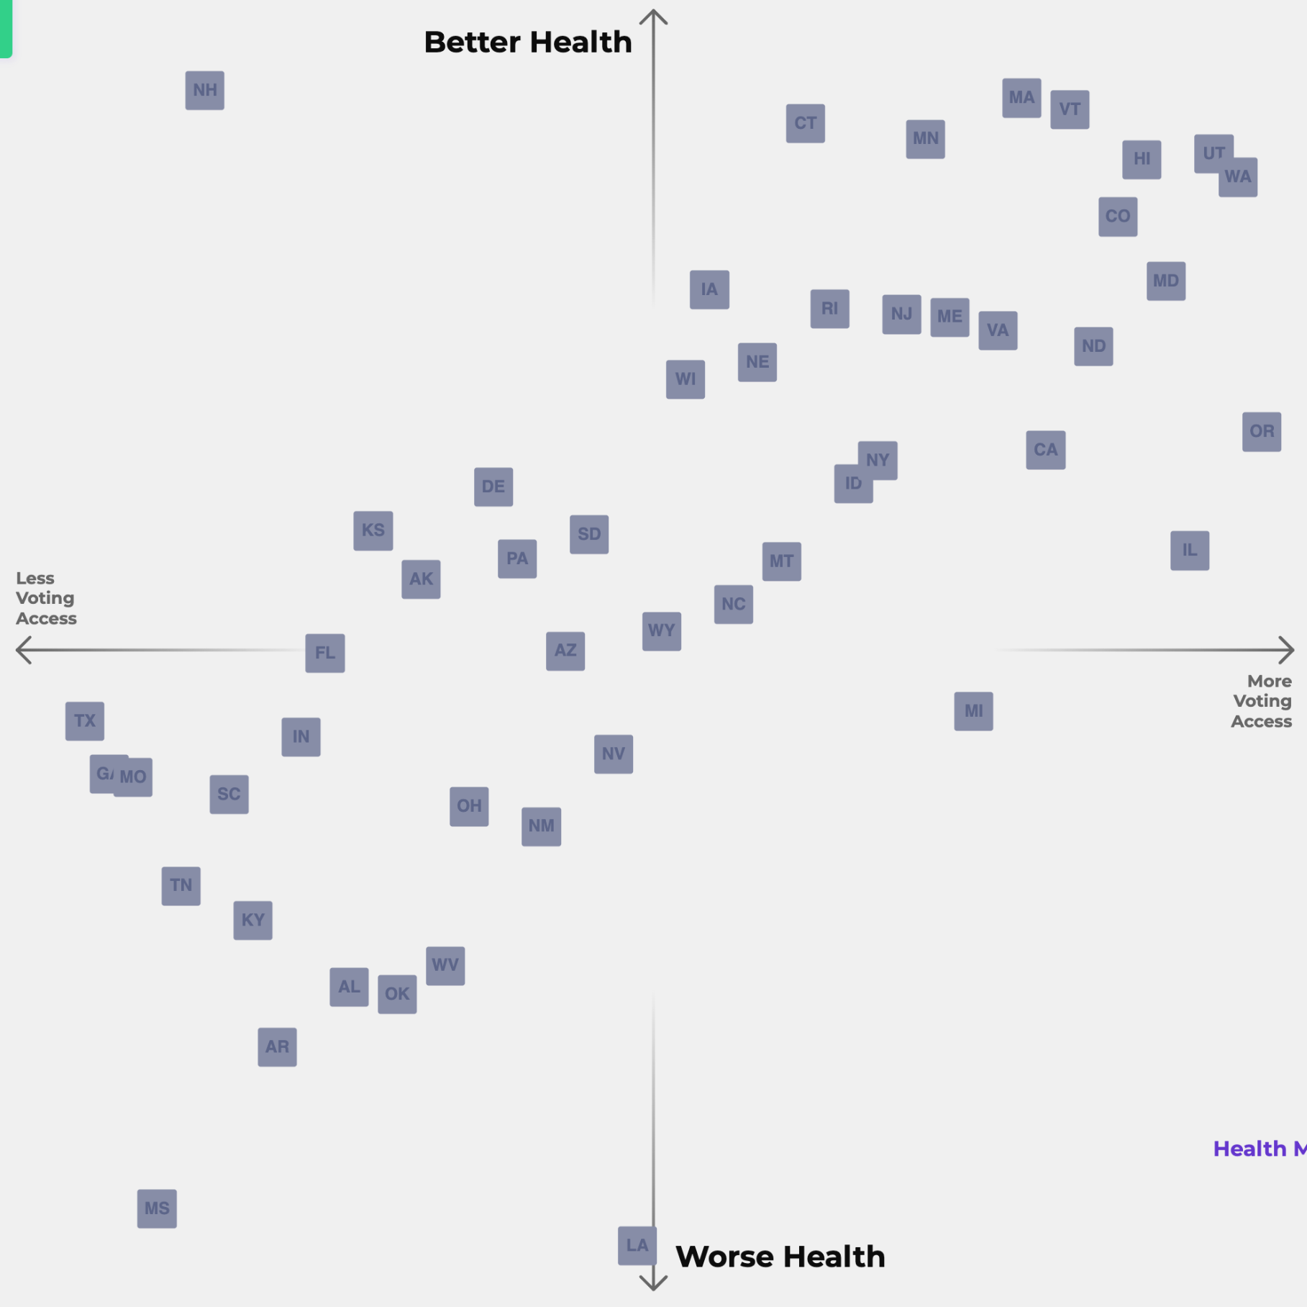

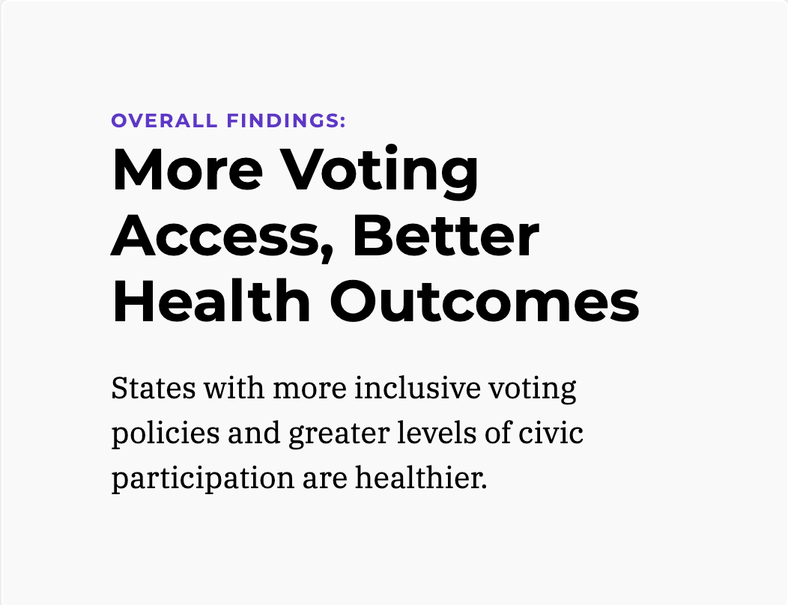
Main Findings

Slide 39

Additional research: Consistent association between civic/voter participation and health
States where it is easier to vote are more likely to have:
  better rates of state-level health across time (1996-2020); Schraufnagle, 2023
  lower uninsured rates; Pabayo et al., 2021
  lower working age mortality rates; Montez et al., 2023
  counties had lower pre-vaccine COVID case and mortality rates; Pabayo et al., 2022
Civic engagement (voting, volunteering, and activism) among adolescents and young adults is positively associated with better future income, education levels and mental health compared to non-voters; Ballard et al., 2019
Notes:
Jennifer Karas Montez, Jason, K., & Grumbach, J. M. (2023). Electoral Democracy and Working‐Age Mortality. Milbank Quarterly. https://doi.org/10.1111/1468-0009.12658
Schraufnagel S. Voting Restrictions and Public Health: An Analysis of State Variation 1996–2020. State and Local Government Review. Published online October 10, 2023. doi:https://doi.org/10.1177/0160323x231202421
Pabayo R, Grinshteyn E, Steele B, Cook DM, Muennig P, Liu SY (2022) The relationship between voting restrictions and COVID-19 case and mortality rates between US counties. PLoS ONE 17(6): e0267738. https://doi.org/10.1371/journal.pone.0267738
Pacheco J, LaCombe S. The Link between Democratic Institutions and Population Health in the American States. Journal of Health Politics, Policy and Law. Published online May 6, 2022. doi:https://doi.org/10.1215/03616878-9978103
Nelson C, Sloan J, Chandra A. Examining Civic Engagement Links to Health: Findings from the Literature and Implications for a Culture of Health. RAND Corporation; 2019.
Ballard PJ, Hoyt LT, Pachucki MC. Impacts of Adolescent and Young Adult Civic Engagement on Health and Socioeconomic Status in Adulthood. Child Dev. 2019 Jul;90(4):1138-1154. doi: 10.1111/cdev.12998. Epub 2018 Jan 23. PMID: 29359473.

Slide 40
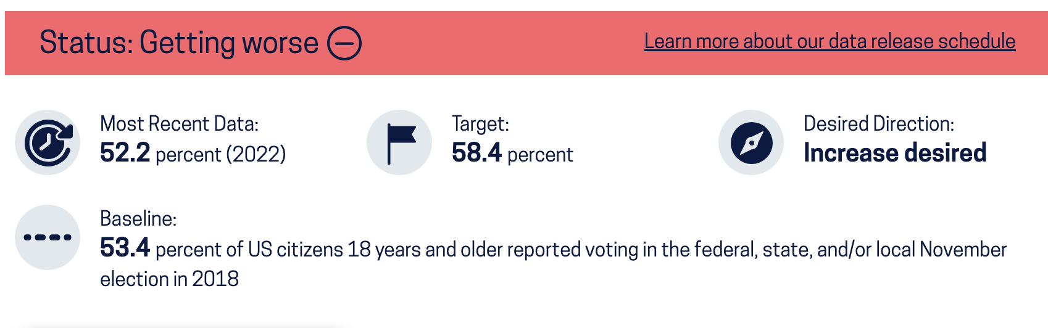
Healthy People 2030: All eligible voters vote
Increase the proportion of the voting-age citizens who vote SDOH-07

Slide 41
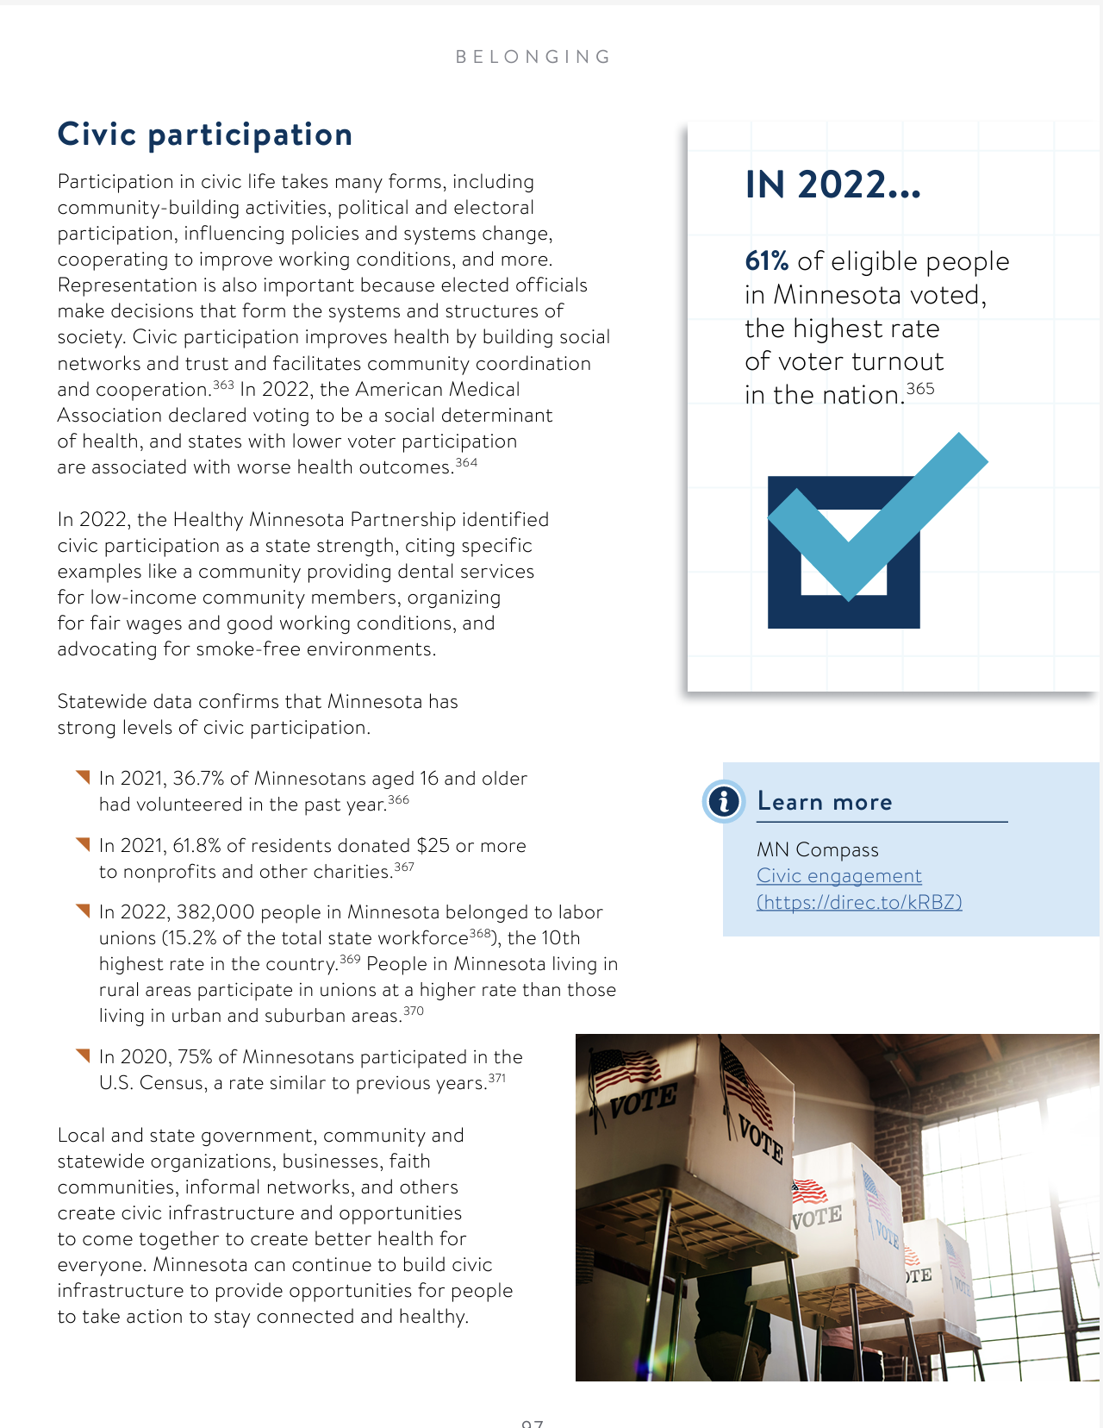
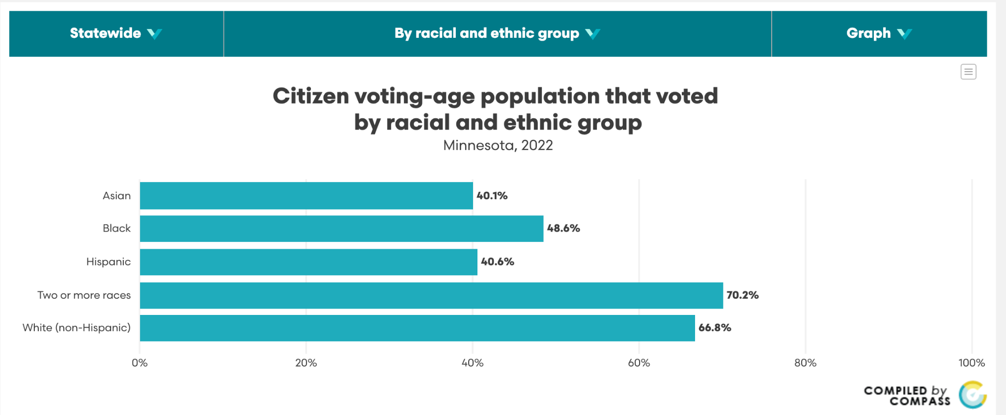
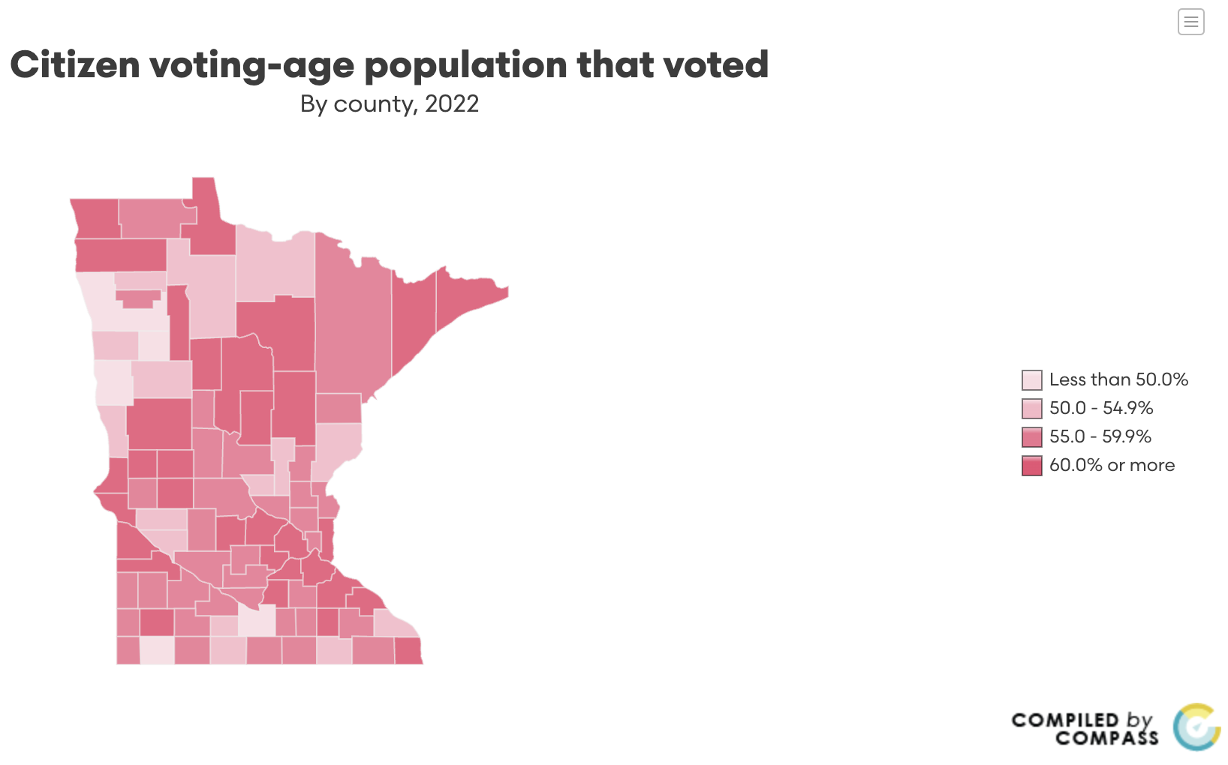
Civic Participation in Minnesota State Health Assessment

Slide 42
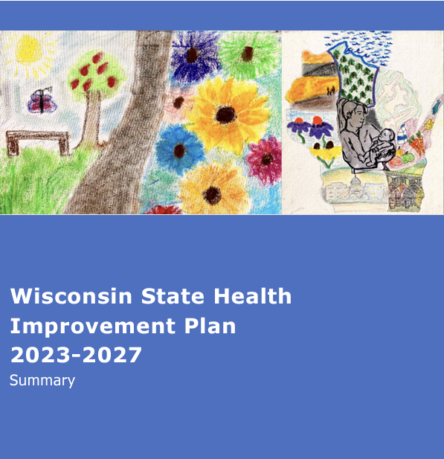
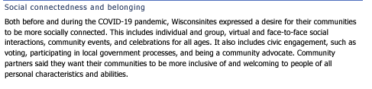
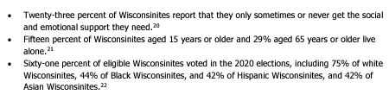

Civic Participation in Wisconsin State Health Improvement Plan

Slide 43
Missouri Public Health Challenges and Opportunities
Spring Schmidt- Executive Director, Missouri Public Health Institute (MOCPHE) &
Director, Office of Public Health Practice, Saint Louis University College for Public Health and Social Justice

Slide 44
Public Health is Local
Governmental public health is different
  Always governed by elected officials
  Some incomplete intersections between federal, state, and local levels
  Significant delivery of public health services takes place locally
    And are largely popular
  More likely to be focused on existing mandates
  Likely to perform a variety of additional services based on community need
  Extremely low funding with severe restrictions

Slide 45
Community Trust
Governmental agencies are held to high standards of public accountability
  Direct community engagement
  More direct involvement from local elected officials
Relationship-oriented familiarity with public health services delivered locally are more trusted
Distrust and misinformation at the national level cannot be out-messaged by locals
  But can be mitigated by direct community engagement and education

Slide 46
A few Missouri facts
115 local public health jurisdictions
Lowest per capita state public health funding= $7
Lower quartile rankings in almost every health outcome
Very large urban/rural gaps in resources and outcomes
Decentralized infrastructure with diverse governmental authority

Slide 47
Missouri is a Home Rule state
Responsive to local pressure and local needs
Determined local officials can be more disruptive to service delivery
  However, local services are broadly popular especially when problems arise
Wide variability in environment, services, and relationships

Slide 48
Missouri and Foundational Public Health Services
Grassroots model built specifically by/for Missouri, adopted by DHSS
Studies on capacity, cost gap analysis
Bi-partisan support for the delivery of services statewide
Strong awareness of needs
Accountability efforts
Funding, education, advocacy, training, and infrastructure being lifted to meet these standards

Slide 49
Ongoing concerns
National conversations that increases misinformation or disinformation makes messaging extremely difficult and influences behavior choices
Situations that are preventable, particularly outbreaks, are likely to increase (but we were on that trajectory already)
Public health funding at the national level is uncertain
There are people in positions of power over local public health that are not invested in improving public health

Slide 50
Why I am hopeful
Our public health system delivers services communities care about
Our state leadership, local leaders, state associations, and an increasingly bi-partisan group of lawmakers are interested in solutions
Our LPHAs are worthy of trust and investment
Public health endures
You can get involved locally and it can make a difference

Slide 51
Thank you

Slide 52


2024 Elections & Looking Forward
Reflections on the 2024 Elections
November 21, 2024
Institute for Responsive Government
2024 Election Reflections

Slide 53

Who We Are: The Institute for Responsive Gov.
The Institute for Responsive Government is a good government group that works to make government work for everyday people. Our mission is to help policy makers find solutions that make government more efficient, accessible, and responsive to the needs of real human beings.
Responsive Gov got its start working to streamline, modernize and secure our elections systems. One of the hallmarks of our work has been passing and implementing Automatic Voter Registration (AVR) in states all across the country.
Over the past year, Responsive Gov has expanded its portfolio to reduce administrative burdens across all sectors of government. For additional information about the Institute for Responsive Government and our work, please contact gnora@responsivegov.org.
Government should work for the people.
Institute for Responsive Government
Building Multi-Agency Partnerships for Success | 53

Slide 54

Contents
2024 Election Reflections
Political Landscape
2025: Democracy is on the Docket
Democracy that Delivers
01
02
03
04
Institute for Responsive Government
2024 Election Reflections

Slide 55
01
2024 Election Reflections
Institute for Responsive Government
2024 Election Reflections | 1

Slide 56

2024 Elections

Slide 57
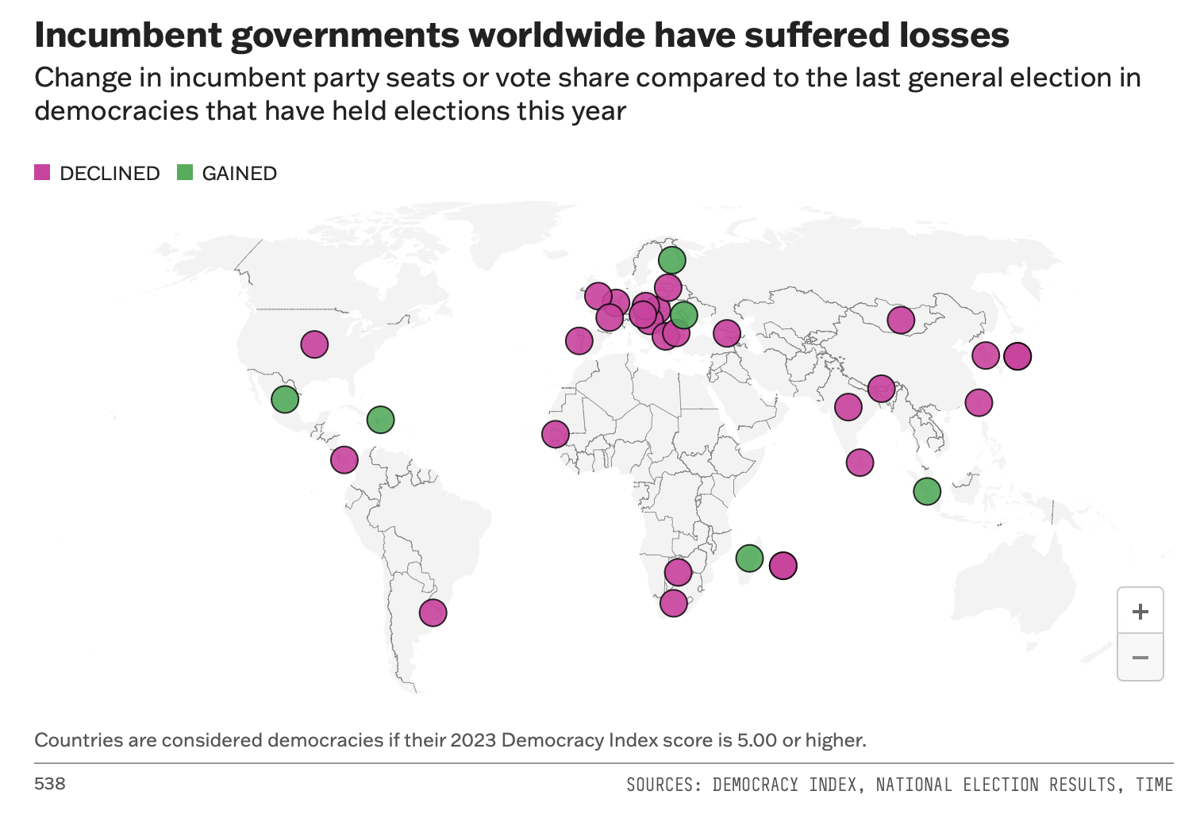
#1 Global Anti-Incumbency Wave
Notes:
ged them

Slide 58
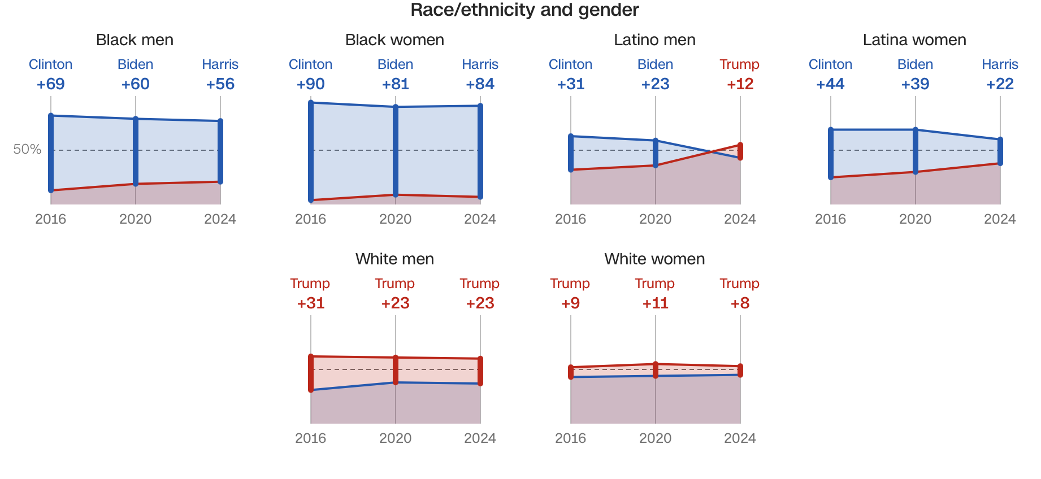
#2 Demographics are not Destiny

Slide 59
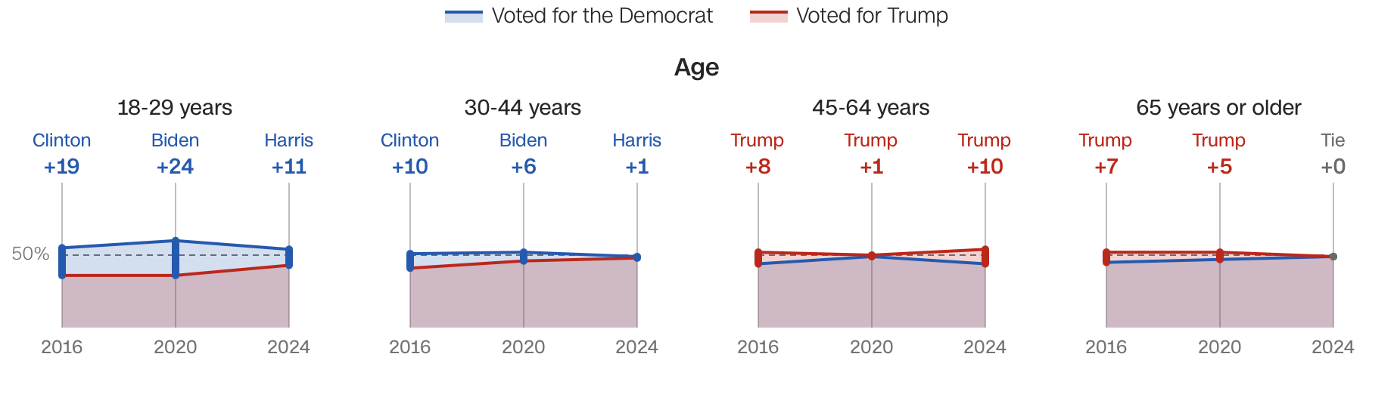
#2 Demographics are not Destiny

Slide 60
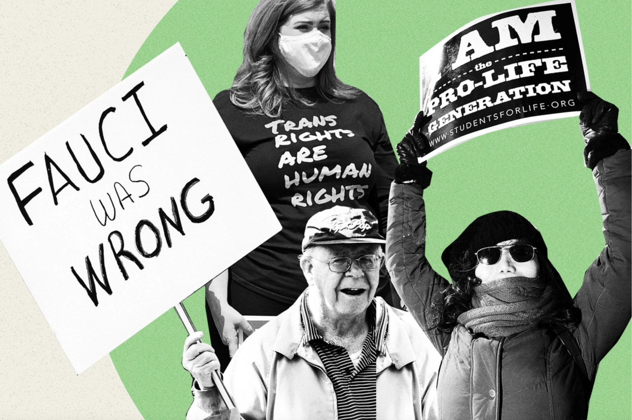
#3 The Issues
Notes:
There were 11 ballot measures on abortion in 2024 as states continue to deal with the fallout of the Dobbs Supreme Court decision. 9 of the 11 states approved measures which preserved access to abortion while Florida and South Dakota rejected those measures.
Similarly, Ranked Choice Voting was on the ballot in 5 states and Washington DC. All 5 states rejected RCV while Washington DC approved the measure.

Slide 61
02
Political Landscape
Institute for Responsive Government
Political Landscape | 2

Slide 62

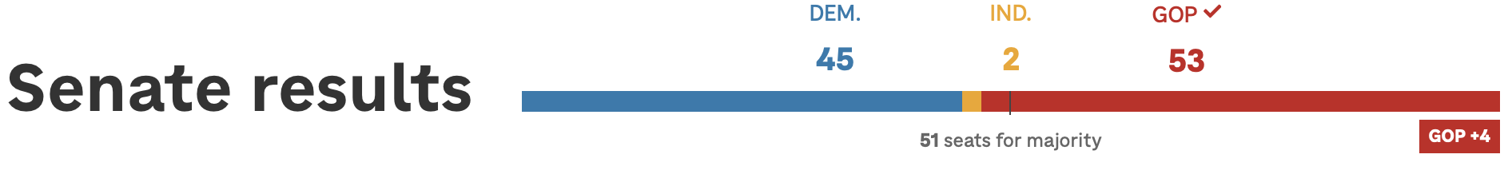
Congressional Landscape

Slide 63
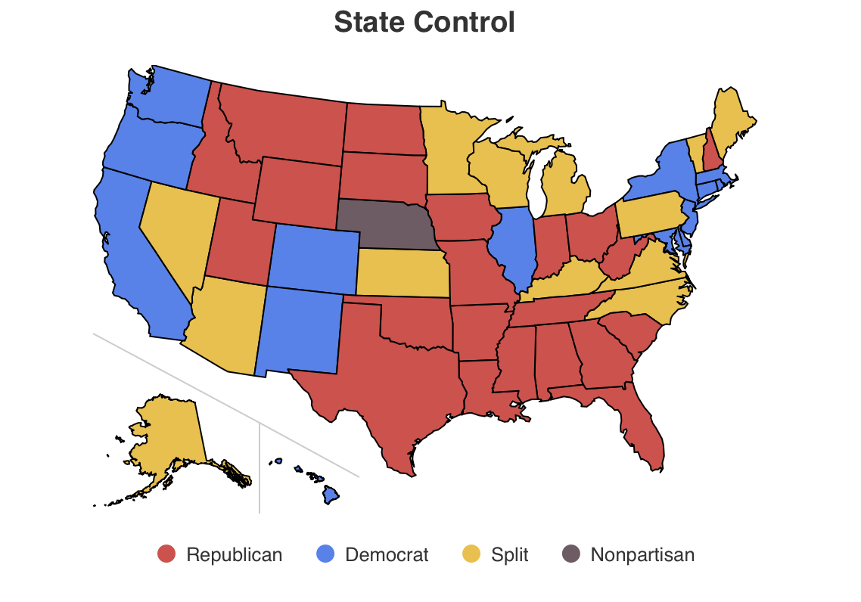
State-Level Landscape
Credit: National Conference of State Legislatures

Slide 64
03
2025: Democracy is on the Docket
Institute for Responsive Government
2025 | 3

Slide 65
2025: What to Expect? (Democracy Edition)
01
02
03
Proof of Citizenship
We expect legislation adding new requirements for voter registrants to provide documentary proof of citizenship in most states and at the federal level. Texas has already seen five versions of this bill drop for the upcoming legislative session and, in Congress, the SAVE Act is focused on introducing these requirements nation-wide.
Voter ID Laws
Voter ID requirements will continue to be a focus in states and at the federal level. While Voter ID requirements can be implemented in an accessible manner, legislation which is restrictive in the types of voter ID permitted to be used can cause voters confusion and problems casting their ballot.
Federalization of Elections & Political Activity
With one-party control of the Federal Government, there will be legislation which would federalize control over elections, provide increased power to the federal government to go after nonprofits, and far-reaching revisions to election codes around issues like vote by mail, ballot drop boxes, election reporting, and more.
Institute for Responsive Government

Slide 66
04
2025: Democracy that Delivers
Institute for Responsive Government
Democracy that Delivers | 4

Slide 67
2025: Democracy that Delivers
01
02
03
Customer Service
A government with a customer service orientation shows that it values the needs of its citizens. By being responsive, transparent, and efficient in its interactions, government agencies can foster a sense of respect and accountability, which in turn strengthens public trust. When people feel heard and supported, they are more likely to view their government as reliable and effective, creating a foundation for stronger civic engagement and confidence in public institutions.
Data Sharing
The U.S. has decentralized information systems with local, state, and federal governments selectively sharing data with each other. In many ways, this is a valuable byproduct of U.S. federalism. However, sometimes the lack of data sharing is simply a byproduct of poor investments in IT and insufficient collaboration across departments & agencies. Addressing high-impact areas where data sharing can provide constituents with better service will help remove a common pain point.
Addressing Critical Needs
When government effectively addresses critical needs, such as healthcare, housing, or disaster relief, it demonstrates its ability to deliver meaningful results that improve people's lives. This success builds public confidence in the government’s capacity to solve pressing issues, making citizens more likely to support future public policy solutions.
Institute for Responsive Government

Slide 68
2025: Democracy that Delivers
01
02
03
Protecting & Expanding Healthcare
State and local governments will be the main line of defense against a federal government which is seeking to make a mark on healthcare programs like Medicaid. Work requirements, among other new policies, will add new burdens to an already challenging process for applicants. Effective implementation of these policies, with appropriate automation of eligibility determinations, will help constituents ensure they maintain coverage for themselves and their families.
Access to Identification
Streamlined access to identification is vital because it serves as a gateway to essential services, including healthcare, housing, education, and employment. By ensuring all constituents can easily obtain identification, state and local governments promote equity and inclusion, reducing barriers for marginalized populations. This service demonstrates a commitment to meeting basic needs efficiently and fairly, building trust in government as a responsive and effective provider of critical resources.
Cutting Red Tape
The day-to-day experiences submitting applications for permits, licenses, and other certifications from state and local government can resemble a nightmare. Complicated and lengthy processes to be able to set-up businesses, make repairs to your home, or to start a new licensed occupation are most likely to impact lower-income and marginalized communities. Improving these processes can help to build trust in government as an effective agent for delivering services for their constituents.
Institute for Responsive Government

Slide 69
Institute for Responsive Government

Slide 70
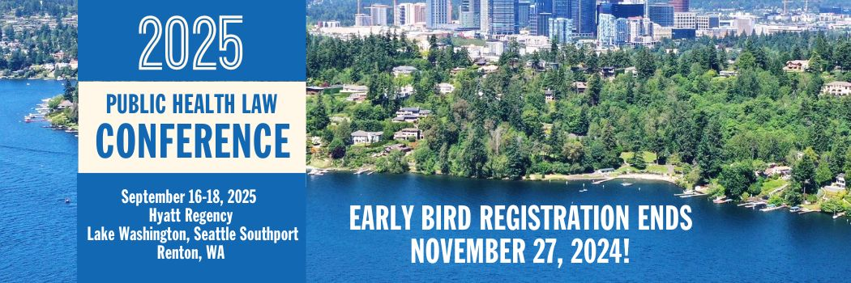
More than 40 sessions examining core issues for
healthier, stronger, and more equitable communities.
networkforphl.org/2025PHLC | #PHLC2025

Slide 71
Thank you for attending.
You will receive an email notification when the slides and recording of today’s webinar have been posted on the Network website.
71

