Slide 1

Implementing state and local overdose prevention policies in the criminal/legal system
June 25, 2024

Slide 2
The Network for Public Health Law
The Network’s Harm Reduction Legal Project works to address the legal and policy barriers that impede the establishment and expansion of evidence-based harm reduction measures such as naloxone distribution, syringe access programs, and access to evidence-based substance use disorder treatment.
The Project provides guidance and consultation to governmental and nongovernmental organizations as well as impacted individuals to assist them in navigating the often extremely confusing maze of existing laws and regulations that hamper harm reduction initiatives.
The Project also provides non-partisan, evidence-based publications and training regarding the state of laws impacting individuals who use drugs, individuals in recovery, and their communities, as well as research regarding the impact of those laws.

Slide 3

Funding Acknowledgment
This training was supported by the Centers for Disease Control and Prevention of the U.S. Department of Health and Human Services (HHS) as part of a financial assistance award with 100 percent funded by CDC/HHS.
The contents are those of the author(s) and do not necessarily represent the official views of, nor an endorsement, by CDC/HHS, or the U.S. Government.

Slide 4
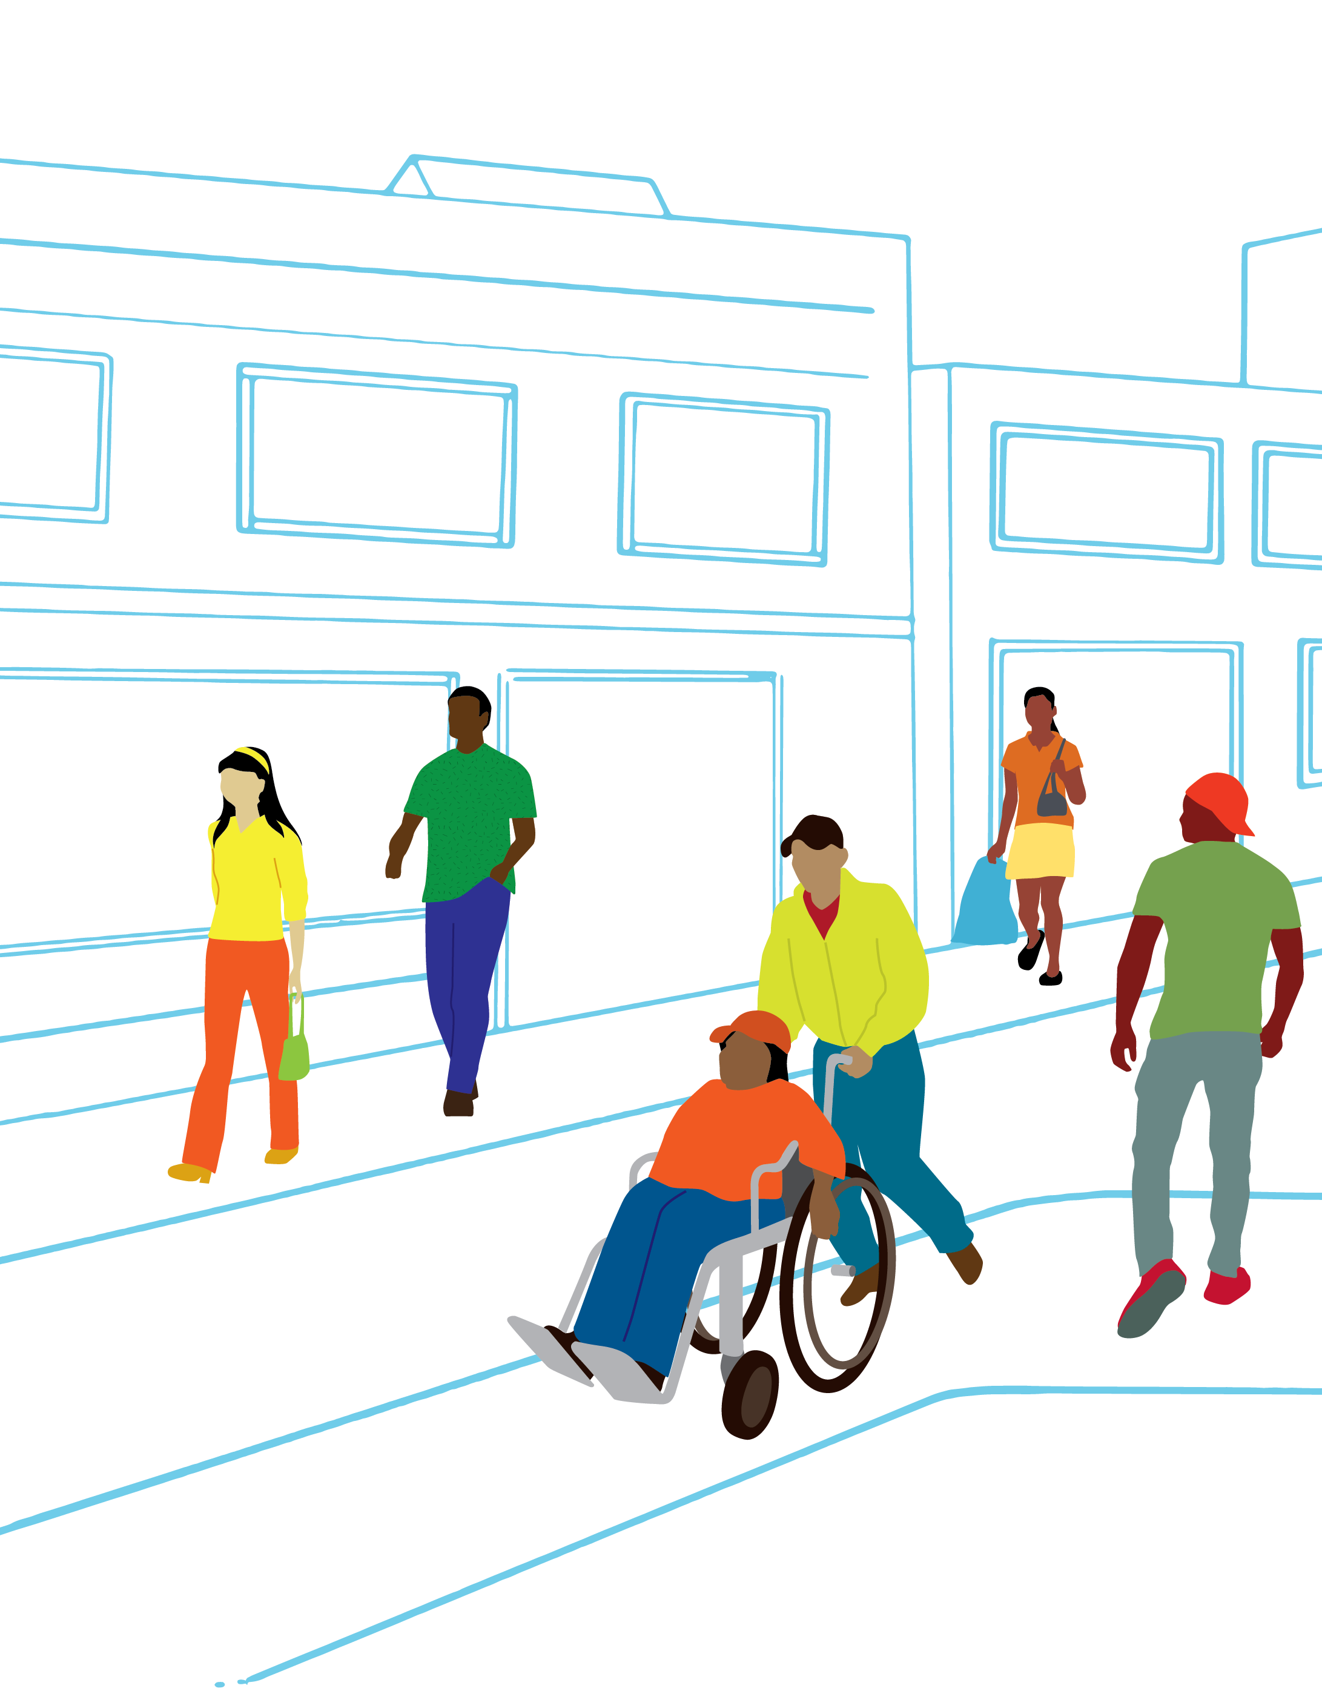

Our mission
Healthier communities
for all through equitable
laws & policies.
Notes:
For those who may not know us, ChangeLab Solutions is a nonpartisan, nonprofit organization that uses the tools of law and policy to advance health equity.
We partner with communities across the nation to improve health and opportunity by changing harmful laws, policies, and systems.
Our interdisciplinary team works with community organizations, governments, and local institutions to design and implement equitable and practical policy solutions to complex health challenges.

Slide 5
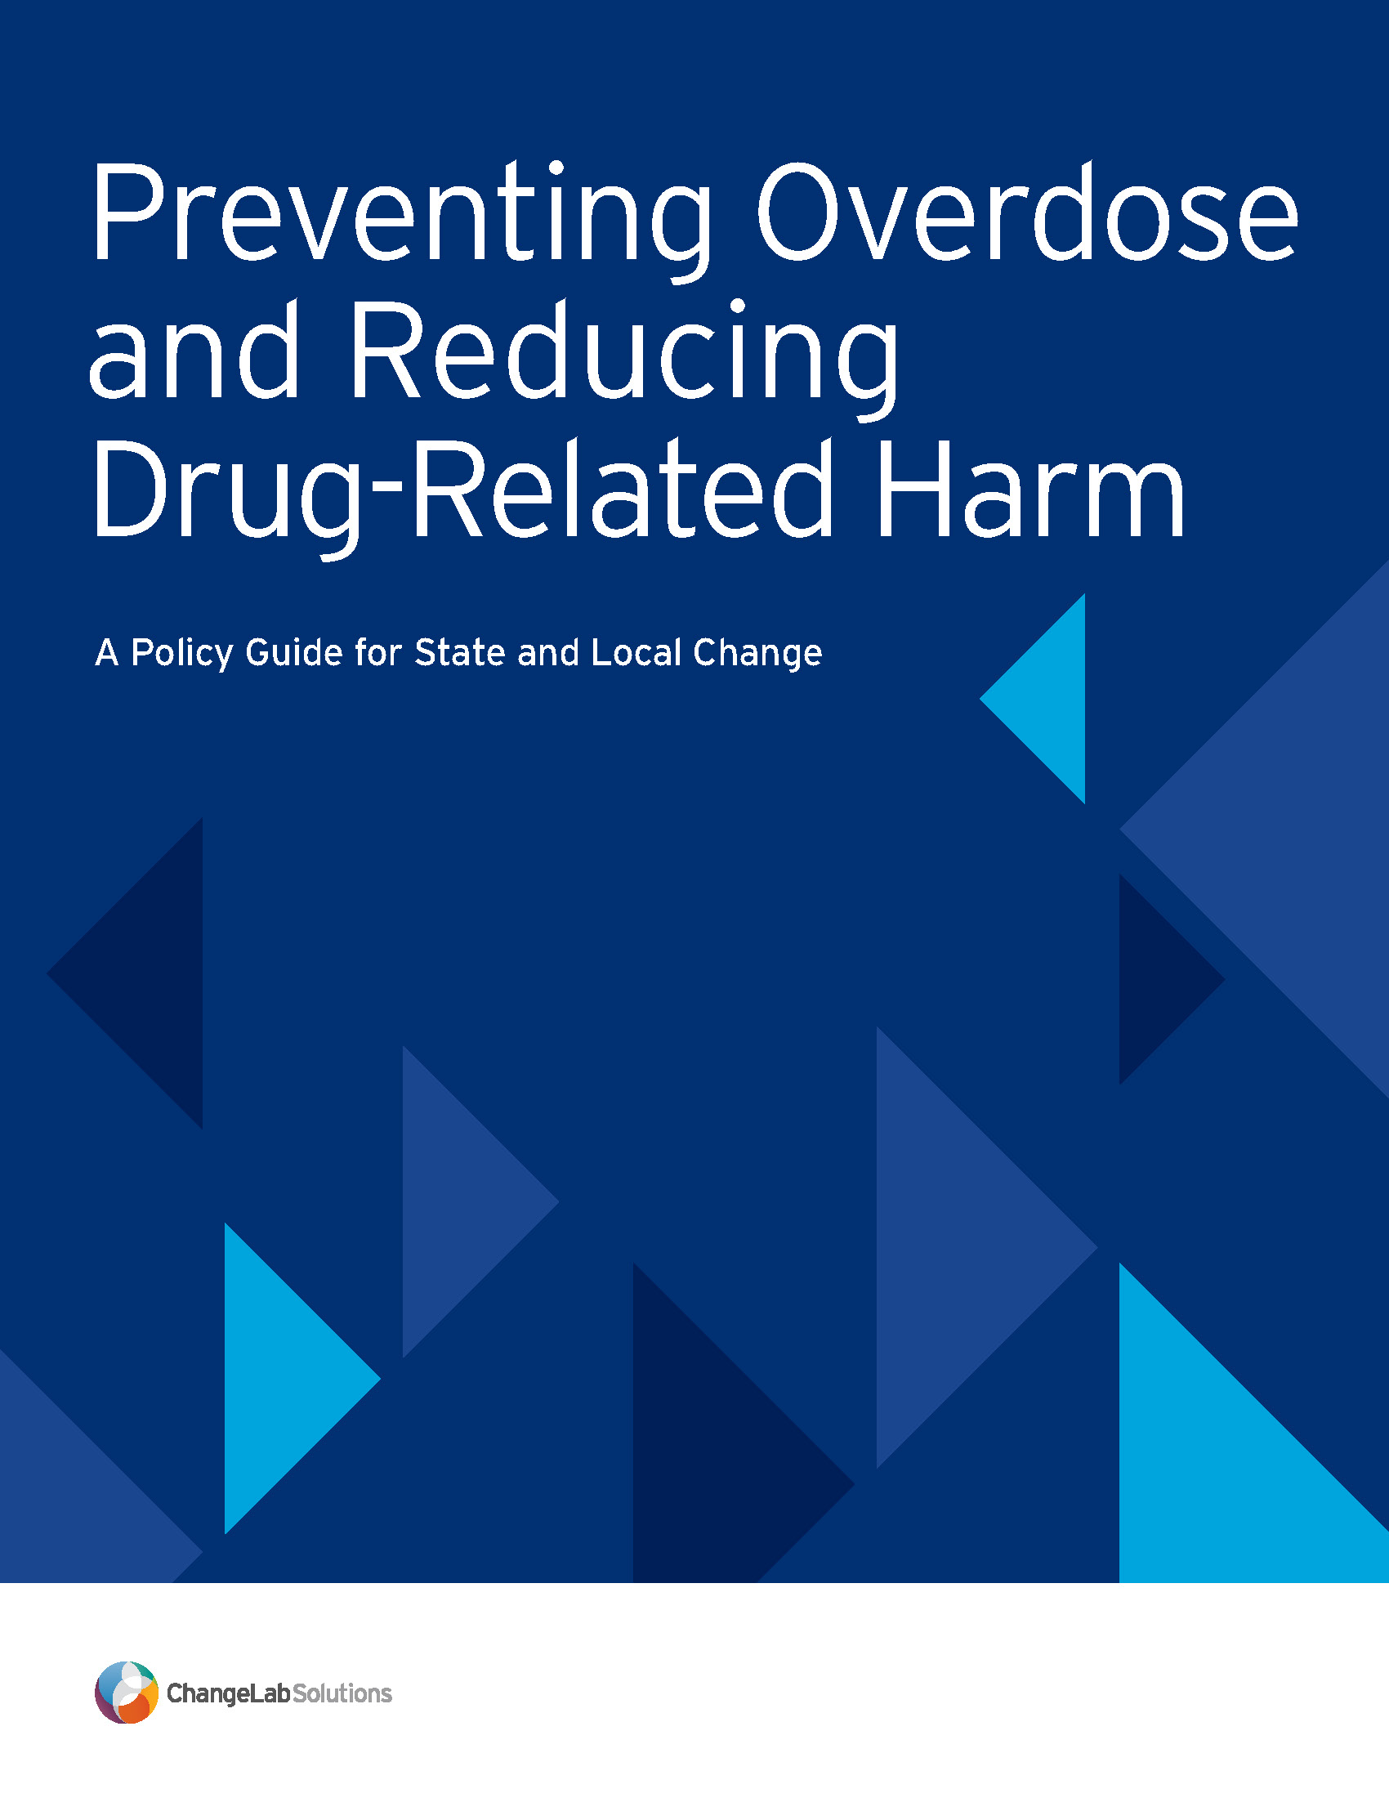
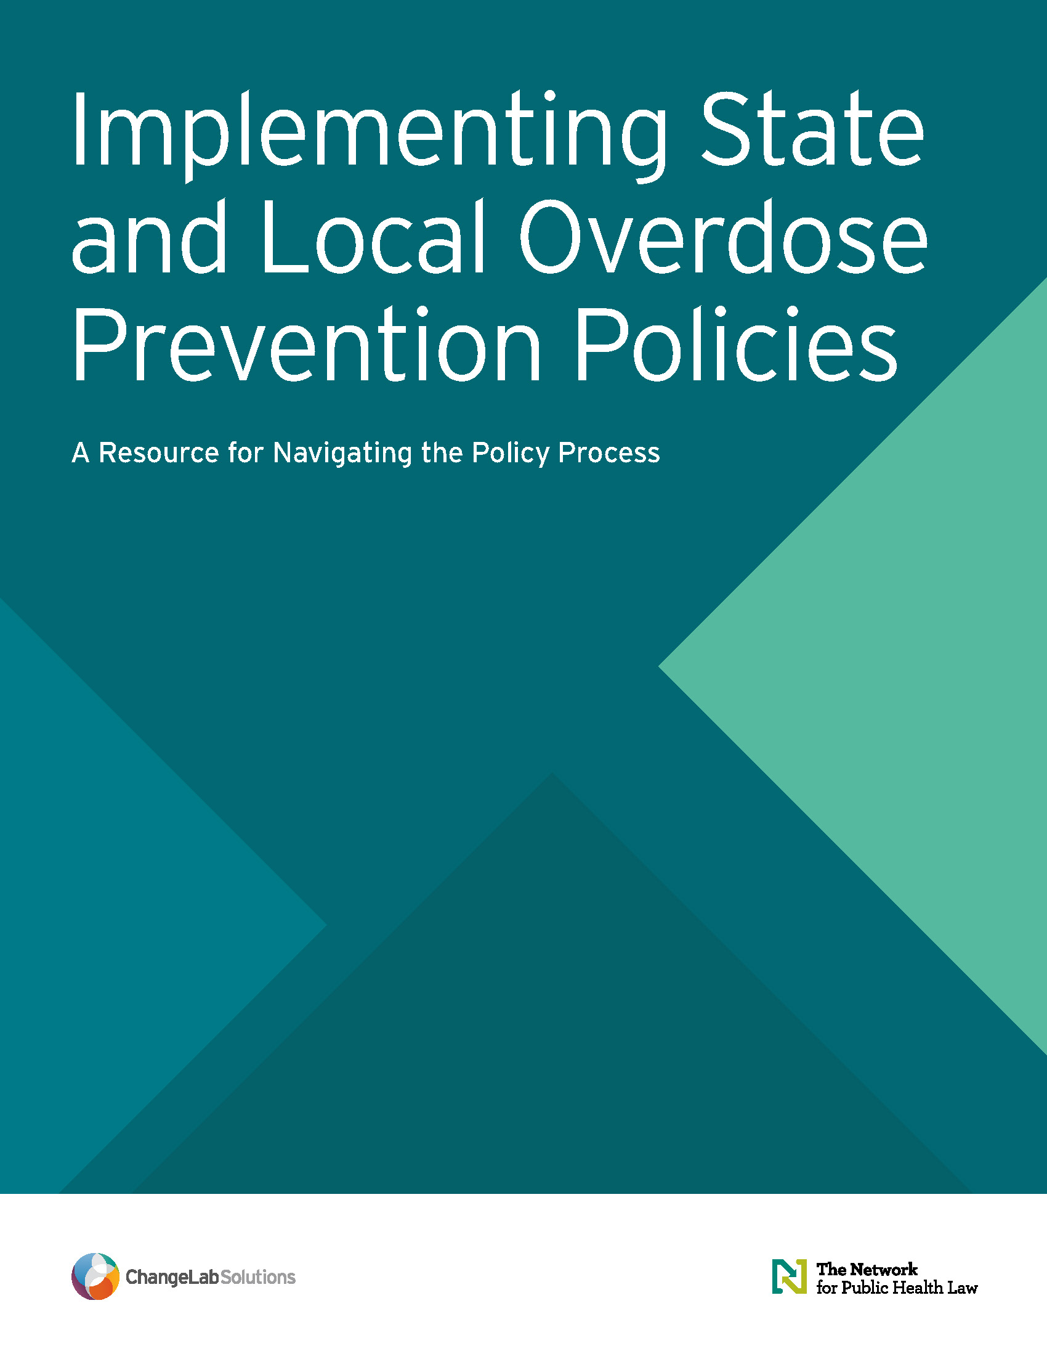
New resources on state and local policies to prevent overdose
Policy guide highlights a range of state and local policy strategies
Implementation resource offers guidance on the policy process
Notes:
Today, we’re excited to introduce two new resources we’ve developed – with support from the Centers for Disease Control and Prevention, and in partnership with the Network for Public Health Law – that highlight state and local policy strategies to reduce overdose and other drug-related harms.
The policy guide (pictured on the left of this slide) highlights a range of state and local policy strategies, outlining the details of potential options for new policy or change to existing policy to help mitigate the overdose crisis.
The implementation resource (pictured on the right) offers guidance on the policy process – supporting readers to put those strategies into practice on the ground. The policy guide is the “what” and the implementation resource is intended to help you think through the “how.”
They are both now available on the ChangeLab Solutions website, and we will share the link in the chat.
https://www.changelabsolutions.org/product/state-local-od-prevention-policies

Slide 6

Additional tools
NACo’s case studies highlight five counties using opioid settlement funds to advance health equity
Notes:
In addition to these, another resource was developed by our partners at the National Association of Counties for this project – it highlights five counties using opioid settlement funds to advance health equity, detailing the steps they’ve taken in the early years of payments from the master settlement and highlighting considerations for other localities.
This is available on NACo’s Opioid Solutions Center website, which offers many valuable resources to support local leaders in their prevention and crisis response work. We will share that link in the chat as well.
https://www.naco.org/resource/osc-health-equity

Slide 7

Methods
Scan of existing policies in peer-reviewed and gray literature
Key informant interviews with 22 overdose prevention experts
Policy assessment across a range of feasibility and impact criteria (e.g., strength of evidence & ability to advance equity)
Notes:
For a bit of context on how the policy guide and implementation resource were developed, I’ll share that our team used a couple of different methods to identify the strategies outlined in the documents, including:
An initial scan of peer-reviewed and gray literature to identify existing overdose prevention policies implemented in our four focus sectors (healthcare, criminal/legal, schools, and community);
Interviews with 22 experts across those sectors who work in a diversity of state and local contexts across the nation, including as researchers, health care providers, policymakers, community-based organization and government agency staff, and policy experts and advocates. Many also shared their perspectives as people with lived experience. We are extremely grateful to each of them for sharing their expertise with us; their insights are foundational to the materials, and you’ll hear some of their quotes today.
We also conducted an assessment to screen policies across a range of impact and feasibility criteria (including strength of evidence, ability to advance equity), which helped us to produce the final group of strategies that are highlighted in the guide.

Slide 8
Policy Guide
Includes strategies selected for their ability to save lives; mitigate growing inequities; and be feasibly implemented at the state, local, and/or institutional levels
Introduces policy details, reviews evidence, and highlights examples of the policy in action
Notes:
The strategies included in the guide were selected for their ability to save lives; mitigate growing racial, socioeconomic, and other intersecting inequities in drug-related harm; and be feasibly implemented at the state, local, and institutional levels.
The guide introduces each strategy, briefly reviews relevant evidence & considerations for how the policy can be designed to reach people facing elevated risk (including people who are currently or formerly incarcerated; people who are pregnant or postpartum; and people who are unhoused), and highlights an example in action at the state or local level.

Slide 9
Implementation Resource
Intended for readers who may be less familiar with the policymaking process
Outlines key steps to put policy strategies into action & shares guidance for identifying, adopting, and implementing strategies that respond to community needs
Notes:
The implementation resource is intended for readers who may be less familiar with the policymaking process. It outlines key steps to put policies into practice – sharing guidance for identifying interventions best positioned to meet a community’s needs, advance them through the adoption process, and implement them so they create meaningful change in peoples’ lives.

Slide 10





Webinar series
Community
June 3 | 2-3pm ET, 11am-12pm PT
Criminal Legal
June 25 | 1-2pm ET, 10-11am PT
Health Care
June 27 | 1-2pm ET, 10-11am PT
Schools
July 1 | 1-2pm ET, 10-11am PT
Notes:
This conversation is the second of a four-part webinar series, each focused on one of the four sectors we explore in the resources.
Today will focus on policies that can be implemented within the criminal legal system or within carceral settings. We are very honored to be joined by Tracie Gardner who will share with us about her experiences leading harm reduction policy work and supporting people who have been impacted by the criminal legal system.
Recordings of the other sessions in the webinar series will be available on the Network for Public Health Law’s website – we encourage you to check those out to hear conversations with leaders working in community, health care, and school settings.
We hope that these materials and this conversation will be useful in your work and are excited to engage with all of you. Thank you again for joining us today! With that, I’ll turn it back over to Amy.

Slide 11


Themes from Key Informant Interviews

Slide 12


Law and policy changes are critical to making progress in overdose prevention
      Need for structural change
“Many of the things that we're dealing with are the results of—or exacerbated by— wealth inequality. Navigating the harm that poverty has on the people we're trying to serve and keep safe is impossible. If there is a way of doing a better job of being more loving and caring, then that’s what we should be doing. And I feel like
access to health care and alleviating poverty,
creating community—these are all the pieces that
need to come together to support people in their lives.”

Slide 13
Existing law and policy may pose a barrier to overdose prevention
      Need to end the criminalization of the person
“The ways that we criminalize people who use drugs act as a disincentive for them to be able to get treatment and ensnares them in the criminal legal system, which just makes it harder for them to get well and more likely for them to die from overdose.”

Slide 14

Substance use disorder should be treated as a medical condition first
      Health care needs to be evidence-based
“I'll never forget a case of a woman who was pregnant and didn't want to try medication treatment because she knew that it would lead to a child welfare filing at delivery…. she overdosed and she and the baby both died.”

Slide 15

Overdose prevention is distinct from recovery needs and treatment of substance use disorder
      Support both those in recovery AND those currently using drugs
“We know from other countries that have overdose prevention centers in place that they seem to be effective in terms of reducing overdose and other harms associated with drug use without any consequent harm to the surrounding community. So, especially with the increasingly lethal drug supply that we're seeing in the United States, offering a place for people to be able to consume drugs under supervision so that overdoses can be intervened on early and where their drug supply can be checked are critical.”

Slide 16

Structural racism is a significant driver of inequitable outcomes for drug policy
      Address the racist basis of the war on drugs
“There are way too many communities in this country where calling 911 for a medical emergency is synonymous with calling the cops.… And oftentimes, law enforcement being the first responder—or the idea that if EMS isn't in the vicinity and a cop could show up before the ambulance comes—is enough of a deterrent that in the moment of an emergency, people will not call 911. And that often contributes to death.”

Slide 17
Drug overdose can often be best prevented by addressing the social determinants of health
      Drug use is often an outcome of poor health and poor access to resources, not the driver
“It’s interesting to think about the Housing First model, where people with substance use problems and housing instability are offered housing and are not kicked out of housing because they continue to use. The [model] seems to be effective in ensuring that they’re retained in treatment and receive other services… [And] some studies have shown that opportunities to place people in housing have broader, longer-term consequences for their health and their mental health.”

Slide 18
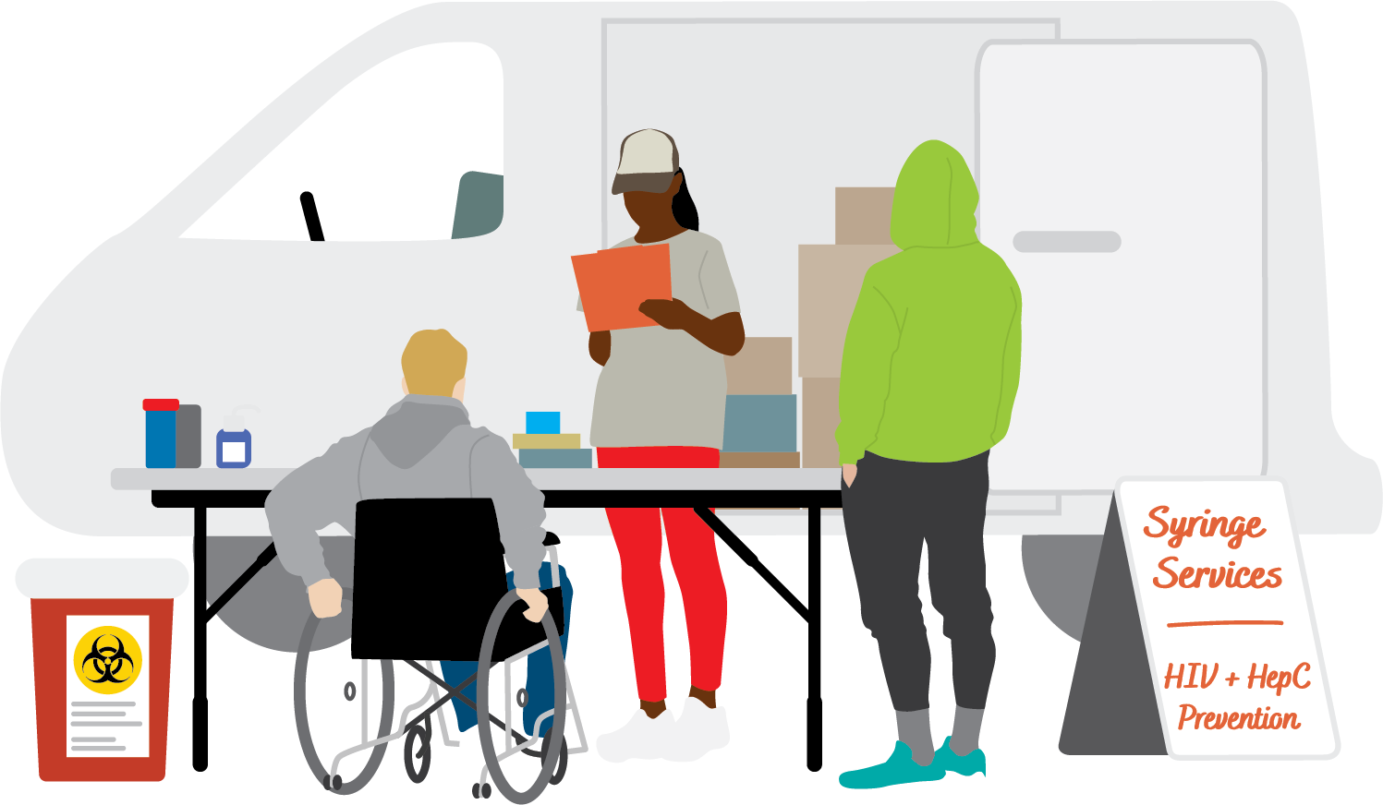
Lived experience is key
      And living experience! Listen and hear.
“What we really have to do is identify uncommon allies, [starting with] people with lived experiences in the driver’s seat and building out from there.”

Slide 19
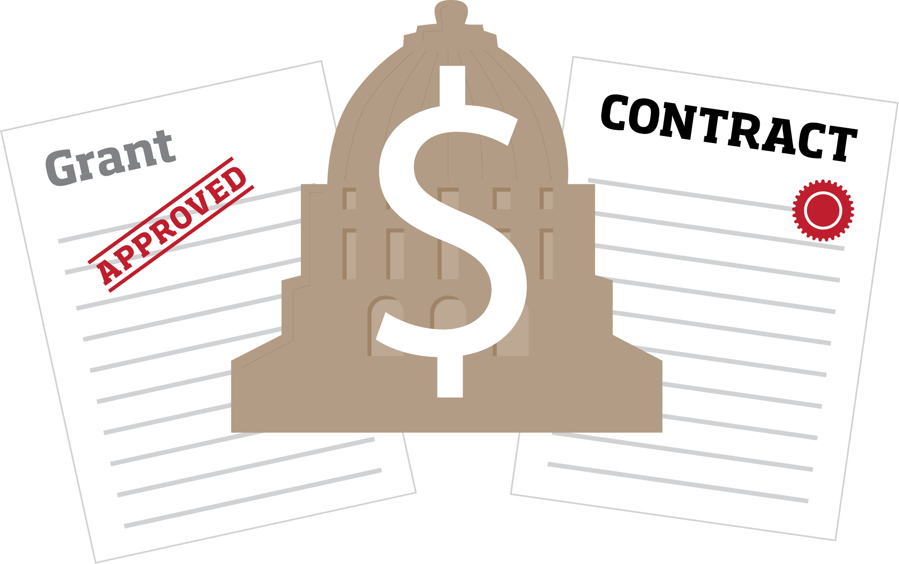
Sustainable and attainable funding is essential for implementing policy solutions
      Especially for employee stability and retention
"... Funding and grant contracts operate on a very short cycle. So you're constantly sort of chasing your tail and there's not really any sustainability to the program—you're hiring people who don't have a lot of job protection and you're always at the whims of administration changes. If you think about it, that's not the way we do cancer care.
If our oncology model changed every four years because of
funding, that would be a completely ridiculous way to
deliver health care."

Slide 20
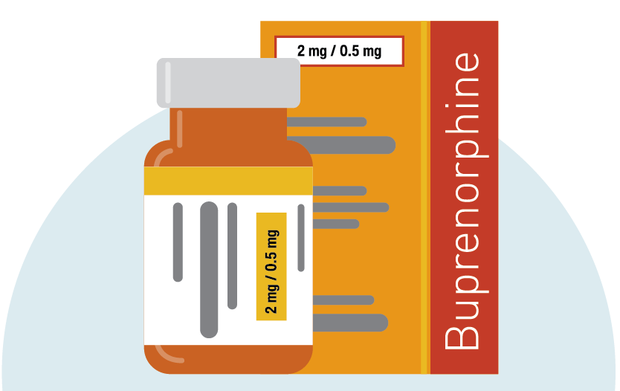
Example Policy Strategies for the Criminal/Legal Sector
    Legal and policy strategies rooted in harm reduction
      Provide MOUD to people who are incarcerated
      Naloxone distribution in prisons and jails and upon release
      Medicaid enrollment for people who are incarcerated
      Strengthen Good Samaritan Laws
      Amend or repeal paraphernalia laws
      Remove criminal penalties for drug possession
Wide variety of choices depending on the context and needs
Notes:
There are many ways to approach these problems

Slide 21
MOUD and Medicaid for incarcerated individuals
MOUD provided during incarceration increases community-based substance use treatment engagement, and can decrease illicit opioid use and injection drug use post-release.
Using Medicaid flexibility to enroll incarcerated individuals prior to release can allow them to continue treatment and ease re-entry
Overdose rates in the first 2 weeks after release are 129% higher than that of the general population; this bridge to community care is desperately needed

Slide 22
The Policy Process
PWUD (People Who Use Drugs) and community members should be involved and engaged.
Notes:
At every stage, PWUD and community members should be involved and engaged.

Slide 23
Selection, Adoption, Implementation
Policy Selection: How can jurisdictions identify and prioritize the policies needed to mitigate overdose in their communities?
  Highlights key steps to consider in selecting which evidence-based, equity-centered strategies to pursue.
Policy Adoption: What strategies can be employed to move from a proposal to actual policy change?
  Offers information to support strong policy design and help a proposal move through the adoption process.
Policy Implementation: What practices can help ensure that policy change, once enacted, translates to meaningful outcomes in peoples’ lives?
  Provides guidance to ensure that once a policy has been enacted, it is implemented and enforced in ways that it achieves its goals.
Notes:
The guide is intended to assist those who are interested in changing law and policy. It is best used as a companion to the Policy Guide, in which we detail many policy options for preventing overdose and reducing drug-related harm

Slide 24
Implementation Focus
Key partners: Nothing about us without us: centering people who use drugs
Education/outreach: Coalition building, community support, messaging and outreach
Equitable enforcement: Important to think about how the policy will be enforced in different communities
Evaluation: Critical to have an evaluation process in place from the beginning in order to have accurate information for the future of the policy
Notes:
Are key partners at the table to design, evaluate, and improve implementation?
How will the community be engaged?
Have partner roles been clearly defined? Is there a mechanism for collaboration across entities?
How will education and outreach be conducted?
How will community members learn about the policy and any new services or opportunities it provides?
What training and support will the workforce responsible for implementation need?
How will the policy be enforced?
What strategies can help ensure that enforcement actions do not worsen harms to BIPOC communities, people with low incomes, and others most affected by drug-related harm?
How will success be measured?

Slide 25

Tracie Gardner
Co-Director
National Black Harm Reduction Network (NBHRN)
www.nbhrn.org
Twitter/X @TracieMGardner

Slide 26
Questions?

