Slide 1
It Takes a Village of Care Professionals to Increase Access to Reproductive Health Care and Improve Maternal Health Outcomes Setting the stage with data . . . Moderator Kathi Hoke
April 18, 2024

Slide 2
Maternal Mortality Definitions
Maternal mortality: When a person dies due to pregnancy-related complications or a pre-existing condition that is exacerbated by pregnancy
Different measures—from 42 days to 1 year post-partum
Maternal mortality rate: Rate of deaths per live births

Slide 3
Maternal Mortality in the U.S.
When do pregnancy-related deaths occur?
31% during pregnancy
33% during labor or within first week postpartum
33% one week to one year postpartum
What is the MMR for the US?
32.9 deaths per 100,000 live births
For Black women: 69.9 per 100,000

Slide 4
Maternal Morbidity
Maternal morbidity: any health condition attributed to or aggravated by pregnancy and childbirth that leads to negative health outcomes
What factors increase maternal morbidity?
Preexisting mental health conditions, inc. substance use
Lack of access to reproductive health care
Previous trauma
Stress during prenatal period
Provider bias or discrimination

Slide 5
Direct Entry Midwives Across the Nation
Presented April 18, 2024

Slide 6
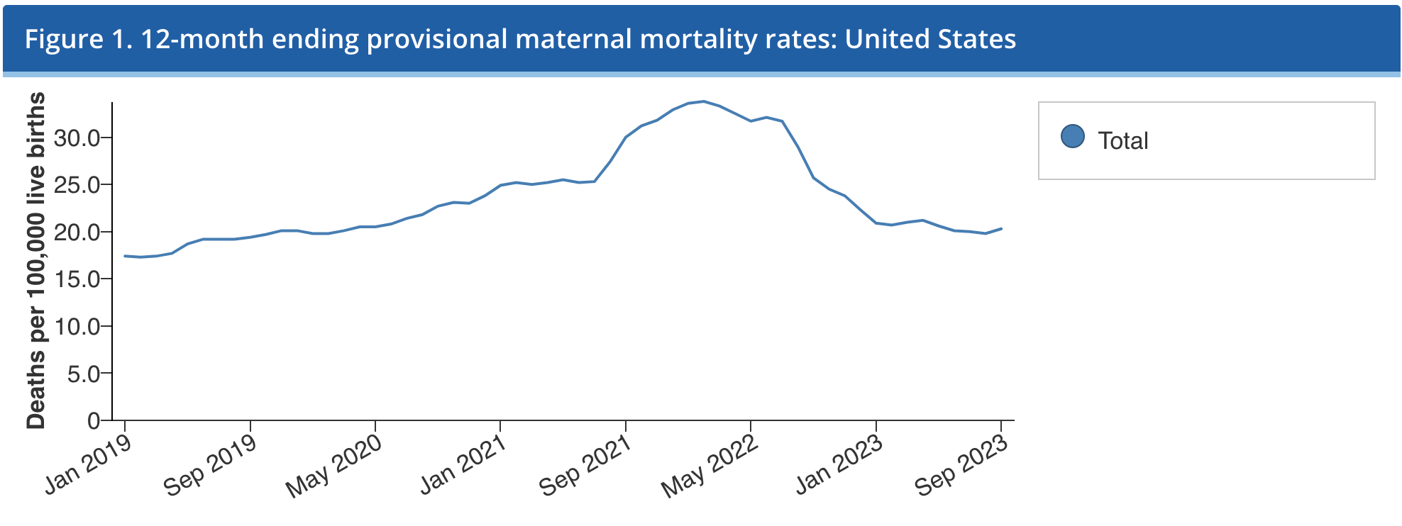
Maternal Mortality in the United States
Chart taken from the Centers for Disease Control and Prevention
https://www.cdc.gov/nchs/nvss/vsrr/provisional-maternal-deaths-rates.htm

Slide 7
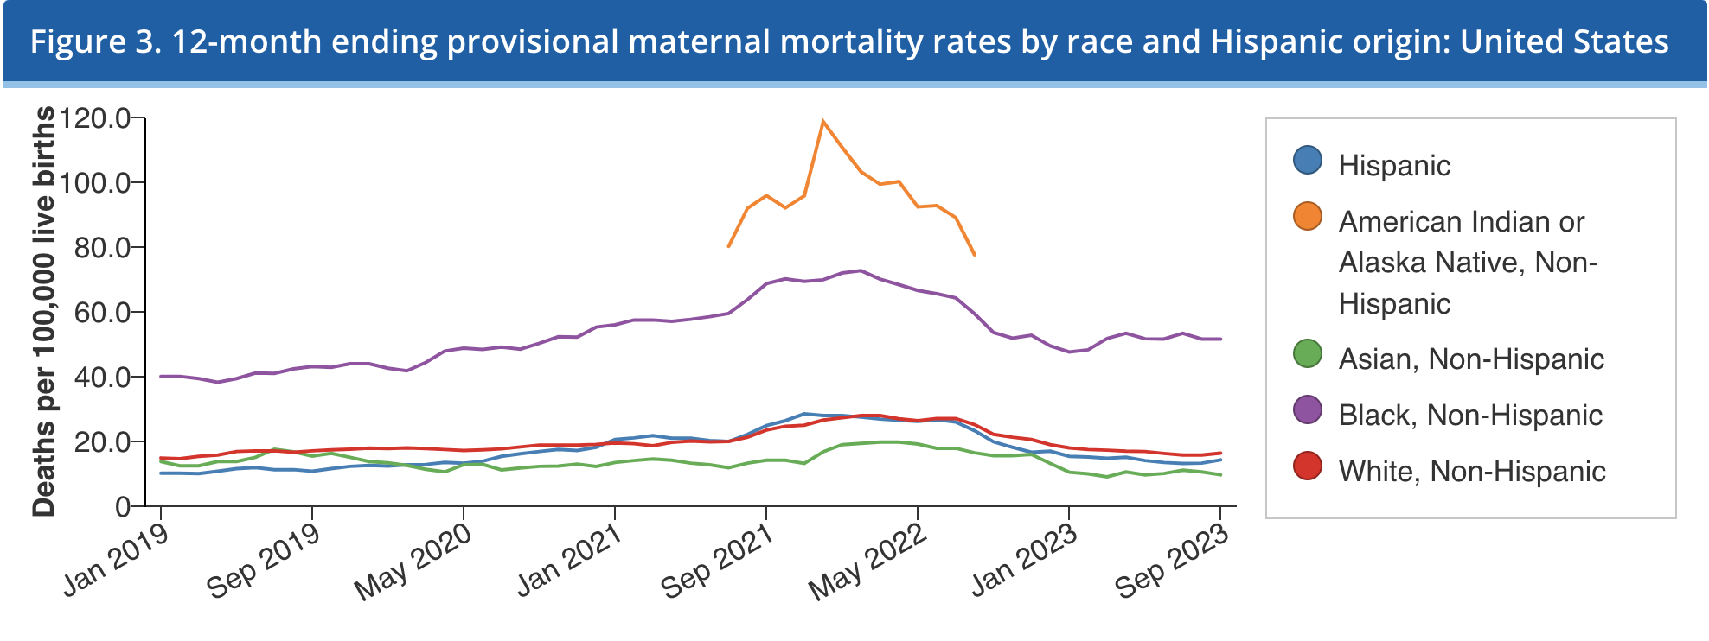
Maternal Mortality in the United States- By Race and Ethnicity
Chart taken from the Centers for Disease Control and Prevention
https://www.cdc.gov/nchs/nvss/vsrr/provisional-maternal-deaths-rates.htm

Slide 8
Maternal Mortality Rates Compared
The United States has one of the highest maternal mortality rates of high- income countries. In 2021, the rate was 32.9 deaths per 100,000 live births.
Netherlands- 1.2 deaths per 100,000 live births
Canada- 8.4 deaths per 100,000 live births
United Kingdom- 6.5 deaths per 100,000 live births

Slide 9
Maternal Care Providers
According to the World Health Organization, the use of midwives as part of the maternal care team is an evidence-based way to reduce maternal mortality rates. The United States
United States- 4 midwives and 11 Ob-gyns per 1,000 live births
Netherlands- 25 midwives and 10 Ob-gyns per 1,000 live births
Canada- 4 midwives and 8 Ob-gyns per 1,000 live births
United Kingdom- 43 midwives and 11 Ob-gyns per 1,000 live births

Slide 10
Direct Entry Midwives as a Solution
Direct entry midwives are midwives who may be credentialed to provide childbirth support and services despite not having a formal nursing education.
License required in a majority of states
State licensing boards create professional standards and set training and education requirements for licensure
State boards also proscribe guidelines for the administration of medication by direct entry midwives

Slide 11
Commonly Used Terms
Midwifery Education Accreditation Council: An organization whose purpose it is to establish standards for the education of competent midwives, including providing accreditation to schools of midwifery
North American Registry of Midwives: An organization which sets the standard for the Certified Professional Midwife credential
Bridge Certificate: A certificate offered by NARM upon successful completion of 50 accredited approved continuing education contact hours within the five-year period prior to application

Slide 12
Alabama
Education Requirements: A certified professional midwife credential through a program or pathway accredited by the MEAC
Regulating Body: Alabama State Board of Midwifery
Medication Administration: Anti-hemorrhagic medication and oxygen in emergency circumstances

Slide 13
Arkansas
Education Requirements: Must obtain the Certified Professional Midwife certification from NARM or hold an equivalent certification
Regulating Body: Arkansas Department of Health
Medication Administration: Eye prophylaxis and oral vitamin K to infants acting as the agent of the client

Slide 14
Hawaii
Education Requirements: Must hold a certification as a certified professional midwife and complete a formal midwifery education program accredited by the MEAC or obtain a bridge certificate from NARM
Regulating Body: Department of Commerce and Affairs: Professional and Vocational Licensing: Board of Nursing
Medication Administration: Can purchase and administer non-controlled legend drugs and devices

Slide 15
New Hampshire
Education Requirements: Must have completed high school or its equivalent, completed a college level course in anatomy and physiology, meet practical experience requirements, completed a credential course in birth-related laceration repairs, have a current certification from NARM, and pass a written and oral exam
Regulating Body: New Hampshire Midwifery Council
Medication Administration: May obtain, possess, and administer a specific list of drugs, and any other drugs prescribed by a physician that are consistent with the scope of midwifery practice

Slide 16
Virginia
Education Requirements: Must have a current certification as a certified professional midwife and provide a report from NARM indicating whether there has ever been adverse action taken against the application.
Regulating Body: Virginia Board of Medicine (in consultation with the Advisory Board on Midwifery)
Medication Administration: Cannot administer medication

Slide 17
Barriers to Entry
Cost
Time
Compensation
Differences in Insurance Coverage

Slide 18
Supporters
The Network for Public Health Law is a national initiative of the Robert Wood Johnson Foundation.

Slide 19
50 State Survey: Doula Care
It Takes a Village of Care Professionals to Increase Access to Reproductive Health Care and Improve Maternal Health Outcomes Webinar
Jordan Jekel, Student Attorney, Public Health Law Clinic
April 18, 2024

Slide 20
Presentation Overview
What is a doula? Why is doula care important?
Overview of current doula laws & regulations
Policy recommendations to increase doula care access

Slide 21
What is a Doula?
Doula: a trained professional who provides continuous physical, emotional and informational support to their client before, during and shortly after childbirth – that is non-medical
Examples of doula services:
Advocacy
Preparation
Support
Culturally competent care

Slide 22
Why is Doula Care Important?
Doula care increases health equity & improves maternal mortality outcomes
Benefits include:
Postpartum care
Improved physical & mental health outcomes
Lower likelihood of c-section
Higher likelihood of culturally competent care
Greater support during L&D
More autonomy

Slide 23
Current State of Doula Regulation

Slide 24
Certification
To practice as a doula, certification not required
Outside of statutes & regulations, certifying organizations
Two state certification pathways:
(1) State-certified doula title
(2) Medicaid-enrolled doula

Slide 25
Training & Eligibility
Examples of training & eligibility requirements:
Training from doula certification organization
Core competency training
Live birth observation & practice
First aid & CPR training
High school diploma or equivalent
Code of ethics
Reference or recommendation letters
Background check or fingerprint clearance

Slide 26
Medicaid Coverage & Reimbursement Rates
Average cost: $500 to $3,500
Medicaid covered births: 45%
Current states providing some form of Medicaid coverage: 20+

Slide 27
Doula Advisory Boards & Maternal Mortality Review Committees

Slide 28
Solution 1: Improve Coverage of Doula Services Through Greater Affordability & Accessibility
Increase reimbursement rates
Remove hurdles to Medicaid provider enrollment
Require all insurers to provide coverage
Lengthen the statutory postpartum period
Create more alternative certification pathway
Provide access in correctional facilities

Slide 29
Solution 2: Greater Inclusion of Cultural Competency Training & Services

Slide 30
Solution 3: Increasing Awareness about Doula Care
Increase doula participation in state Maternal Mortality Review Committees (“MMRCs”)
Educate public & professionals about doulas
Improve understanding of racial disparities

Slide 31
Supporters
The Network for Public Health Law is a national initiative of the Robert Wood Johnson Foundation.

Slide 32
Creating a safe Harbor in Maryland for Reproductive Health
Dr. Jessica Lee MD
Mary Jo Bondy DHEd, PA-C

Slide 33
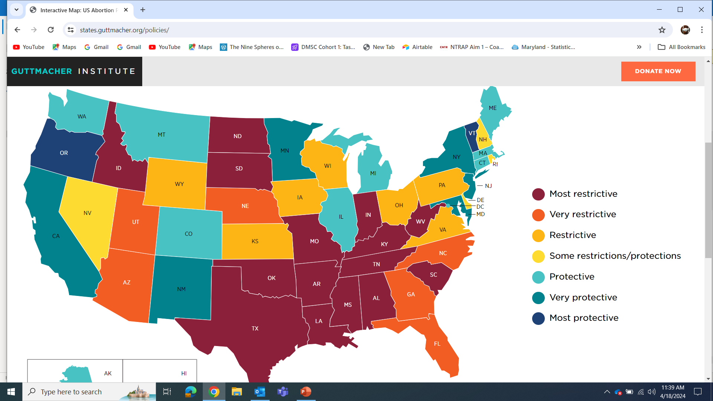
Current map of US abortion policies from Guttmacher Institute
April 8,2024 (policies are current as of this date)
[1-2]

Slide 34
Research Informing Policy
SAFETY: PAs, NPs and CNM provided abortion care is safe
ACCESS: Inclusion of advanced practice clinicians can expand access
NEED: In Maryland there has been a reduction of abortion clinics providing care
DISPARITY: Decreased abortion care access disproportionately impacts underrepresented populations, increasing health inequity.

Slide 35
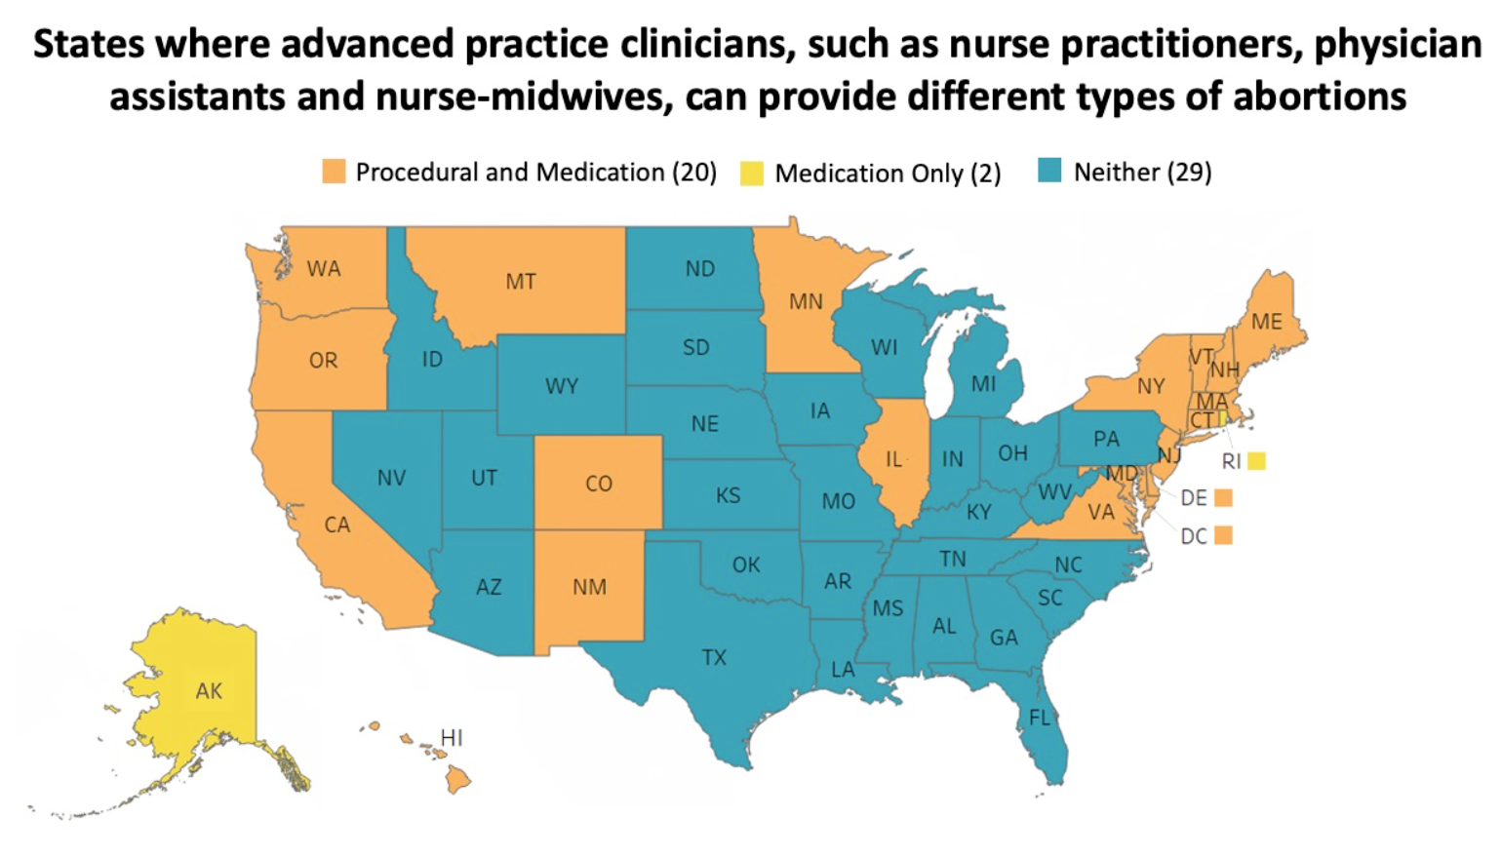
States where advanced practice clinicians can provide abortion

Slide 36
Legislation
2022
The Maryland Abortion Care Access Act (2022) passes
June 2022
Dobbs v. Jackson Women’s Health Organization the Supreme Court changes precedent
19 Jan. 2023
Governor Moore released funding Jan 19th, 2023, one day after being sworn into office.

Slide 37
MD Abortions Pre and POST DOBBS

Slide 38
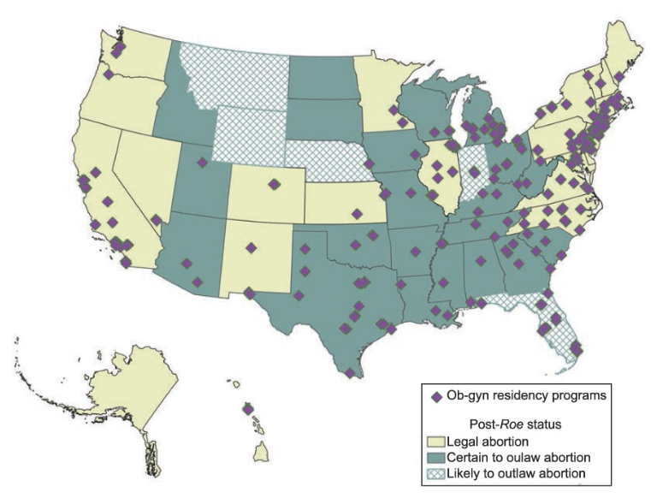
Dobbs Impact on Ob/Gyn Abortion Training
286 OB/GYN programs in US
45% OB/GYN programs in abortion prohibitive states
Post Dobbs- 14% lost in-state abortion training
10% decrease in applicants to abortion prohibitive states

Slide 39
Dobbs Impact on Non-Ob/Gyn Residents
Impacts on EM, IM, FM, Peds
Many physicians desire to provide care for patients seeking abortion
Changes seen in residency applications 2022-2023
Training may be impacted by traveling Ob/Gyn residents

Slide 40
Medical Student Education
Abortion care is an essential component of medical school education
2021: >10,000 students matriculated into schools where abortion is banned or likely to be.
Clinically experiences are challenging to provide

Slide 41
CURRENT ABORTION TRENDS
93% of Abortions are conducted within the first 6 weeks of pregnancy
>50% of Abortions are medical interventions, and this is increasingly the preferred method by patients
Training to competence using vacuum extraction techniques takes time, clinical experience and access to patients.

Slide 42
Legislation Changes Nationally and in Maryland and Implications
Patients
Physicians
Advanced Practice Providers

Slide 43
FUTURE Workforce

Slide 44
STRATEGY
Raise awareness about the legislative change.
Train up the current workforce to make medical abortion more available, identify those who wish to advance skills.
Expand training to Residents, MD,PA,NP and Midwives who opt-in to training. Didactic, Simulation and Clinical.

Slide 45
MARCH program curriculum and technology
Adaptation of an open educational resource
TEACH Abortion Training curriculum with Maryland-specific content
Pressbooks
Asynchronous online modules
In-person training simulation

Slide 46
Progress To Date
UMB Notice of Award-
UMB has partnered with MDH, NAF,PP and the AHECS
Needs Assessment survey has been created and has been deployed in April
Review of the TEACH Curriculum by our expert interprofessional faculty team is complete
Media awareness campaign about the legislation and upcoming training
Call for interest has begun
Fellow’s application and selection is underway

Slide 47
Thank You Questions?

Slide 48
[1] Roe v. Wade Overturned: Our Latest Resources | Guttmacher Institute n.d. https://www.guttmacher.org/abortion-rights-supreme-court (accessed August 12, 2022).
[2] Interactive Map: US Abortion Policies and Access After Roe | Guttmacher Institute n.d. https://states.guttmacher.org/policies/maryland/abortion-policies (accessed March 27, 2024).
[3] Increasing Access to Abortion: ACOG Committee Opinion, Number 815. Obstetrics and Gynecology 2020;136:e107–15. https://doi.org/10.1097/AOG.0000000000004176.
[4] State Facts About Abortion: Maryland | Guttmacher Institute n.d. https://www.guttmacher.org/fact- sheet/state-facts-about-abortion-Maryland (accessed August 8, 2022).
[5] Goldman MB, Occhiuto JS, Peterson LE, Zapka JG, Palmer RH. Physician assistants as providers of surgically induced abortion services. Am J Public Health 2004;94:1352–7. https://doi.org/10.2105/AJPH.94.8.1352.
[6] Freedman MA, Jillson DA, Coffin RR, Novick LF. Comparison of complication rates in first trimester abortions performed by physician assistants and physicians. Am J Public Health 1986;76:550–4. https://doi.org/10.2105/AJPH.76.5.550.
[7] National Academies of Sciences E and M. The Safety and Quality of Abortion Care in the United States. The Safety and Quality of Abortion Care in the United States 2018. https://doi.org/10.17226/24950.
[8] Home - AP Toolkit n.d. https://aptoolkit.org/ (accessed March 27, 2024).
[9] American Public Health Association. Provision of Abortion Care by Advanced Practice Nurses and Physician Assistants 2011. https://www.apha.org/policies-and-advocacy/public-health-policy- statements/policy-database/2014/07/28/16/00/provision-of-abortion-care-by-advanced-practice- nurses-and-physician-assistants (accessed August 13, 2022).

Slide 49
[10] Abortion Care Access Package | Planned Parenthood of Maryland, Inc. n.d. https://www.plannedparenthood.org/planned-parenthood-maryland/abortion-care-access-package (accessed August 14, 2022).
[11] House Bill 937: Abortion Care Access Act. Maryland General Assembly; 2022.
[12] Section 20-103 - Abortion, Md. Code, Health-Gen. § 20-103 | Casetext Search + Citator n.d. https://casetext.com/statute/code-of-maryland/article-health-general/title-20-miscellaneous-health- provisions/subtitle-1-consent-provisions/part-i-minors/section-20-103- abortion?searchWithin=true&listingIndexId=code-of-maryland.article-health-general.title-20- miscellaneous-health-provisions&q=abortion&type=statute&sort=relevance&p=1 (accessed August 8, 2022).
[13] Maryland - Center for Reproductive Rights n.d. https://reproductiverights.org/maps/state/maryland/ (accessed March 27, 2024).
[14] Barry D, Rugg J. Improving Abortion Access by Expanding Those Who Provide Care 2015.
[15] Coleman-Minahan K, Sheeder J, Arbet J, McLemore MR. Interest in Medication and Aspiration Abortion Training among Colorado Nurse Practitioners, Nurse Midwives, and Physician Assistants. Women’s Health Issues 2020;30:167–75. https://doi.org/10.1016/J.WHI.2020.02.001.
[16] Foster AM, Polis C, Allee MK, Simmonds K, Zurek M, Brown A. Abortion education in nurse practitioner, physician assistant and certified nurse-midwifery programs: a national survey. Contraception 2006;73:408–14. https://doi.org/10.1016/J.CONTRACEPTION.2005.10.011.
[17] Abortion training and education. Obstetrics and Gynecology 2014;124:1055–9. https://doi.org/10.1097/01.AOG.0000456327.96480.18.

