Slide 1
Cannabis Legalization: Critical Policy Issues Impacting the Health of Children
Mathew Swinburne, J.D., Senior Advisory, Network for Public Health Law—Eastern Region Office, Director, Legal Resource Center for Public Health Policy-Cannabis
Emily Schwartz, J.D. Candidate at University of Maryland School of Law
Hallie Bereday, J.D. Candidate at University of Maryland School of Law
April 4, 2024

Slide 2
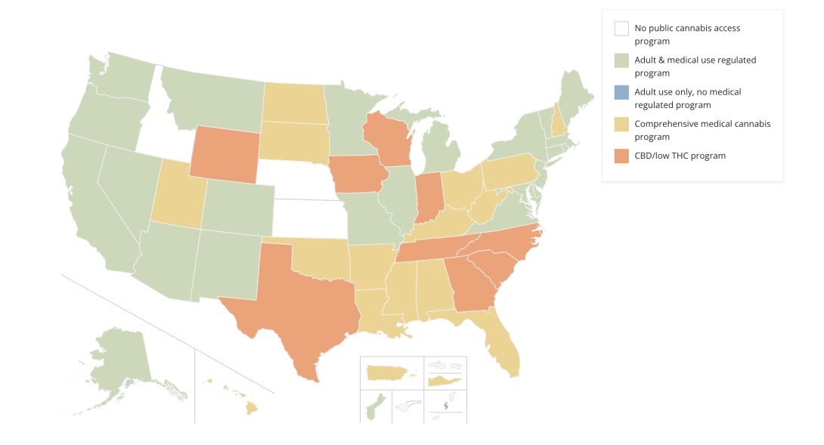
State Legalization of Cannabis
Notes:
· As of 2023, cannabis use among high schoolers is the highest it’s been since the early-1990s.
o More than 12 million young people report using cannabis.

Slide 3
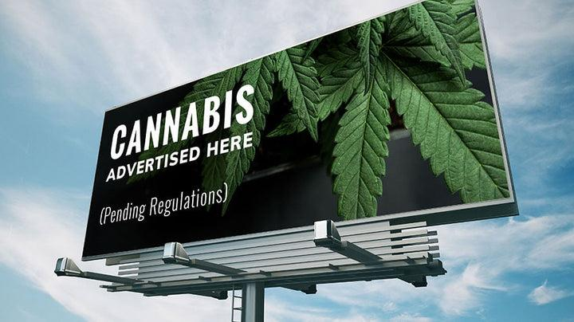
Selected Topics: Outdoor Cannabis Advertising
Notes:
In recent years, the legalization of cannabis for both medical and recreational purposes has sparked a specific concern for the health and safety of children. Many factors influence teens' use of cannabis, such as the proportion of peers and family members in a teen's life who use cannabis, a teen's level of psychological distress, as well as the advertising and marketing of cannabis. The latter factor will be the specific focus of today’s presentation. While advertising comes in many forms, whether it be social media, website ads, or paper handouts, I will specifically focus on the impact of outdoor cannabis advertising, such as billboards, on children.
During this presentation, I will discuss the three categories of advertising policies used by the 39 jurisdictions that have legalized cannabis for medical and/or recreational purposes. But first, I plan to give you an overview of how cannabis advertising directly impacts the well-being of kids.

Slide 4
Cannabis Advertising is a Public Health Concern
Adolescents who view cannabis advertising are:
More likely to use cannabis
Have more-positive expectations about the substance
Express intentions to use the drug
More likely to report negative consequences of cannabis use
Notes:
Restrictions on outdoor cannabis advertising protect children from unnecessary exposure to cannabis that results in adverse public health consequences.
Studies have concluded four specific impacts that cannabis advertising has on children:
First, researchers have found that children that are exposed to cannabis advertising are significantly more likely to use cannabis. For instance, kids that saw advertisements were more likely to consume cannabis in the last month than children that were not exposed to cannabis advertisements.
Second, children exposed to cannabis advertisements are more likely to have more positive perceptions about the drug, like believing that cannabis is a safe, natural, and medicinal product. This lures children into a false sense of security when deciding to use cannabis.
Third, children who view advertisements are more likely to express intentions to use cannabis and or more likely to consume cannabis within the next six months.
And lastly, increased usage of cannabis during adolescence is linked to negative outcomes, such as decreased attention span, poor mental health, impaired cognitive development, development of psychosis, anxiety, and depression, and other issues that Mat touched upon in his introduction of the topic.

Slide 5
Cannabis Advertising is a Public Health Concern
According to tracking data, 42% of cannabis advertising is done on billboards and other outside placements.
Outdoor advertisements have a much stronger effect on teens than other forms of advertising:
Children frequently exposed to cannabis billboard advertising were seven times more likely to use cannabis and nearly six times as likely to have symptoms of cannabis use disorder.
Notes:
So why focus on outdoor advertising?
According to tracking data, 42% of all cannabis advertising is done on billboards and other outside placements. This is particularly problematic because physical advertisements, such as billboards, have a much stronger effect on teens than other forms of advertising. For example, one study found that children frequently exposed to cannabis billboard advertising were seven times more likely to use cannabis and nearly six times as likely to have symptoms of cannabis use disorder.

Slide 6
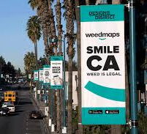
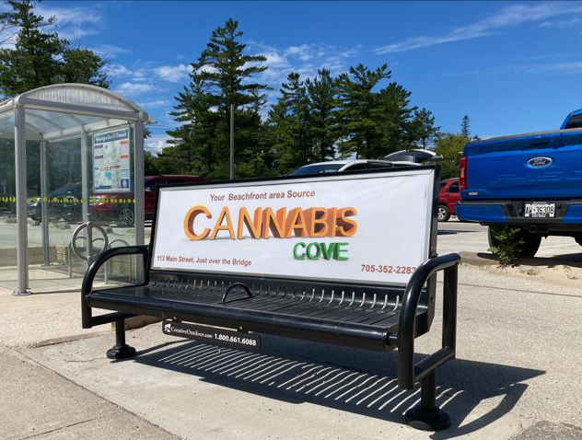
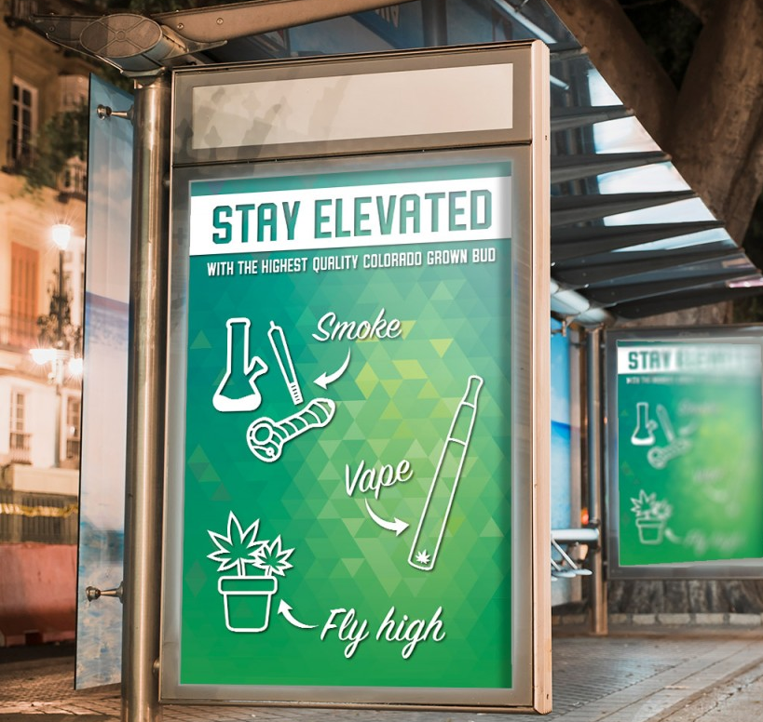
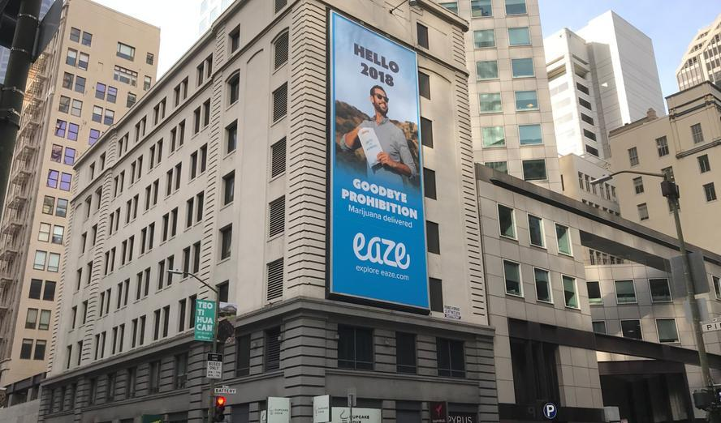
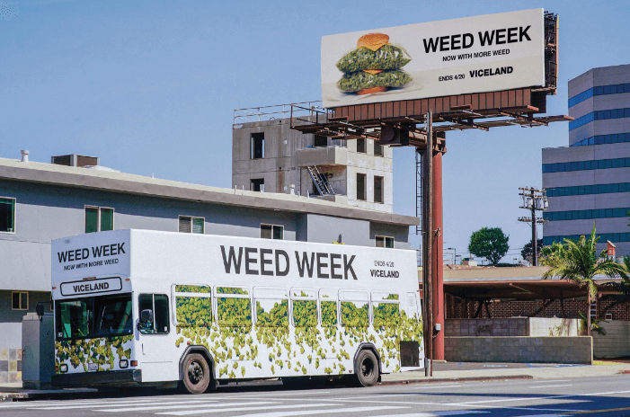
Notes:
A couple specific reasons why outdoor cannabis advertising can be more impactful than other forms of cannabis advertising is because:
Visibility: Outdoor ads are often placed in high-traffic areas, such as highways, urban centers, or on public transportation, ensuring maximum exposure.
Broad Reach: Unlike digital or print advertising, which usually targets specific demographics, outdoor ads have a broad reach, reaching people of all ages.
Creative Opportunities: Outdoor advertising offers creative opportunities for eye-catching and memorable campaigns. Large billboards, posters, and other outdoor media formats allow for visually appealing designs and messaging that can capture attention and leave a lasting impression.
Complement to Digital Advertising: While digital advertising is highly targeted and effective, outdoor advertising can complement digital campaigns by providing additional exposure and reinforcing brand messaging in the physical world.
Many states have taken these factors into consideration and started to take action to reduce the odds that children will be exposed to outdoor cannabis advertising.

Slide 7
State Policies
39 jurisdictions have advertising regulations, which are divided into three main categories:
(1) No restrictions on outdoor advertising
3 states: AZ, LA, and PA
(2) Complete outdoor advertising prohibition
8 states: DE, FL, KY, MD, MN, MS, MT, and UT
(3) Restrictions but not an outright prohibition
28 states: AK, AL, AR, CA, CO…
Notes:
There are three categories that states fall into regarding the regulation of outdoor cannabis advertising. Of the 39 jurisdictions that allow the medical use and/or adult-use of cannabis products, only 3 states do not currently have regulations that address the advertisement of cannabis products and businesses. (2) 8 states have a complete ban on outdoor advertising; and (3) 28 states + DC have restrictions on outdoor advertising but do not outright prohibit it.
I want to note that while there is a trend by States to to add restrictions to outdoor cannabis advertising, do not take comfort where your state has a ban because there is always movement. In maryland, this year there was a bill brought in our State Senate to ban outdoor cannabis advertising. And of the three states that have no restrictions on advertising, 2 of the states had strict regulations on cannabis advertising, but these laws have been repealed.
I also want to note that from a public health standpoint, a complete prohibition is the most ideal approach for a state to implement so that the risk of exposure to youths drops drastically.

Slide 8
Restrictions on Outdoor Cannabis Advertising
Prohibition of a Specific Type of Advertising
Location Based Restrictions
Buffer Zones
Audience composition
Size/Quantity/Other Features
Content Requirements/Restrictions
Content Targeting Children
Therapeutic Claims
Product Warnings
Validity of statements
Images of consumption of cannabis/cannabis plant
Notes:
Regarding the third category, after completing an assessment of the 28 states that have restrictions but do not prohibit outdoor advertising, these are the types of restrictions that jurisdictions have put in place. The different restrictions include: the prohibition of a Specific Types of Advertising, Location Based Restrictions, Buffer Zones, Audience composition restrictions, physical Feature restrictions, and Content Requirements and Restrictions.

Slide 9
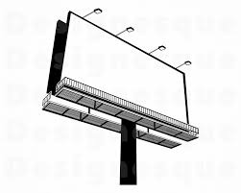
Prohibition of a Specific Type of Advertising
11 states prohibit a specific form of outdoor advertising, rather than implementing a complete ban.
11 states prohibit the use of billboards to advertise cannabis.
2 states prohibit the use of handheld or portable signs.
1 state prohibits the use of adopt-a-highway signs.
1 state prohibits the use of any type of sign outdoors unless the sign is on the retailer's property.
X
Notes:
First up, 11 states prohibit a specific form of outdoor advertising, rather than implementing a complete ban on all forms of outdoor advertising. I found 4 different types of prohibitions.
11 states prohibit the use of billboards to advertise cannabis products and businesses. 2 states prohibit the use of handheld or portable signs. 1 state prohibits the use of adopt-a-highway signs. 1 state prohibits the use of any type of sign outdoors unless the sign is on the retailer's property.

Slide 10
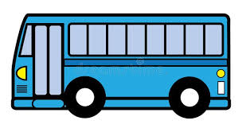
Location Based Restrictions
X
19 states restrict outdoor cannabis advertising in specific locations.
14 states prohibit advertising on public vehicles/mass transit.
10 states prohibit advertising at locations related to transportation
6 states restrict cannabis advertising on publicly owned or operated property.
4 states do not allow cannabis advertising in a public place.
7 states prohibit advertising at locations such as secondary school campuses, highways, doors, shopping malls, and arcades.
X
Notes:
19 states restrict outdoor cannabis advertising in specific locations. I found five different types of location based restrictions.
14 states prohibit advertising on public vehicles and mass transit. 10 states prohibit advertising at locations related to transportation (i.e. train stations, taxi stands, and bus stops). 6 states restrict cannabis advertising on publicly owned or operated property. 4 states do not allow cannabis advertising in a public place. For example, Florida restricts advertising to places that are not visible to members of the public from any street, sidewalk, park, or other public place. And 7 states prohibit advertising at locations such as secondary school campuses, highways, shopping malls, arcades, and sporting events.

Slide 11
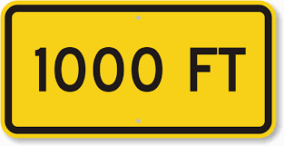
Buffer Zones
16 states have advertising buffer zones around schools, child-centered locations, and other vulnerable locations.
Variation: 1,500 ft, 1,000 ft, 500 ft, 300 ft, and 200 ft.
States restrict the proximity of cannabis advertising to a variety of child-focused locations.
Notes:
16 states have advertising buffer zones around schools, child-centered facilities, and other vulnerable locations. This means that no cannabis business can advertise within a certain distance from the specified location.
The distance of the exclusionary zone varies considerably between states. New Jersey has the smallest buffer zone which is within 200 feet of a grade school and Connecticut has the largest buffer zone at 1,500 feet. The most common distance is 1,000 feet, but states also have 500 ft, and 300 ft buffer zones.
States also vary in where they restrict the proximity of cannabis advertising. Some states specifically identify schools, playgrounds, recreation centers, public parks, libraries, and arcades as the center of an exclusionary zone, while other states broadly restrict the proximity of outdoor cannabis advertising to “child-centered facilities.” Some states have even more vague restrictions, preventing advertising that is a certain distance away from a place that targets or is attractive to minors.
I want note that children are inherently transient. So restricting outdoor advertisements solely around schools and other child-centered facilities is often ineffective in preventing their exposure to cannabis marketing because kids mobility extends beyond these areas. Completely prohibiting outdoor cannabis advertising instead of just providing a buffer zone or location-based restrictions will help make a more impactful difference.

Slide 12
Audience composition
9 states prohibit advertising if a certain percent of the audience is reasonably expected to be under 18 or 21 (depending on the state),
based on current audience composition data.
4 states directly apply their audience composition restriction to outdoor advertising.
5 states provide a broader restriction, prohibiting cannabis establishments from advertising their products via any medium.
Notes:
There are 9 states that prohibit advertising if a certain percent of the audience is reasonably expected to be under 18 or 21, based on current audience composition data. Out of these 9 states, 4 states directly apply their audience composition restriction to outdoor advertising. For instance, Massachusetts states that advertising by billboard or other outdoor advertising methods is prohibited unless at least 85% of the audience is reasonably expected to be 21 years of age or older. 5 states provide a broader restriction, prohibiting cannabis establishments from advertising their products via any medium unless the required audience composition exists.
The percentage of the audience composition varies considerably between jurisdictions. The strictest state, Connecticut, prohibits cannabis advertising unless at least 90% of the audience is 21 or older. Other audience composition percentages include 85%, 71.6%, and 70%.

Slide 13
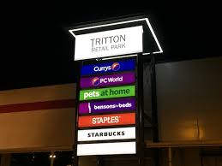
Physical Features
7 states restrict the size of advertising signs.
4 jurisdictions place restrictions on the use of illuminated signs.
3 states limit the quantity of signs that a retailer may display outside of the licensed premises to two signs.
Notes:
12 jurisdictions restrict physical features of cannabis advertising signs. 7 states restrict the size of advertising signs. Alaska restricts signs for a cannabis establishment to 4,800 square inches. 4 jurisdictions place restrictions on the use of illuminated signs. The District of Columbia prohibits illuminated signs both onsite and offsite. Massachusetts prohibits the use of illuminated signs, except for the period of 30 minutes before sundown until closing. 3 states also limit the quantity of signs that a retailer may display outside to only two signs.

Slide 14
Content Requirements/Restrictions
32 of 39 jurisdictions have some form of content restriction:
Content Targeting Children
Therapeutic Claims
Product Warnings
Validity of statements
Images of consumption of cannabis/cannabis plant
Notes:
Children:
29 states have an explicit prohibition against advertising content that targets children;
10 states do not mention children, youth, adolescents, or minors anywhere in their regulations.
Example: New Jersey prohibits any a depiction of a person under 21 years of age consuming cannabis items; and the inclusion of objects, “such as toys, characters, or cartoon characters suggesting the presence of a person under 21 years of age, or any other depiction designed in any manner to be especially appealing to a person under 21 years of age.”
Therapeutic claims:
9 states prohibit the use of therapeutic or curative claims in cannabis advertising.
Example: Maine prohibits cannabis retailers “from making any claims related to health or physical benefits of cannabis consumption.”
10 states require that claims be supported by substantial scientific and/or clinical evidence.
Example: New Jersey requires that the claims be supported by at least two scientific studies.
Product warning
14 states require some form of product warning in outdoor cannabis advertisements.
Example: Nevada requires that cannabis retailers ensure that all advertising contains such warnings as may be prescribed by the Board, which must include, without limitation, the following words: (1) "keep out of reach of children"; and (2) "for use only by adults 21 years of age and older."
Images of cannabis
15 states prohibit the use of any image, or any other visual representation, of the cannabis plant or the consumption of cannabis.
Example: In Rhode Island, “Any advertising by or on behalf of a licensee shall not: (a) Contain statements that are deceptive, false or misleading; (b) Display images or representations of marijuana plants, marijuana or marijuana products; (c) Display the consumption, use or transfer of marijuana or marijuana products.”

Slide 15
Content Requirements/Restrictions
32 of 39 jurisdictions have some form of content restriction:
Content Targeting Children (29 states)
Therapeutic Claims
Product Warnings
Validity of statements
Images of consumption of cannabis/cannabis plant
Notes:
Children:
29 states have an explicit prohibition against advertising content that targets children;
Example: New Jersey prohibits any depiction of a person under 21 years of age consuming cannabis items; and the inclusion of objects, “such as toys, characters, or cartoon characters suggesting the presence of a person under 21 years of age, or any other depiction designed in any manner to be especially appealing to a person under 21 years of age.”
10 states do not mention children, youth, adolescents, or minors anywhere in their regulations

Slide 16
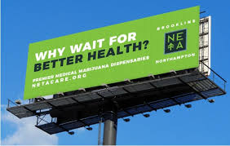
Content Requirements/Restrictions
32 of 39 jurisdictions have some form of content restriction:
Content Targeting Children
Therapeutic Claims (19 states)
Product Warnings
Validity of statements
Images of consumption of cannabis/cannabis plant
Notes:
Therapeutic claims:
9 states prohibit the use of therapeutic or curative claims in cannabis advertising.
For instance, Maine prohibits cannabis retailers “from making any claims related to health or physical benefits of cannabis consumption.”
10 states allow therapeutic or health claims but require that the claims are supported by substantial scientific and/or clinical evidence.
Example: New Jersey requires that the claims be supported by at least two scientific studies.

Slide 17
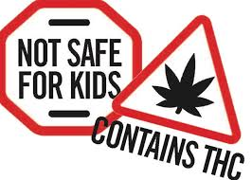
Content Requirements/Restrictions
32 of 39 jurisdictions have some form of content restriction:
Content Targeting Children
Therapeutic Claims
Product Warnings (14 states)
Validity of statements
Images of consumption of cannabis/cannabis plant
Notes:
14 states require some form of product warning in outdoor cannabis advertisements.
For example, Nevada requires that cannabis retailers ensure that all advertising includes, without limitation, the following words: (1) "keep out of reach of children"; and (2) "for use only by adults 21 years of age and older."

Slide 18
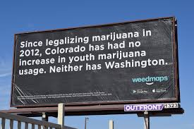
Content Requirements/Restrictions
32 of 39 jurisdictions have some form of content restriction:
Content Targeting Children
Therapeutic Claims
Product Warnings
Validity of statements (38 states + DC)
Images of consumption of cannabis/cannabis plant
Notes:
Every state has a provision explicitly prohibiting false and/or misleading statements. In a regulation, this often worded like “any advertisement must not contain any statement, design, representation, picture, or illustration that contains or communicates False or misleading statements.”

Slide 19
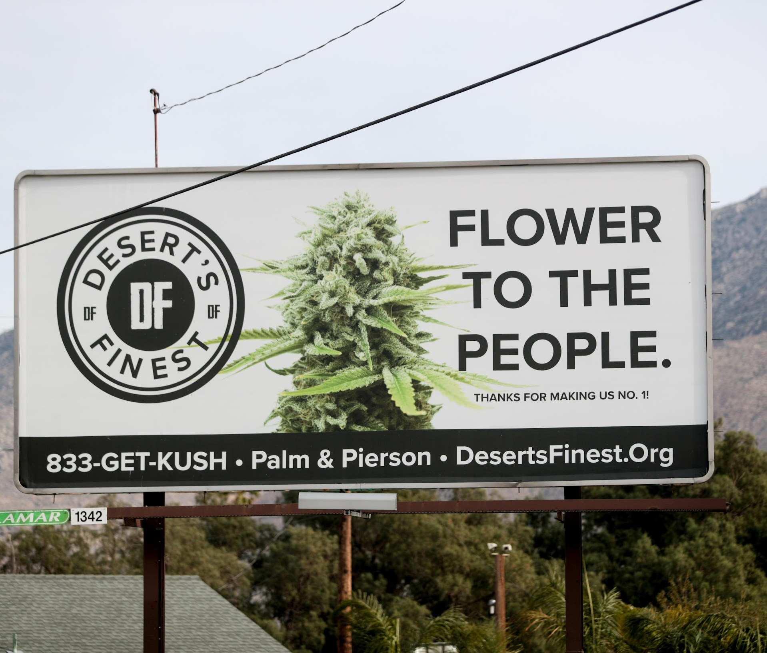
Content Requirements/Restrictions
32 of 39 jurisdictions have some form of content restriction:
Content Targeting Children
Therapeutic Claims
Product Warnings
Validity of statements
Images of consumption of cannabis/cannabis plant (15 states)
Notes:
Images of cannabis
15 states prohibit the use of any image, or any other visual representation, of the cannabis plant or the consumption of cannabis.
Example: In Rhode Island, “Any advertising by or on behalf of a licensee shall not Display images or representations of marijuana plants, marijuana or marijuana products or Display the consumption, use or transfer of marijuana or marijuana products.”
Overall, the limitations on outdoor cannabis advertising play a crucial role in shaping a responsible and informed cannabis market, mitigating the normalization of cannabis use, and reducing the inadvertent exposure of minors to potentially influential messages. Ultimately, the advertising restrictions on cannabis contribute to a healthier and more responsible cannabis industry, ensuring the paramount interest of protecting the well-being of children.

Slide 20
Selected Topics: Medical Cannabis in School
Notes:
This presentation and the accompanying resource examine various state policies that permit or prohibit medical cannabis in the school setting.
There are several objectives in compiling this resource:
For states without medical cannabis policies for schools in place, we hope legislators and policy makers can look to this resource and understand why it is important to have a policy that permits medical cannabis in school.
For states that already have a pertinent policy, we will shed light on the most beneficial policy approaches so that states can alter their programs as needed to reduce barriers and burdens to patients, caregivers, and families, and promote the best interest of public health.

Slide 21
Why Have a Policy Permitting Medical Cannabis at School?
Only debilitating conditions qualify
HIV/AIDS, severe chronic pain, severe nausea, epilepsy, severe muscle spasms, or wasting syndrome
Access to medical cannabis = improved quality of life
Without, potential for recurrence of symptoms
Example: epilepsy → seizure
Notes:
Only debilitating conditions qualify
Most states - for minors, some combination of cancer, HIV/AIDS, severe chronic pain, severe nausea, epilepsy, severe muscle spasms, or wasting syndrome
For certain patients with these often painful conditions, access to medical cannabis is critical for improved quality of life
For some minor patients, it is the only way they can get through the school day.
Going without a dose of medical cannabis can lead to recurrence of symptoms
Example: for a student with epilepsy, a missed dose could result in a seizure at school

Slide 22
Public Health Consequences of Not Permitting Policy
Harm to the Child/Patient
Education Impacts
Health Consequences
Stigma → chronic stress, physical health conditions
Harm to the Caregiver/Family
Extraordinarily burdensome when schools do not permit cannabis
Loss of income / loss of job
Policy Fixes
Best approach = permit school personnel or school nurses to administer, or self administering?
Notes:
The child / patient is harmed when there is no permitting medical cannabis policy.
Two options when no policy is in place:
Child pulled out of school / absent from school → Education suffers
Detrimental in the aggregate - child may be pulled from school weekly, daily, or even multiple times a day
Harms education. Problematic because education is a critical social determinant of health that is crucial for ensuring a long, healthy life.
Education is linked to higher paying jobs that provide health-promoting benefits, such as health insurance.
High income is also protective against a host of negative health outcomes such as obesity, asthma, and heart disease.
Children who miss school face poorer long-term health outcomes, and are more likely to receive poor grades, drop out of school, incur a mental health condition, and exhibit unhealthy behaviors during adolescence, such as smoking, alcohol and drug use, juvenile delinquency, and not exercising
Child misses a dose of medical cannabis → Health suffers
Health- potential for symptoms to reoccur when a child who needs medical cannabis misses a dose.
Stigma-
Prohibitions on medical cannabis but not other medications in the school setting only enhances negative stigma
Practicalities of the child having to leave school each day, or even multiple times a day: student perceived as an outsider, gossip, etc. This enhances stigma.
Stigma has negative health consequences such as chronic stress. Chronic stress negatively impacts an individual’s mental health and can contribute to many physical health conditions, such as high blood pressure, heart disease, stroke, obesity, and diabetes.
The Caregiver / Family is Harmed
When schools fail to permit medical cannabis, the family unit is harmed because of the burden placed on caregivers
Without a policy, burdensome process- must get to child’s school, get child, remove child from school, administer the medical cannabis, then drop child off back at school.
Some patients may need their medical cannabis multiple times a day. Amplifies negative consequences of not having a permitting policy.
Caregivers must either temporarily leave work and lose out on income, or may be forced to become a stay at home parent to accommodate.
In half of U.S. households, both parents work full-time → associated loss of income
BUT: Over eighteen million U.S. kids (About ⅓ of U.S. kids) are raised by single parents.
How are single parent families supposed to make this work?
Policy Fixes
Worst- no policy
Better- implementing a policy that allows only caregivers to administer medical cannabis on school grounds
Best- permits designated school personnel or school nurses to administer medical cannabis on school grounds
I’m going to come back to this point later when we compare state policies on who is permitted to administer the medical cannabis.

Slide 23
Counterargument: Potential Violations of Federal Law
Schools hesitant to adopt policy because potential loss of federal funding
Controlled Substances Act
Drug Free Workplace Act
Highly unlikely any loss of federal funding will result
DOJ spending rider
Cole Memorandum
Rescindment of Cole Memorandum, but no enforcement
Notes:
Some school Administrators and Legislators remain hesitant to adopt a policy permitting cannabis on school premises because they fear violating federal law, which would result in a loss of federal funding.
Cannabis remains a schedule one controlled substance under the Controlled Substances Act, meaning it is still illegal under federal law.
Drug Free Workplace Act requires all federal contractors and grantees of federal funds maintain a drug free workplace or risk having their funding revoked.
However, in practice, little possibility of enforcement.
When Congress appropriates funds to the DOJ every year, it attaches a condition prohibiting the DOJ from using the funds to enforce state-authorized cannabis activities.
In essence, if a state legalizes cannabis, or adopts laws permitting medical cannabis in schools, the DOJ cannot go after the state/school/school administrators.
2013 DOJ guidance- Cole Memorandum- DOJ declined to pursue all future enforcement against state-authorized cannabis activities.
2018- Cole Memorandum rescinded by Attorney General Jeff Sessions, but the DOJ has continued to adhere to nonenforcement of state-authorized cannabis activities.

Slide 24
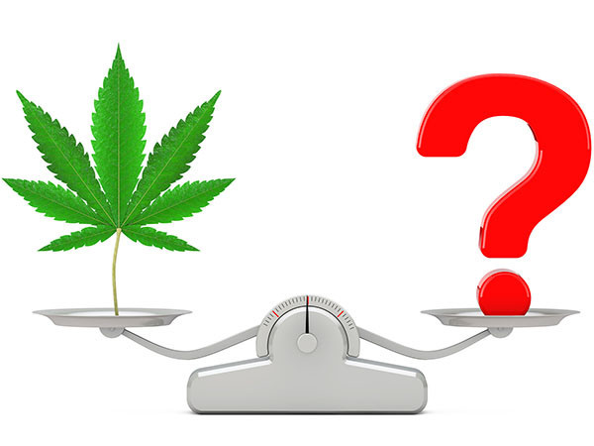
Current State of Laws & Policies on Medical Cannabis in School
States that prohibit medical cannabis in school: 11 (AL, AR, AZ, CT, HI, MI, MN . . .)
States that permit medical cannabis in school: 21 (CA, CO, DC, DE, FL, IL . . .)
Not a free for all
Alaska: Neither bucket
No Policy: 6 (LA, MA, NV, OH, OR, UT)
BUT: MA to develop a permitting policy?
S.B. 3096, (Mass. 2022)
Notes:
States that prohibit medical cannabis in school: 11 (AL, AR, AZ, CT, HI, MI, MN, MT, ND, NH, VT)
States that permit medical cannabis in school: 21 (CA, CO, DC, DE, FL, IL, KY, ME, MD, MO, MS, NJ, NY, NM, OK, PA, RI, SD, VA, WA, WV)
Not a free for all - all states have specific and generally extensive restrictions on medical cannabis in schools. State law includes policies on who can administer the medical cannabis to the patient, where the cannabis can be administered, how must the cannabis be stored and if overnight storage is permitted, what forms of cannabis are permissable, etc.
Alaska: Neither bucket
schools are not required to accommodate use of medical cannabis.
No Policy: 6 (LA, MA, NV, OH, OR, UT)
BUT: MA has indicated an interest in developing a policy permitting medical cannabis in school.
S.B. 3096, (Mass. 2022)
In 2022, Massachusetts passed a cannabis reform bill that required the Massachusetts Cannabis Control Commission (“CCC”) to conduct a study on medical cannabis in schools and submit results no later than August of 2023. As of the time of this writing, no study results have been released by the Massachusetts CCC.

Slide 25
Two Approaches: State Mandate vs. School Discretion
State Mandate – all schools in the state must adopt policy
State set minimum requirements
16
School Discretion – schools have discretion to adopt policy
State set minimum requirements
6
Policy Merits of State Mandate vs. State Discretion
Notes:
Not worth spending too much time on because state mandate and school discretion approaches have a similar practical implications.
State Mandate – requires all schools in the state to adopt a policy permitting medical cannabis
All have state set minimum requirements that must be incorporated.
16 (CO, DE, FL, IL, KY, ME, MD, MO, NJ, NM, OK, PA, RI, SD, WA, WV)
School Discretion – schools in the state have complete discretion to decide whether to adopt a permitting policy
If a school decides to adopt a policy, they must incorporate state set minimum requirements
6 (CA, DC, MD, MS, NY, VA)
Note on MD
You may have noticed that Maryland was included twice. I actually did not mess up the math here! Maryland has a policy that mandates public schools adopt a permitting policy, but private schools have discretion to adopt a policy.
The state mandate approach is best because it ensures the most inclusive approach because all schools in the state are required to adopt a compliant policy. But, legislators might be hesitant to take such a big step. With the state discretion approach, kids who need medical cannabis may still not have access to it if they go to a school that chooses not to adopt a policy. However, for states where medical cannabis in school remains a contentious issue, the school discretion approach is a more moderate approach that certain legislators and stakeholders may be more likely to support.

Slide 26
Patient / Caregiver Verification Process
19 have verification procedures
States generally require
medical cannabis card of patient and/or caregiver verification: 9
medical recommendation, certification, or authorization: 12
treatment plan: 7
FL: compiled with principal
release from liability: 5
caregiver authorization or affirmation: 6
Annual Renewal
5
Notes:
Nineteen states (CA, CO, DC, DE, FL, IL, ME, MD, MO, MS, NJ, NM, NY, PA, RI, SD. VA. WA. WV) have verification and certification procedures that must be met in order for a student to receive their medical cannabis at school.
States generally require
medical cannabis card of patient or equivalent and/or caregiver verification: 9 (IL, MD, MO, MS, NY, PA, SD, WA, WV)
medical recommendation, certification, or authorization from a practitioner or equivalent: 12 (CA, DC, DE, FL, ME, MD, MO, MS, NM, PA, VA, WV)
treatment plan: 7 (CO, FL, IL, MD, NM, RI, SD)
Details dosage, timing, and delivery
Florida’s must be compiled with the principle
a release from liability: 5 (CO, MD, NM, RI, SD)
Caregiver must release the school from liability if anything goes awry
caregiver authorization or affirmation: 6 (DC, DE, FL, IL, ME, MD)
Form where caregiver authorizes school to administer, store, or possess the cannabis, and/or affirm that the caregiver agrees to be the student’s caregiver
Annual Renewal - 5 states (IL, FL, NJ, NM, SD) require annual renewal of verification documents.
Upshot of all of this is that verification procedures widely differ from state to state, and a lot of documentation is needed to secure access to medical cannabis in the school setting. It is a highly regulated process.

Slide 27
Packaging / Labeling Requirements
7 total jurisdictions
Packaging: 2
DC: Labeled container & sealed package
MD: Original packaging
Labeling: 6
CO, SD: Clear instructions
MD: Display label provided by dispensary
NM, FL, RI: Student’s name, date of birth, and dosage
RI requires ingredients
Notes:
7 total jurisdictions have some sort of packaging / labeling requirement.
Packaging: 2 (DC, MD)
DC: labeled container & sealed package
MD: original packaging & display label provided by dispensary
Labeling: 6 (CO, FL, NM, RI, SD)
CO, SD: require that the medical cannabis be labeled with clear instructions for administration.
MD: Display label provided by the dispensary
NM, FL, RI: New Mexico, Florida, and Rhode Island require the medical cannabis to be labeled with the student’s name, date of birth, and dosage. Rhode Island additionally requires labeling to include a list of the ingredients.

Slide 28
Prohibited Forms of Medical Cannabis
States that prohibit smokable forms: 17
Interesting Policies
FL: bans any form of continuous delivery
NM: permits only capsules, extracts, and concentrates
DE / VA: cannabis oil only
Notes:
States that prohibit smokable forms of medical cannabis: 17 (CA, CO, DC, FL, IL, KY, ME, MD, NJ, OK, RI, SD, WA, WV)
Florida - In addition to smokable forms, bans any form like patches that provides continuous delivery of medical cannabis
New Mexico - Does not ban smokable forms, but instead permits only non-refrigerated capsules, extracts, and orally ingested concentrates
Delaware and Virginia only permit cannabis oil in schools.

Slide 29
Individuals Permitted to Administer the Medical Cannabis
Caregivers
Caregiver = varies by state law, administers medical cannabis to minor patient
19 permit
Rhode Island permits parent’s designees
School Personnel
8 prohibit
7 permit
School Nurses
10 prohibit
7 permit
Self Administering - more controversial
16 prohibit
2 permit
lL – student must be under supervision
NY – patient must be “capable” and the school must have permitting policy
Notes:
As mentioned earlier, allowing school nurses and school personnel to administer medical cannabis enables access to care and lowers burdens on caregivers and families. But still, about half of jurisdictions that permit medical cannabis only allow caregivers to administer.
Caregivers
Caregiver = varies by state law, but generally the parent or guardian of the patient who administers medical cannabis to minor qualifying patient
19 (CA, CO, DE, FL, IL, KY, ME, MD, MO, MS, NJ, NM, NY, OK, PA, RI, SD, WA, WV) permit caregivers to administer the medical cannabis.
Rhode Island also permits parent’s designees to administer medical cannabis to the student
School Personnel
8 (DE, FL, ME, MO, MS, OK, WA, WV) prohibit school personnel from administering medical cannabis to the student
7 (CA, CO, IL, KY, MD, NY, SD) permit school personnel to administer medical cannabis
School Nurses
10 (CA, DE, FL, ME, MO, MS, OK, SD, WA, WV) prohibit school nurses from administering medical cannabis in the school setting.
7 (IL, KY, MD, NM, NY, RI, VA) permit school nurses to administer medical cannabis
Self Administering- more controversial. Concerns that student could overdose, share cannabis with other students, etc. BUT: the two states that do permit self administration do so in a highly regulated manner.
When the patient administers the cannabis to themselves
16 (CA, CO, DE, FL, KY, ME, MD, MO, MS, NM, OK, PA, RI, SD, WA, WV) prohibit the patient from self-administering medical cannabis
2 (IL and NY) permit self-administration of medical cannabis in school
lL– self-administering is only permitted if the student is under supervision of the school nurse or school personnel
NY – self-administering is permitted if the patient is “capable” and the school has a permitting policy

Slide 30
Places Where the Medical Cannabis Can Be Administered
Why allow cannabis on more than just school premises?
School Premises: 16
School Buses: 9
School Sponsored Events: 10
Notes:
Why allow cannabis on more than just school premises?
For kids who have one of the severe qualifying conditions needed to qualify for medical cannabis as a minor, they may need their medicine in more locations than just school premises in order to enable these kids’ full inclusion in school life.
One example - Child may need medical cannabis on school bus en route to school sponsored field trip. Without access to medical cannabis, child likely would be unable to attend the field trip with the rest of their class.
But one caveat: this policy aspect has implicit limitations, as state’s medical cannabis policies do not apply across state lines.
Sixteen states (CA, CO, DC, DE, FL, IL, KY, ME, MD, MO, NJ, NM, SD, VA, WA, WV) permit administration of medical cannabis on school premises.
Nine states (CO, DE, IL, ME, MD, MO, NJ, NM, WA) permit administration of medical cannabis on school buses.
Ten states (CO, IL, MD, MO, NJ, NM, SD, VA, WA, WV) permit administration of medical cannabis at school-sponsored events.

Slide 31
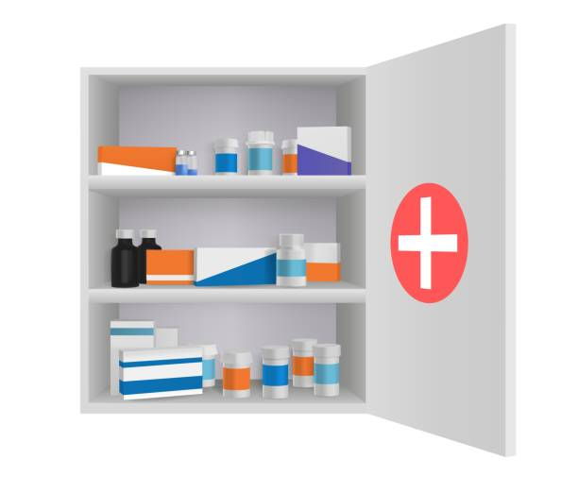
Storage of Cannabis on School Premises
Why are storage procedures important?
8 prohibit storage of medical cannabis on school grounds.
Examples:
CA, FL, MO, OK, PA: caregiver must transport the cannabis to school
6 permit storage of medical cannabis
Examples:
Overnight Storage
MD: permits
IL / RI: permit if school personnel / school nurse administers
Storage of Cannabis
CO, NM, RI, SD: locked container
IL: consistent with other student medication
Notes:
Having storage procedures in place, especially overnight storage procedures, lessen burdens on the caregiver and reduce stigma against the child. States looking to reform or implement a policy should include storage procedures.
8 (CA, DE, FL, MO, NJ, OK, PA, WV) prohibit storage of medical cannabis on school grounds.
Examples:
CA, FL, MO, OK, PA: caregiver must transport the cannabis to school and remove the cannabis from school every day.
DE: medical cannabis must, at all times, be kept on the caregiver’s person.
6 (CO, IL, MD, NM, RI, SD) permit storage of medical cannabis
Examples
Overnight Storage
MD: permits overnight storage
IL / RI: permit overnight storage if school personnel or a school nurse administers the medical cannabis. If administered by a caregiver, the cannabis must be removed from school premises.
Storage of Cannabis
CO, NM, RI, SD: cannabis must be stored in a locked storage container
IL– Storage must be consistent with the storage of other student medication

Slide 32
Questions?
Mathew Swinburne, J.D.
Senior Advisor, Network for Public Health Law-Eastern Region
Director, Legal Resource Center for Public Health Policy-Cannabis
mswinburne@law.umaryland.edu

