Slide 1
The State of State-level Public Health Advocacy
Thursday, January 18th, 2024

Slide 2
Moderator
Attica Scott, Director of Special Projects at Forward Justice Action Network and Former Kentucky State Representative

Slide 3
Speakers
Martha Katz, Health Policy Consultant; Chair, James F. and Sarah T. Fries Foundation
Notes:
Health Policy Consultant; Chair, James F. and Sarah T. Fries Foundation

Slide 4
Speakers
Quang H. Dang, Public Health Law Attorney and Educator, 50-State Scan Consultant

Slide 5
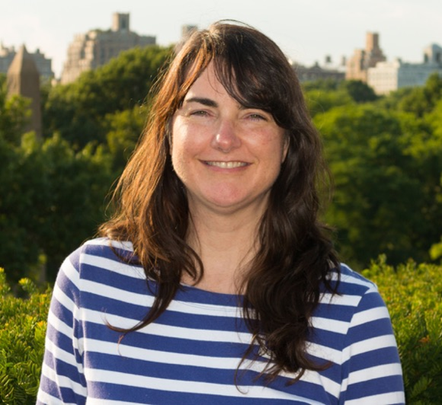
Speakers
Leslie Zellers, Public Health & Public Policy Attorney, Act for Public Health

Slide 6
Fighting for the Public’s Health
www.networkforphl.org

Slide 7
1979 Surgeon General’s Report

Slide 8
Why Invest in Advocacy?
Policy Solutions Work
greatest benefit for the greatest number of people in the least amount of time at the least cost
Sustained Investments in Advocacy Make a Difference
“Bills are a’droppin’, admins are a’hoppin’ and, - until March 28 (sine die) - ain’t nobody a’stoppin’!” - Polly McKinney

Slide 9
POLL 1
Do you think PH advocacy leaders in your state will be more engaged in “defense” or ”offense” in the upcoming legislative season?
Defense
Offense

Slide 10
CHAT 1
What is the MOST politically divisive public health issue in your state?

Slide 11
CHAT 2
What public health issue in your state enjoys the most bipartisan support?

Slide 12
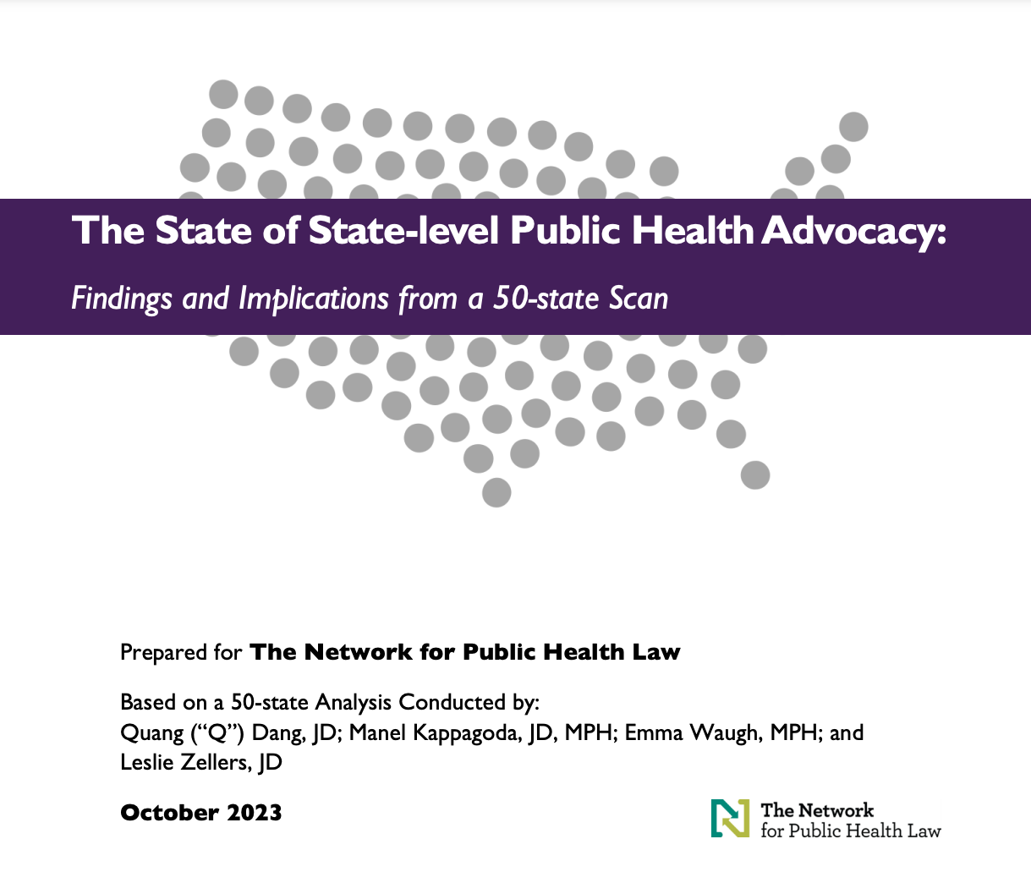
Project Advisors:
Martha Katz
Maddy Frey
Gene Matthews
Dawn Hunter
With funding from:
Notes:
Q: Intro report; Thank you Network, de Beaumont, CDC Foundation; Project Advisors; Project Team

Slide 13
50-State Scan of Public Health Advocacy Capacity March – June 2023
Key informants in all 50 states and DC
State and local health department representatives
Elected officials
Lobbyists
Partners in other sectors and organizations
Notes:
Q:
Respondents included state and local health department representatives, elected officials, lobbyists, and partners in other sectors and organizations, although the specific type of respondent was different in each state.
Regardless of their specific titles, current roles, or locations, all respondents represent voices from the field who are advocates for the health and well-being of everyone in their respective states.

Slide 14
Findings & Opportunities
1
PH’s role and value is often misunderstood
Elevate public health’s value proposition
2
PH is often reluctant to rely on lobbying and advocacy
Encourage strategic advocacy and lobbying
3
Counter challenges to public health authority
Challenges to PH authority make advocacy more difficult and essential
Fight for health equity
4
Health equity is fundamental and requires nuanced communication
5
Tap the strengths of supportive allies
Public health allies remain untapped resources
6
The PH workforce is underfunded
Support the public health workforce

Slide 15
Definition of Advocacy
“The term ‘advocacy’ encompasses a broad range of activities—including research, public education, lobbying, and voter education—that can influence public policy.”
—Bolder Advocacy
Notes:
Photo credit: https://www.eatrightpro.org/advocacy

Slide 16
POLL 2
Which component of the definition of advocacy (“a broad range of activities—including research, public education, lobbying, and voter education—that can influence public policy”) do you think is most important to strengthen public health?
RESEARCH
EDUCATION
LOBBYING

Slide 17
POLL 3
Which would you like the most assistance/support with in your work?
RESEARCH
EDUCATION
LOBBYING

Slide 18
What about a definition for Public Health Advocacy?
Hard to keep simple: Public Health can be a profession, field of work, a broad system, a concept, a target
Different definitions might be needed for different uses
Equity language important but needs to be tailored
Different tools, but lobbying has special role
Community partners; mobilizing individuals and groups
Broad PH v. specific issues
[working definition = building support for a strong, equitable public health system that promotes the best possible health outcomes for all, especially those that need it the most, by working with community partners, drawing on a full array of advocacy tools (including lobbying), and mobilizing individuals and groups to support, protect, and defend the authority and capacity of organizations across the broad public health system to continue in their efforts to bring about social change on behalf of a particular health goal, program, interest, or population.]

Slide 19
Finding #1
Public health has the expertise and tools to help all communities achieve health and well-being, but the role and value of public health are often hidden and/or misunderstood.

Slide 20
Finding #1: Understanding PH Role/Value
Difficult to communicate scope of public health and its successes, sub-disciplines, data
Disinformation campaigns
BIPOC mistrust from prior and existing harms by PH, health, others
Specific health issues may be more relatable than broad idea of PH
Make the case to more conservative decisionmakers (workforce, economy, prosperity, ROI, rural health)
Indiana’s republican-led 1500% increase in state funding for LHDs

Slide 21
Quotes
“If given the right arguments, Republicans would support [residents of this (red) state].”
“Public health bills have to be workforce bills, not public health bills.”

Slide 22
Finding #2
Members of the public health workforce and state/local public health leaders are often reluctant to rely on tools such as advocacy and lobbying that have served other sectors well.

Slide 23
Finding #2: Need stronger advocacy + lobbying
Lobbying is crucial for success
Not well understood
Many in PH workforce are constrained from doing or THINK they are constrained
Variable legislative cycles from state to state
Need more training, resources, and clarity

Slide 24
Quotes
“The public health workforce underestimates and undervalues how much it can actually advocate.”
“The [public health] organizations are the subject matter specialists, but the paid lobbyists have the relationships, make the calls, and get things through.”
“We [public health] care about how policy looks and affects people; lobbyists care about winning. Both are important.”

Slide 25
Finding #3
Public health measures in response to COVID have sparked ongoing challenges to public health authority, making advocacy even more difficult and essential.
States Limiting Public Health Authority
States Limiting AND Reallocating Public Health Authority

Slide 27
Health law partners addressing challenges to public health authority and infrastructure.
Perhaps more than at any other time in its history, public health is being directly and significantly impacted by how laws and policies are being implemented—or weakened.
Notes:
Here to provide an update on the framework committee’s work so far on developing our legal framework for “good” public health authority.

Slide 28
Act for Public Health Partners:
Track legislation and litigation
Provide direct consultation and legal technical assistance
Produce resources and conduct webinars and events
Keep the public health community informed

Slide 29
Defensive: Stopping Bad Bills

Slide 30
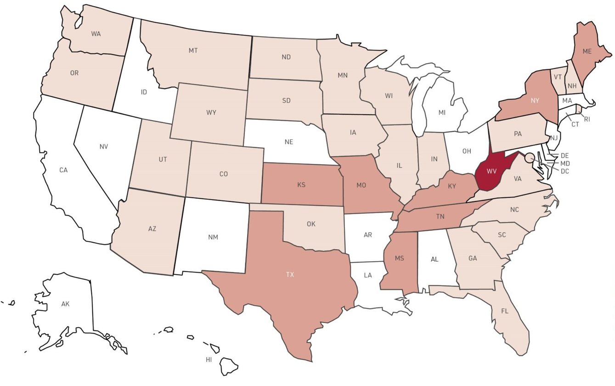
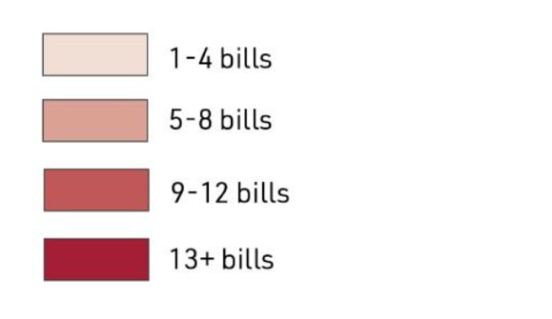
Bills Limiting Vaccination
Prohibited Vaccination Requirements for School Entry, Expanded Non-Medical Exemptions, or Reallocated Control Over Vaccination Requirements

Slide 31
Proactive: A Positive Agenda for Public Health

Slide 32
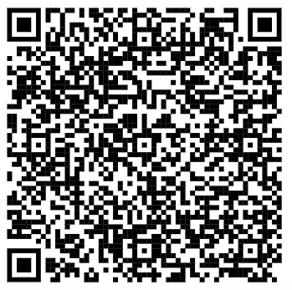
Working toward a coordinated response

Slide 33
Bright Spots
Strengthen Public Health
Funding
Infrastructure
Workforce
Public Health Interventions and Emergency Orders
Health Equity
Governance

Slide 34
APHA Alliance’s crosswalk of 12 reports’
recommendations for an improved PH system
Stronger Public Health System
Funding
Infrastructure
Workforce
Public Health Interventions and Emergency Orders
Health Equity
Governance
Financing/Funding
Data/Information Technology
Workforce
Public Health Law/Governance/Policy
Community Engagement
Partnerships
Equity
Social Determinants of Health
[…]

Slide 35
Central Question
What laws, policies, and governance structures are needed to ensure that public health officials and staff serve the public’s health effectively and equitably, in ways responsive to community priorities? Authority to…
Respond nimbly to public health emergencies;
Provide stable, day-to-day public health services to all; &
Facilitate upstream activities that improve public health

Slide 36
Toward a Framework for “good” public health authority
A set of shared values/ measures
A catalog/ network of examples
Notes:
We arrived at this central question… [read]. AND, to ensure any of these PH activities happen in ways that don’t risk doing harm. That we’re not thwarting ourselves unintentionally, and that PH isn’t co-opted for other purposes.

Slide 37
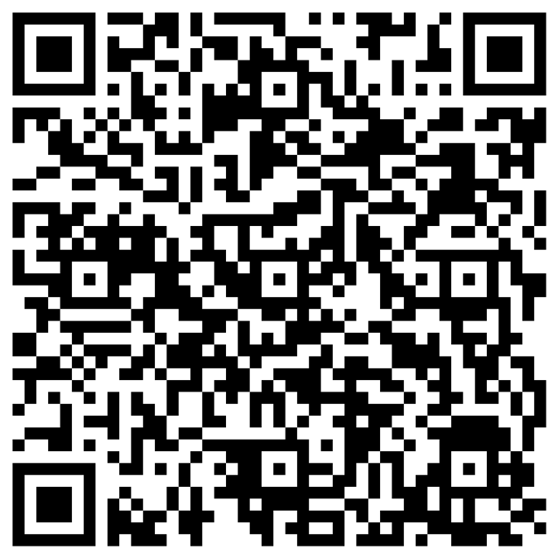
Share policy examples and ideas!
http://tinyurl.com/Act4PH-form

Slide 38
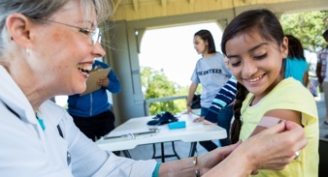
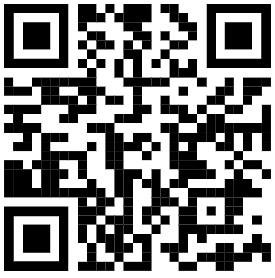
Visit the Act for Public Health Website
actforpublichealth.org
Request assistance
Join the email list
Connect to partners and networks
Learn about public health authority
View resources and past events
Sign up for upcoming events

Slide 39
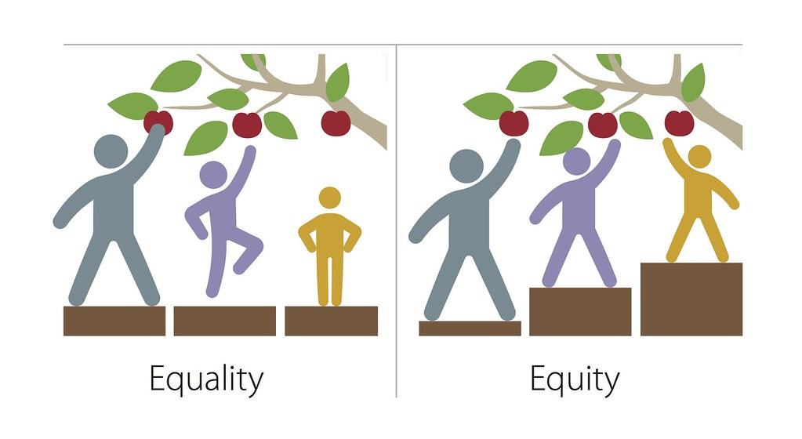
Finding #4
Health equity is fundamental to public health and requires nuanced communication in some states/regions.
Notes:
This Photo by Unknown Author is licensed under CC BY-NC

Slide 40
POLL 4
If you were training a voter to talk to a lawmaker in your state legislature about a public health issue, would you suggest they use the term HEALTH EQUITY, especially as it relates to race and ethnicity? (please feel free to expand on your yes/no answer in the Chat Box)
YES
NO

Slide 41
POLL 5
If you were training a voter to talk to a lawmaker in your state legislature about a public health issue, would you suggest they use the term SOCIAL DETERMINANTS OF HEALTH? (please feel free to expand on your yes/no answer in the Chat Box)
YES
NO

Slide 42
Quotes
“While it is hard to deny the facts around racial disparities, the challenge is to figure out a way to discuss health equity without making it immediately toxic.”
“[We’re a] long way off from talking about health equity. In most communities, [we’re] still just introducing the concept … Community Health Centers in the state and the fight for Medicaid expansion all overlap with healthy equity, but … Buzzwords and splashy DEI terms are not used.
Notes:
This Photo by Unknown Author is licensed under CC BY-NC

Slide 43
Finding #4: Health Equity
Crucial work of PH
Offices of Health Equity and Declarations of Racism as Public Health Crisis
Tribal Health: History of having to advocate for own existence and survival; “One Health” and tribal council models; may be bipartisan; need for further work
Resistance to use of term, even removed from official usage
A handful of states have equity analyses built into legislative review process
"Non-medical factors,” fairness, access, rural

Slide 44
Finding #5
Many public health allies at the local and state levels remain untapped resources for protecting and promoting the public’s health, including supporting public health advocacy and lobbying efforts.

Slide 45
Examples
Some states want support for coordinating resources
Others want new organizations, e.g. a 501(c)(4)
Purpose:
Share advocacy models and lessons learned
Respond more nimbly
Nurture coalitions

Slide 46
Finding #6
The public health workforce stepped up to protect all of us during COVID, despite not being at full strength going into the pandemic and being severely tested during the pandemic. COVID-related funding infusions are helpful but not sufficient unless sustained.
Notes:
This Photo by Unknown Author is licensed under CC BY

Slide 47
Examples
Among state health officers, only four pre-COVID leaders remained in place across all 50 states.

Slide 48
Opportunities to Respond
1
Elevate public health’s value proposition:
Create consistent messages to highlight public health’s contributions;
Customize public health messages to local/state contexts
Address misinformation;
Affinity group for advocates in red states
2
Encourage the strategic deployment of advocacy and lobbying on behalf of the public’s health:
Build capacity and motivation to deploy a full range of advocacy tools
Include advocacy skills in core competencies, curricula, and professional development
Bolster/expand lobbying capacity
Notes:
Added preliminary

Slide 49
Opportunities to Respond
3
Counter challenges to public health authority
Understand scope of challenges, share success stories
Enlist allies to counter challenges
Track legislative and litigation attacks on public health
4
Fight for health equity, with or without the language of health equity:
Share multiple ways to express concept of health equity
Develop/test how to make a strong case for health equity in different political environments
Share successful examples
Notes:
Added preliminary

Slide 50
Opportunities to Respond
5
Tap the strengths, capabilities, and shared interests of supportive allies
Strengthen ties to allies with ability to lobby on shared goals, including in other areas such as voting rights, climate justice, etc.
Support collaboration among existing organizations
Fund new advocacy and lobbying organizations where needed
6
Support the public health workforce:
Document and advocate for what “full strength” public health would look like
Rebuild public health infrastructure with sustained investments
Funders: supplement government funding
Notes:
Added preliminary

Slide 51
Thank you! The Georgia Health Initiative, Montana Healthcare Foundation, CDC Foundation, de Beaumont Foundation, and the Network for Public Health Law supported this work financially and conceptually as part of a larger initiative to assess and boost public health advocacy. Questions: mkatz122@comcast.net maddy@freyevaluation.com
51

