Slide 1
Harm Reduction Laws in the United States
March 14, 2024
Notes:
Corey does the intro

Slide 2
Background
Nearly 107,000 people died of overdose in 2021
Most caused by opioids or opioids in combinations with other drugs, but stimulant-related overdoses are rapidly increasing
Many people contract HIV, hepatitis C, endocarditis, and sustain injury from shared or re-used injection or smoking equipment
Many of these deaths and injuries are preventable
Many are caused or exacerbated by the “War on Drugs”
No silver bullets, but many opportunities to move to evidence-based, person-centered law and policy
Notes:
Corey does the intro

Slide 3
What are we trying to do here?
Every system is perfectly designed to produce the results it’s producing
The “War on Drugs” is designed to produce human suffering
It preferentially targets members of already stigmatized groups, particularly non-white and economically disadvantaged people
Beyond incarceration (which is terrible) and public health harms (which are devastating), the War also has huge negative externalities: lost employment, destroyed families, traumatized children, etc.
As we often observe, “The War on Drugs ruins everything.”

Slide 4
But aren’t things getting better?
Some policies have improved – there has been movement recently to make some laws that restrict access to MOUD less racist, classist and stigmatizing, to incrementally increase access to syringes and naloxone, etc.
These changes are largely tinkering around the edges. They are positive, and the advocates and policymakers responsible for them should be applauded
However, policy at all levels is still directed largely towards the creation and maintenance of a permanent underclass of criminalized, stigmatized people who use or used the wrong drugs
Reform is possible and necessary

Slide 5
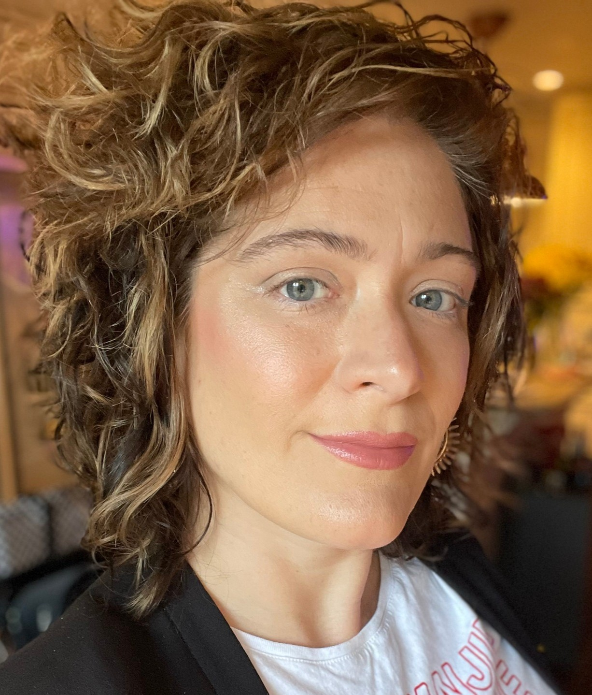
Your presenters
Ashleigh Dennis
Staff Attorney
Harm Reduction Legal Project
Amy Lieberman
Senior Attorney
Harm Reduction Legal Project
Corey Davis
Director
Harm Reduction Legal Project

Slide 6
Roadmap for today
State laws related to the opioid antagonist naloxone
State laws related to safer injection, smoking, and drug checking supplies
State overdose Good Samaritan laws
Reflections and thoughts on the future
Q&A

Slide 7
Naloxone Access Laws
Notes:
Ashleigh

Slide 8
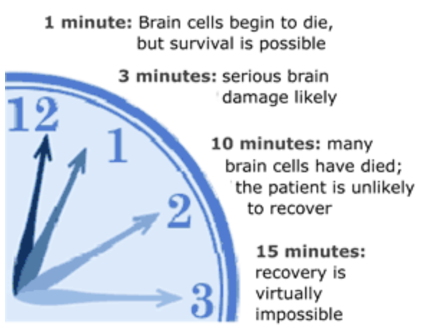
What is Naloxone?
A pure opioid antagonist
Naloxone was discovered and patented at the beginning of the 1960s and approved by the FDA in 1971
WHO added naloxone to its list of essential medicines in 1983
It has no effect on non-opioid drug overdoses, no dependency potential and a high safety margin
Safely and effectively reverses opioid overdose if given in time
Notes:
“knocks out” the opioids responsible for the overdose (SAMSHA video https://www.youtube.com/watch?v=RcAaZQQqd50) –
“it attaches to opioid receptors and reverses and blocks the effects of other opioids. Naloxone can quickly restore normal breathing to a person if their breathing has slowed or stopped because of an opioid overdose. But, naloxone has no effect on someone who does not have opioids in their system, and it is not a treatment for opioid use disorder. Examples of opioids include heroin, fentanyl, oxycodone (OxyContin®), hydrocodone (Vicodin®), codeine, and morphine.” https://nida.nih.gov/publications/drugfacts/naloxone
SO Dan Bigg for getting it to the streets https://www.vice.com/en/article/7x3yag/dan-bigg-overdose-harm-reduction
9-1-1 isn’t always going to make it in time – every minute someone is not breathing matters

Slide 9
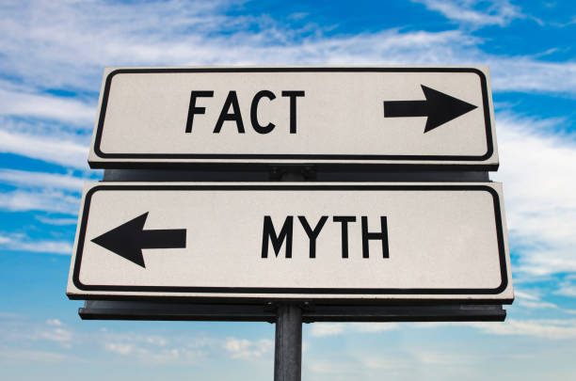
Naloxone and Fentanyl Myths
If I give someone naloxone, they will wake up violent
If I touch someone who has used fentanyl, I may overdose
The more naloxone, the better
Notes:
It is highly unlikely that the person will wake up violent. But, a person using opioids may be sent into precipitated withdrawal by naloxone, in which case they may be very sick and in pain. Being a calming influence and non-confrontational will work wonders.
Despite stories in the media, a casual skin encounter with fentanyl will not cause an overdose. If you are performing rescue breaths, you should use proper PPE, but if you have only administered naloxone and are worried you may have exposed yourself to fentanyl, don’t panic and go wash your hands.
If the person is breathing, even if they have not woken up, you don’t need to give more naloxone. If after 2 doses the person is still not breathing, it is likely that there is another substance (like benzodiazepenes or xylazine) depressing the respiratory system.

Slide 10
Naloxone Access Laws update
As of August 1, 2023:
All 50 states and DC have laws that reduce regulatory barriers to naloxone
39 states allow lay distribution, 16 states allow possession without a prescription, 11 states allow pharmacist prescribing
Most states changed references to “naloxone” to some version of “opioid antagonist”
Most states updated their standing orders for naloxone distribution
Notes:
https://www.networkforphl.org/news-insights/changing-state-policy-to-promote-stronger-opioid-antagonists-unnecessary-and-potentially-harmful/

Slide 11
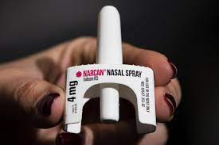
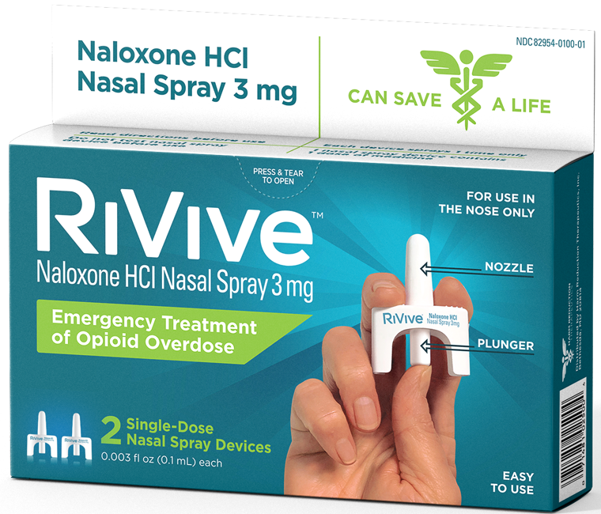
Some formulations of naloxone are now OTC
Notes:
Important to note that only some formulations of naloxone are OTC: Narcan and Narcan generics and RiVive. All other naloxone (including the 0.4mg injectable many harm reduction programs distribute and Kloxxado) remain Rx only

Slide 12
From “naloxone” to “opioid antagonist”
Nebraska is the only state that exclusively uses the term “naloxone” in what we used to call “naloxone access laws”
Every other state includes “naloxone” and/or some version of the term “opioid antagonist” in its law
Indivior, the maker of Opvee, a nalmefene product, has been advocating for these changes
Notes:
https://www.networkforphl.org/news-insights/changing-state-policy-to-promote-stronger-opioid-antagonists-unnecessary-and-potentially-harmful/

Slide 13
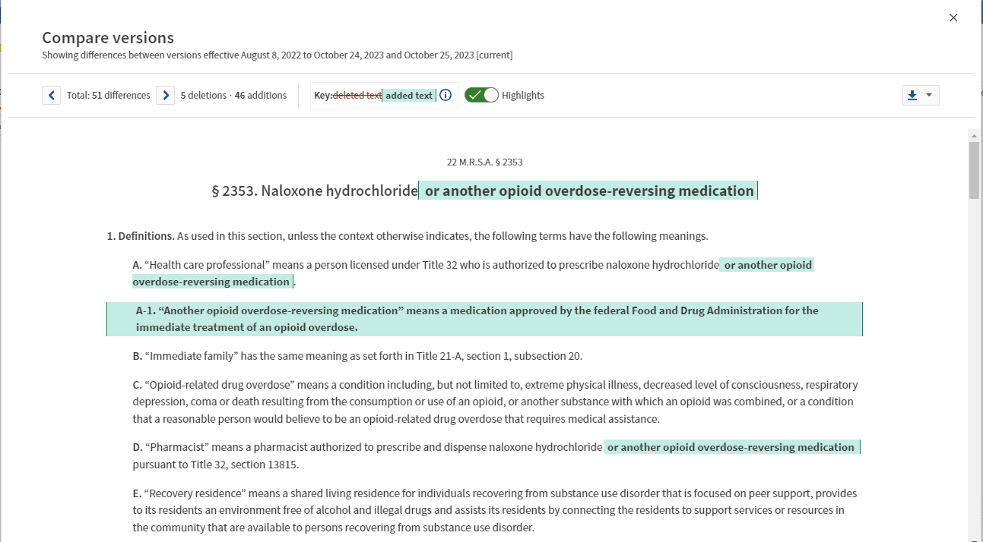
From “naloxone” to “opioid antagonist”
Nebraska is the only state that only uses “naloxone” in its law
Every other state includes naloxone and/or some version of the term opioid antagonist in its law
Notes:
https://www.networkforphl.org/news-insights/changing-state-policy-to-promote-stronger-opioid-antagonists-unnecessary-and-potentially-harmful/
Maine

Slide 14
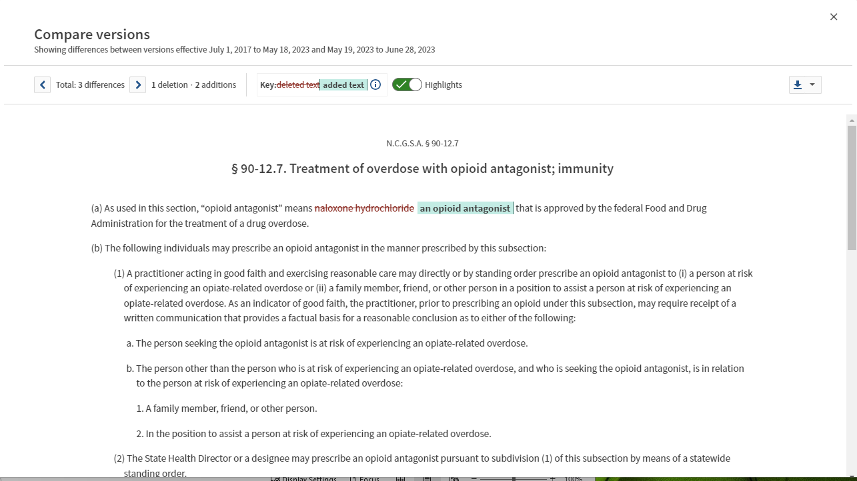
From “naloxone” to “opioid antagonist”
Notes:
https://www.networkforphl.org/news-insights/changing-state-policy-to-promote-stronger-opioid-antagonists-unnecessary-and-potentially-harmful/
North Carolina

Slide 15
Nalmefene & high dose naloxone
Nalmefene and other high dose opioid antagonists can be harmful
Many harm reduction programs, including those in areas with high fentanyl penetration, have found that the 0.4mg intramuscular naloxone remains effective
Nalmefene is longer acting than naloxone
A February 2024 study shows no benefit to 8mg compared to 4mg naloxone
Both nalmefene and higher dose naloxone can lead to precipitated withdrawal (Symptoms include: diarrhea, nausea, vomiting, runny nose, goosebumps, chills, headaches, more serious risks include pulmonary edema, tachycardia, and increased risk of overdose from attempts to overcome withdrawal symptoms)
Risks of withdrawal cause avoidance by PWUD (wouldn’t you avoid those symptoms too?)
Notes:
https://www.networkforphl.org/news-insights/changing-state-policy-to-promote-stronger-opioid-antagonists-unnecessary-and-potentially-harmful/
https://www.cdc.gov/mmwr/volumes/73/wr/mm7305a4.htm?s_cid=mm7305a4_w

Slide 16
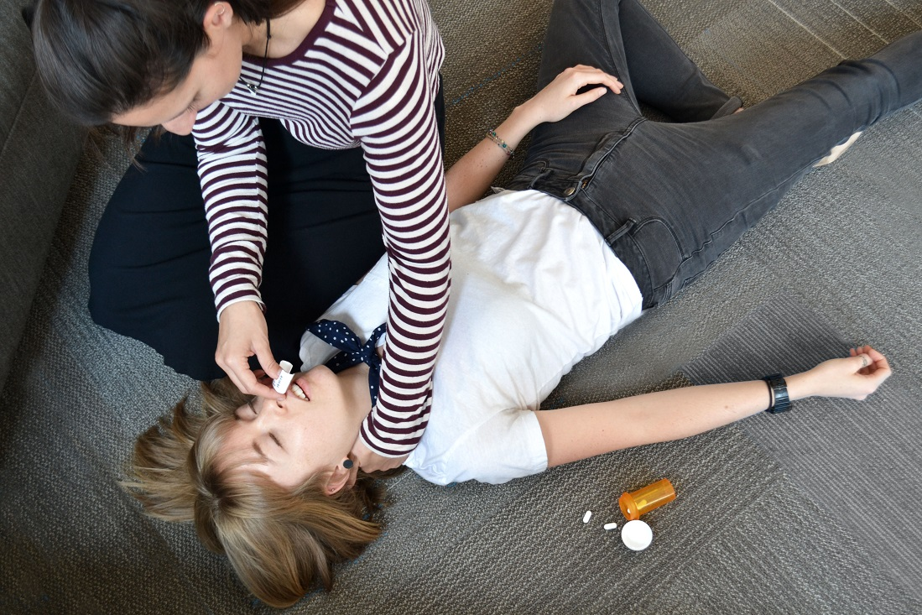
Layperson distribution and immunity
As of August 1, 2023
39 states allow layperson distribution of prescription naloxone (38 in 2020)
16 states allow possession without a prescription (12 in 2020)
48 states have explicit civil immunity for administering naloxone (45 in 2020)
Notes:
Truth is, the only people who get in trouble for possessing or distributing naloxone are people who the police want to arrest anyway, and we know of no one who has been prosecuted for naloxone.
It’s always the case that Someone might sue Somebody for Something. But, as naloxone will not hurt someone who is not experiencing an overdose, the chances of that lawsuit going anywhere are nil.
https://www.japha.org/article/S1544-3191(16)30890-1/pdf

Slide 17
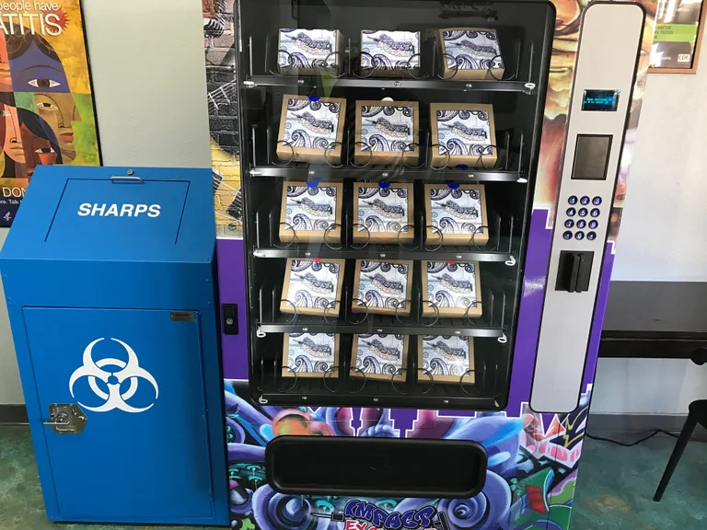
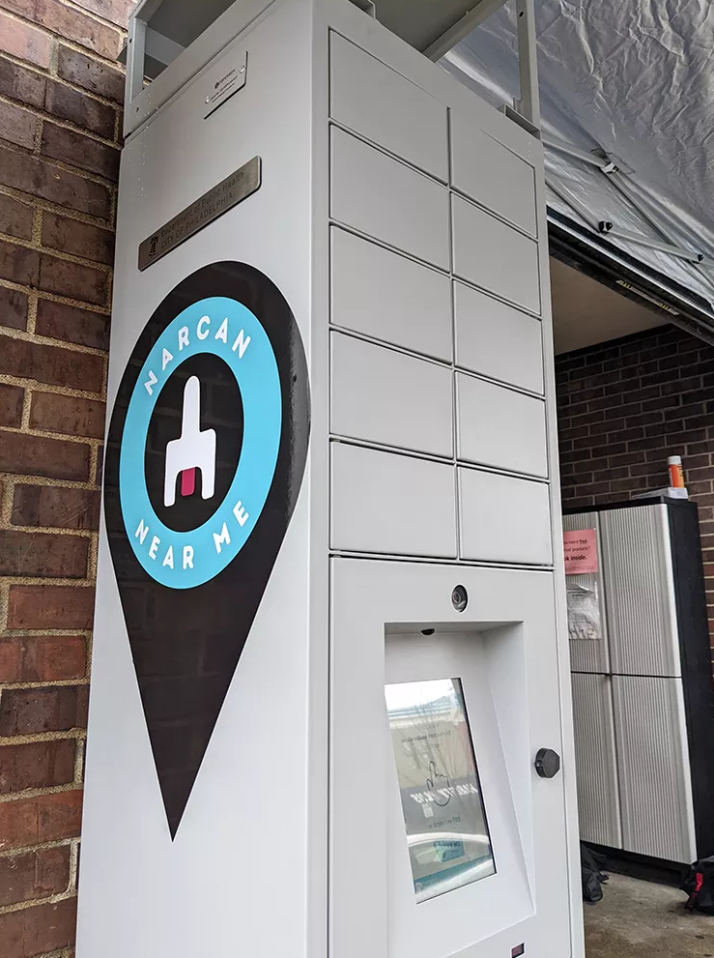
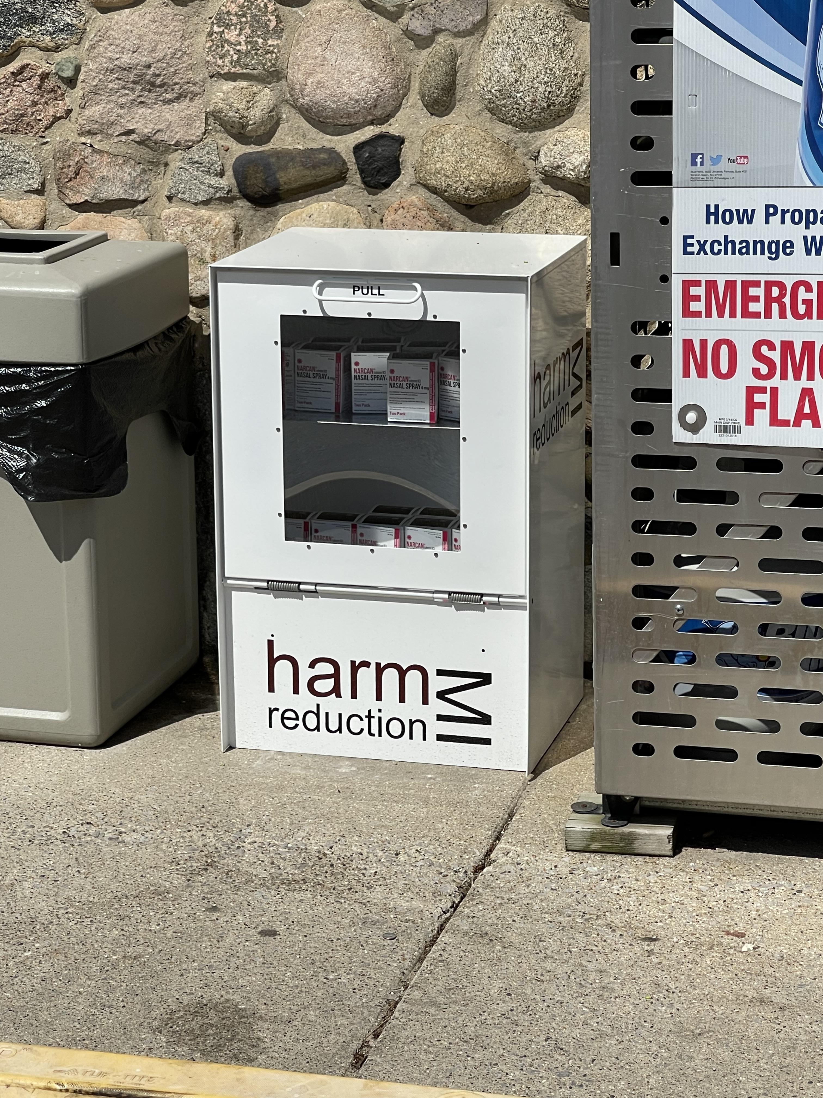
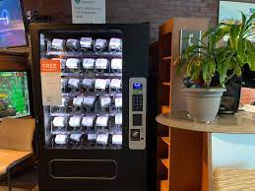
Naloxone Vending Machines
Notes:
A few quick examples of naloxone vending machines currently in use
A way for people to access naloxone anonymously and at a time that works for them can further increase access
The specifics differ, but in many states if the law permits community workers to distribute naloxone it also permits people to access it from a vending machine
in most states there's no problem with putting OTC naloxone in vending machines, and in many the Rx is fine as well, under a standing order. Good place to note that if people have any questions or run into issues they can/should reach out.

Slide 18
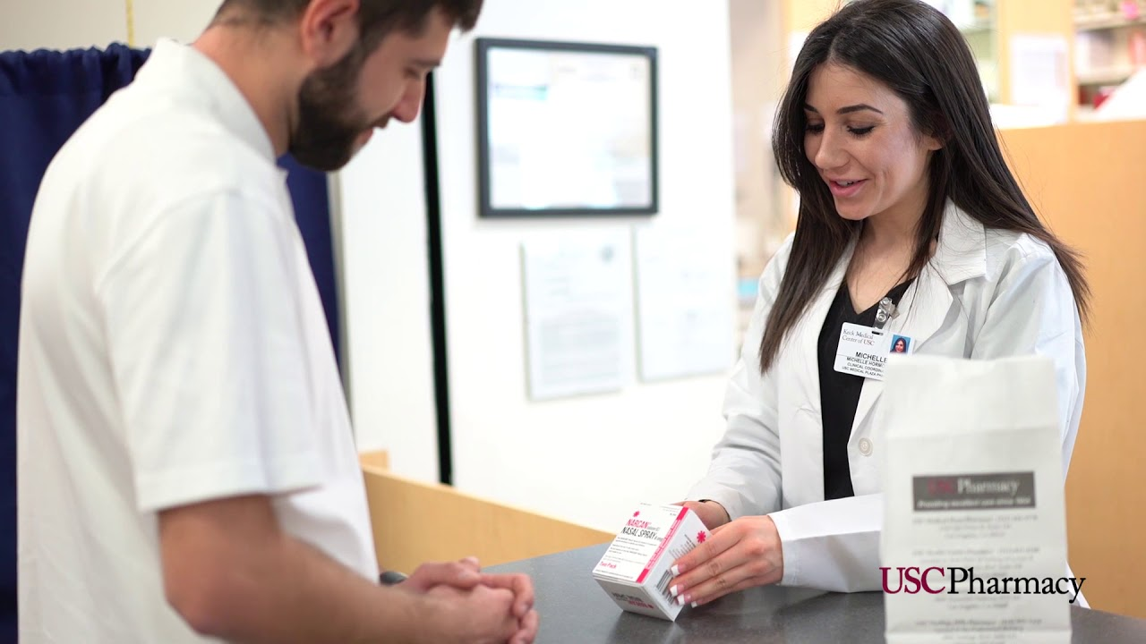
Medical Professional Liability
As of August 1, 2023
11 states allow pharmacist prescribing (8 in 2020, 5 in 2016)
43 states have explicit civil immunity for prescribers/dispensers (43 in 2020, 36 in 2016)
36 have explicit disciplinary immunity for prescribers/dispensers (36 in 2020, 31 in 2016)
Notes:
https://www.japha.org/article/S1544-3191(16)30890-1/pdf

Slide 19
Naloxone Insurance Coverage Mandates
As of April 1, 2023, seven states require that private insurers cover naloxone
Arkansas, Colorado, Illinois, Missouri, New Jersey, Rhode Island, Washington
Five states have lowered access barriers when insurance covers naloxone
Connecticut, Delaware, Maryland, New York
Pre-authorization requirements prohibited
Minnesota
If plan covers prescriptions, must cover prescriptions for opioid antagonists, including pharmacist prescribed opioid antagonists
“Opioid antagonist” language here too
Notes:
Here also, many refer to “opioid antagonists” etc.
Many insurers provide coverage of naloxone even without a mandate, so this document should not be viewed as a list of states where insurance coverage is available
Insurers can provide coverage of OTC medications, and we urge them to cover the currently available OTC naloxone product as well as future OTC naloxone products.
https://www.networkforphl.org/wp-content/uploads/2023/05/Naloxone-Insurance-Coverage-Mandates.pdf
https://www.revisor.mn.gov/statutes/2020/cite/62Q.529

Slide 20
What is a standing order for naloxone?
Most naloxone laws allow any prescriber to issue “non-patient specific prescription” for individuals who meet predetermined criteria
Ex: person likely to experience an overdose, person who will likely be in a position to assist a person experiencing overdose, first responders, school employees, harm reduction program employees/volunteers, etc.
Many states have issued a statewide standing order applying to all entities in the state, subject to outlined requirements
Ex: requirements that pharmacist or receiver complete a training prior to dispensing/receiving, only dispensing to predetermined individuals, pharmacist providing education on administration of naloxone and identifying/responding to overdose
Protocol or collaborative practice agreement often the functional equivalent
Notes:
Protocols are issued by governing boards like board of pharmacy

Slide 21
Characteristics of Statewide Standing Orders
As of August 1, 2023:
47 states have some form of standing order, protocol or collaborative practice agreement
Most states have changed from “naloxone” to some version of “opioid antagonist”
Limited formulations
Ex: only 4mg and 8mg formulations which exclude RiVive
Outdated inclusion of products like Evzio autoinjectors
Some states specifically updated to include nalmefene
Notes:
https://www.networkforphl.org/news-insights/changing-state-policy-to-promote-stronger-opioid-antagonists-unnecessary-and-potentially-harmful/
https://www.japha.org/article/S1544-3191(16)30890-1/pdf

Slide 22
Where do we go from here?
Increase saturation of naloxone, specifically in communities where it’s most likely to be used - NOT number and types of products
Naloxone works. Limited funds shouldn’t be spent on creating products that potentially do more harm than good
Liability protections in all 50 states and DC
State laws that clearly permit lay distribution of Rx naloxone
More insurance coverage mandates that require naloxone specifically and/or provide for patient choice in product prescribed
“opioid antagonist” leaves room to only cover nalmefene
Move all naloxone formulations OTC

Slide 23
Injecting, smoking, and drug checking prohibitions
Notes:
Amy

Slide 24
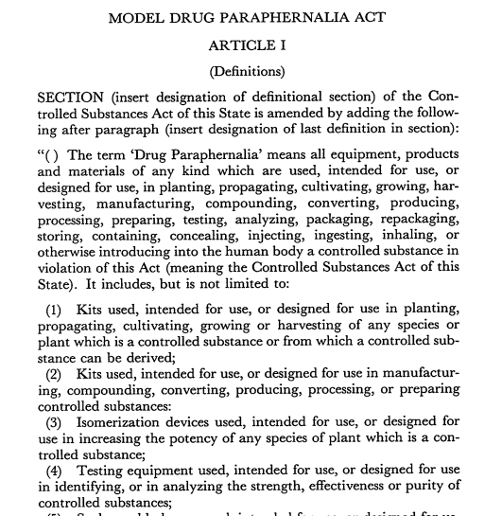
Background on relevant law
Prior to 1979, drug equipment was not illegal in most states. That year, DEA created a model law that defined essentially anything used with illicit drugs as paraphernalia
Many states adopted that model. However, some have since created exceptions, such as for SSPs or drug checking equipment
This has created a patchwork of paraphernalia restrictions across the country
Notes:
The DEA model law was intentionally designed to be extremely broad. But when you read it, it’s clear that the drafters mostly had marijuana in mind. It was never designed to impede SSPs, which didn’t exist at the time

Slide 25
Outliers
Alaska – never passed a paraphernalia law (but some municipalities have them)
Arkansas, Illinois, Ohio – free distribution to adults not prohibited
Massachusetts, Michigan – possession/free distribution not prohibited
Nebraska – DCE never illegal
New Hampshire – injection has not been in definition since 1/1/01
New York – possession not illegal
Rhode Island – injection has not been in definition since 9/1/00
South Carolina – syringes not in definition
West Virginia – only sale to minors and at festivals is illegal

Slide 26
General format of paraphernalia laws
Definition section: “Any equipment, products, and materials which are used, intended for use, or designed for use in … a controlled substance in violation of the law are considered drug paraphernalia."
Illegality section: “illegal to use, possess with intent to use, sell, or deliver drug paraphernalia in violation of the law”
Crime category section
Penalty section
Exceptions

Slide 27
Definitions
Usually contains the words “injecting,” “inhaling,” “testing,” “analyzing,” or words to that effect, sometimes in addition to specifically mentioning syringes
“or otherwise introduce into the human body” – a catch-all at the end of most definition laws
For example: NJ’s law has never included the word “injecting,” but the definition includes the catch-all. Since Jan. 2022, syringes have been specifically excluded from the definition of paraphernalia
Often, an additional section exists that explains how to make the determination that an object is or is not paraphernalia

Slide 28
Illegality & Crime Category
Sometimes syringes are explicitly removed from the definition of paraphernalia, but the laws making it illegal to use or distribute paraphernalia still contain references to injection
Or vice versa
Mens rea requirements are usually present, and typically require knowledge (or should reasonably know) that the paraphernalia will be used for violating the law
Where prohibited, violations can be:
Infractions
Misdemeanors
Felonies
Notes:
WV only criminalizes sale; Alaska doesn’t criminalize (but some localities do)

Slide 29
Penalty
Possession:
Ranges from no incarceration to 6 years in prison, and no fine to $10,000
The possession of drug paraphernalia with the purpose of using it to break the law is, if the controlled substance is methamphetamine, heroin, fentanyl, or cocaine, a class D felony. Ark. Code Ann. § 5-64-443(a). “A Class D felony is punishable by a maximum of 6 years in prison and a fine of up to $10,000.” Ark Code Ann. §§ 5-4-401(a)(5); 5-4-201(a)(2). For DCE, it is a Class B felony – up to 20 years in jail and $15,000 fine.
Delivery:
Ranges from no incarceration to 9 years imprisonment, and no fine to $30,000
"Delivery or possession with intent to deliver drug paraphernalia is a felony punishable by 9 years maximum imprisonment, $30,000 maximum fine, or both.” Idaho Code Ann. § 37-2734B.
Sometimes, the penalties for use/possession and the penalties for distribution are the same; sometimes they are wildly different
Notes:
ex. Hawaii both are max $500 fine, North Dakota both are class c felonies with max 5 years/$10000; Nebraska use/possession is an infraction that is a max $100 fine and distribution is a class II misdemeanor, 6 months imprisonment and $1000 fine; Nevada is mis/6mo/$1000 fine – e felony/4 years

Slide 30
Exceptions
Exceptions are found in either the definitions or the illegality sections, or in a separate SSP law
Common exceptions include:
Syringes and other injection equipment
Fentanyl test strips/testing equipment
More general testing equipment exceptions
Only one state (Maine) has specifically removed smoking equipment from list of paraphernalia
Notes:
Some state SSP law exceptions can be read to include smoking supplies and other things, for example CA “SSP staff and volunteers of are not subject to criminal prosecution for distribution of syringes or other materials “deemed by a local or state health department to be necessary to prevent the spread of communicable diseases, or to prevent drug overdose, injury, or disability” to SSP participants, and participants are permitted to possess those materials. Cal. Health & Safety Code § 121349.1.” Also, some states just don’t criminalize the use/possession or delivery of paraphernalia

Slide 31
Why does this matter?
Injection drug use is NOT a risk factor for HIV, hepatitis C, and other bloodborne disease – lack of access to new syringes is the risk factor
Smoking drugs can often be a harm reduction method over injection
Most illicit opioids now contain fentanyl – increasingly prevalent in illicit stimulants in some areas as well – and xylazine is showing up more frequently
However, due to paraphernalia laws, in several states the legal status of drug checking is unclear, and in most syringe access is highly constrained. Access to other paraphernalia, such as smoking equipment, is almost completely forbidden, and where access is allowed it is usually not explicit.

Slide 32
Even “good” paraphernalia laws are problematic
Syringes removed from definition?
Great, but what about smoking equipment?
Great, but what about cookers/cottons/sterile water?
DCE removed from definition?
Great, but is it only FTS?
Great, but is possession of controlled substances tested still illegal?
SSP authorization laws?
Great, but do they require local authorization to operate?
Great, but are participants as well as staff protected?
(More) SSP authorization laws?
Great, but why the distinction between sources?
Great, but what about smoking supplies?
Notes:
For example, folks are prosecuted in FL for syringes they got from an SSP because they can’t PROVE they got them at an SSP

Slide 33
States taking bold steps
Minnesota – “Full repeal” August 1, 2023
Use and possession with intent to use drug paraphernalia law was repealed
A separate law was modified to remove prohibitions on all syringe-related activities other than sale
A limit on the number of syringes that can be sold from pharmacies was removed
Language that prohibited the delivery of drug paraphernalia was removed
Drug possession law was modified to exclude possession of a residual amount of a controlled substance in drug paraphernalia
Notes:
However, there are already local communities passing local ordinances criminalizing paraphernalia, and residue is only legal for a 5th degree possession crime (having residue near a school zone still counts as “any amount” and is a 3rd degree possession crime) Still illegal to manufacture for delivery or sale, deliver to minor

Slide 34
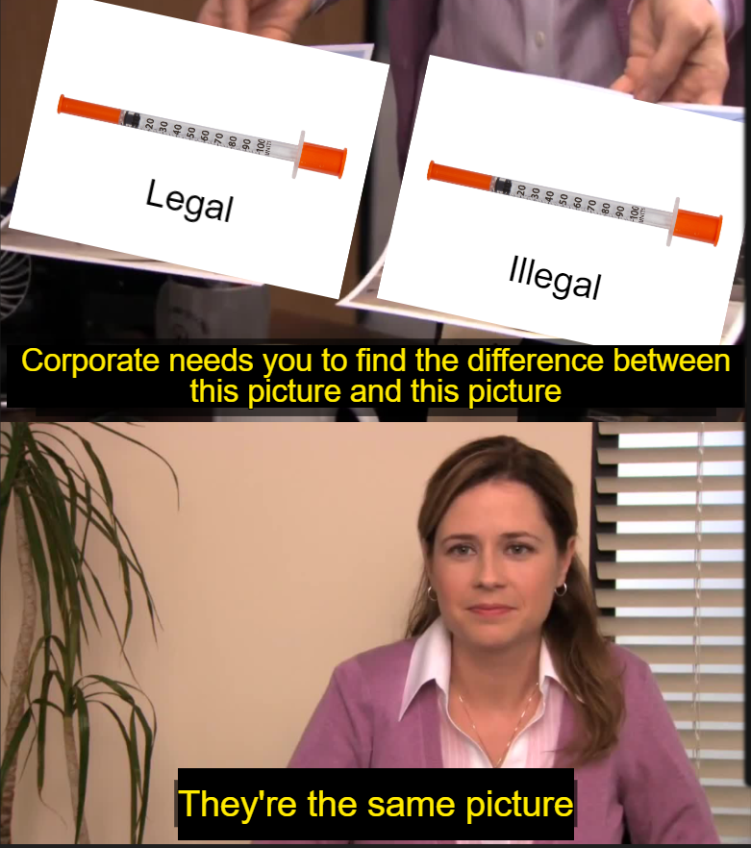
Notes:
Almost everything that falls under the definition of “drug paraphernalia” is something that can be used for another purpose. So what is the difference between items of paraphernalia that are legal and those that are not?

Slide 35
Drug checking prohibitions
Rapid adoption of DCE permissions, 2020-2022

Slide 36
Drug checking prohibitions
The model law and most state laws criminalized devices for “testing” or “analyzing” controlled substances in violation of the law
Although not intended to apply to drug checking devices, could be interpreted that way
While arrest and prosecution for DCE is rare to nonexistent, these laws discouraged distribution and use of DCE
Most states have modified those laws to exclude at least some DCE
Whack-a-mole strategy is always addressing last year’s problem – states that authorized only FTS are now facing xylazine

Slide 37
Reforming safer equipment access
SSPs were once a progressive idea, but in practice SSP laws generally only permit SSPs with local authorization, involve complex paperwork and over-regulation, and do not ensure support when SSPs come under local attack – these flaws can render SSP authorization laws almost useless
Removing certain devices or equipment from paraphernalia laws can be helpful, but cannot predict what devices or equipment might be needed in the future and continues the default of criminalization
Full repeal of paraphernalia laws is the only way to address the needs of people who use drugs and all people in our communities, reducing harm, disease, overdose, over-incarceration, and waste of public resources.

Slide 38
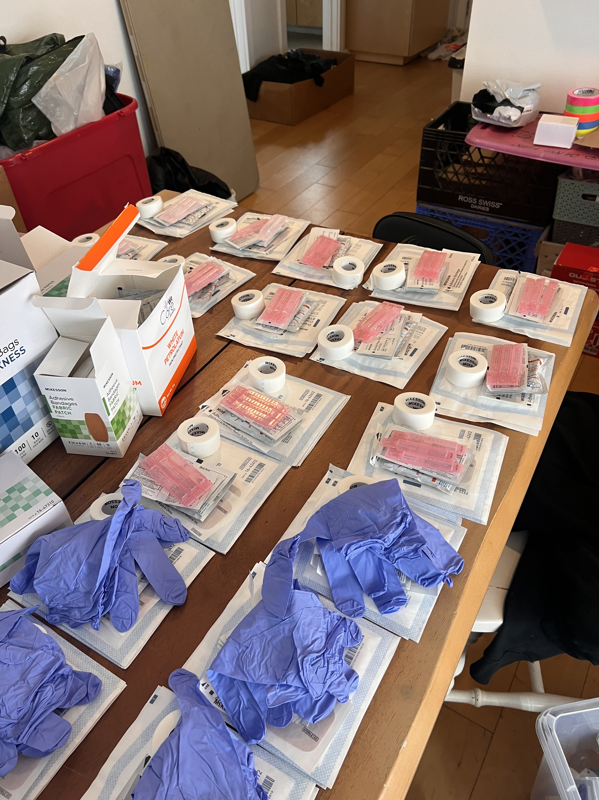
Why decriminalize paraphernalia?
Criminalization of everyday objects when they are used to consume drugs makes life as a person who uses drugs infinitely more difficult and confusing
Criminalization increases health risks to people who inject drugs and everyone else in the community, including LEOs
Criminalization costs money
Laws that cost money and make people less healthy are bad

Slide 39
Specific benefits of paraphernalia decrim
Less stigma keeping people from seeking help or reducing harm
Less litter, as turning in used equipment will not result in penalties
Less bloodborne pathogen transmission
Less healthcare provided on community’s dime
Less incarceration
More connection to treatment
More knowledge of safer drug practices
More options for using drugs
More equity, removing extra charges LE may add on a whim
More funding available for other programs

Slide 40
This area is ripe for decriminalization
DEA pushed states to enact extremely broad paraphernalia laws, and could encourage them to modify or repeal them
Nothing to that effect is on the table at the federal level
However, states can and have removed criminal penalties for safer use supplies. Some never criminalized possession and free distribution, and Minnesota recently removed its prohibitions.
Meanwhile, states as varied as Idaho, West Virginia, and California are seeing threats to repeal SSP authorization laws or shut down SSPs by local regulation

Slide 41
New Beginnings
Decriminalization of equipment used to consume drugs should only be the starting point, not an end point
Once we have stopped discouraging paraphernalia access, we must take steps to ENCOURAGE it:
Funding harm reduction programs
Developing innovative products
Removing obstacles like local NIMBY regulations
Teaching harm reduction practices to learners from many fields (medicine, nursing, law, social work, etc)
Decriminalizing drugs
Notes:
For example, the hammer pipe was developed to make smoking heroin easier so folks could have a better option than injection. https://filtermag.org/heroin-pipes-harm-reduction/
Of course, decriminalizing drugs takes careful planning, funding, and support to execute it properly

Slide 42
Overdose Good Samaritan laws
Notes:
Corey

Slide 43
Overdose Good Samaritan laws
Because the “War on Drugs” criminalizes nearly all aspects of drug use, people present at an overdose often hesitate to call for help
Many people fear, correctly, that doing so might result in themselves, the person overdosing, or both being arrested or otherwise subjected to state-caused harm
In Indianapolis, 10% of overdose calls result in someone being incarcerated
Nationwide, around 20% of law enforcement agencies report that overdose calls result in incarceration
To encourage people to call for help in an overdose, most states have enacted laws that provide limited immunity to at least some individuals at the scene of an overdose

Slide 44
Rapid adoption of GSLs
Notes:
Who are the holdouts? Kansas and Wyoming.

Slide 45
Overdose Good Samaritan laws
In general, overdose Good Samaritan laws have become more comprehensive over time
Many now provide protection from arrest as well as prosecution, and immunity from violations of probation and parole
However, most continue to provide very limited protection from criminal prohibition, and no protection at all from other collateral consequences
Most GSLs are limited to minor drug-related crimes, which leaves people vulnerable to arrest and prosecution for other offenses
People who call for help also often face other negative consequences, such as eviction or involvement with child protective services
Evaluations generally find a mild protective effect on drug overdose, particularly for GSLs that provide more protections
GSLs, however, often tend to perpetuate racial disparities in arrests

Slide 46
Particularly bad GSLs
Nearly all GSLs continue the premise that people who use drugs deserve to die, and that making an arrest is more important than saving a life
In addition to being limited to certain minor crimes, many impose requirements such as staying on the scene and “cooperating” with police
Some are particularly egregious:
In Iowa, immunity is only provided one time for the person overdosing and one time for the reporter
In Indiana, immunity is provided only to people who obtained naloxone under the state naloxone law and administered that naloxone to the person who overdosed
In Ohio, immunity applies only twice
In South Carolina immunity is only guaranteed once, more than that is up to the judge
In South Dakota immunity is only provided one time (there’s no immunity at all for the person who OD’d)
In Tennessee immunity for the person who OD’d only applies on the first OD
Texas imposes a number of limitations, including being inapplicable to people with certain prior convictions, and only being available once

Slide 47
One GSL on the right track
In 2019, Maine enacted a run-of-the-mill GSL
In 2022 – due to sustained advocacy from local advocates – the law was almost entirely replaced
The new law reverses the default, so that it is presumed that a person who calls for help, renders aid, or experiences an overdose is immune from arrest and prosecution for all crimes unless otherwise excluded
The list of excluded crimes is relatively long – 21 to be exact – but few (kidnapping, arson, sexual assault, etc) are anything a person at an overdose need be concerned about
Room for improvement, but this is the way.

Slide 48
Overall thoughts on GSLs
A GSL is marginally better than no GSL, but most existing GSLs are quite bad
States should follow the Maine path, and set immunity as the default rather than the exception
They should also go further, and provide immunity for collateral consequences in addition to criminal penalties

Slide 49
Final thoughts
Notes:
Corey

Slide 50
Much more information on these laws is available on our website
Comprehensive overview of harm reduction laws in the United States
Overdose Good Samaritan Laws
Drug Checking Equipment Laws
Naloxone Access Laws
Naloxone Prescription Mandates
Naloxone Insurance Coverage Mandates

Slide 51
Summary: two steps forward, one step back?
States and the federal government have made many incremental changes to reduce some iatrogenic harms from punitive law and policy
The overall landscape, however, remains heavily tilted in favor of criminalization
Despite continued rhetoric that we cannot “arrest our way out” of overdose and addiction, government at all levels remains committed to trying exactly that
While there are some green shoots, criminalization and stigmatization remain the default
Many states, for example have increased prosecutions for drug-induced homicide, have increased penalties for fentanyl-related crimes, etc.

Slide 52
Summary: two steps forward, one step back?
In just the past few weeks:
The mayor of San Francisco supported a local ballot measure that requires drug screening to receive county assistance benefits
Lawmakers in Oregon partially repealed the country’s first drug possession decriminalization measure
Police in Boise and Caldwell raided two local SSPs and confiscated supplies; the health department responded by cutting all SSP funding and launching an investigation
Bills to repeal SSP laws have been introduced in West Virginia and Idaho
A bill to permit SSPs in Nebraska was vetoed by the governor, and the legislature fell short of over-riding that veto

Slide 53
What are we trying to do here?
Every system is perfectly designed to produce the results it’s producing
We can choose to double-down on criminalization and continue to incarcerate more of our own citizens than almost every other country on the planet
We can make incremental changes that, while beneficial, are clearly insufficient
Or, we can recognize that criminalization is morally repugnant and counterproductive, and pivot to policies that would actually improve lives and save $
It really is a choice

Slide 54
How do we get to where we need to be?
Evidence and education are important, but they’re usually not enough (and we already know a lot!)
Lawmakers (and voters) are often driven by emotion. But emotion can go several ways!
We are at a once-in-a-generation inflection point. We believe that now is the opportunity to make meaningful, lasting change. The chance may not come again.
Change is not a given – it is contingent on the actions of humans. The war the US has been waging on its own people can be stopped, but it’s not going to end on its own

Slide 55
How do we get to where we need to be?
Whether the state should harm its own citizens – including literally putting them into cages – is primarily a moral question, not a public health question, and it should be discussed on those terms
The federal government can, and should, force states to change laws designed to harm people who use drugs
States should systematically examine their laws, and be forced to justify those that cause harm
Let us know how we can help!

Slide 56
Questions?
harmreduction@networkforphl.org
Notes:
Corey

Slide 57
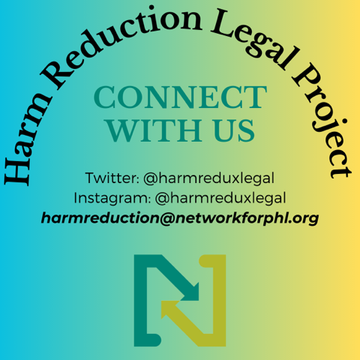
Notes:
DCE doc and naloxone access doc on website!!

