Slide 1
Addressing Legal Obstacles to Hiring Formerly Incarcerated Individuals as Community Health Workers
February 15, 2024

Slide 2




Speakers
Susan Fleurant
James Mackey
Moncies Franco
Shira
Shavit

Slide 3





Agenda
The Issue & The Need
Transitions Clinic Network Model
Legal Barriers to Hiring CHWs with Incarceration Histories
Policy Recommendations
Lived Experience in Minnesota

Slide 4
Transitions Clinic Network Model

Slide 5



TRANSITIONS CLINIC NETWORK
Addressing Legal Obstacles to Hiring Formerly Incarcerated Individuals as Community Health Workers
02/15/24

Slide 6

T
C
N
James Mackey, MSW, DHSc
National Program Manager
Shira Shavit, MD
Executive Director

Slide 7

TRANSITIONS CLINIC NETWORK

Slide 8
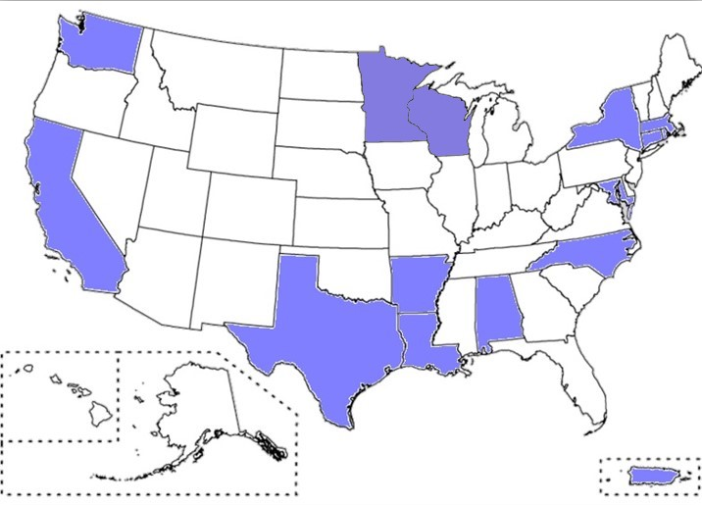
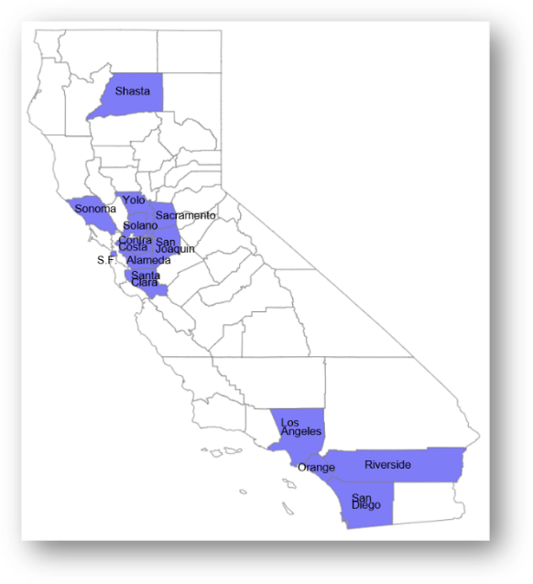
TRANSITIONS CLINIC NETWORK
Supported 48 primary care programs in 14 states and Puerto Rico.
In CA, 20 health systems in 12 counties.

Slide 9
TCN MODEL OF CARE
Criminal Legal System
(prison/jail/court)
Community Supervision (parole/probation)
ENHANCED PRIMARY CARE
Interdisciplinary team with CHWs
Integrated mental health treatment
Primary care-based SUD treatment
Specialized Primary Care, HIV/STI treatment
HCV treatment, Trauma-informed care
System Transformation in collaboration
with community (CAB)
Community Based Organizations
(reentry services)
Community Networks
(faith based, family)
Behavioral Health System
(residential, community mental health)
Housing System
(shelters, supportive housing, halfway house)
Tertiary Care
(ED/hospital)
Public Health
system

Slide 10

TCN CHW Services
Outreach & Engagement:
Parole & Probation
Home & transitional housing
Jail & prison
Emergency Department & Hospital
SUD treatment facilities
Homeless encampments
Health Systems Navigation:
Medication assistance
Health insurance
Specialty appointments
Pharmacy, lab, radiology

Slide 11

TCN CHW Services
Referrals & Advocacy:
Housing, employment, job training, education, food resources and other social services.
Health Education:
Educating patients about their chronic diseases especially new diagnoses.
Chronic Disease Self-Management:
Education about self-reliance and chronic disease management.
Emotional Support & Mentorship

Slide 12


TCN evidence-based Results
TCN program reduces ED visits for patients¹.
TCN program is associated with fewer preventable hospitalizations².
TCN program impacts criminal legal system outcomes².
TCN programs improve health and reentry outcomes for returning community members
1. EE. A. Wang et al BMJ Open 2019, March 13 , 2. EA. Wang, et. al. AJPH 2012 Jul 19

Slide 13


PROGRAMMATIC DATA: PRE-RELEASE ENGAGEMENT
Santa Clara Valley Medical Center TCN program
Referral From jail health staff
Referral from jail + CHW in reach pre-release
Show rate at scheduled primary care appointment
33%
70%
Contact with CHWs with histories of incarceration increases
post-release engagement
Data provided by Dr. Ari Kriegsman, Santa Clara Valley Health & Hospital System 2017

Slide 14

Hiring for health equity
$317 billion in earning potential lost every year by people with a record.
People of color disproportionately impacted by criminal records.
Health systems have excluded people with criminal records from employment.
Hiring people with lived experience builds health equity and improves health and reentry outcomes.
Bucknor et al 2016

Slide 15

Results
TCN CHWs
92% racial and ethnic minorities
63% Black/African American
39% female identified
61% male identified
60% history of serious felony conviction

Slide 16
TCN 360 Health SYSTEM TRANSFORMATION FOR HIRING CHWS with HX INCARCERATION
Employer
Program
CHW
HIRING BEST PRACTICES
HR TRAINING
COMMUNITY PARTNERSHIPS IN HIRING
NAVIGATING BACKGROUND CHECKS
CHW CAREER LADDER
CHW SUPERVISOR TRAINING
BURNOUT PREVENTION STRATEGIES
CHW TRAINING
CHW MENTORSHIP
CHW PROFESSIONAL DEVELOPMENT
PRIMARY CARE TEAMS WITH EMBEDDED CHWS TEAM TRAINING FIDELITY TO TCN MODEL

Slide 17
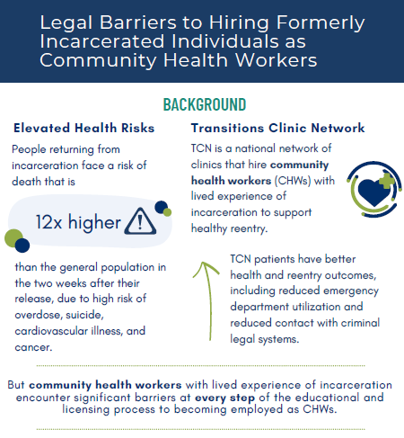

OPPORTUNITY: 1115 WAIVERS INSPIRATION: ISSUE BRIEF

Slide 18
Legal Barriers

Slide 19
Overview
Legal Obstacles
  Role of Federal Law
  State-Level Legal Barriers
Opportunities
Policy Recommendations

Slide 20
This presentation is for informational purposes only. It is not intended as a legal position or advice from the presenters or their employer.
For legal advice, attendees should consult with their own counsel.

Slide 21
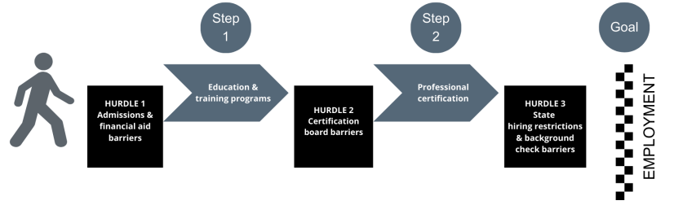
Legal Obstacles

Slide 22

Role of Federal Law
Health care professions are generally regulated at the state level
Federal law influences on CHW employment:
    Fourteenth Amendment’s Due Process Clause
    Title VII of the Civil Rights Act of 1964
    Funding programs

Slide 23
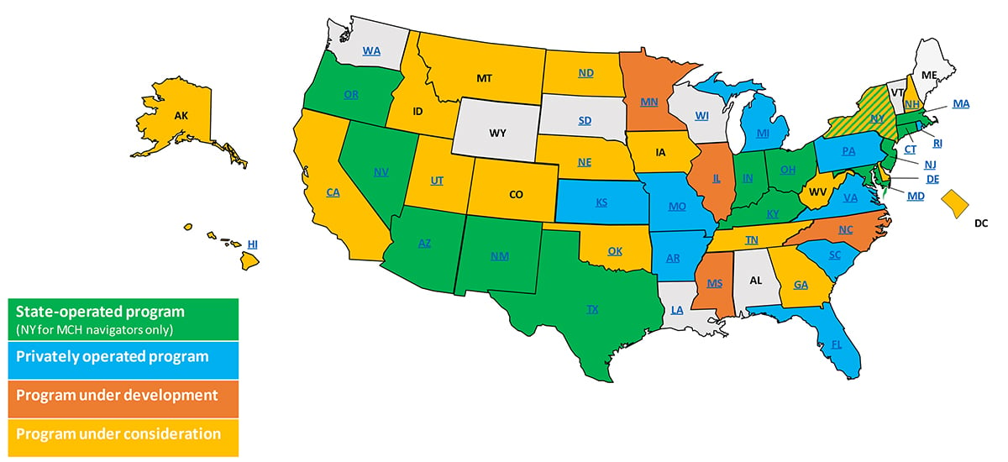

State law – CHW certification
Association of State and Territorial Health Officials. (2022, June 14). State Approaches to Community Health Worker Certification. https://www.astho.org/topic/brief/state-approaches-tocommunity-health-worker-certification/.

Slide 24
State law – health care worker hiring restrictions
Restrictions on hiring people with specified criminal convictions for patient contact positions
Examples – laws restricting hire of:
  Applicants convicted of “serious crimes” unless they have demonstrated proof of rehabilitation
  Applicants convicted of crimes “substantially related to the care of a client”

Slide 25
State Law Example – Minnesota
Human Services Background Study Law
  Certification
    Students must complete an internship at a state-licensed facility
      Law prohibits many facilities from hiring students with certain convictions
  Employment
    Prevents individuals with incarceration histories from working in positions involving direct client contact

Slide 26

Opportunities
Incentivizing employment of people with conviction histories
    Federal Bonding Program
    Tax Breaks
Rehabilitation certificates and waivers
    Application processes may be lengthy and rigorous
    Some people may not be eligible
Ban the Box policies
    May complicate the hiring process for organizations that specifically want to hire individuals with incarceration histories

Slide 27
Policy Recommendations
Prioritize lived experience and expertise when developing CHW certification programs
Increase incentives for employers to hire individuals with incarceration histories
Use Medicaid funds to increase opportunities for individuals who have been incarcerated to work as CHWs

Slide 28

Policy Recommendations cont.
Issue guidance on Ban the Box policies for employers
Eliminate or greatly simplify the process to receive certificates of rehabilitation
Eliminate state restrictions on hiring health care workers with criminal records

Slide 29

Issue Brief Hyperlink
Promoting Health Equity in Communities Affected by Mass Incarceration: Addressing Legal Obstacles to Hiring Formerly Incarcerated Individuals as Community Health Workers

Slide 30
Moncies Franco- Minnesota

Slide 31
Thank you!
Colleen Healy Boufides cboufides@networkforphl.org
Susan Fleurant sfleurant@networkforphl.org
Moncies Franco mfranco@hhrinstitute.org
James Mackey james.mackey@ucsf.edu
Shira Shavit shira.shavit@ucsf.edu

