Slide 1
Advancing Equity for All Racial Groups through the Governmental Use of Racial Equity Tools
August 17, 2023

Slide 2
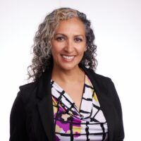
Micro-Toolkit:
Equity Assessment Framework for Public Health Laws and Policies
Dawn Hunter, J.D., MPH
Director
Southeastern Region
Network for Public Health Law
Notes:
Phyllis Jeden is a Senior Attorney with the Network for Public Health Law who just started with the Network in February of this year in the Office of Health Equity. Phyllis has worked as a nonprofit attorney for several years and led the development of the Micro-Toolkit: Equity Assessment Framework for Public Health Laws and Policies that we are launching here today.

Slide 3
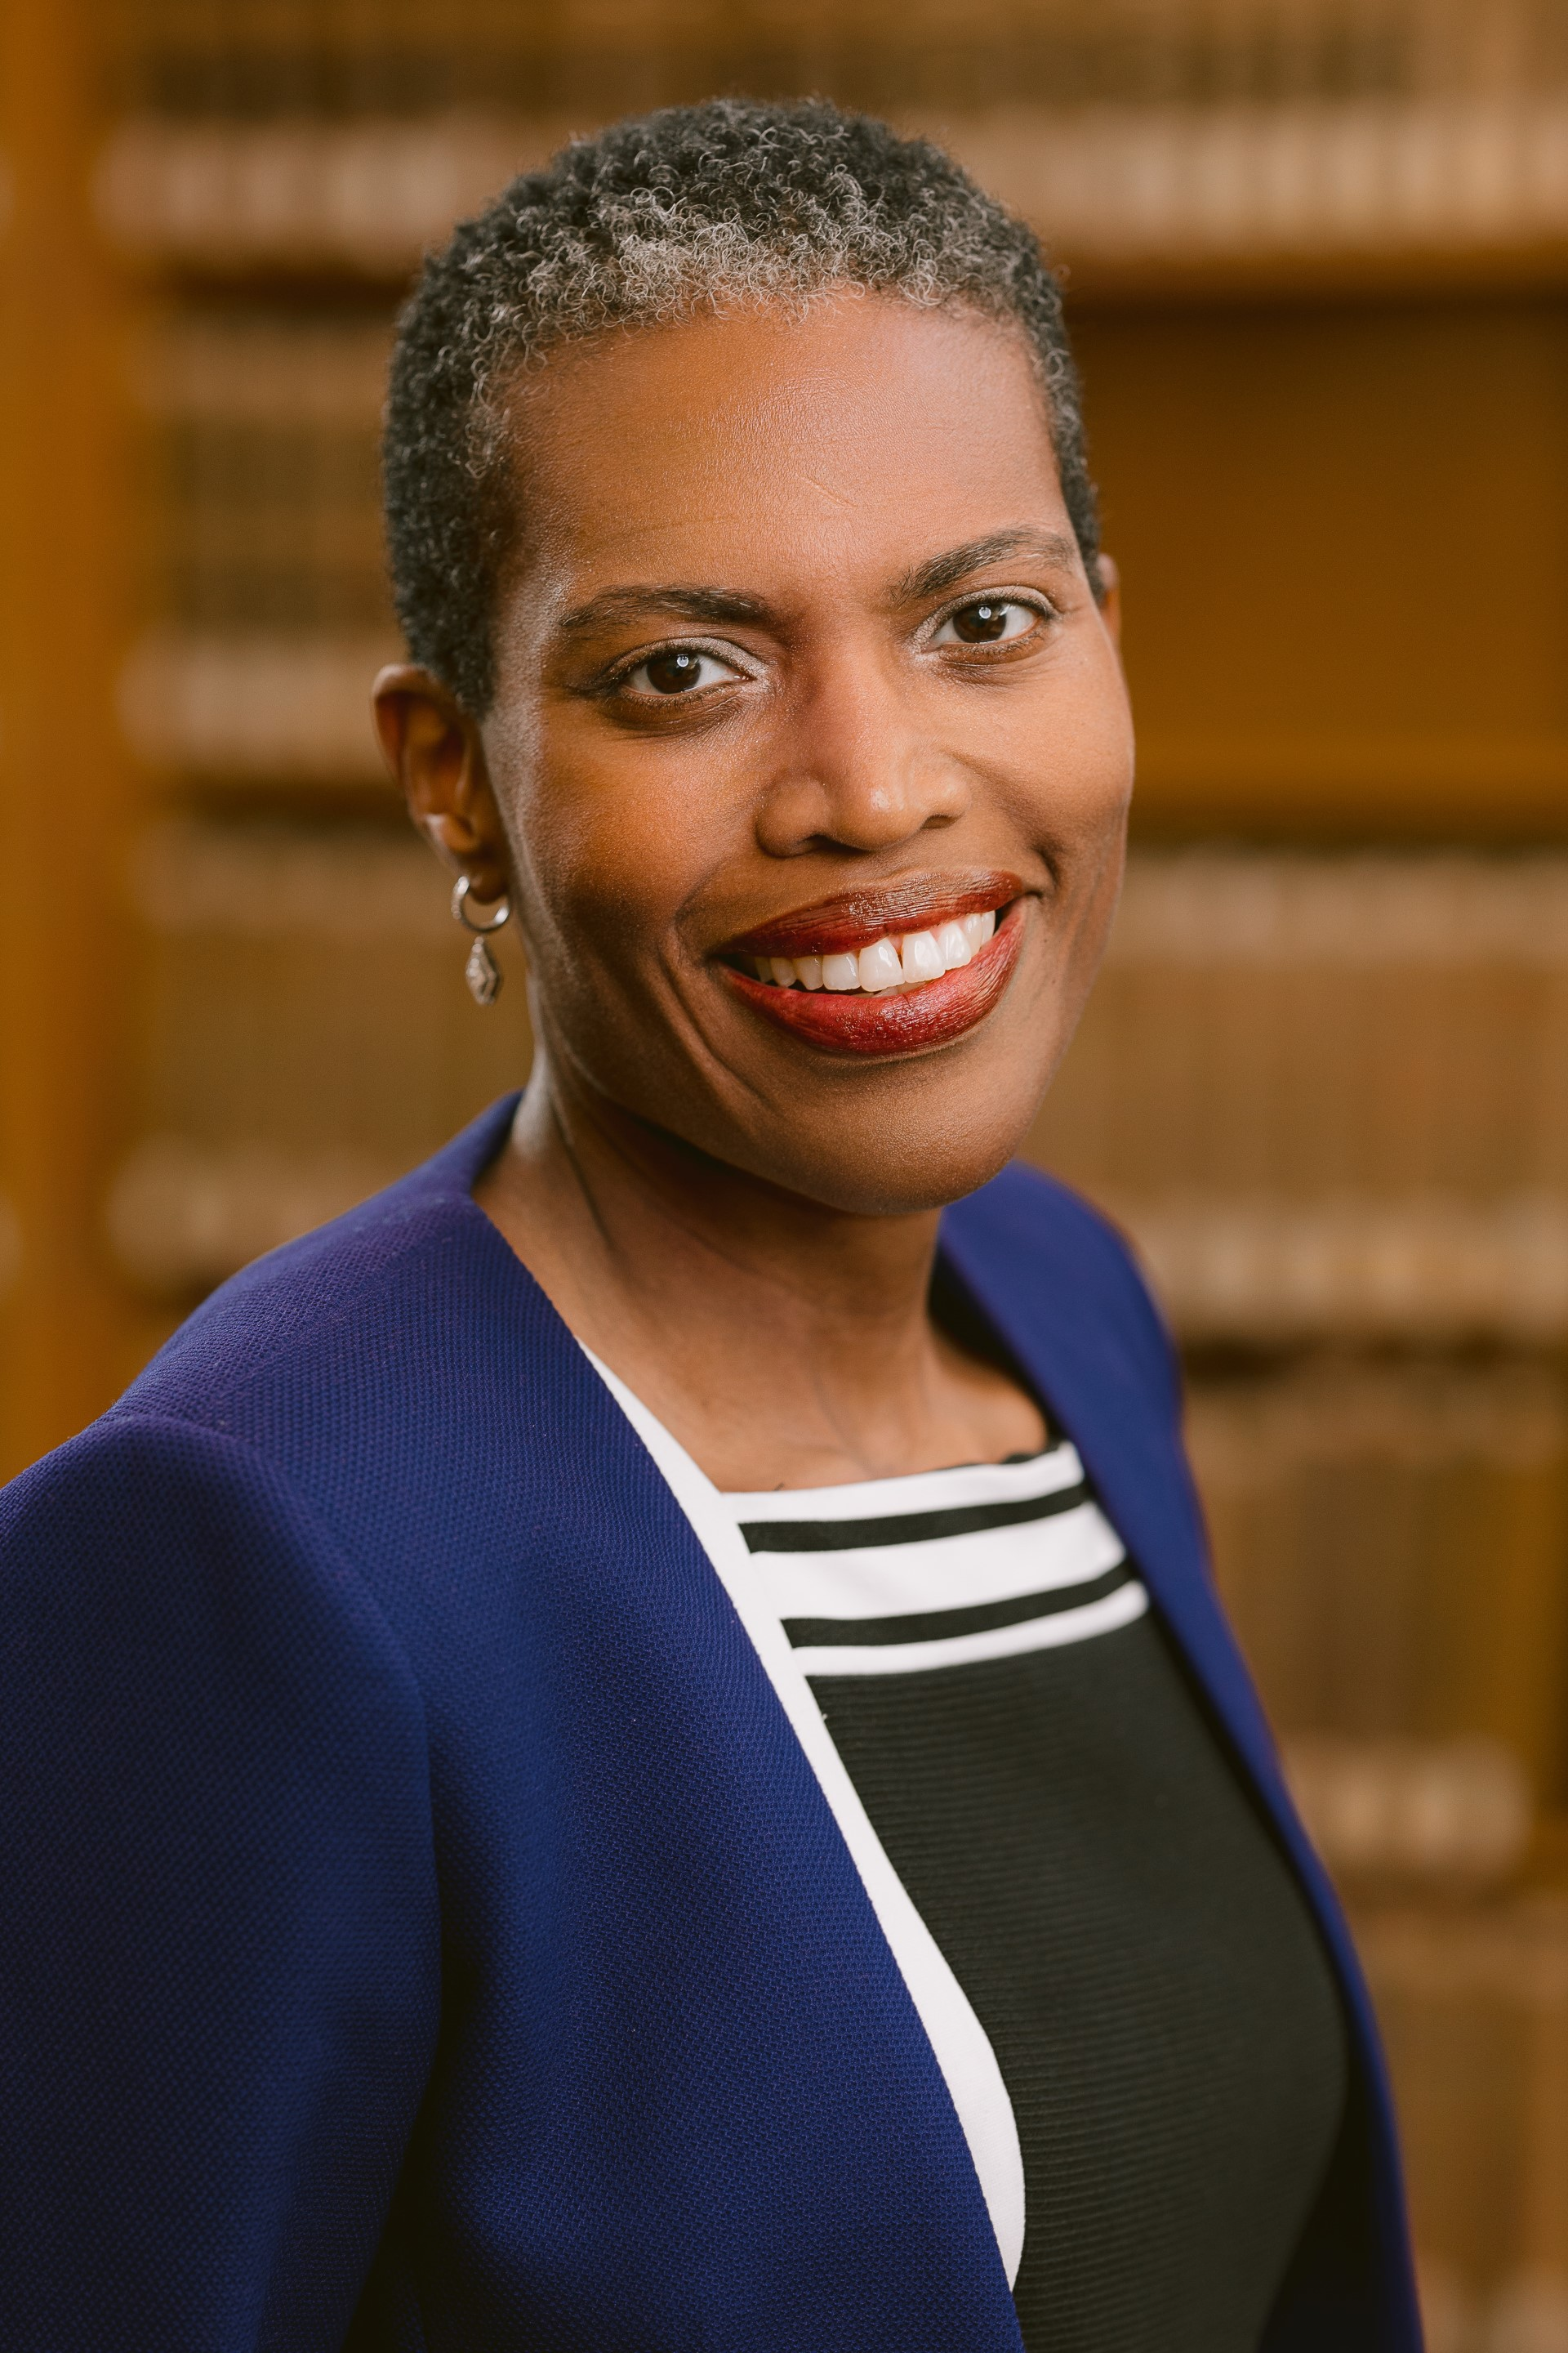
Governmental Use of Racial Equity Tools to Address Systemic Racism
and the Social Determinants of Health
Ruqaiijah Yearby, J.D., M.P.H., Kara J. Trott Professor in Health Law, Moritz College of Law, The Ohio State University
Notes:
Ruqaiijah Yearby is the inaugural Kara J. Trott Professor in Law at the Moritz College of Law and a faculty affiliate of the Kirwan Institute at The Ohio State University. She is also Co-founder and a faculty affiliate of St. Louis University's Institute for Healing Justice & Equity and one of the Co-Founders of the Collaborative for Anti-Racism & Equity.
Crystal Lewis has several years of social justice and legal research experience; specifically legal epidemiology, policy surveillance, and transdisciplinary collaboration and is currently co- teaching at the Moritz School of Law with Professor Ruqaiijah Yearby on Health Equity, Policy, and Advocacy.
Report and fact sheet here: https://ihje.org/our-work/reports/governmental-use-of-racial-equity-tools/

Slide 4

Published November 2021;
Robert Wood Johnson Foundation Grant (2018-2020)
Racial equity tools: training materials, toolkits, data indicators, and frameworks to guide leaders, employees, and community members in working towards racial equity
Focus: the use of racial equity tools to address systemic racism and the social determinants of health
Data analysis:
  Quantitative data from policy surveillance and surveys and
  Qualitative data from interviews
https://ihje.org/our-work/reports/governmental-use-of-racial-equity-tools/
Copyright © 2023 by Ruqaiijah Yearby and Crystal Lewis. All rights reserved.
Notes:
CNL

Slide 5
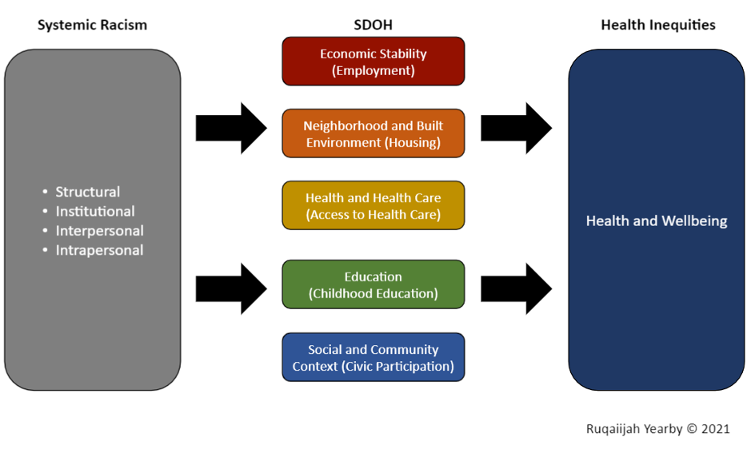
Systemic racism is a complex array of social structures, government policies, institutional practices, and interpersonal interactions used to create a hierarchy that categorizes people into “superior” and “inferior” racial and ethnic groups.
Systemic racism not only results in poor health outcomes for all racial groups, but it also “saps the strength of the whole society through the waste of human resources” (Jones, 2018). This harm is a public health crisis, which must be addressed.
Figure 1. System of Racial Inequity Model, 2021
Note. This model was produced by Ruqaiijah Yearby in 2021, summarizing the connection between systemic racism and the social determinants of health. Copyright 2021 by Ruqaiijah Yearby.
Copyright © 2023 by Ruqaiijah Yearby and Crystal Lewis. All rights reserved.
Notes:
RY

Slide 6
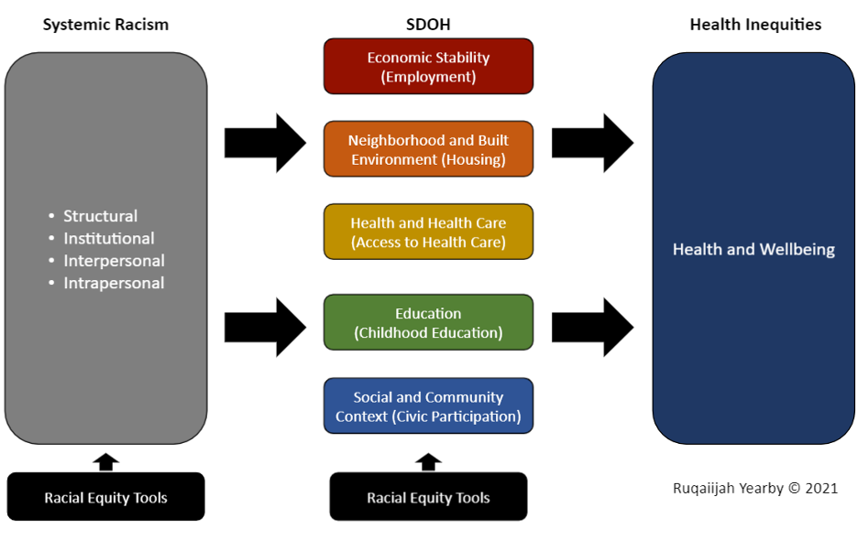
Examples from King County, WA
The County used racial equity tools to develop a shared vision of the “unhealthy stream” that creates inequities and the “healthy stream” that creates equity to guide their work
Also, “when setting up the FY21-2022 County budget [consideration was given to] investing away from systems that cause harm and investing in [the] community [instead]; a divest-and-invest strategy. “Some departments [also] do an equity review of their entire budget.”
Figure 2. Addressing Racial Equity Model, 2021
Note. This model was produced by Ruqaiijah Yearby in 2021, summarizing the use of racial equity tools to address systemic racism and the social determinants of health. Copyright 2021 by Ruqaiijah Yearby.
Copyright © 2023 by Ruqaiijah Yearby and Crystal Lewis. All rights reserved.
Notes:
RY

Slide 7
The first step in achieving Racial Equity
Internal Systems Change
An organization cannot successfully work on external racial equity policies and practices until it looks at and changes its own internal policies and practices in a way that reflects equity.
“Training alone is not enough to address systemic racism, because racism is embedded in … actions, processes, and policies.”
Copyright © 2023 by Ruqaiijah Yearby and Crystal Lewis. All rights reserved.
Notes:
CNL

Slide 8
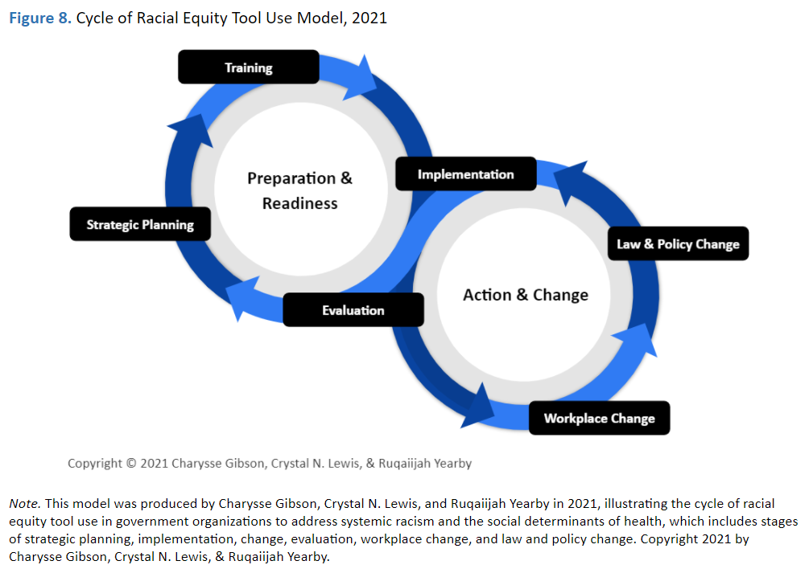
Notes:
CNL
Each organization that we interviewed and studied went through a cycle of racial equity tool use, including strategic planning, training, implementation, workplace change, law and policy change, and evaluation.

Slide 9
Examples of Successful Racial Equity Strategies:
Creating conditions under which employees can succeed in their work and lives
  Providing professional development as well as showing appreciation for employees
Transforming the hiring process
  Removing barriers that prevent a diverse pool of applicants and hires, such as prohibiting the use of referrals and replacing written assessments with oral assessments
Changing budgeting allocation processes
Developing positions, departments, and offices specific to the implementation of racial equity tools and strategies
Evaluating the impact of the changes is integral to the overall process, not an afterthought
Copyright © 2023 by Ruqaiijah Yearby and Crystal Lewis. All rights reserved.
Notes:
RY

Slide 10
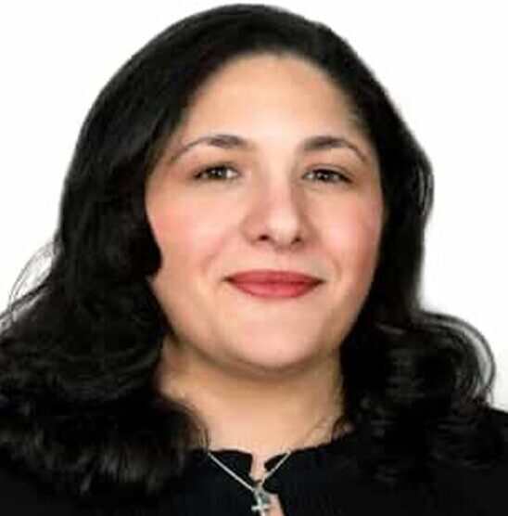
Micro-Toolkit:
Equity Assessment Framework for Public Health Laws and Policies
Phyllis Jeden, J.D.
Senior Attorney
Southeastern Region
Network for Public Health Law
Notes:
Phyllis Jeden is a Senior Attorney with the Network for Public Health Law who just started with the Network in February of this year in the Office of Health Equity. Phyllis has worked as a nonprofit attorney for several years and led the development of the Micro-Toolkit: Equity Assessment Framework for Public Health Laws and Policies that we are launching here today.

Slide 11

Notes:
- Thank you; Welcome; SE Region/Health Equity; excited to launch micro toolkit
-The Micro – Toolkit came out of an equity assessment framework
-developed by the NPHL’s HEWG, partnership with staff across Network regions
-two pages and gives a succinct and easy to follow framework for an equity assessment.
-to make more visually appealing
Interested in getting equity’s foot in the door
This is a great start to an assessment
Several staff members contributed to the creation of the micro-toolkit
Essentially a set of worksheets
Step by step, fill in the blanks process
both local governments and community-based orgs can use to assess equity and discover opportunities to improve policy.
Six clear steps with instructions to guide you and your team through an equity assessment.

Slide 12

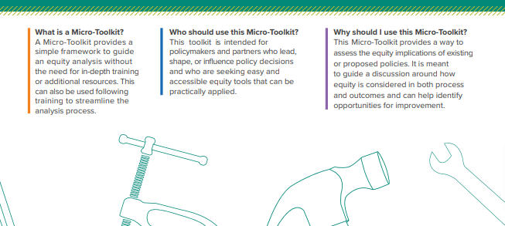
An accessible equity tool to be practically applied
For policymakers and partners
A simple framework to guide an equity analysis
WHAT?
WHO?
WHY?
Notes:
-Toolkits can often be lengthy and make entities weary of the time and resources
Make no mistake, there is no shortcut to equity, it is difficult work that requires resource allocation
However, the micro toolkit is an out-of-the-box tool that can be used w/out in-depth training and with limited use of limited resources
The micro toolkit is for policymakers and partners who lead, shape, or influence policy and guide discussion around how equity is considered
Easy and accessible equity tool that can be practically applied
I will spend a few minutes providing an overview of this tool
As we review the tool, keep in mind that this is a living document that we intend to update with feedback from teams who use the micro toolkit

Slide 13
Step One
Establish why the policy is being reviewed or proposed
Determine the Impact of the Policy on Internal and External Partners
Step Three
Step Two
Explain the Context of the Policy
Notes:
-six steps overview
-Filled in by hand or fillable pdf
- For purposes of the micro-toolkit, policy can mean a statute, regulation, ordinance, exec order, org policy, formal guidance, or other

Slide 14
Step Four
Identify Potential Outcomes
Make It Sustainable
Step Six
Step Five
Consider Other Policy Pathways
Notes:
-We can take a peek at the toolkit itself with an example

Slide 15
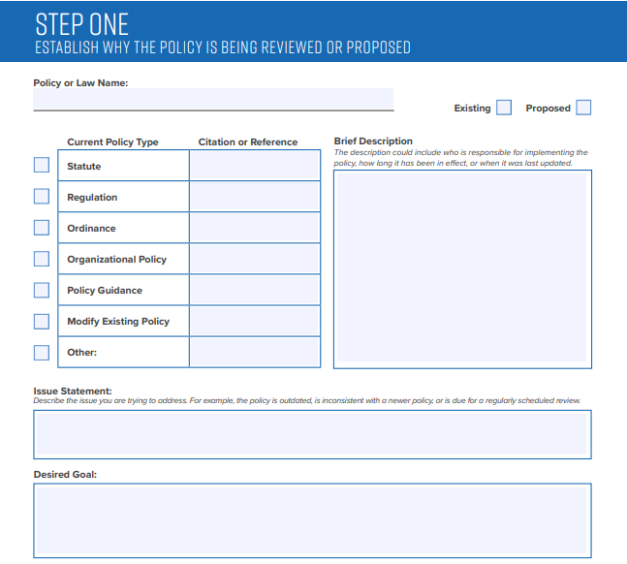
Bill seeking SPA for Medicaid covered doula services
High maternal mortality rate
Notes:
Brief review of toolkit with a high-level, generalized example
WHY THE POLICY IS BEING CONSIDERED
State seeking state plan amendment (SPA) for Doula Medicaid coverage
Description: bill seeking SPA for pregnant beneficiaries to receive doula service under state Medicaid plan
Issue: US has high maternal mortality rate, lower income higher risk, Black Americans at the highest risk, Doulas improve health outcomes
(can’t see this part of Step 1 here) perspectives to be engaged
for our example could include organizations that serve pregnant and birthing people in communities of color

Slide 16
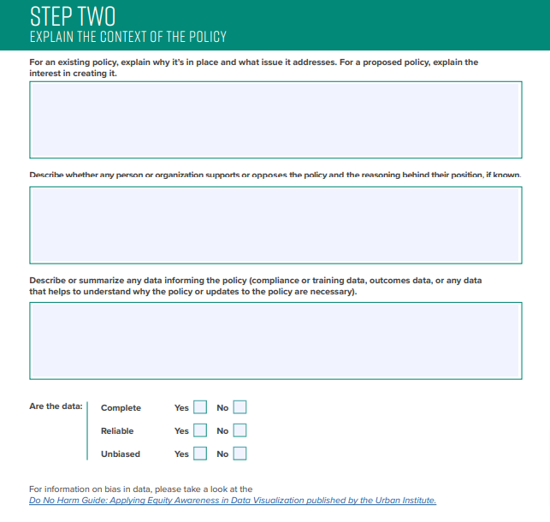
What does the policy address?
Does the policy have existing support or opposition?
Describe or summarize the data
Reach out to the Network for Public Health Law’s data experts to help .
Notes:
Step two
Opportunity to provide more context and information on data
For our SPA for Doulas example, the interest in creating it would be to address the high rate of maternal mortality among low-income persons and especially communities of color in the state
Support
For this example under data we have a lot of data on the high rate of maternal mortality as well as the positive impact of doulas for outcomes
Note the checklist for complete, reliable and unbiased data and the link to the handy guide on bias in data by the Urban Institute

Slide 17
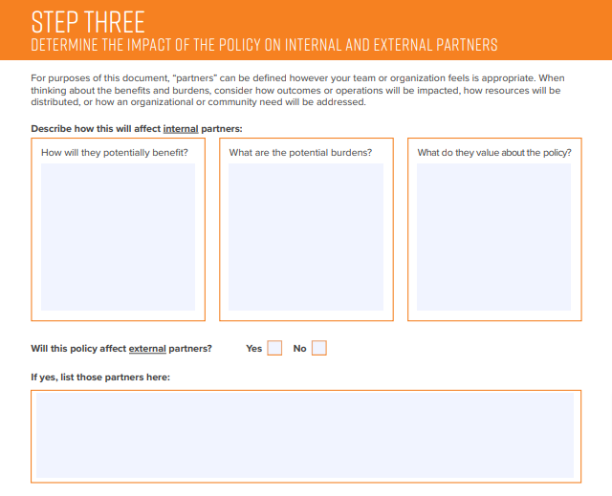
Decrease in maternal mortality rates
Costs of implementing the policy
Notes:
Step 3
Focuses on policy impact and whether the policy will affect internal partners, external or both
For our example, a state health dept. may consider the impacts of cost of improved health and the burden of implementing the policy
And you will consider external partners, for example, organizations that serve Black expectant mothers in the state, will be impacted by this policy
For external partners you will also consider ways to engage them (not shown here)
(also not shown here) final decisions should be communicated clearly to all partners and it should be clear whether feedback impacted that final decision

Slide 18
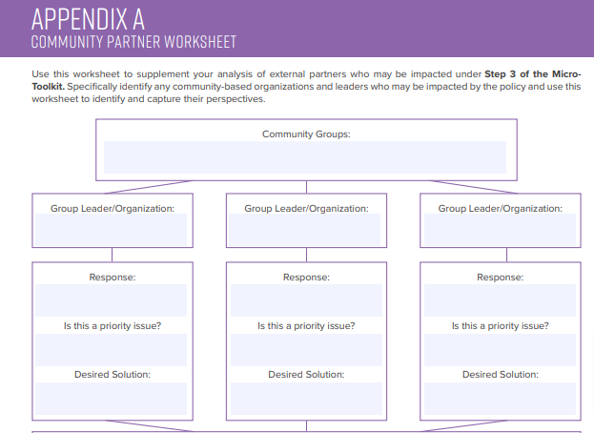
Appendix A will help guide policy discussions with community partners
Input from several community groups should be collected
Engage in meaningful communication
Notes:
Appendix A is a supplement to Step 3
For external partners who may be impacted
Space provided to identify groups, note input, and other considerations including who in the organization is responsible for reaching out to the partners.
For our example, we identified organizations serving Black expectant mothers as a possible external partner but input from several community groups should be collected
Appendix A guides that discussion in a meaningful way.
In fact, in the Network’s Southeastern Region Office we focus a lot on declarations of RPHC
One theme among these declarations is encouraging meaningful communication with communities of color

Slide 19
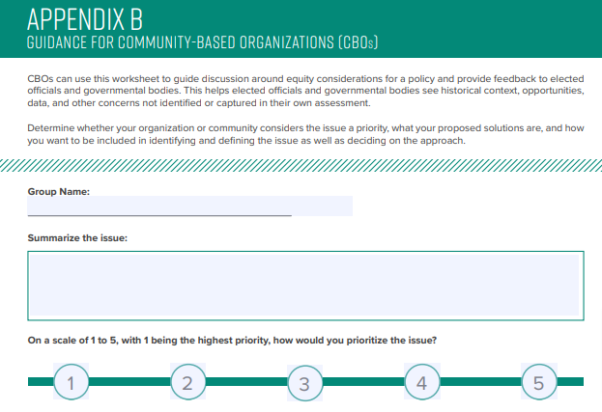
Community-Based Organizations need tools to engage in policy discussions
Capture in-depth and focused input
Notes:
Appendix B, also referenced under Step 3
Specifically for Community Based Organization use for additional input even though these partners can also use the Micro-Toolkit themselves.
With stretched time and resources, it is helpful to have the separate worksheet for more in-depth and focused input from CBOs
Through the Southeastern Region’s work we have found that CBOs are in need of tools to help facilitate participation in policy discussions

Slide 20
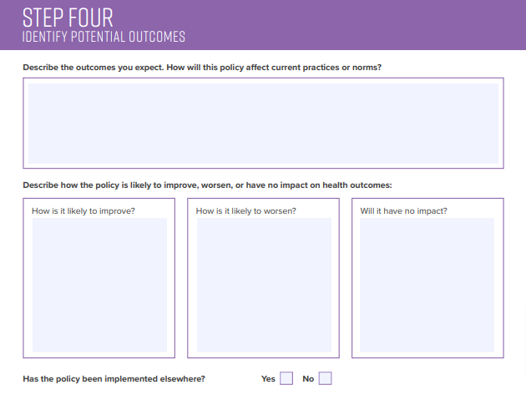
Improve maternal health outcomes for those with less resources
Consider lessons learned by others who have already implemented the policy
Notes:
Step Four focuses on potential outcomes from the policy being considered and how it will impact the status quo.
There may be an obvious desired affect for a policy to improve health outcomes, but this space allows for an opportunity to consider how the policy can worsen or have no impact.
For our Doula SPA example, the desired outcome is obvious, to improve maternal health outcomes for those with less resources
Though the analysis on impact is small and a true and thorough analysis would take much more time and energy, it is for that reason the Micro-Toolkit asks that your team at least start with obvious outcomes that we hope will lead to further discussion
In our example, the policy has been implemented elsewhere and what is not shown is a space to consider lessons learned by other states who already implemented this policy

Slide 21
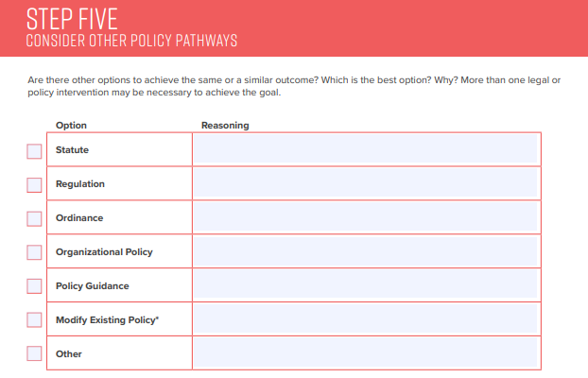
More than one policy intervention may be necessary to achieve the goal
Consider the differences in policy types
Notes:
-Step five asks you to consider if there are better options to achieve the desired outcome
You may even find in your assessment that more than one policy intervention is necessary to achieve the goal.
For our example, the state may consider approving additional doula training programs to aid the success of implementation of the SPA doula policy
Another example may be a change in hospital policy that allows birth parents to choose their care team

Slide 22
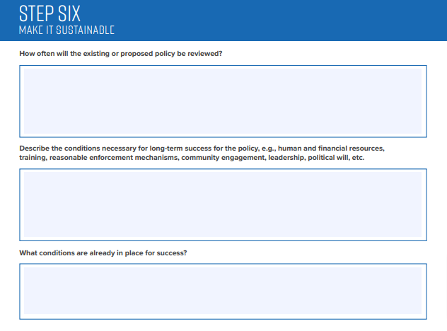
Program reviewed on an annual basis
The doula policy has bipartisan support
Notes:
Finally, Step Six focuses on the sustainability of the policy.
For our example, the program may need to be reviewed on an annual basis to ensure that the state has enough trained doulas to meet the need among other issues for review.
Step 6 also asks that you consider the conditions necessary for success and those already in place. For example, the doula SPA may have bipartisan support

Slide 23
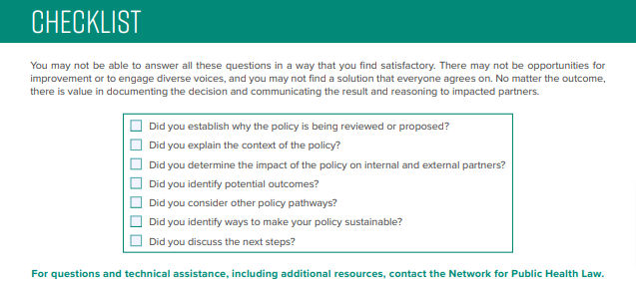
Notes:
-Last, a checklist is provided in the Micro Toolkit to make certain all steps were considered carefully
- Should your team complete the micro toolkit and wish to delve further into an equity assessment of the policy, you can contact the Network for Public Health Law and we are happy to help you walk those next steps.
- As your team uses the Micro-Toolkit, we invite your feedback to make the tool better by pointing out items we may not have considered or steps that you found helpful to aid in your assessment.

Slide 24
Reach out to the Network for Public Health Law’s Southeastern Region Office for assistance. pjeden@networkforphl.org
Thank you!
Notes:
Our office focuses on heatlh equity and how to operationalize equity
We look forward to answering your questions during our Q and A later.

Slide 25
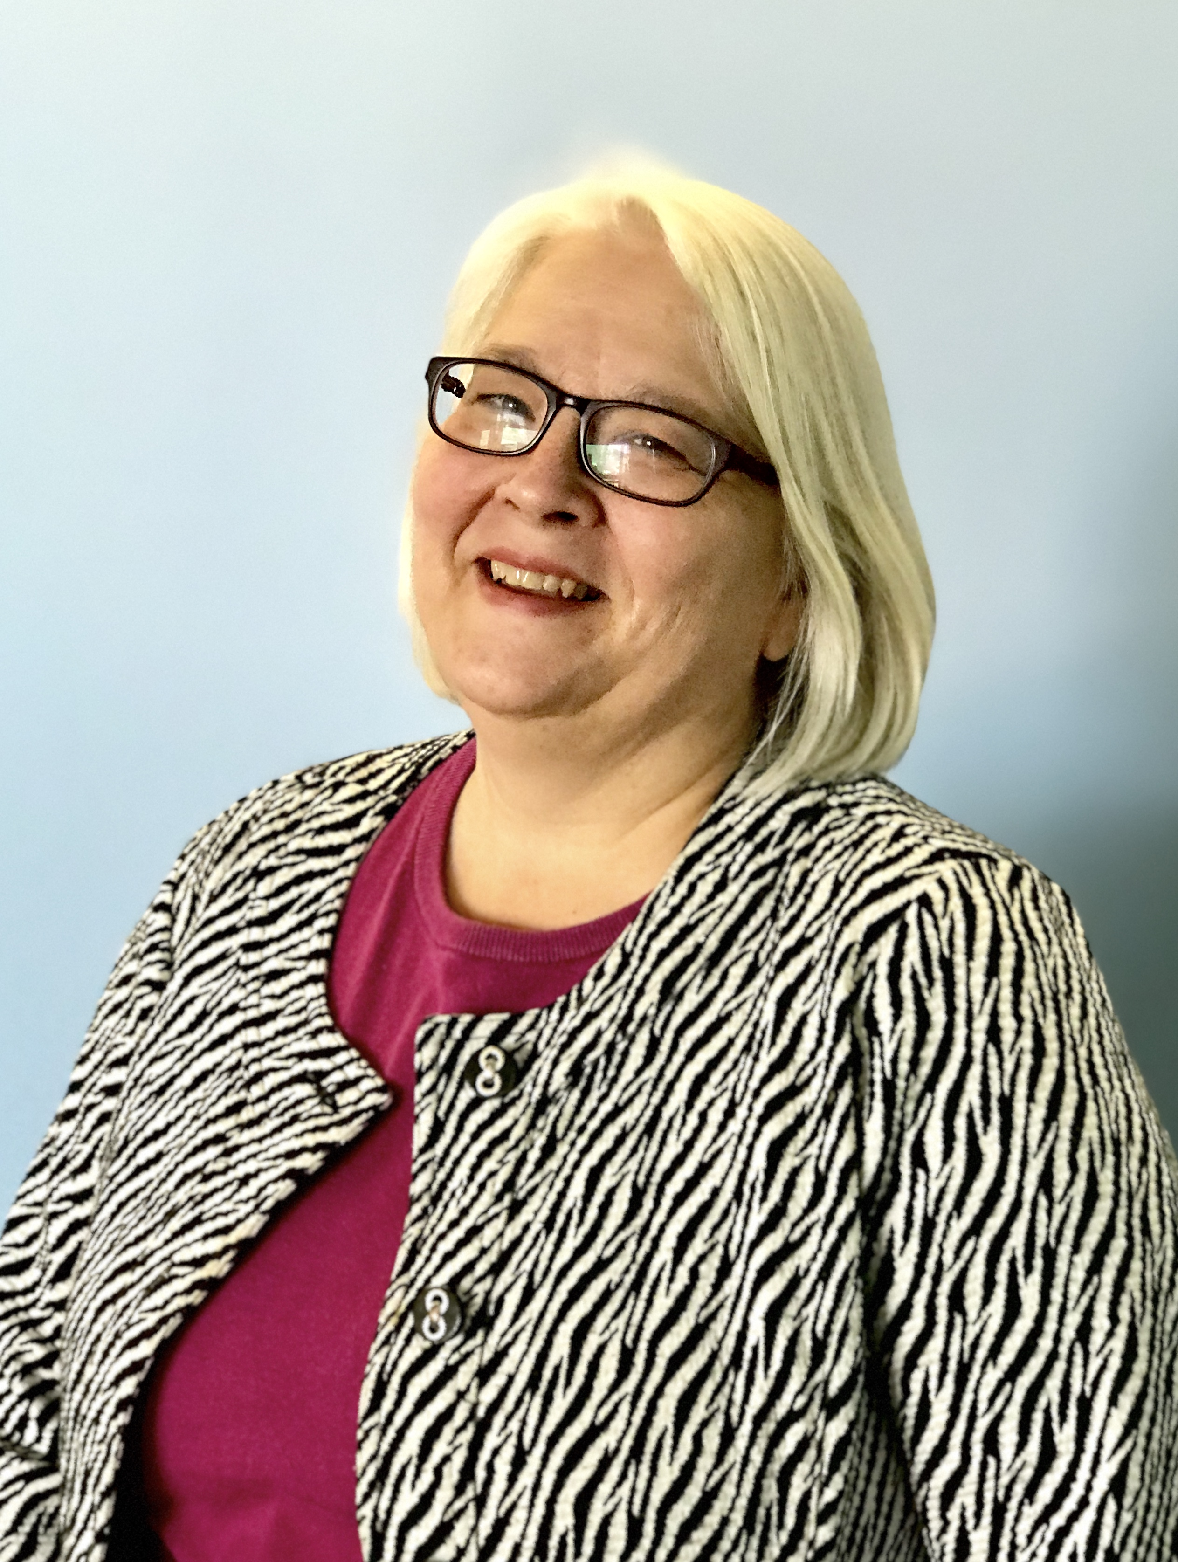
HEDA:
Conducting a Health Equity Data Analysis
Jeannette Raymond,
Assistant Director,
Center for Public Health Practice,
Minnesota Department of Health
Notes:
Jeannette Raymond has over 25 years of experience advancing health equity and authentic community engagement through public health practice and is currently the Assistant Director for the Center for Public Health Practice in the Minnesota Department of Health. Her experience includes advancing the Health Equity Data Analysis (HEDA) process which supported local public health departments to conduct qualitative research and share the results with their communities.
Link to Document: https://www.health.state.mn.us/data/mchs/genstats/heda/hedaguide.pdf

Slide 26

Conducting Health Equity Data Analyses at the Local Level
Jeannette Raymond
Public Health Practice, Minnesota Department of Health
8/17/2023

Slide 27
HEDA Background
2013: Center for Health Equity at the Minnesota Department of Health Established
2014: Minnesota Department of Health released the “Advancing Health Equity in Minnesota: Report to the Legislature.”
2015: MDH released the “Conducting a Health Equity Data Analysis: A guide for local health departments in Minnesota.”
2016-2018: Piloted the HEDA framework with local public health agencies through the Statewide Health Improvement Partnership.

Slide 28
Grounding from the Advancing Health Equity in Minnesota: Report to the Legislature
One of the first government reports to name structural racism as a root cause of health inequities.
Recommendation 6.2 “Assure that health equity and the analysis of structural inequalities, including structural racism, become integral aspects of all MDH divisions and programs.”

Slide 29
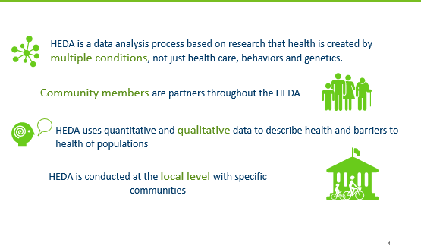
HEDA changes how one approaches data analysis

Slide 30
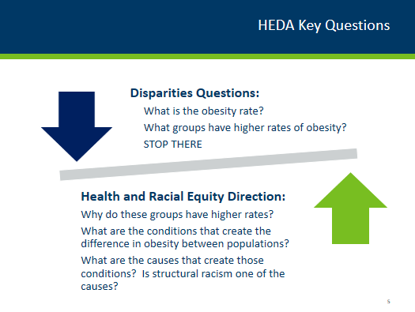

Slide 31
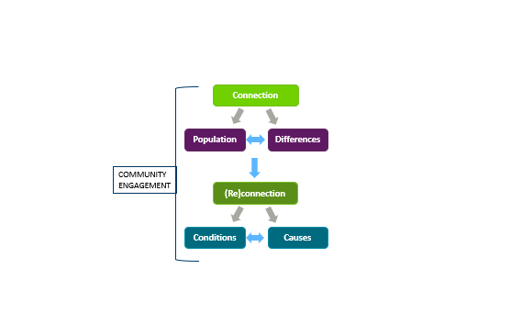
HEDA Steps

Slide 32
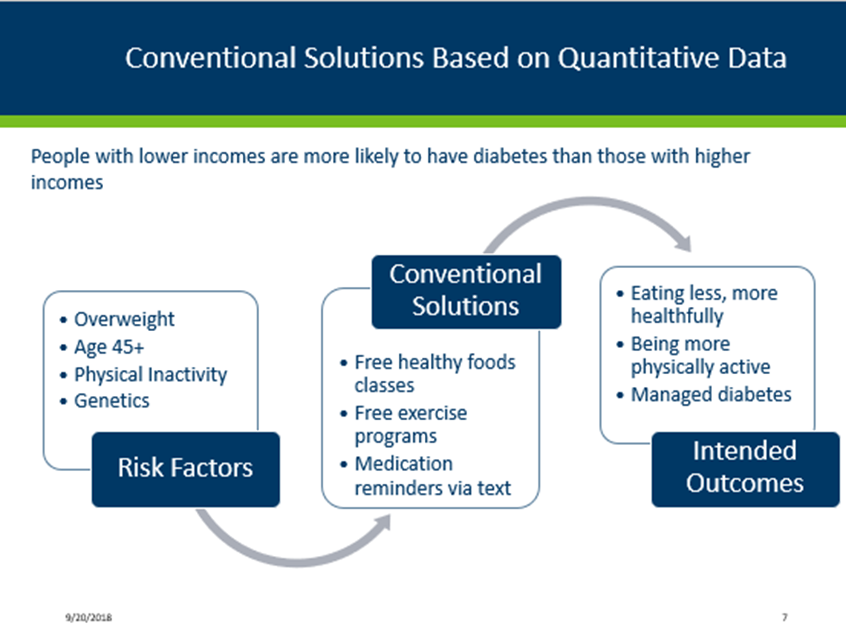

Slide 33
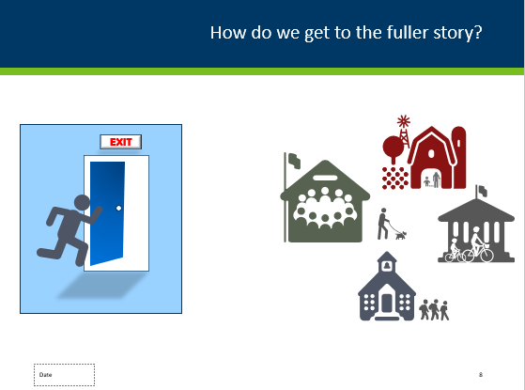

Slide 34
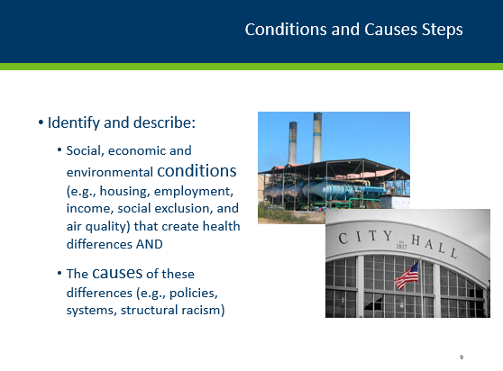

Slide 35
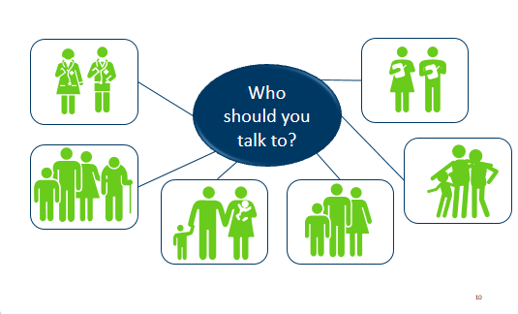
Qualitative Data Collection: Who

Slide 36
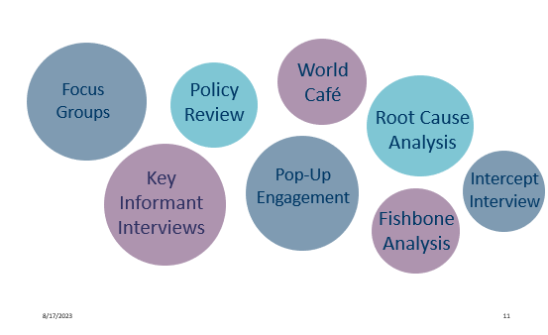
Qualitative Data Consideration: Methods

Slide 37
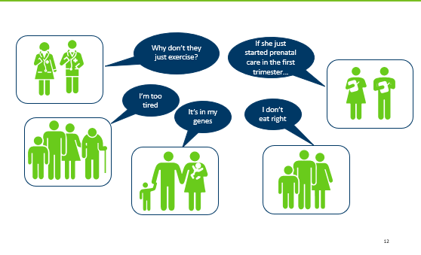
The Challenge of the Predominant Health Narrative

Slide 39
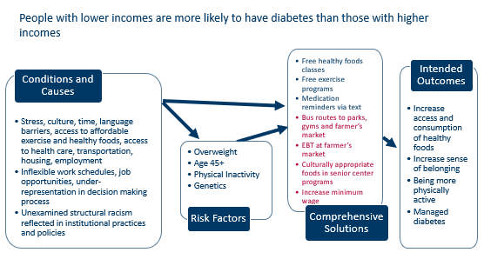
Expanded Solutions based on Expanded Data

Slide 40
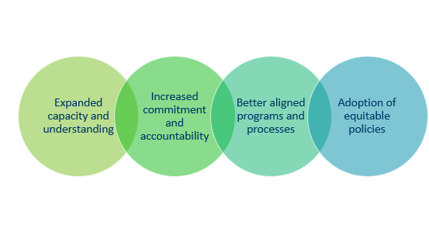
Shared Benefits of HEDA for the Community and Local Public Health

Slide 41
“The [HEDA] has changed the way I think about how our agency interacts with our community. It has made me think extensively about how we obtain information from people in our community.”
MN LPH HEDA Participant

Slide 42
Other thoughts about Health Equity Tools
  Requiring v.s. opt in
  Evolving understanding and revisions
  Power of the predominant narrative and status quo

Slide 43
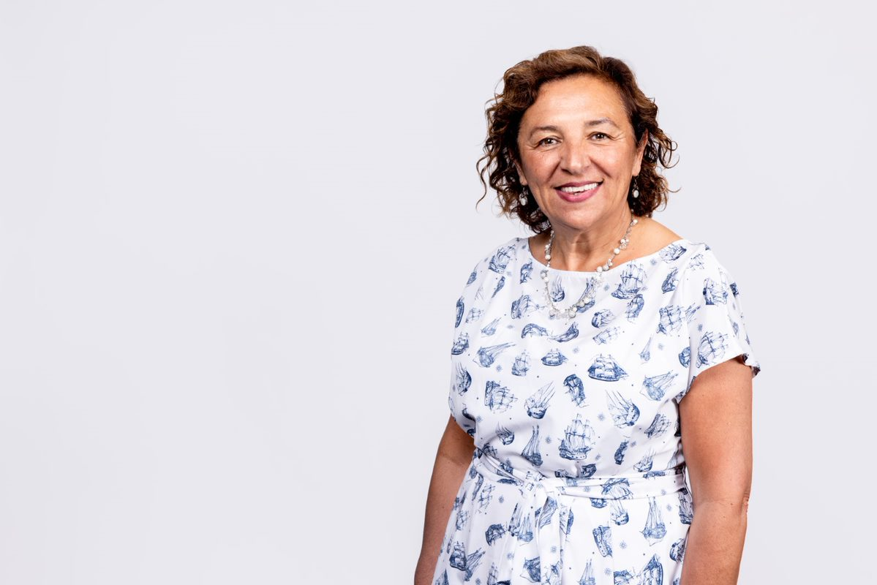
Equity in Budgeting Playbook
Bookda Gheisar,
Master’s degree in Social Work and Social Policy
Senior Director
Port of Seattle Office of Equity, Diversity & Inclusion
Notes:
Bookda Geisar is the Senior Director of the Office of Equity, Diversity, and Inclusion where she provides leadership and strategic direction for the Port’s Equity, Diversity, and Inclusion efforts, both internal and external.

Slide 44


2024 Equity in Budgeting Playbook
Office of Equity, Diversity, and Inclusion

Slide 45


A Progressive Force
Created over 100 years ago to control and develop Seattle’s waterfront
Special purpose municipal government elected by locals
Ports enjoy state statutory powers to raise taxes, develop, operate and maintain public facilities
75+ Port districts statewide

Slide 46


About the Port
Voters of Pierce County
Voters of King County
Port of Seattle Commission
Port of Tacoma Commission
Port of Seattle Executive Director
NW Seaport Alliance CEO
SEA Airport
Cruise
Marinas
Commercial Fishing
Environmental Programs
Real Estate
Maritime Cargo
Notes:
SLIDE 5
Special purpose government
Operates assets of statewide significance that support all of Washington’s most critical industries
Funded in large part through user fees, leases, and business revenue
Also a small tax levy, about $72 a year for the median priced home.
Five years ago we joined forces with the Port of Tacoma to form the Northwest Seaport Alliance.
Cooperating with Tacoma versus competing with Tacoma saved local jobs and made our gateway the 4th largest in North America for international shipping.

Slide 47
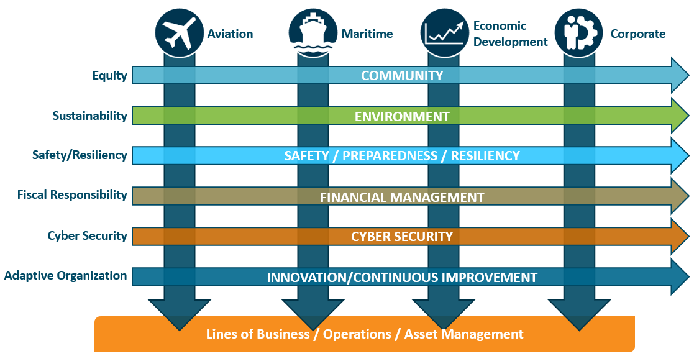
The Port’s Vision for Equity
Our vision is to develop a Port that mirrors — throughout its breadth of operations and services and within its leadership structure — the diversity of our community, instills principles of equity in its culture, and ensures a fair and intentional distribution of opportunities with the goal of expanding economic development and quality of life for all.
Notes:
OEDI is an organizationally cross-cutting office, building capacity to address institutional racism and other forms of oppression within the Port and to transform policies, practices, and processes.
Our goal is to foster transformational and lasting change to the culture of the Port. Those directly and deeply impacted by systemic and institutional discrimination will find opportunities for economic gain, leadership development, and participation in how the Port operates and impacts communities.

Slide 48
OEDI 2022 Strategic Plan
Strategy 1: Transform the Port by infusing racial equity principles and practices into all aspects of organizational structure, programs, policies, and processes.
Strategy 2: Provide equitable and tangible benefits to impacted communities of color and immigrant and refugee communities.
Strategy 3: Build OEDI’s capacity and expertise to lead equity change work internally and to be a resource for and thought partner with external peer agencies.
Notes:
Over the period of several months, Bookda Gheisar met with 600+ staff, leadership, Commissioners, and community partners to receive input about the Port’s EDI efforts. That feedback led to the creation of this strategic plan.
These three strategies guide the plan.
The first refers to the tactic and activities that we’re doing internally. These are our efforts to create a culture of belonging and inclusion and center racial equity in our day-to-day work.
The second strategy is external, focusing on how we are in relationship with communities, especially Port-impacted communities of color and immigrant & refugee communities.
The third strategy is about uplifting the first two. This focuses on building out the OEDI and the CA goal of becoming a model of EDI locally and nationationally.

Slide 49
Overview of Budgeting with Equity
Our budget is both a fiscal and moral document. It reflects our priorities and values – both to the communities we serve and to ourselves.
2024 will be year 3 of our effort towards budgeting with equity.
The Port of Seattle’s Equity in Budgeting Playbook (EBP) is designed to integrate explicit considerations of racial equity into decisions, including policies, practices, programs, and ultimately, Departmental budgets. Using this tool helps our departments develop strategies and actions that reduce inequities, with a particular focus on racial inequities, and improve success for everyone.
This year, there are specific and additional instructions at both the Division-level and Department-level.
The 2024 EBP includes instructions on a new way of tracking how we budget for equity, also known as equity spending.

Slide 50
An Updated Approach – Division Level
A broken record and breaking new ground:
This is a journey we are on together
  Learning as we go: prior responses are guiding current actions
  Moving past the normalize phase
Show me the money: quantitative data
  Equity spending matrix
Every Division will assess their department’s budget for items that qualify as equity spending according to the following instructions. This new process is known as the Equitable Spending and Accountability Project (ESAP).

Slide 51
Equity Policy Directive - Guidance
The Executive Director, or a delegate, shall:
  Develop a definition for “equity-related resources.” The proposed definition shall be reviewed by Commissioner Mohamed, Commissioner Cho, and the Equity and Workforce Development Committee.
  Calculate and summarize all such equity-related resources in the 2019-2022 Port budgets. These resources shall be calculated as a percent of the total operating budget.
  Propose a structure for communicating and executing a pilot for “equity-related resources” in the 2024 budget to Commissioner Mohamed, Commissioner Cho, and the Equity and Workforce Development Committee before the adoption of the 2024 budget. The results of this pilot shall be considered for further action.

Slide 52
At the Division Level
All divisions will present their equity spending budget during their budget presentations.
Step 1
For a budget item to qualify as equity spending, it must meet at least one of the three elements. Please measure budget items against these definitions, and if a budget item meets at least one of these elements, then proceed to Step 2.
A budget item is classified as equity spending if it:
Invests directly in structurally excluded communities, either through grants, contracts, programs, sponsorships, or dedicated facilities.
Invests in businesses and individuals outside of the Port to help us realize our internal and external equity priorities.
Invests in Port employees whose essential work functions were designed to primarily focus on advancing equity work.

Slide 53
At the Division-Level (continued)
Step 2
If the budget item meets one of the above three definitions, then please sort the item into the most applicable category below. If the item could fit into multiple categories, please either select the category that it was assigned in a previous year or consult with OEDI. Please record the corresponding category in Adaptative Insights. (Full definitions of these categories are included in the 2024 Equity in Budgeting Playbook).
Advancing Diversity
Supplier Diversity
Removing Systemic Barriers
Engagement
Community Investments
Environmental Justice

Slide 54
Why ESAP?
COMMITMENT TO EQUITY
Applying an equity framework to our budgeting allows us to target our strategies and invest where the needs are greatest, in employees and in community partnerships.
ACCOUNTABILITY
Our budget is both a fiscal and moral document. It reflects our priorities and values – both to the communities we serve and our internal community. The budget is critical to how we operationalize our values.
INNOVATION
Applying an equity frame to our budgeting allows for innovation and adaptability. This allows us to be responsive as we become a pro-equity and anti-racist organization.
TRANSPARENCY
Our leaderships commits to showing how we are progressing and changing as an organization as we work to prioritize equity. This means that we are upfront about both our success and our struggles.

Slide 55
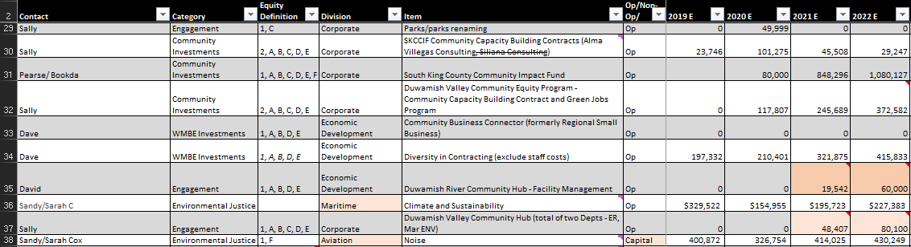
Methodology for Initial Analysis
Established a baseline using the past 4 years of spending
Used direct, clear definition of equity to analyze spending; only included spending that is easily accessible to ensure repeatability
Spending include staff costs only for FTEs whose primary functions are equity-focused
Engaged all Divisions in this analysis

Slide 56
Equity Spending Summary
(Focusing on Operating Expenses w/o WMBE)
Note: The increase of % of Tax Levy Spending from 2019 to 2020 was mainly due to the new Opportunity Youth Initiative (OYI) spending in 2020. The decrease of % of Tax Levy Spending from 2021 to 2022 was mainly due to delay of OYI spending in 2022.

Slide 57
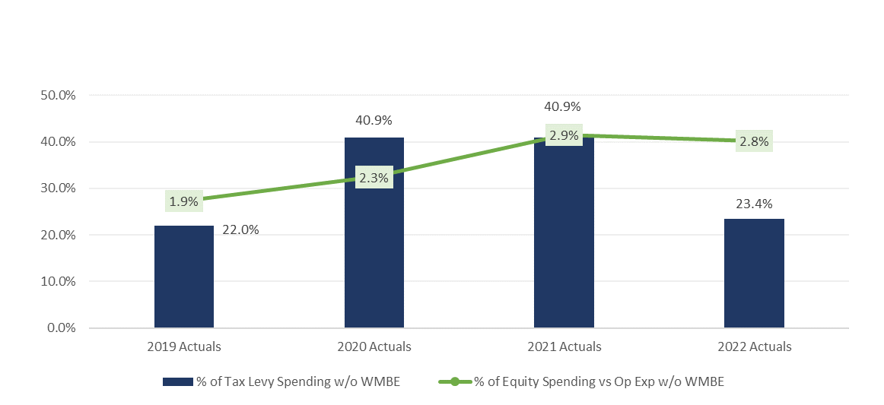
Equity Spending Summary
(w/o Capital & WMBE)

Slide 58
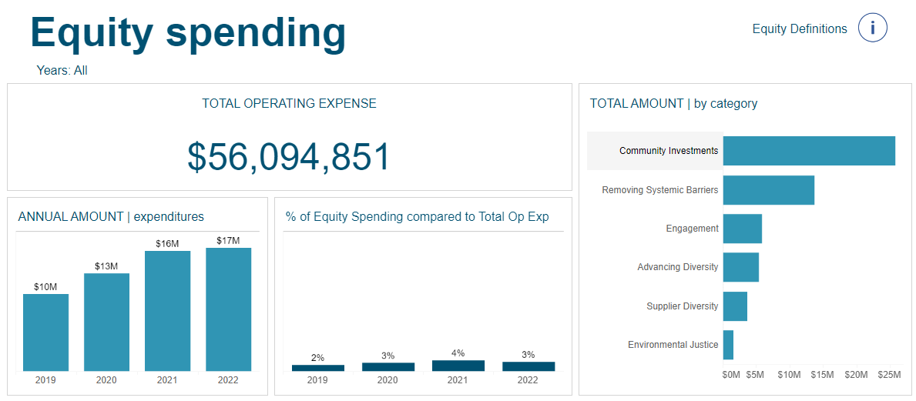
ESAP Dashboard
https://bi-hub.portseattle.org/#/views/Equityspending/Equityspending?:iid=1

Slide 59
Quick Tutorial on the
ESAP Dashboard https://public.tableau.com/app/profile/tania.park/viz/Equityspending/Equityspending

Slide 60
At the Division-Level (continued)
Step 3
Answer the following questions, regarding your 2023 and 2024 budgets.
Reminder – All Divisions will present their Budget Equity responses.
Did you have difficulty spending your budgeted equity dollars in 2023? And if so, why?
In your 2024 budget, how did your Division choose to prioritize equity programs with the available budget?
How did you engage with staff and/or community during the 2024 budget process?
What new items have you added related to Equity, Diversity, and Inclusion in your 2024 budget (new requests and baseline budget)?

Slide 61
At the Department-Level
All Departments must answer the following questions. The responses will be provided to the Division-level. Change for this year - Departments will not present their responses during their budget presentations.
Departments have been working with Change Team members to set equity goals. Review your department’s equity goals with your Change Team members and respond to the following:
Select your Division.
Which Department(s) are you answering for? Please provide a single department ORG number or list multiple department ORG numbers, separated by a comma. If your draft department Equity Goals differ by department under a shared director, consider submitting responses by ORG.
How does your proposed budget align with your department’s draft annual equity goals?
OEDI is offering a comprehensive suite of training and learning opportunities for Port employees. Does your department need additional or specialized training that OEDI is not currently offering? If so, please propose this cost in your budget asks.
Has the external training, education, and development for all team members been discussed and taken into consideration in your proposed budget?
How did you engage with your department’s staff, other Port staff, and/or external stakeholders or communities during the budget process?

Slide 62
Advancing Equity for All Racial Groups through the Governmental Use of Racial Equity Tools
Questions & Answers
August 17, 2023

Slide 63


People. Policy. Progress.
More than 40 sessions examining core issues for healthier, stronger, and more equitable communities.
networkforphl.org/2023conference | #phlc2023

