Slide 1
Trends in Vaccination Law and Judicial Challenges
July 26, 2023 | 1 – 2:30 p.m. EST

Slide 2
Moderator
Darlene Huang Briggs, J.D., M.P.H., Deputy Director, Act for Public Health Initiative, Network for Public Health Law

Slide 3
Health law partners addressing challenges to public health authority and infrastructure.
Perhaps more than at any other time in its history, public health is being directly and significantly impacted by how laws and policies are being implemented—or weakened.

Slide 4
Act for Public Health Partners:
Track legislation and litigation
Provide direct consultation and legal technical assistance
Produce resources and conduct webinars and events
Keep the public health community informed

Slide 5
Visit the Act for Public Health Website
actforpublichealth.org
Request assistance
Join the email list
View resources
Sign up for events

Slide 7
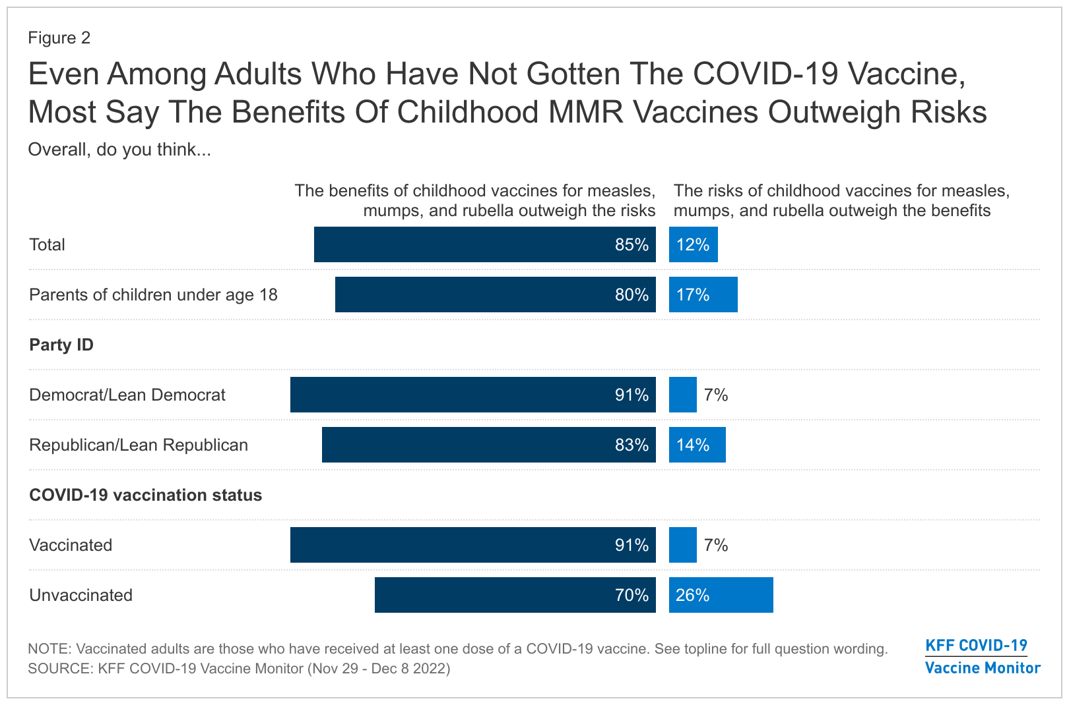

Slide 8
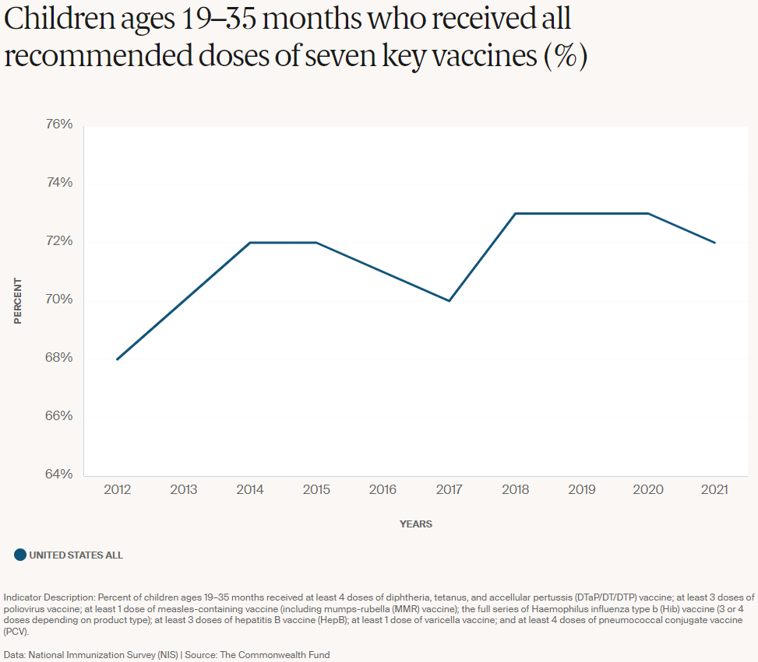

Slide 9
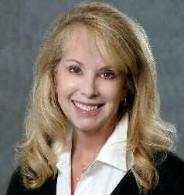
Presenter
Barbara Schneeman, Vice President, Communication and Public Affairs, RiverStone Health

Slide 10
Presenter
Wendy Parmet, J.D., Matthews Distinguished University Professor of Law and Faculty Director, Center for Health Policy and Law, Northeastern University School of Law

Slide 11
Presenter
Maggie Davis, J.D., M.A., P.M.P., Director, State Health Policy, Association of State and Territorial Health Officials

Slide 12
Presenter
Katie Moran-McCabe, J.D.
Lead Law and Policy Analyst,
Center for Public Health Law Research, Temple University Beasley School of Law

Slide 13
Act for Public Health: Vaccine-Related Legislative Tracking
Katie Moran-McCabe, JD
Center for Public Health Law Research
Temple University Beasley School of Law
July 26, 2023

Slide 14
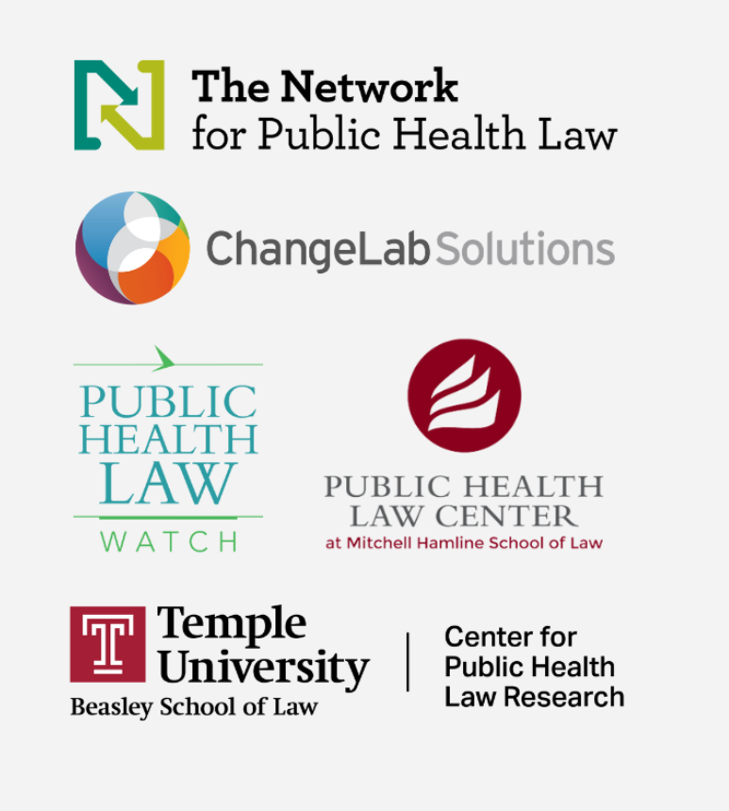
Legislative Tracking Team

Slide 15
Year 1: Bill Tracking January 1, 2021, through May 20, 2022

Slide 16
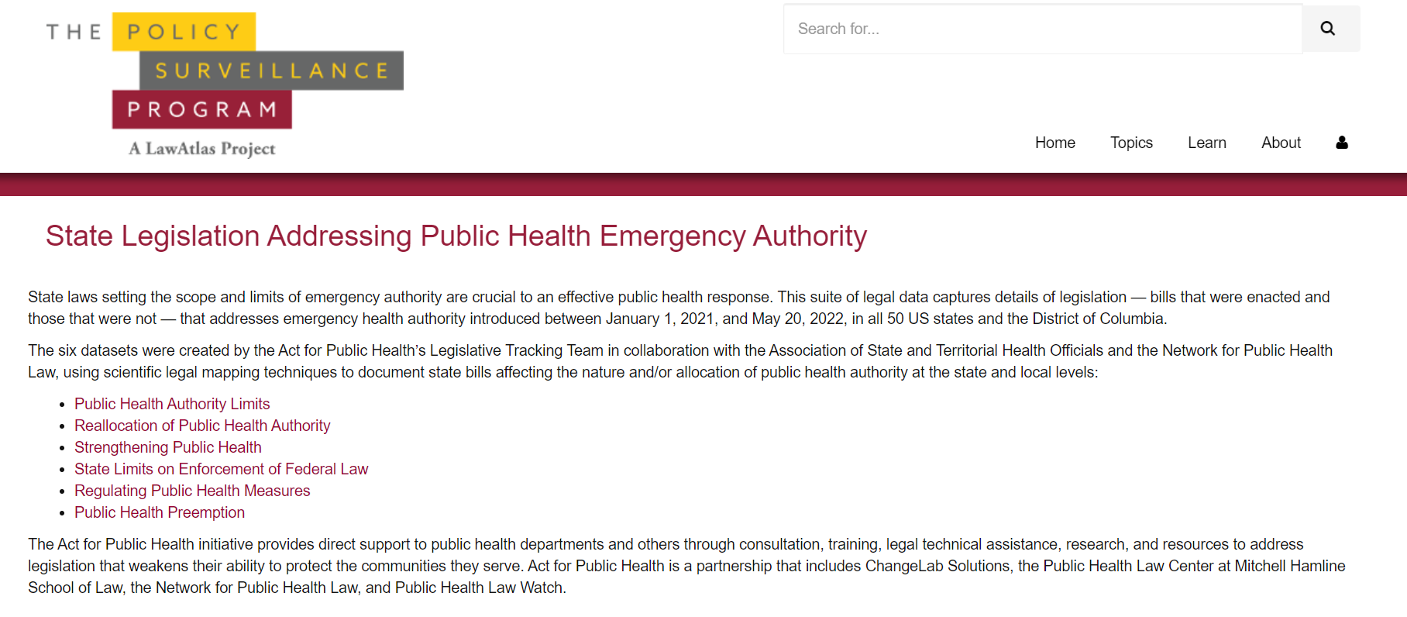
Datasets Live on LawAtlas.org now!
https://lawatlas.org/page/state-legislation-addressing-public-health-emergency-authority

Slide 17
1,531
individual bills tracked between
January 1, 2021 – May 20, 2022
191
of the 1,531 bills enacted into law
in 43 states and D.C.

Slide 18
Total Bills Regulating Public Health Measures
Total Bills Introduced Since 1/1/2021
As of 1/1/2022 | As of 5/20/2022
501 | 691
70 | 115
51 | 68
108 | 174
71 | 105
42 | 60

Slide 19
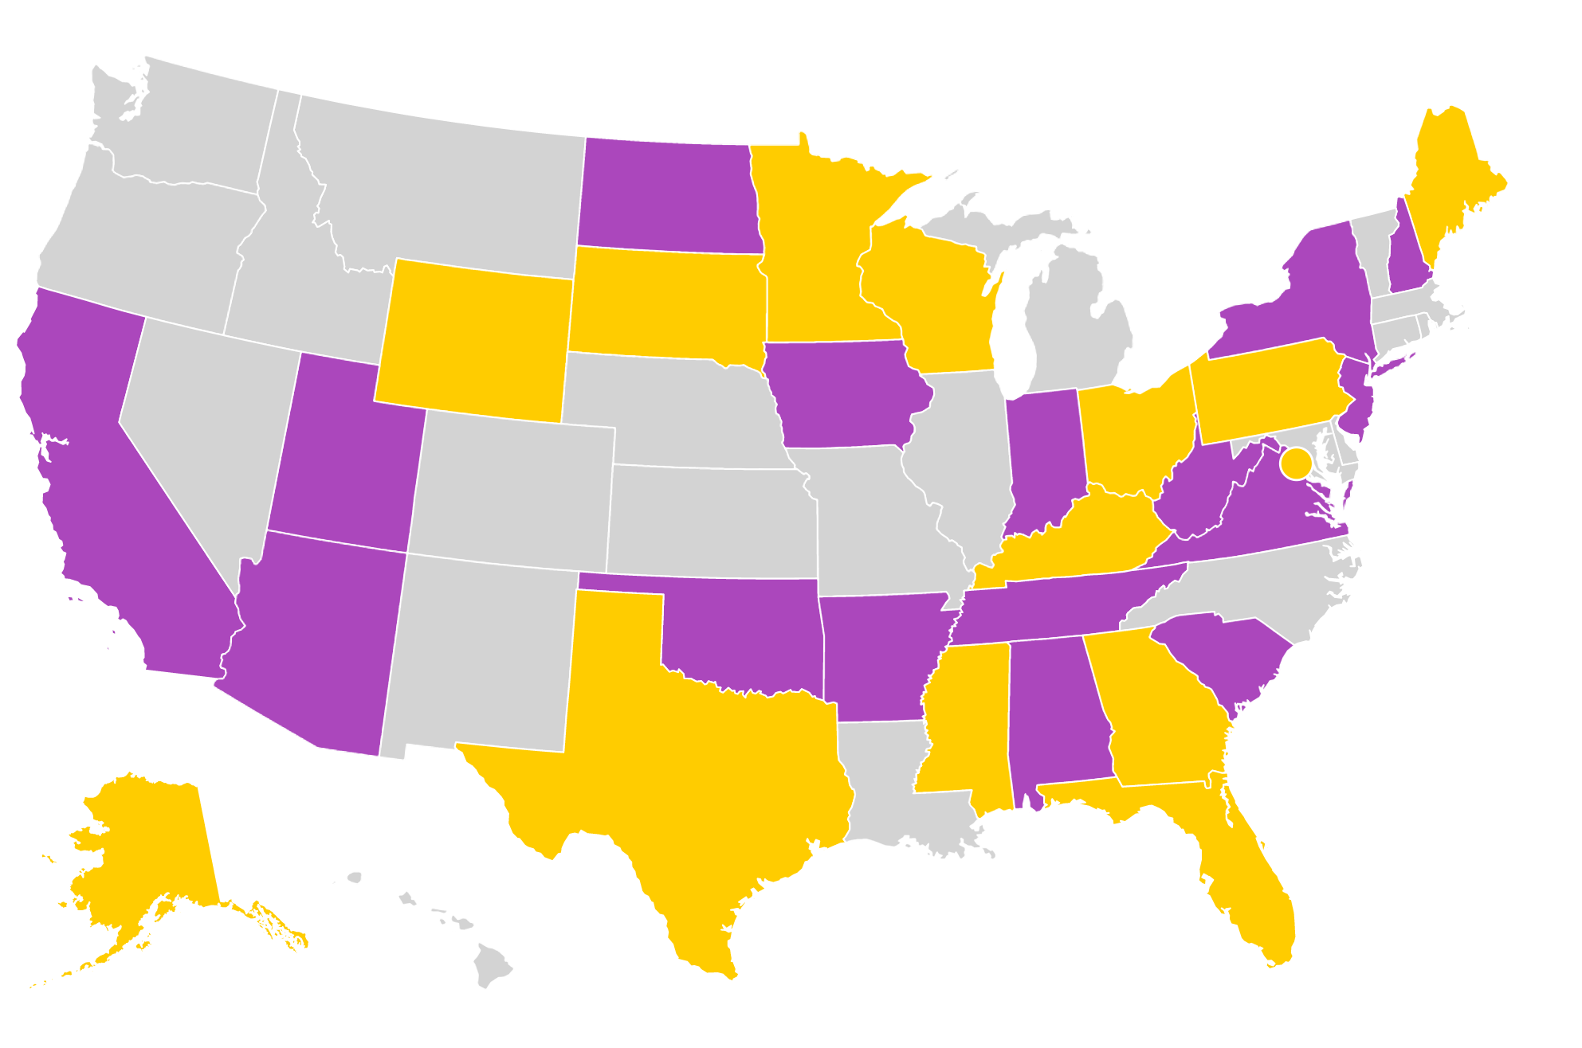
Regulating Public Health Measures – Vaccines
66 Total Enacted Bills as of May 20, 2022
New York SB 4807: authorizes pharmacists to provide immunizations recommended by the CDC
Utah HB 63: requires employer to provide vaccine exemption for previous COVID-19 infection
South Carolina HB 3126: prohibits COVID-19 vaccine mandates for state employees and school children

Slide 20
Years 2 & 3: Enacted Bills & Select Bill Tracking

Slide 21
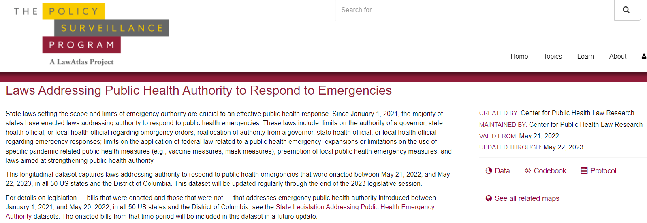
Laws Dataset Live on LawAtlas.org now!
https://lawatlas.org/datasets/laws-addressing-public-health-authority-to-respond-to-emergencies

Slide 22
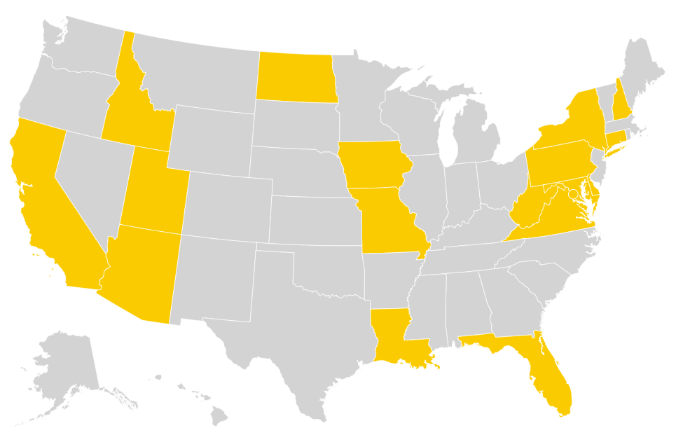
Laws Addressing Public Health Authority to Respond to Emergencies
37 Total Enacted Bills between May 21, 2022 – May 22, 2023
17 States and the District of Columbia

Slide 23
Types of Enacted Laws - May 21, 2022, to May 22, 2023
Law Type | Number of Enacted Laws
Limiting public health measures | 17
Vaccine measures | 15
Expanding public health measures | 14
Vaccine measures | 8
Preempting public health measures | 6
Vaccine measures | 5
Limiting public health authority | 10
Reallocating public health authority | 1
Strengthening public health authority | 3
Limiting state enforcement of federal law | 1

Slide 24
2023 Select Bill Tracking - Vaccines
COMING SOON!
School entry vaccination requirements
Adding
Removing
Non-medical exemptions for vaccination requirements
Limiting
Expanding
Reallocating determinations of vaccination requirements from health agencies
Expanding scope of practice for vaccination administration

Slide 25
Coming Soon: 2023 Vaccination Bills
Preliminary Data: Not Yet Finalized
241 Total Introduced Bills between January 1, 2023 – May 22, 2023
As of May 22, 2023:
Total Enacted Bills: 11
Passed First Chamber: 14
Passed Second Chamber: 7
Did not pass either chamber: 209
Vetoed: 2

Slide 26
Coming Soon: 2023 Vaccination Bills
Preliminary Data: Not Yet Finalized
Type of Bill | Introduced | Enacted
Removing school-entry requirements | 79 | 2
Expanding non-medical exemptions | 74 | 1
Expanding scope of practice for vaccine administration | 70 | 8
Reallocating determination of vaccine requirements | 40 | 1
Adding school-entry requirements | 18 | 0
Limiting non-medical exemptions | 4 | 0

Slide 27
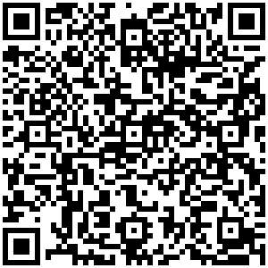
Explore the Data
Katie Moran-McCabe
Kathleen.mccabe@temple.edu
Access the data at LawAtlas.org
Follow us at @PHLR_Temple
SCAN TO EXPLORE THE LAWS DATASET

Slide 28
Vaccine Policy Spotlight:
2023 State Legislative Sessions
July 26, 2023

Slide 29
Helping Health Agency Staff Navigate the Policy Process
Legislative Liaison Peer Network
Public Health Lawyers Peer Network
Technical Assistance Requests
Learning Opportunities
Annual Legislative Prospectus Series
Health Policy Updates

Slide 30
Legislative Tracking Efforts
Public Health Authority
Executive Emergency Powers
Immunization
Legislation that enhanced or restricted powers to conduct core public health functions, including:
Isolation and quarantine
Contact tracing and case investigation
Routine vaccination requirements
Legislation that enhanced or restricted the emergency powers of a governor or public health official.
Legislation directly related to the COVID-19 mass vaccination efforts, including:
Expanding scopes of practice to facilitate vaccine administration
Prohibitions to employer or government vaccine mandates
Prioritization of COVID-19 vaccination status
Requirements to show proof of vaccination in public
Supported by the Robert Wood Johnson Foundation
Notes:
Katie provided a great overview of the legislative tracking we conducted beginning in 2020 through now, with the Act for Public Health taking our raw data and visualizing it as part of the LawAtlas policy surveillance program. I’m going to discuss a few efforts during this session—both supportive and challenging to vaccine policy—in greater detail.

Slide 31
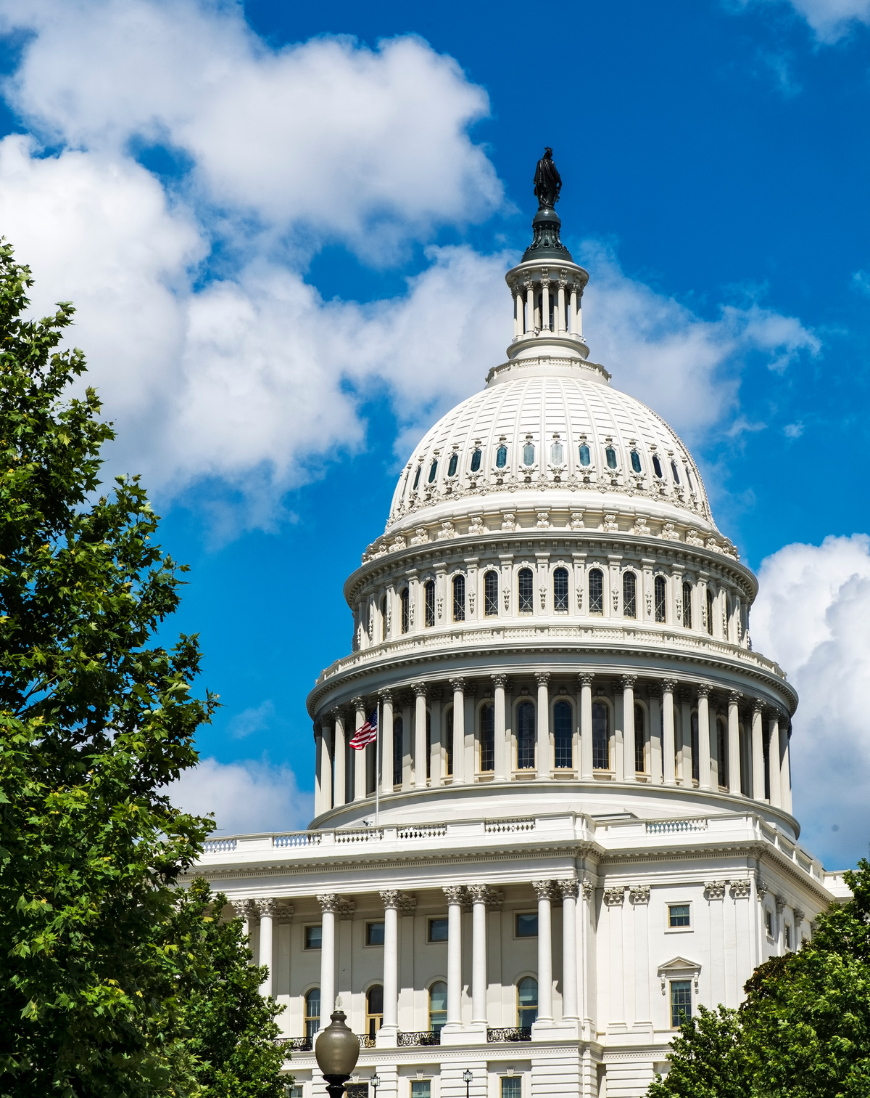
Policy Themes
Over the 2023 legislative sessions, ASTHO identified several themes:
Public health powers related to vaccination
Determining vaccines required for school entry
Whether a governmental actor can establish a COVID-19 vaccine requirement
School entry requirements for routine childhood vaccinations
Expanding scopes of practice to increase vaccinator workforce
Vaccine Injury Studies or Reporting
Notes:
Public Health Authority – Determining Vaccines Required for School Entry
Shifting responsibility for determining what vaccines to be required for school attendance from state health agency to legislature (IN, NH, MO, OK, SD, TX). The bill in Indiana is not expected to receive a hearing. Identical legislation was introduced in Missouri and New Hampshire in 2022 and ultimately failed. The bill in South Dakota appears to have failed.
Public Health Authority – Other
Moves power of granting vaccine exemptions from the health commissioner to the child's physician (WV). Prohibit the health agency from conducting contact tracing (IA). Prohibiting state agency or government entity from establishing COVID-19 vaccine requirements (KY, NJ, NY, OR, RI) or vaccine requirements other than for school entry (MN). Removing local health department authority to isolate and quarantine.
School-entry Vaccine Requirements
Repealing or removing vaccine requirements for school entry (WV, WY). Require annual influenza vaccination for student enrollment at public and private K-12 schools, preschools, childcare centers, and institutions of higher education (NJ) or for daycares (NY). Require COVID-19 for certain students (NJ, NY, OR).
Scope of Practice
Expanding scope of practice for vaccine administration by podiatrists (IL, IA), dentists (MO, WV), pharmacy techs (CA, GA, MT, NE, NH, OR, WV), pharmacists (CT, IA, MD, MO, MT, NH, NM, OR, SC, TN, TX), optometrists (NH), medical assistants (WA), EMTs during emergencies (NJ, NY, VA), midwives (VA).
Non-medical Exemptions
Expanding non-medical exemptions for school vaccination requirements (CT, KY, ME, MS, NY, SD, VA, WV). Allowing childcare facilities to opt out of accepting non-medical exemptions (MN).
Vaccine Review
Bills to require studies, reporting of vaccine adverse events. Related to COVID-19 and/or other vaccines (MA, ND, TX) or infant vaccines (NJ). These bills are akin to state executive action that occurred over the last couple of years. In September 2020, New York created the COVID-19 Clinical Advisory Task Force. In October 2020, California established the Scientific Safety Review Workgroup. Washington, Oregon, and Nevada also joined the effort. Florida established a Public Health Integrity Committee in December 2022. The committee is charged with “assessing federal decisions, recommendations, and guidance related to public health and health care.”
Vaccine Injury Reporting
Establish state vaccine reporting system for adverse events in children (NJ), require online publishing of adverse events in the state (ND), require healthcare providers to report each potential vaccine-related injury or adverse event to the federal Vaccine Adverse Event Reporting System (MA, TX), require state-based process for receiving reports of adverse events (VA, WV). These bills are similar to recent executive action in Florida where, in December 2022, the state announced it is conducting research through the University of Florida “to assess sudden deaths of individuals in good health who received a COVID-19 vaccine.”

Slide 32
Arizona
Legislature considered at least 8 vaccine related bills, with 2 bills passing the chamber and ultimately vetoed by the Governor.
HB 2474: Would prohibit adding a vaccine under an EUA to the school entry vaccination requirements VETOED
SB 1250: Would require employers to recognize religious exemptions for the COVID-19 vaccine, influenza vaccine, and any vaccines under an EUA. VETOED
Notes:
Governor veto letter for HB 2474 noted that the bill would undermine public trust in vaccines approved by the FDA (https://www.azleg.gov/govlettr/56leg/1r/hb2474.pdf)
Governor veto letter for SB 1250 noted that employee’s religious beliefs are already protected under federal employment law and the threat of a large penalty/fine could damage small businesses (https://www.azleg.gov/govlettr/56leg/1r/sb1250.pdf)

Slide 33
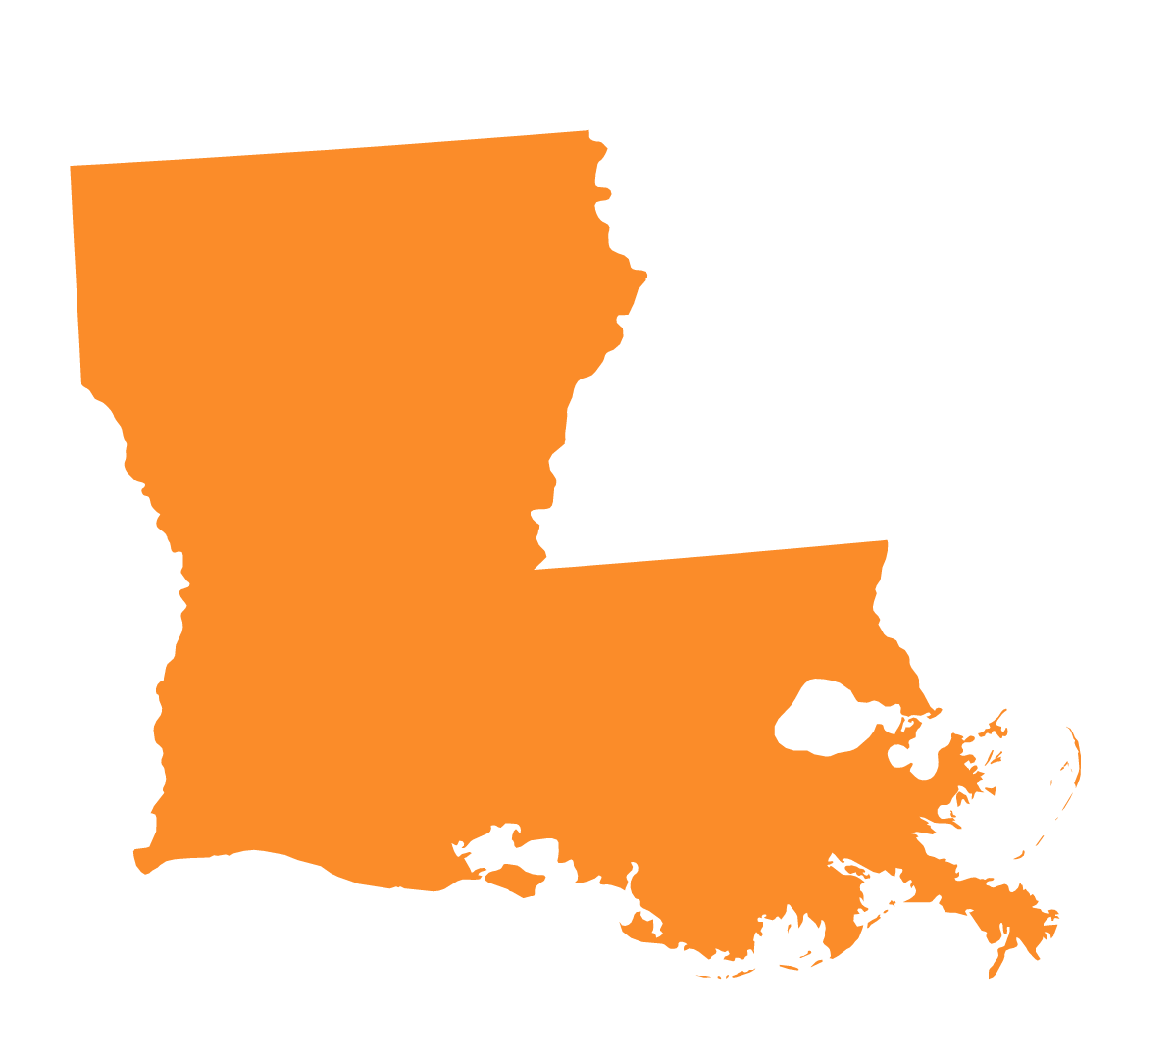
Louisiana
Legislature considered at least 7 vaccine related bills, with 2 bills passing the chamber and the Governor vetoing 1.
HB 291: Prohibits nursing home facilities from requiring visitors to submit proof of vaccination. ENACTED
HB 399: Requires any communication about student immunization requirements include language about medical and non-medical exemptions. VETOED
Notes:
Governor vetoed HB 399 citing that it would undermine faith of the public in vaccines (https://gov.louisiana.gov/assets/HB399Veto.pdf).

Slide 34
Advocacy Throughout the
Legislative Process
Building relationships with key legislators, as possible
Providing information on existing vaccination program and how it aligns with national best practices
Grassroots advocates vocal support for vaccination policies
“….existing school and daycare vaccination laws are a public health success and really a necessity to continue to protect children and communities, and must be preserved.” – Claire Hannan, Executive Director of AIM
Notes:
Claire’s quote from Newscast episode 357: https://newscast.astho.org/357-testing-school-vaccination-requirements-retail-food-safety-focus/
West Virginia S/THO efforts to build connection within the legislature, especially with key committees (West Virginia legislators considered several bills (SB 535, HB 2036, and HB 3143), to add non-medical exemptions to school immunization requirements. These proposals were unsuccessful, with West Virginia maintaining its current vaccine policy of only allowing medical exemptions for routine school vaccinations.)
New Hampshire on retaining commissioner rulemaking authority to determine school and childcare immunization requirements (focused on expertise of public health officials and trust in the ACIP process), alignment with how other states administer vaccine policy were arguments for countering the bill (which successfully kept bill from advancing out of the house by a 184-193 vote)
Resources: https://www.astho.org/communications/blog/building-vaccine-confidence-among-state-territorial-legislatures/

Slide 35
Vaccine Update
Wendy E. Parmet
Matthews Univ. Distinguished Prof. of Law
Northeastern University
Notes:
Support by Change Lab. Thanks to the Act 4 PH Partnership and my former colleague Faith Khalik.

Slide 36
Litigation Tracking
With support from ChangeLab Solutions & RWJ Foundation

Slide 37
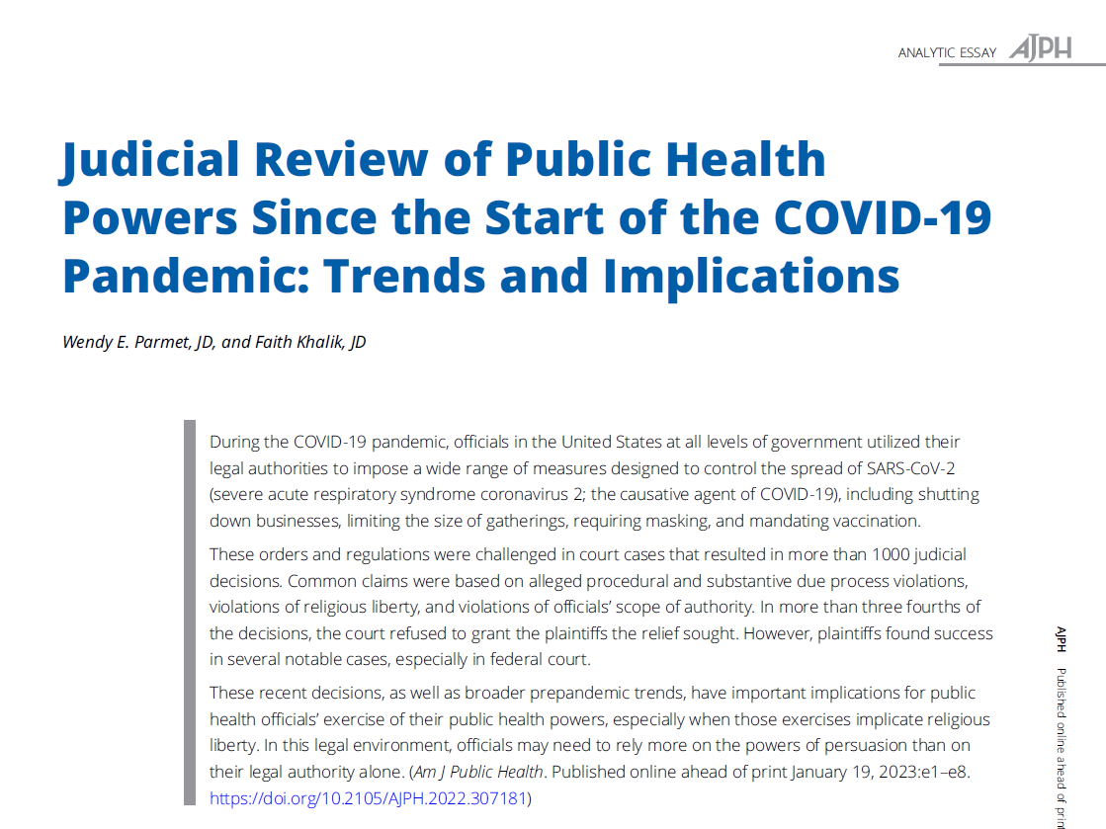
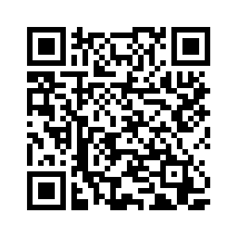
Our Studies
March 20, 2020 – May 29, 2020: Review of 53 decisions citing Jacobson
March 2020 – July 1, 2022: Review of 1,069 public health authority-related decisions
July 1, 2022 – Dec. 23, 2022: Review of vaccine mandate cases
January 1, 2023 – July 17, 2023: Review of 82 vaccine mandate cases
Not included: contract claims, tort claims, detention claims, ADA claims, Title VII and labor law claims, tribal cases
Notes:
My talk is based on 4 different studies I’ve done of litigation concerning public health powers during the COVID pandemic. The largest study, reported in the AJPH paper available via the URL, looked at over 1000 judicial decisions from state and federal courts about the authority of any level of government to respond to the pandemic. A later study still under publication looked at vaccine mandate cases through Dec. 2022.

Slide 38
Three Plus Years of Cases
Over 1,000 decisions from March 2020 to July 2023
Over 300 vaccine decisions
Commonly-discussed claims in vaccine cases
Due Process
Free Exercise
Religious Freedom Restoration Act (RFRA)
Scope of Authority

Slide 39
Doctrinal Roots of Vaccine Law
A 3-legged stool
Jacobson v. Mass.
Employment Division v. Smith
Church of Lukumi Babalu Aye v. Hialeah
Almost all traditional public health laws including vaccine mandates survived FE challenges
But federal & state statutes, including RFRA & Title VII provided extra protections for religious objectors.
“Congress shall make no law respecting an establishment of religion, or prohibiting the free exercise thereof.” 1st Amend., US Cons’t.
Notes:
To understand the legal challenges, it’s helpful to go back to pre-COVID roots of the COVID-era FE challenges.
The 1st A to the US cons’t states that “Congress shall make no law respecting an establishment of religion, or prohibiting the free exercise thereof.”
Although the Amendment purports only to limit Cong, in 1940 in Cantwell v. Conn the Court ruled that the FE clause applied to the states.
Despite that, until 2020, the FE clause had little effect on PH laws. One major reason for that was Employment Div. v. Smith, which held that neutral laws of general applicability were subject only to rational basis review – the most lenient form of review. Or, to put it another way, laws that do not single out or target religion, so for example, a law that sets a 65 mph driving license, or requires TB testing to work in a hospital, were subject only to rational basis review, and would be upheld if the state could show that the law was rationally related to a legitimate state interest. The state could almost always do this.
But as the Court made clear a few years later in Church of Lukumi Babalu Aye v. Hialeah, if a law targeted religion, aimed at a religious group or practice, it could be subject to SS, in which the state would have to show that the law was the least restrictive means of achieving a compelling state interest. This is a very high bar, which few laws can pass.
Still prior to 2020, all public health laws including vaccine mandates survived FE challenges. That’s because most public health laws do not mention or single out or target religion. For example, prior to 2020, courts consistently and unanimously ruled that vaccine mandates that apply to all children except those with medical exemptions do not violate the FE clause.
But I should note that in some important cases, statutory protections under the RFRA (which applies to federal laws) or Title VII provides greater protections for religious liberty.

Slide 40
The Initial SCOTUS COVID Cases
South Bay United Pentecostal Church v. Newsom (South Bay I)
5-4 decision from the shadow docket
No majority decision
C.J. Roberts, concurring
Cited Jacobson for the point that the Constitution “principally entrusts” health decisions to politically accountable officials
State appeared to treat worship similarly to comparable activities.
Dissent by J. Kavanaugh
State did not treat worship comparably to secular activities
Calvary Chapel Dayton Valley v. Sisolak
5-4 decision from the shadow docket
No majority decision
Multiple dissents found lack of comparable treatment
Alito in dissent said Jacobson was not relevant to Free Exercise cases.
Notes:
Between March 2020 and May 29, when the Supreme Court heard its first COVID case, lower courts issued 19 decisions discussing FE claims, usually brought against restrictions on worship.
On May 29, 2020 SCOTUS decided its first COVID case. This was a challenge to a California restriction on in-person gathering.
Like most of the court’s COVID-cases, it was decided from the court’s so-called shadow docket. These are the decisions rendered without full briefing. There was no majority opinion. The Court simply refused to block the CA law. But CJ Roberts issued a concurring decision, in which he cited Jacobson for the point that the cons’t principally entrusts health officials to politically accountable officials.
In a dissent, J. Kavanaugh argued that the state had not treated religious worship comparably to some comparable secular activities.
2 months later, the court again refused to block a restriction on worship. In this case, there was no majority decision, but there were several dissents. In one important one, J. Alito said that Jacobson was not relevant to FE cases.

Slide 41
The Evolution of Free Exercise Law During the Pandemic
Roman Catholic Diocese v. Cuomo
Strict scrutiny required because some secular activities treated more favorably than religious activities
No deference to health officials on why some activities more restricted than others
Tandon v. Newsom
Order did not mention worship, but strict scrutiny still required
Fulton v. City of Philadelphia
Non-COVID cases
Discretion to provide an exemption triggers strict scrutiny
Notes:
The victories won by FE plaintiffs follow in large measure from the evolution of the Supreme Court’s FE jurisprudence during the pandemic.
Briefly, pre-pandemic, courts relied on 2 major S Ct cases to analyze FE challenges to PH laws: 1) Jacobson, which was not a FE case, but called on courts to uphold reasonable PH orders and give considerable deference to PH officials and 2) Smith, which held that laws that were neutral and generally applicable were subject only to RB review, the lowest level of review. This meant that a law banning all gatherings, for example, would probably be constitutional, even if it applied to religious gatherings. And in a concurring decision in May 2020, Chief Justice Roberts cited Jacobson for refusing to block a California restriction on gatherings that applied to worship.
But in Nov. 2020, the Supreme Court seemed to change course, in RCD v Cuomo. Without going into the details, the case concerned a law limiting the size of religious worship in COVID hot zones. The court could have blocked it under prior precedent, but instead, it held that the law was not neutral and generally applicable even though most secular gatherings were more harshly treated because some – like health care establishments – were not. Most importantly, the Court gave no deference to health officials, and found that the restriction could not pass SS because the state could not show that people had died from the plaintiff’s gatherings – effectively disallowing prevention. And the Ct never discussed Jacobson.
In several cases between Nov. 2020 and April 2021, the court blocked further COVID restrictions. Then in April in Tandon v. Newsom, it applied RCD’s reasoning to an order restricting gatherings in home. The order made no mention of religion. Still because retail stores and train stations could have more people, the Ct blocked it. And in June 2020, in Fulton, the Court held that if a law grants officials the power to grant exemptions, religious exemptions must be granted.
All together these cases have upended vaccine law – and several courts are now holding or suggesting that if a vaccine mandate allows for medical exemptions, it must provide for religious exemptions.

Slide 42
Beyond Worship: Vaccines
Free exercise claims are not limited to regulations of worship.
Nor are they limited to activities that contradict the tenets of any major religion
Courts generally defer to plaintiffs’ claim that a regulation burdens their sincerely held religious beliefs.
This has paved the way for Free Exercise and RFRA challenges to vaccine mandates.
Notes:
As for the implications, it’s critical to note that this doct. reaches beyond laws that reg. worship qua worship.
In effect they can touch any law that regulates any activity or practice that any litigant claims substantially burdens their religious practice – so driving laws, if a religion requires one to speed.
And in deciding whether a religious practice is substantially burdened, the court gives substantial deference to the plaintiff; and does not care if the practice violates the tenets of any known religion. An individual can have a unique or idiosyncratic religion, or could read their religion differently than others. So even though most religions support vaccines, individuals can argue that vaccination violates their religion and they have.

Slide 43
Excluding Exemptions: Does 1-3 v. Mills
3 Courts of Appeals have held that medical and religious exemptions are not comparable.
Maine’s mandate for health care workers did not include a religious exemption
1st Cir. found that a religious exemption is not comparable to a medical exemption because the former harms health and the latter protects it
Cir. Court also found that the mandate could survive strict scrutiny
SCOTUS refused to hear the case
Gorsuch, Thomas & Alito in dissent said plaintiffs were likely to win on the merits, and questioned if controlling COVID remains a compelling state interest.
Notes:
To give a bit of a flavor of these two type of cases, consider first mandates without exemptions.
In these cases, litigants have claimed that the presence of a medical exemption and the absence of a religious exemption violated Tandon’s comparability requirement.
3 federal courts of appeals have rejected that argument. For example, in a case concerning Maine’s COVID vaccine mandate for health care workers, the 1st Cir. found that medical and religious exemptions are not comparable because medical exemptions protects health and religious exemptions do not.
The Supreme Court refused to hear that case, but in a strong dissent, 3 justices stated that the two exemptions were comparable and that the plaintiffs were likely to win on the merits.
Plaintiffs also prevailed in such claims before lower courts.

Slide 44
… but Lowe v. Mills
District Court: Rational basis scrutiny was met. Determined the mandate was religiously neutral, generally applicable, and rationally related to Maine’s legitimate public health interests.
Circuit Court focused on the comparability of medical vs. religious vaccines.
Refused to determine the proper level of scrutiny.
Focused on the plausibility standard applicable to 12(b)(6).
Determined that the workers plausibly pled that the vaccine mandate violated the Free Exercise Clause.
Notes:
But last month in a related case brought by workers challenging the same mandate, the 1st Circ. Appeared to change its views, reversing a lower courts dismissal of the workers’ case, holding that the workers plausibly pled that statute violated Free Exercise Clause, and employers' failure to provide religious exemptions did not violate Title VII. In discussing the FE claim, the Court found it was plausible that the mandate treats comparable secular and religious activity dissimilarly without adequate justification. The court explained that its earlier ruling was based on the burden that plaintiffs carry in seeking a preliminary injunction; here at the dismissal of a case on the merits, the burden shifts and the court believed that the case should proceed to allow plaintiffs to establish their point on comparability..

Slide 45
Religious Freedom Restoration Act (RFRA)
Federal RFRA claims require a strict scrutiny analysis, meaning that the government must prove that the policy:
furthers a compelling governmental interest; and
is the least restrictive means of furthering that compelling governmental interest.
21 state legislatures have passed a version of the RFRA.
In 2023, the majority of RFRA cases were brought by service members.
Notes:
STATE RFRA Claims
Bosarge: ”Court is persuaded that Plaintiffs have demonstrated a likelihood of success on the merits on their facial challenge under the Free Exercise Clause, and that the MRFRA does not salvage the statute from its constitutional infirmity.” (8)
Brandon: Mandate allowed both medical and religious exemptions. The school district granted disability and medical exemptions but denied all requests for religious exemptions. Court applied strict scrutiny to 1a claim. Cited Heights Apartments to determine strict scrutiny for FEC. Found that the vaccination policy plausibly burdned Plaintiffs' religious beliefs through a policy that was not generally application, was not justified by a compelling state interest and was not narrowly tailored in pursuit of the interest. Court used rational basis review for SDP right to privacy argument, found to be rational, granted motion to dismiss. Used strict scrutiny to analyze the EPC, determining the religious exemption-seekers to be a "class", analogized to Yick Wo.

Slide 46
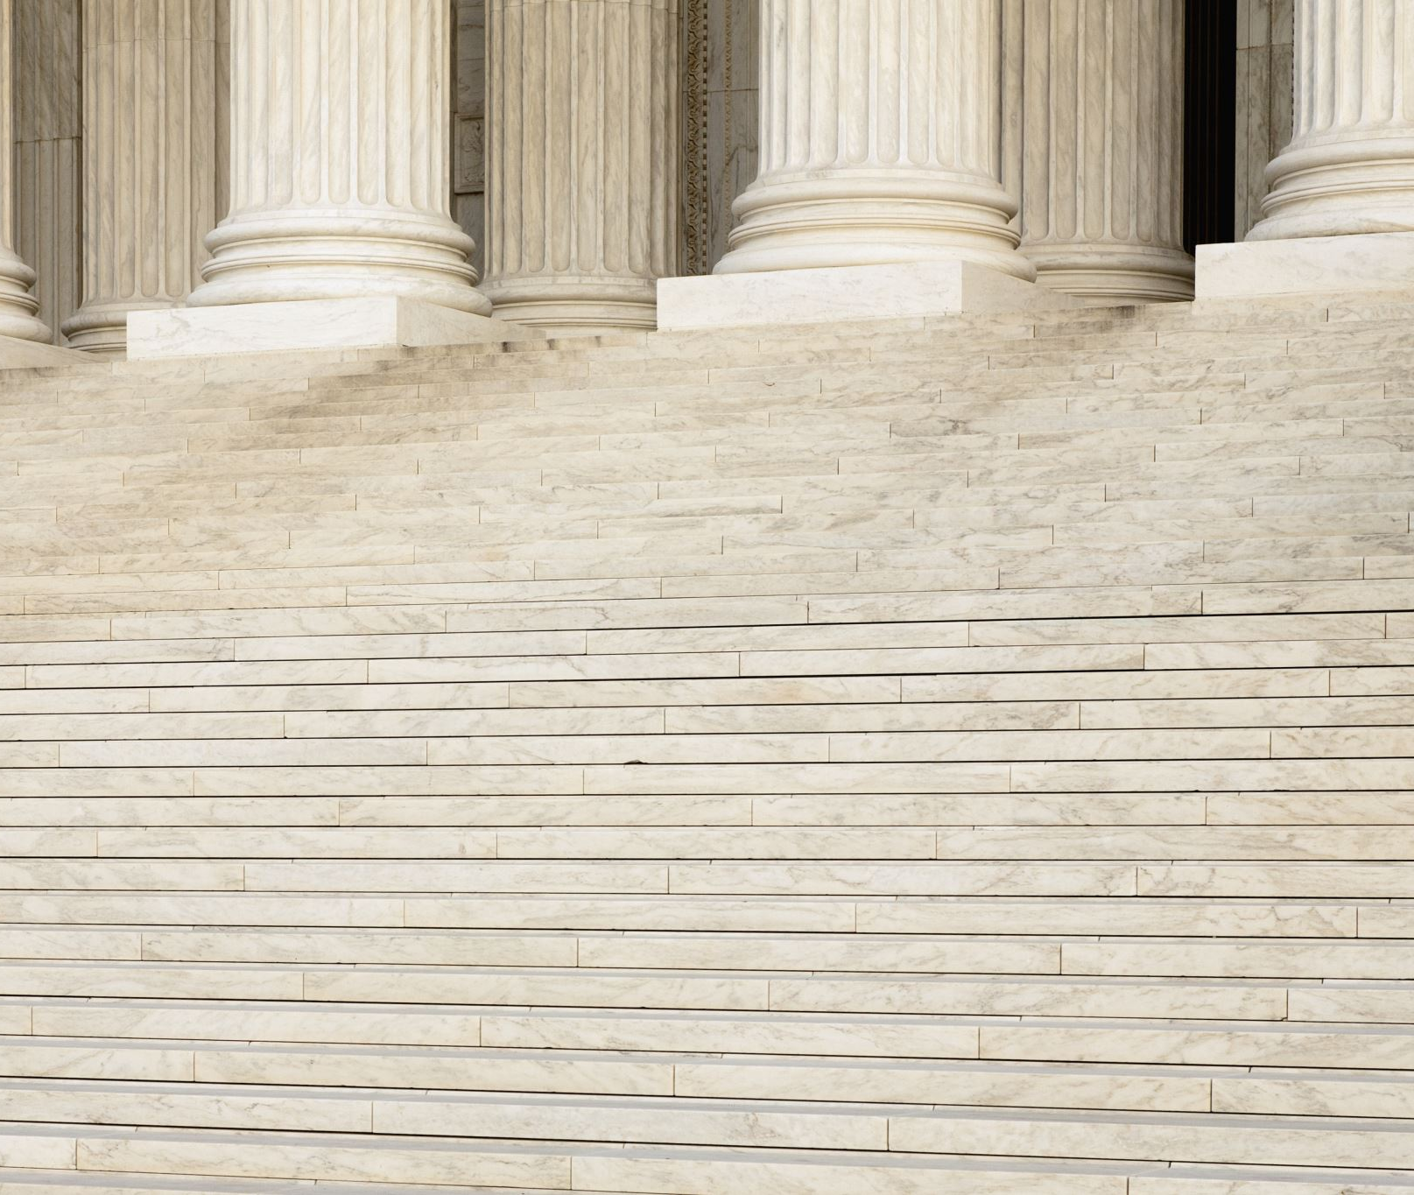
Denying Exemptions: US Navy Seals v. Biden
Mandate was offered, but never granted
Dist. Ct. found Navy violated Seals free exercise rights because a medical exemption was offered
Court also found that the policy could not survive SS, because plaintiffs had not been shown to spread COVID, and there are other equal risks in the military
5th Cir. upheld injunction on RFRA grounds, agreed with lower court that the mandate could not survive SS
SCOTUS granted limited stay as to deployment decisions.
Mandate was withdrawn by the Secretary of Defense in February 2023.
Notes:
Plaintiffs have actually been more successful challenging the denials of exemptions that exist on paper.
In one case, a district court ruled that the Navy’s failure to grant sailors an exemption violated the FE clause. The 5th Cir. upheld the opinion on statutory grounds, but ruled that the denial could not pass SS.
SCOTUS granted a limited stay, but again several justices argued that the Navy’s action was uncons’t.
In February 2023, the Secretary of Defense withdrew the vaccine mandate. This withdrawal eliminated the distinction of vaccinated and unvaccinated service members and removes any disciplinary action or remark from their profiles. Service members continued their cases to appellate courts in several Circuits (e.g., Fourth, Fifth, Sixth, and Eleventh Circuits). Cases were dismissed as Moot. Plaintiffs in the Sixth Circuit filed to reargue, stating hat without an official decision on the religious exemption questions, there was nothing stopping the federal government from enacting the policy in the future.

Slide 47
Vaccines and the Major Questions Doctrine
In federal courts, the major questions doctrine now bars administrative agencies from issuing orders or regulations with major economic or political significance without explicit statutory authority authorization
But what is a “major” question?
What will be the impact on state court rulings?
Notes:
Starting in 2021, many cases were brought against federal orders.
The gov’t fared poorly in these cases.
The most major development here is the canonization of the MQD – which holds that orders or regulations relating to a major question are invalid unless the power to issue such order or regulation is explicitly granted by statute. In other words, officials cannot use broad grants of authority – catchall phrases – to regulate a major issue.
The Court has used it to strike CDC’s eviction moratorium, OSHA’s vaccine or test mandate as well as EPA’s power to regulate green house gases and more recently the President’s student debt forgiveness program.
OSHA vs. CMS: one agency’s Secretary is given greater deference to impose vaccine mandates among employees.
Lower courts used it to strike CDC’s mask mandate for travel and several vaccine mandates.
A key question: what is a major question. The justices have given some hints – novelty, effect on the economy, but the answer is still uncertain. Another question is whether state courts will begin to follow it? So far, we haven’t seen that – at least in the state courts that have upheld authority – but it is important to remember that SCT cases affect state jurisprudence.

Slide 48
SCOTUS Decisions and the Major Questions Doctrine
Nat'l Fed'n of Indep. Bus. v. Dep't of Lab., Occupational Safety & Health Admin.
held that the Secretary of Labor lacked statutory authority to issue emergency temporary standard (ETS) to mandate vaccinations or testing in businesses with over 100 employees.
Biden v. Missouri
held that Secretary of HHS did not exceed its authority to mandate vaccines for health care facilities, and that conditions set by the Secretary were necessary in the interest of health and safety.
This doctrine has been successfully used by Plaintiffs to stop other federal vaccine mandates.

Slide 49
Threats to Agency Deference
Firefighters4Freedom v. City of Los Angeles (Cal. Ct. App. June 21, 2023)
Appellate Court determined it was inappropriate for the trial court to take judicial notice of documents from the FDA and CDC on the safety and efficacy of COVID-19 vaccines.
Determined that the safety and efficacy of COVID vaccines were “disputed factual matters.”
Notes:
Firefighters4Freedom v. City of Los Angeles “A trial court, of course, may take judicial notice of certain aspects of the COVID-19 pandemic, the disease caused by the virus, and the existence of certain government actions and publications concerning COVID-19. But the trial court here took judicial notice of the truth of disputed factual matters.” (1)

Slide 50
Title VII Claims
Title VII claims are mostly unsuccessful for religious exemptions of vaccine mandates
The reviewed 2023 cases for this project were decided prior to the Supreme Court’s recent decision in Groff v. DeJoy .
Groff represents a shift in Title VII claims related to religious accommodations. SCOTUS held that to defend “denial of a religious accommodation under Title VII, an employer must show that the burden of granting an accommodation would result in substantial increased costs in relation to the conduct of its particular business.”
Title VII requires federal agencies to reasonably accommodate the religious beliefs or practices of employees or applicants unless doing so would impose an undue hardship upon the agency.
Notes:
“Plaintiff asserting religious discrimination claim under Title VII must make prima facie case that bona fide religious practice conflicts with employment requirement and was reason for adverse employment action, and if she does so, burden then shifts to employer to show that it offered reasonable accommodation or, if it did not offer accommodation, that doing so would have resulted in undue hardship.” Lowe v. Mills

Slide 51
The Impact on Childhood Vaccines
Since the start of the pandemic, support for childhood vaccine mandates has fallen.
Litigants are now using the COVID cases to challenge childhood vaccine laws
In MA v. Rockland Cty, the Second Circuit overturned a lower court’s summary judgement order in a challenge to a health order barring an unvaccinated child from attending school during a measles outbreak.
A federal court in Miss. recently ruled that that state must have a religious exemption.
Notes:
As for the 6 states that don’t have a religious exemption, until the past year, courts consistently held that the failure to have an exemption was not unconstitutional.
But last fall the 2nd Cir. suggested that a NY law keeping unvaccinated children with religious exemptions out of school during a measles outbreak, but not unvaccinated children with a medical exemption out, may violate the FE clause. The court sent the case back to a lower court for a trial.
Recently, a group that has been challenging vaccine laws claims that it won an order from a federal court in Miss. Holding that that state’s failure to have a religious exemption violates the FE clause.
In short, I think as we go forward, we can expect more challenges and more successful challenges to state vaccine mandates. And unfortunately, increases in vaccine preventable diseases may follow.

Slide 52
Concluding Thoughts
We’ve entered into a world of doctrinal instability regarding religious exemptions and scope of authority cases.
Complicating the picture: mandates with or without religious exemptions can be successfully challenged on Free Exercise grounds.
It is therefore constitutionally risky for states to withhold or deny exemptions to those who seek them (even when the sincerity of the religious claim may be dubious).
This may open a significant loophole in mandates that ideological opponents can and do use.
Notes:
More uncertain is whether the new FE litigation will affect other PH laws –
And whether the ability of religious objectors to opt out will lower the temperature on the culture wars over health, over create a new pathway for contestation, disunity, and the evisceration of PH.

Slide 53
2023 Montana Legislature Vaccination Policy Landscape & Strategy
Barbara Schneeman, RiverStone Health
Vice President, Communication & Public Affairs

Slide 54
Mission To unite environmental and public health professionals and amplify their impact on the health of all Montanans. Vision All Montanans are thriving and living in healthier communities because of an innovative, connected, and trusted environmental and public health workforce.

Slide 55
Coalitions & Partners
Montana Families for Vaccines
Alliance for a Healthy Montana
Montana Alliance for Prevention
Local Solutions Coalition
MT Home Visiting Coalition
Health Partner Caucus
Montana Association of Counties
MT AAP
Montana Medical Association
American Heart Association
American Cancer Action Network
Montana Primary Care Association
Members
Policy & Advocacy Committee
Staff: Executive Director & Operations Specialist
MPHA Representatives
AMPHO Representatives
MEHA Representatives
Lobbyist
State Health Department
Technical Assistance
Friends of
Public Health

Slide 56
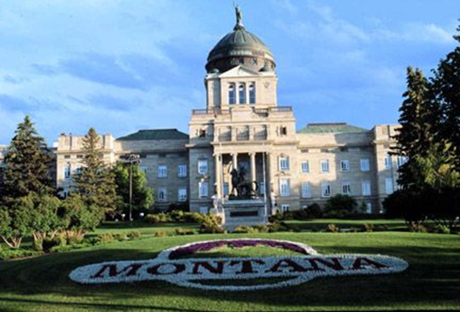
The Montana Legislature
90-day session, every other year (odd)
100 members = House of Representatives – elected to 2 yr terms
50 members = Senate – elected to 4 yr terms
Interim Committees
Term Limits

Slide 57
Process and Politics
Legislative Landscape
Republican super-majority
Partisan legislative interim committees
Term Limits
Diminished institutional memory
Less time for policymakers to impact
Trusted lobbyists become very important

Slide 58
2023 Montana Legislature
Failed: Personal Freedom/ Right of Conscience Act (SB 450)
Added philosophical exemption (along with existing medical and religious exemptions) to immunizations for licensed childcare, schools, employers
Personal choice vs. small businesses
Unfunded impact on counties/local health departments for outbreak control/investigations
Failed: Revise daycare facility immunization requirements (HB 954)
Prohibiting family childcare homes (4-8 children) & group childcare homes (9-15 children) from requiring immunizations
Childcare accessibility – rural childcare options
Passed: Revise School Immunization Laws (HB 715)
Requires all schools to communicate availability of
immunization exemptions; copies or link to forms

Slide 59
Legislative Tactics
Politics
Boots on the ground - public health lobbyist & partner lobbyists
Activating the Grassroots Network
Action Alerts
“Grasstops” calls, emails & testimony
Message/Talking Points
Employer liability and rights
Childcare accessibility for working families
Impact of outbreaks, i.e. varicella

Slide 60
Administrative & Interim Strategy
Administrative Rules Process
Hearing notices
Testimony and comments process
Interim Committee Engagement
“Right” committees monitoring
Testimony and adding value to the work
Membership Engagement & Grassroots Relationship Building
Regular reporting to members
Communications – op-eds, social media

Slide 61
Closing Thoughts
Pay attention to who is running for office
Previous elected/appointed offices
Motivating issues
Community involvement
Develop relationships with policymakers
Influencers – campaign finance reports
Invitations for site visits, behind-the-scenes look at programs/services
Share information with your network
Ask for help

Slide 62
www.confluencepha.org
Website launching this week!

Slide 63
Visit the Act for Public Health Website
actforpublichealth.org
Request assistance
Join the email list
View resources
Sign up for events

Slide 64
People. Policy. Progress.
More than 40 sessions examining core issues for healthier, stronger, and more equitable communities.
networkforphl.org/2023conference | #phlc2023

