Slide 1

Legal Repercussions of Public Health Emergency Rescissions
May 3, 2023

Slide 2

Moderator
Summer Ghaith, J.D., M.D. (candidate) Mayo Clinic Alix School of Medicine; Sandra Day O’Connor College of Law, ASU

Slide 3

Presenter
Lawrence Gostin, J.D., LL.D, Founding O’Neill Chair in Global Health Law; Faculty Director, O’Neill Institute; Director, WHO Collaborating Center on Global Health Law

Slide 4

Presenter
Lauren Dedon, J.D., Senior Legal Policy Advisor, National Governors Association

Slide 5

Presenter
Erica N. White, J.D., Senior Attorney, Network for Public Health Law—Western Region Office

Slide 6


Supporting Governors During a Pandemic:
Key Legal Questions and Lessons Learned
Lauren Dedon, Senior Legal Policy Advisor, National Governors Association

Slide 7
Agenda
NGA Background
Overview of Gubernatorial Emergency Powers
State COVID-19 Landscape: Litigation & Legislation
Legal Lessons Learned for Future Emergencies

Slide 8

Partners
Supporting Governors and Public/Private Relationships
Government Relations
Representing Governors on the Hill and with Federal Partners
Center for Best Practices
501(c)(3) Sharing Research and Solutions for Governors on a Range of State Policy Issues
Membership
Member Services & Bringing Governors/Staff Together at Annual Meetings

Slide 9
NGA Center for Best Practices
Public Safety & Legal Counsel
Public Health
Cybersecurity
K-12 Education
Children & Families
Substance Use & Mental Health
Healthcare Delivery
Homeland Security
Workforce Development & Economic Policy
Infrastructure
Energy
Post-Secondary Education
Energy & Environment
Land Management, Agriculture, and Wildlife

Slide 10
Agenda
NGA Background
Overview of Gubernatorial Emergency Powers
StateCOVID-19 Landscape: Litigation & Legislation
Legal Lessons Learned for Future Emergencies

Slide 11
Emergency Management
From day one, Governors must be prepared for day-to-day events—tornadoes, hurricanes, floods, power outages, fires, and hazardous materials spill—as well as for catastrophes on the scale of the COVID-19 pandemic, Hurricane Katrina, or the September 11 terrorist attacks.
It is crucial to understand the extent of the Governor’s emergency powers and how to declare an emergency.

Slide 12
Gubernatorial Emergency Powers
Declaring an Emergency
Statutory authorities & types
Durational limits
Legislative involvement
Federal/State/Tribal/Local Coordination
Other Constraints
Order Contents
Effective dates
Conditions giving rise to the emergency
Geographic areas covered
Agency leading the response
Applicable response actions
Scope of Order
Activate emergency response plans/mutual aid agreements
Expend funds/deploy emergency personnel & resources
Activate immunity/liability protections
Suspend/waive state rules & regulations
Streamline administrative procedures/procurement requirements
Public health mitigation measures
Other applicable response activities

Slide 13
State/Territory COVID-19 Emergencies
The COVID-19 response marked the first time in US history when all 55 governors of the states and territories issued some type of emergency declaration in response to the same incident.
3/13: Stafford Act Emergency
1/31: HHS PHE
2/4: HHS PREP Act Declaration
3/13: National Emergencies Act
3/20: Defense Production Act
State 2020 Federal
January
February
March
1/29: States/Territories Begin to Declare Emergencies
3/16: Every State/Territory has a Declared Emergency in Place

Slide 14
State COVID-19 Emergency Response Actions
Contracts & Procurement
Mutual Aid Agreements
Isolation & Quarantine
Temporary Physical Business Closures
Stay at Home Orders
Mask Requirements
Anti-Price Gouging
Unlocking Funding
Testing, Screening, Treatment
Essential Business Designations
Gathering & Capacity Limits
Surveillance & Reporting
Waiving Rules & Regs
Travel Restrictions
Resource Allocation
Schools & Virtual Learning
Standards of Care
Vaccine Mandates or Prohibitions
Emergency Response Plans & ICS
Open Meetings
Telehealth
Eviction Moratoriums
Unemployment Benefits
Correctional Populations
Remote/Virtual Flexibilities
Liability Protections & Immunities
Licensing & Scope of Practice
Food Programs
Operational
Health/Public Health Mitigation
Other

Slide 15
Agenda
NGA Background
Overview of Gubernatorial Emergency Powers
State COVID-19 Landscape: Litigation & Legislation
Legal Lessons Learned for Future Emergencies

Slide 16
Emergency powers were used as the legal basis for many COVID-19 response efforts. Legal Challenges to gubernatorial actions were seen in litigation and legislation.
Governor-Involved COVID-19 Legal Challenges
Litigation
At least 400 lawsuits brought in 50 states and territories challenging executive actions taken by Governors and state officials in response to COVID-19.
Legislation
Legislators in almost every state have introduced hundreds of bills to limit state executive authority to respond to COVID-19 or future public health emergencies.

Slide 17
Key Legal Challenges & Claims
Scope of Emergency/Executive Authority
Social Distancing & Public Health Mitigation Measures
Mask Mandates or Prohibitions
Vaccine Mandates or Prohibitions
First Amendment
(e.g., freedom of religion, speech, assembly/association)
Second Amendment
(e.g., related to gun store closures)
Fifth Amendment
(e.g., takings clause)
Fourteenth Amendment
(e.g., substantive and procedural due process, equal protection, interstate travel, privacy)
Other Legal Claims
Generally, State & Federal Courts Affirmed Governors’ Emergency Authorities

Slide 18
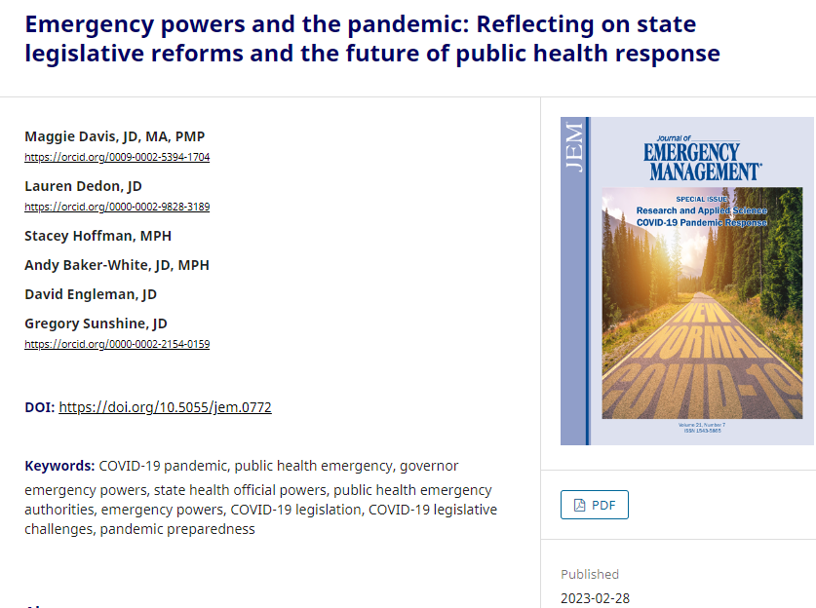
Journal of Emergency Management (JEM) Article
ASTHO, CDC, NGA collaboration
Highlights the New Legislative Landscape
Discusses Enhancements and Restrictions
Journal article: https://wmpllc.org/ojs/index.php/jem/article/view/3394
ASTHO legislative tracking: Sentinel Surveillance of Emerging Laws Limiting Public Health Emergency Orders

Slide 19
State Legislation Impacting
Government Response Capabilities
Enhancements
Increasing Vaccine Access and Supporting Vaccine Administration
Strengthening public health investigation and enforcement authority for state agencies
Preclusion of local orders by orders at the state level
Restrictions
Oversight of Executive Actions
Limits on Duration of Emergencies and Orders
Limits on Scope of Emergency Powers and Public Health Orders
  First and Second Amendment Rights
  Limiting Measure for the Prevention and Control of Infectious Disease

Slide 20
Agenda
NGA Background
Overview of Gubernatorial Emergency Powers
State COVID-19 Landscape: Litigation & Legislation
Legal Lessons Learned for Future Emergencies

Slide 21
Legal Lessons Learned
Understand Your Tools
Develop Processes to Act Quickly
All Hands on Deck Effort
Communication
Balancing Risks

Slide 22
Thank you!
Lauren Dedon, JD
Senior Legal Policy Advisor
National Governors Association
Ldedon@nga.org

Slide 23
Legal Repercussions of Public Health Emergency Rescissions
Erica N. White, JD
Senior Attorney
Network for Public Health Law, Western Region Office
May 3, 2023

Slide 24
Game Plan
Federal Emergency Declarations
  Public Health Emergency (PHE)
  PREP Act
  FDA EUAs
  Stafford Act
  National Emergencies Act
  Defense Production Act
Legal Landscape Post-PHE
  What is changing and what is staying the same
Notes:
What happened during the PHE that isn’t going to happen any longer?

Slide 25
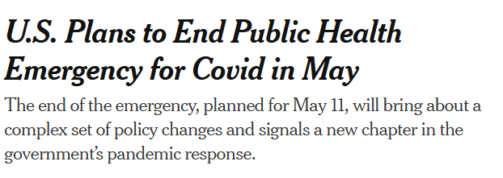

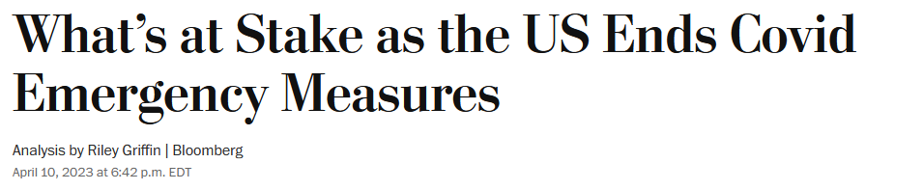
Emergencies Terminating?
Source: https://www.nytimes.com/2023/01/30/us/politics/biden-covid-public-health-emergency.html
Source: https://www.washingtonpost.com/business/2023/04/10/what-ending-us-covid-emergency-means-for-vaccines-tests-drugs/7ecdb278-d7f3-11ed-aebd-3fd2ac4c460a_story.html
Notes:
What happened during the PHE that isn’t going to happen any longer?

Slide 26


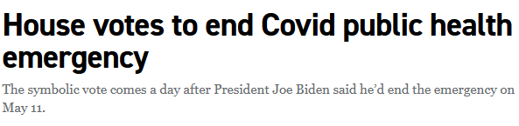

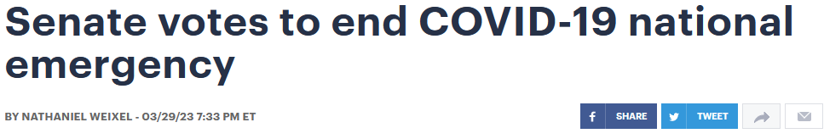



Emergencies Terminating?
Source: https://www.politico.com/news/2023/01/31/house-end-covid-public-health-emergency-00080507
Source: https://thehill.com/policy/healthcare/3924782-senate-votes-to-end-covid-19-national-emergency/
Source: https://news.yahoo.com/biden-ends-covid-national-emergency-012324101.html
Notes:
What happened during the PHE that isn’t going to happen any longer?

Slide 27

Emergency Declarations
WHO Public Health Emergency of Int’l Concern
January 30, 2020
Emergency Declarations by Foreign Governments
Ongoing
International
Federal
Stafford Act or National Emergencies Act
HHS Public Health
Emergency
Emergency or Disaster
Public Health
Emergency
State/Tribal
Emergency or
Disaster
Public Health
Emergency
Local
Source: https://www.networkforphl.org/wp-content/uploads/2021/03/Western-Region-Primer-COVID-002.pdf
Notes:
What happened during the PHE that isn’t going to happen any longer?

Slide 28



Federal Emergency
Declarations (2020)
HHS
PREP
Act Declar-ation
National Emer-gencies Act
Stafford Act Emergency
HHS Public Health Emergency
Defense Production Act
Jan.
31
Feb.
4
Mar.
13
Mar.
13
Mar.
20
Source: https://www.networkforphl.org/wp-content/uploads/2021/03/Western-Region-Primer-COVID-002.pdf
28

Slide 29
Public Health Emergency (PHE)
Jan. 31, 2020: HHS declares Public Health Emergency (PHE) pursuant to sec. 319 of the Public Health Service Act (PHSA), 42 U.S.C. § 201 (2000).
The PHE has been renewed every 90 days since, for a total of 1,196 days on May 11, 2023.
The PHSA:
  Permits federal law waivers and flexibilities (e.g., CMS sec. 1135)
  Facilitates interjurisdictional coordination
  Supports medical countermeasures and social distancing

Slide 30


PHE
Jan. 30, 2023: White House announces PHE will end on May 11, 2023.
Feb. 9, 2023: HHS Secretary Becerra sends letter to governors announcing final renewal of PHE on Feb. 11, to end May 11, 2023.

Slide 31
Public Readiness and Emergency Preparedness (PREP) Act of 2005
Feb. 4, 2020: HHS Secretary issues PREP Act declaration pursuant to sec. 319F-3 of the Public Health Service Act of 2005.
The PREP Act provides liability immunity for COVID-related health care activities (e.g., HCWs, facilities, countermeasures).
Notes:
PREP Act is a tort liability shield
Liability immunity has been extended to providers based on the PREP Act emergency declaration to allow for greater delivery of and access to medical countermeasures. For example, liability immunity has been extended to:
pharmacists and pharmacy interns to administer COVID-19 vaccines (and other immunizations) to children between the ages of 3 and 18, pre-empting any state law that had age limits
healthcare providers licensed in one state to vaccinate against COVID-19 in any state
physicians, registered nurses, and practical nurses whose licenses expired within the past five years to administer COVID-19 vaccines in any state.

Slide 32
PREP Act
April 14, 2023: HHS Secretary Becerra sends letter to governors confirming that the PREP Act declaration will extend past May 11.

Slide 33

FDA Emergency Use
Authorizations (EUAs)
Feb. 7, 2020: HHS Secretary issues a notice pursuant to sec. 564 of the Federal Food, Drug, & Cosmetic (FD&C) Act authorizing emergency use (EUA) of “in vitro diagnostics” for detection or diagnosis of COVID-19.
EUAs require a pre-determined emergency (e.g., PHE) to authorize such countermeasures.
Legally separate from PHE.

Slide 34
EUAs
March 2023 FDA Guidance outlines phased transition plan for manufacturers, health care facilities and providers, and others.
Phase 1: Implementation Date: May 11, 2023
  Adverse reporting requirements to prepare for phase 3
Phase 2: 90 days after implementation date
  Corrections and removals or registration and listing requirements for manufacturers
Phase 3: 180 days after implementation date
  “FDA does not intend to object to continued distribution of devices within the scope of this guidance”

Slide 35
Stafford Act & National Emergencies Act
March 13, 2020: President Trump declares dual emergencies via the National Emergencies Act & § 501(b) of the Stafford Act.
The National Emergency may be terminated by a joint resolution of Congress or non-renewal.
The national emergencies:
  Authorize FEMA Disaster Relief Fund access
  Allows federal reimbursement of eligible state response measures
  Permits federal law waivers and flexibilities
  (e.g., Medicare, Medicaid, CHIP, HIPAA)

Slide 36
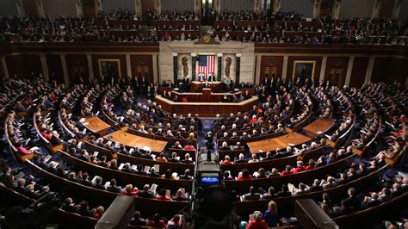
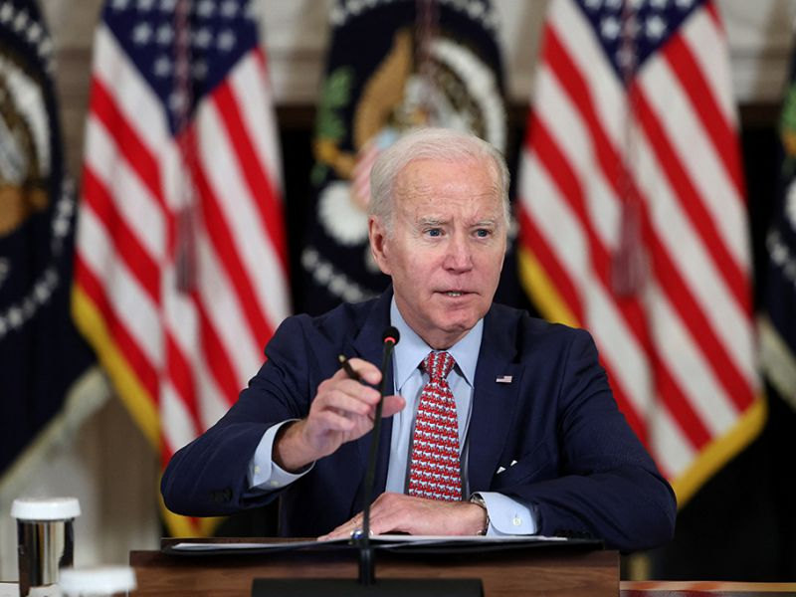
National Emergencies Act
April 10, 2023: President Biden signs H.J.Res. 7, immediately ending the national emergency declaration.

Slide 37
Defense Production Act of 1950 (DPA)
March 20, 2020: President Trump invokes DPA to compel U.S. manufacturers to produce scarce materials and resources (e.g., ventilators, PPE).
DPA authorizes the president to require private companies to accept and prioritize contracts for materials necessary for the national defense.
Legally separate from PHE.
Notes:
Two days earlier (March 18), President Trump signed an EO defining ventilators and PPE as “essential to the national defense”
Biden has since used DPA to spur baby formula production etc.

Slide 38
Game Plan
Federal Emergency Declarations
  Public Health Emergency (PHE)
  PREP Act
  FDA EUAs
  Stafford Act
  National Emergencies Act
  Defense Production Act
Legal Landscape Post-PHE
  What is changing and what is staying the same
Notes:
What happened during the PHE that isn’t going to happen any longer?

Slide 39
PHE vs. National Emergency
Source: https://www.nytimes.com/2023/01/30/us/politics/biden-covid-public-health-emergency.html
Source: https://news.yahoo.com/biden-ends-covid-national-emergency-012324101.html
Notes:
What happened during the PHE that isn’t going to happen any longer?

Slide 40
COVID Vaccines
What’s Changing?
  Uninsured may have access and coverage issues.
  Plans no longer have to fully reimburse out-of-network vaccination (including administration fee) costs.
What’s Staying the Same?
  COVID-19 vaccine and booster availability and access are determined by the supply of federally-purchased vaccines.
  Under ACA preventive service requirements, COVID-19 vaccines must be covered at 100%.
  Medicaid & CHIP coverage no longer tied to PHE.
  COVID vaccination requirements for HCWs
  and others not tied to PHE.
Notes:
Public Health Emergency: Clarification regarding the end of the public health emergency, which expires on May 11, 2023:
After May 11, 2023, administration of the COVID-19 vaccine will still be covered without cost (as are other preventive care vaccines) by health plans and insurers; however, plans and insurers will not be required to cover vaccines administered by out-of-network providers. The FAQs confirm that if the plan or insurer does not have a provider in its network who can provide the vaccine, the plan or insurer must cover the vaccine when furnished by an out-of-network provider in the same manner as would apply to in-network providers (and may not impose cost sharing).
Plans and insurers must consider the date an item or service was rendered, not the date the claim was submitted, when determining if an item or service was provided during the public health emergency.
Plans and issuers are encouraged to notify participants, beneficiaries, and enrollees of key information regarding coverage of COVID-19 diagnosis, treatment, and testing, including the date the plan or insurer will stop providing coverage and/or begin imposing cost sharing requirements or other medical management requirements.

Slide 41

COVID Tests
What’s Changing?
  Tests may not be covered at 100% by private health plans
What’s Staying the Same?
  Medicaid & CHIP coverage no longer tied to PHE.
Notes:
Public Health Emergency: Clarification regarding the end of the public health emergency, which expires on May 11, 2023:
After May 11, 2023, plans and insurers will no longer be required to cover COVID-19 at home or in person diagnostic tests without cost sharing; however, the Departments encourage plans and insurers to continue providing this coverage without cost sharing. Such decisions will be left up to insurance carriers and self-funded employers and their third-party administrators.

Slide 42
Telehealth
What’s Changing?
  Telehealth was greatly expanded under the PHE but was “severed” by recent federal legislation.
What’s Staying the Same?
  Telehealth is no longer tied to the PHE under the Consolidated Appropriations Act of 2023; flexibilities will expire 151 days after end of PHE.
    Medicare beneficiaries
    Federally-qualified health centers
    Rural health clinics
    Medicaid & CHIP

Slide 43

HIPAA
What’s Changing?
  HHS HIPAA penalty waivers, everyday communications technologies usages, and DEA prescription services will end with PHE.
What’s Staying the Same?
  Some states made allowances for inter-state telemedicine, which may still be in place with state emergency declarations.
Notes:
https://www.hhs.gov/about/news/2023/04/11/hhs-office-for-civil-rights-announces-expiration-covid-19-public-health-emergency-hipaa-notifications-enforcement-discretion.html
Today [April 11], the U.S. Department of Health and Human Services’ Office for Civil Rights (OCR) announces that the Notifications of Enforcement Discretion issued under the Health Insurance Portability and Accountability Act of 1996 (HIPAA) and the Health Information Technology for Economic and Clinical Health (HITECH) Act during the COVID-19 public health emergency will expire at 11:59 pm on May 11, 2023, due to the expiration of the COVID-19 public health emergency.

Slide 44
Medicare
What’s Changing?
  COVID vaccines & tests
  Hospitals no longer receive 20% increase in Medicare payment rate.
  Medicare Part D coverage no longer required to provide 90-day supply of covered drugs.
What’s Staying the Same?
  Under 2022 Medicare rules, out-of-network service coverage/parity requirements for Medicare Advantage plans end 30 days after last applicable federal or state emergency declaration.
Notes:
Medicare Advantage plans are required to cover services at out-of-network facilities that participate in Medicare, and charge enrollees who are affected by the emergency and who receive care at out-of-network facilities no more than they would face if they had received care at an in-network facility.
Per new Medicare rules finalized by CMS in 2022, ends 30 days after the latest applicable end date of § 319 PHE, § 564 national emergency, or state disaster declaration (when multiple declarations apply to the same geographic area), i.e., ends when all sources that declared a disaster or emergency that include the service area have declared an end; or there is no longer a disruption to access of health care
https://www.kff.org/coronavirus-covid-19/issue-brief/what-happens-when-covid-19-emergency-declarations-end-implications-for-coverage-costs-and-access/

Slide 45

Medicaid
What’s Changing?
  States lose abilities to adopt flexibilities and waivers.
What’s Staying the Same?
    Continuous enrollment is no longer tied to the PHE under the Consolidated Appropriations Act of 2023 and ended on March 31, 2023.

Slide 46
Private Health Insurance
What’s Changing?
  Out of network vaccines, testing, and treatment may no longer be covered at 100%.
  Mental health parity requirements may be affected by employer coverage of COVID tests or other services.
  See March 29, 2023 DOL Guidance
What’s Staying the Same?
  PHE does not impact ability to continue to cover testing and treatment at 100% (pending future HHS guidance).
  First dollar coverage for telehealth services no longer tied to PHE per specific legislation (expanded to 2024; non-calendar plan years may be affected).
Notes:
During PHE, waiver of cost-sharing will not cause violation of mental health parity rules
After PHE, the “break” will no longer apply—if employer wants to cover COVID tests w/o cost sharing, must consider mental health parity

Slide 47

PREP Act
What’s Staying the Same?
  HHS confirmed on April 14, 2023 that the PREP Act will extend past May 11.
Notes:
Liability immunity has been extended to providers based on the PREP Act emergency declaration to allow for greater delivery of and access to medical countermeasures. For example, liability immunity has been extended to:
pharmacists and pharmacy interns to administer COVID-19 vaccines (and other immunizations) to children between the ages of 3 and 18, pre-empting any state law that had age limits
healthcare providers licensed in one state to vaccinate against COVID-19 in any state
physicians, registered nurses, and practical nurses whose licenses expired within the past five years to administer COVID-19 vaccines in any state.
End of PREP Act declaration specified duration: October 1, 2024 (with some exceptions, e.g., manufacturers have an additional 12 months to dispose of covered countermeasures and for others to cease administration and use)

Slide 48

EUAs
What’s Staying the Same?
  Not effected by PHE termination.
  March 2023 FDA Guidance
Notes:
The FDA has issued EUAs for hundreds of COVID-19 tests, numerous COVID-19 treatments, including antiviral agents and monoclonal antibodies, and three COVID-19 vaccines (Pfizer, Moderna, and Johnson & Johnson). EUAs allow medical countermeasures to be available to the public before formal FDA approval.
Expiration: End of § 564 emergency declaration (to be determined by the Secretary)

Slide 49

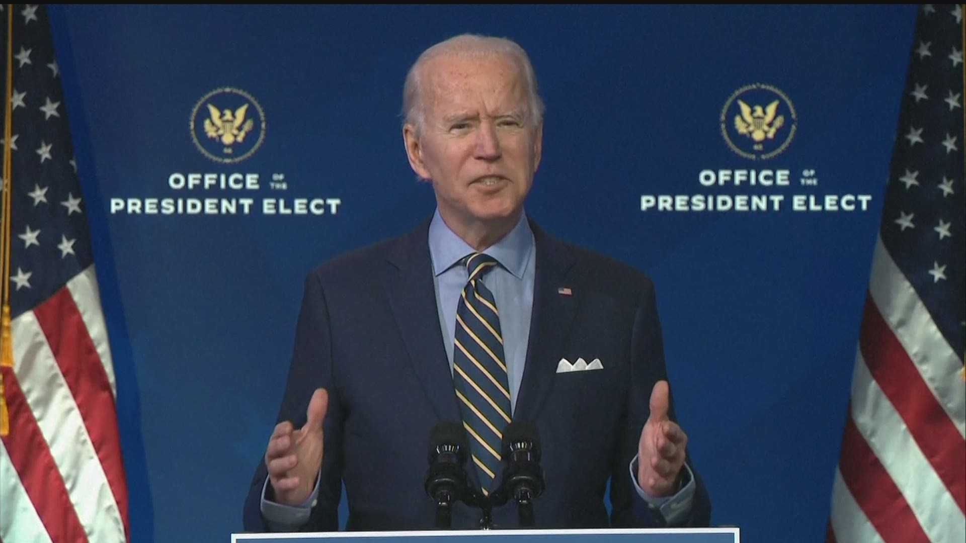
DPA
What’s Staying the Same?
  DPA authorities tied to separate federal statute not legally tied to PHE.

Slide 50
What Else?
Immigration?
  Title 42
Student loan forgiveness?
  HEROES Act of 2003 & SCOTUS

Slide 51

ericawhite@asu.edu @EricaNWhite

Slide 52


People. Policy. Progress.
More than 40 sessions examining core issues for healthier, stronger, and more equitable communities.
networkforphl.org/2023conference | #phlc2023

Slide 53

Thank you for attending.
Webinar attendees who requested CLE credits at the time of registration will receive an email from ASLME, an approved provider of continuing legal education credits, with information on applying for CLE credit for this webinar.
53

