Slide 1
Legal Issues in School Health: Scope of Practice, Standardized Data, and Special Topics
May 25th, 2023

Slide 2

Presenter
Kerri McGowan Lowrey, JD, MPH, Deputy Director and Director for Grants and Research, Network for Public Health Law—Eastern Region Office

Slide 3

Presenter
Kimberly J. Stanislo, DNP, APRN, CPNP-PC, LSN, Research Education and Practice Director, National Association of School Nurses

Slide 4

Presenter
Mathew Swinburne, JD, Associate Director, Network for Public Health Law—Eastern Region Office

Slide 5

Realizing the Full Potential of School Nursing in Public Health through Law & Policy
Kerri McGowan Lowrey, J.D., M.P.H
Deputy Director and Director for Grants & Research
Network for Public Health Law – Eastern Region, University of Maryland Carey School of Law

Slide 6
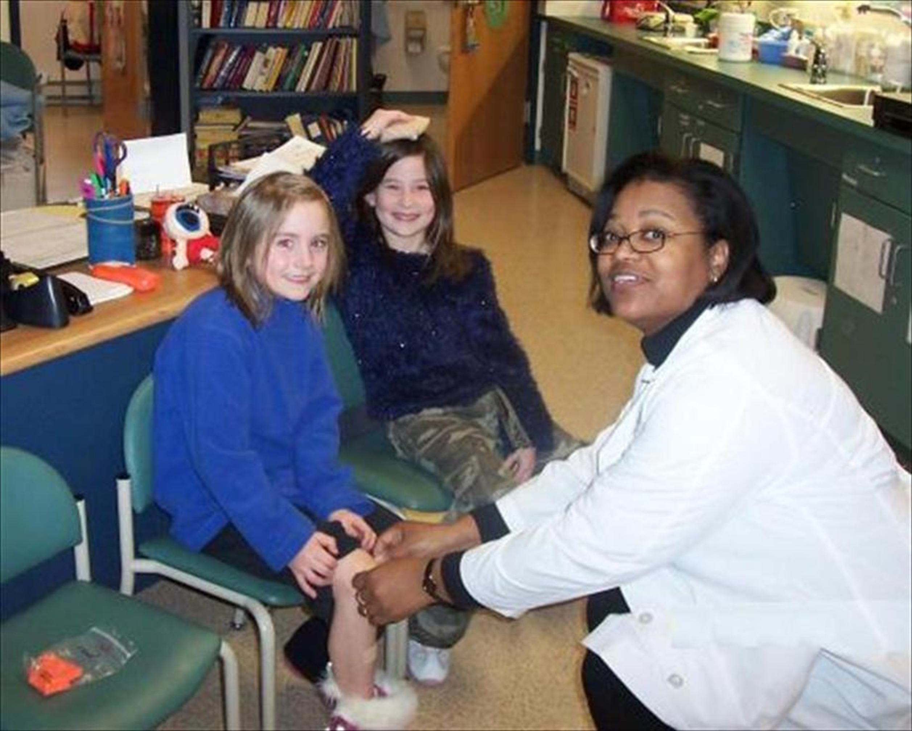

Roadmap
    Network for PHL and NASN partnership
    Why is school nursing important for public health?
    Legislative landscape of school nursing
      State laws affecting access to school nursing services and the practice of school nursing

Slide 7

    Partnership with NASN began in 2016 to research and publish resources on laws affecting school nursing. Resources include:
      Data Privacy Primers I and II
      Data Sharing in the School Setting
      Report: Health and Attendance - The Critical Role of School Nurses in Reducing Chronic Absence
      The Role of School Nurses in Managing Students with Mild Brain Injury (Concussion)
      Medicaid Payment for School Nursing Services
      50 State Survey: School Nursing Scope of Practice and Ratio Laws
          2023 update (from 2017)
www.networkforphl.org/resources/topics__resources/school_nursing/

Slide 8


Slide 10

Registered school nurses are a largely untapped national resource for public health.
    Education is a strong indicator of health outcomes. Ensuring positive academic outcomes for kids is an important public health objective.
    U.S. chronic disease burden has its roots in preventable childhood exposures, such as nutrition, physical inactivity, and tobacco use.
    RSNs are uniquely positioned at the intersection of student health and education
    Trained to understand the complexity of the relationships among, physical/mental wellbeing, and educational attainment
    Opportunity to reach kids where they spend a majority of their time

Slide 11

    RSNs provide access to prevention services, early detection, and mental health services for school-aged children and adolescents, especially in rural and urban areas, where better child health can help break cycles of health inequity.
    For many children in areas, the school nurse may be their primary health care provider.

Slide 12
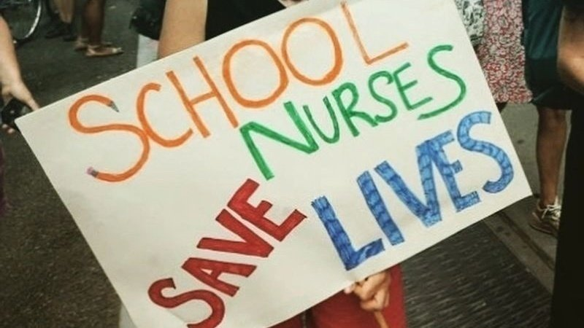
State laws affecting access to school nursing services
    With few exceptions, laws across the country have not recognized the critical role that school nurses can play in improving the health and wellbeing of the next generation.
      For example, only Delaware requires a full-time registered nurse in every school.
    Many jurisdictions require districts to “share” a school nurse or do not have one at all.
      Sharing is not ideal for many reasons…
Notes:
For example, a school nurse will realize that a student who is routinely coming to her office with a “stomachache” may actually suffer from anxiety, but she will not be able to make this connection if she isn’t in the building enough to make that connection.

Slide 13
    Ratio laws
        AAP recommends one FT nurse in every school.
        HP 2020 set an objective to increase the proportion of elementary, middle, and high schools that have a full-time registered school nurse-to-student ratio of at least 1:750. (ECBP-5)
        HP2030 reframed the objective to “increase the proportion of secondary schools with a full-time registered nurse who provides health services to students.” (AH-R08)
          Research Status: meaning it is a “high-priority public health issue that doesn’t yet have evidence-based interventions developed to address it.” May become a core 2030 objective with availability of both baseline data and evidence-based interventions.
Notes:
Achieving HP 2020’s nurse-to-student ratio objective would improve access to school nursing services for all students regardless of where they live.

Slide 14
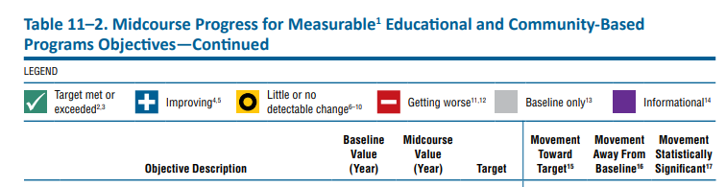
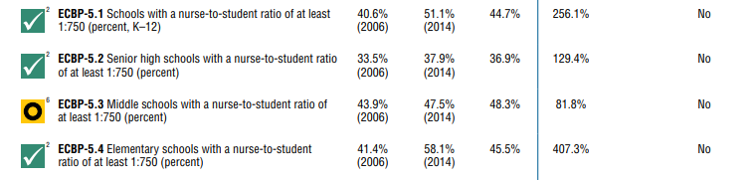
Healthy People 2020 Midcourse Review, Chapter 11, Educational and Community-Based Programs (ECBP)

Slide 15
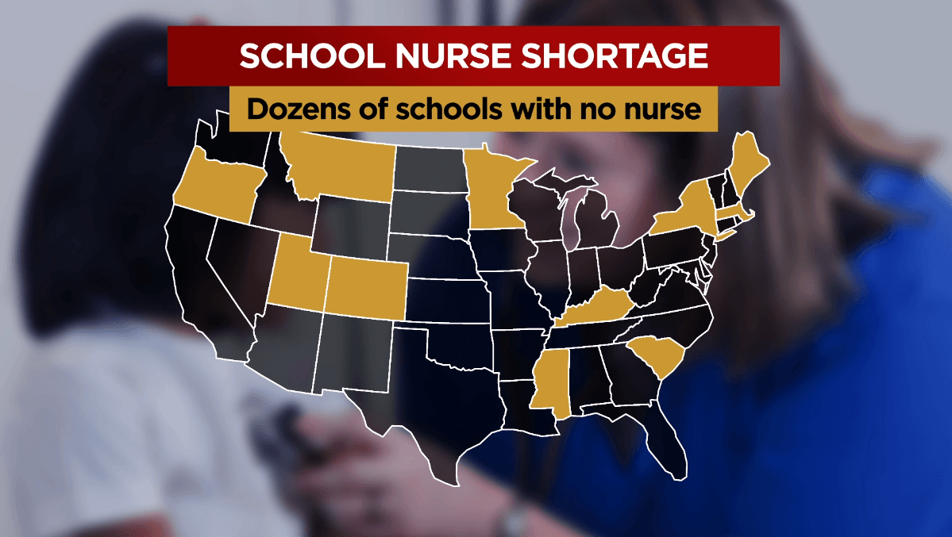
Ratio laws
    25 percent of U.S. schools offer no nursing support at all.
    “Ratio laws” try to address this by mandating a certain RSN-to-student ratio
    As of April 2023, 21 states require some level of school nursing services by law (30 states do not).
Source: foxbaltimore.com

Slide 16
Ratio Laws
    Only 11 states require certain staffing ratios for the general student population.
        Georgia law requires one SN per 750 elementary school students and one school nurse per 1,500 middle and high school students.
        Arkansas requires one SN per 750 students, and 1:400 in districts with a “high concentration of children with disabling conditions” and law stipulates penalty (“probationary status”) for schools/districts that fail to employ a nurse.
          These ratios depend on availability of state funds…

Slide 17
Ratio Laws
    Three states encourage—but do not mandate—a ratio for general student population.
        Oregon requires ratios for medically fragile or complex students but only encourages a ratio of 1:500 for other students.
        Utah encourages LEAs to provide SN equivalent to 1:2,000
        Virginia law requires school boards to provide at least 3 “specialized support positions,” which may include SNs (but also include others), per 1000 students.
Notes:
LEA = Local Education Agency

Slide 18
Delegation of nursing services
    Medication administration
        Epinephrine
          Most states allow any trained school employees to administer epinephrine
          Alaska allows a SN to delegate administration of injectable medications to a certified medical assistant, but only if the RN is onsite
        Insulin/Glucagon
          Several states (e.g., AL, VA, AZ, AR, CO) allow any trained employee to administer insulin and glucagon

Slide 19
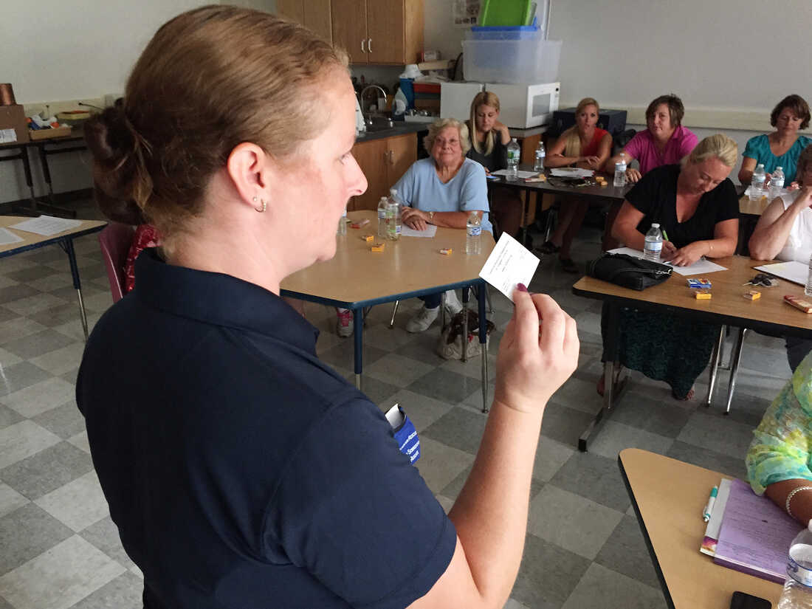
Delegation of nursing services
    Medication administration
        Naloxone/opioid antagonists
          Illinois law allows trained personnel to administer Naloxone.
          Indiana allows schools to stock Naloxone and allows trained employees to administer it.
        Medical cannabis…

Slide 20
Other legal issues: Telehealth and training requirements
    A 2014 study found that rural school nurses were twice as likely as non-rural nurses to:
      Provide clinical services to multiple schools
      Less likely to hold a nursing degree at the bachelor’s level or higher
      Less likely to have received recent continuing education on anaphylaxis, asthma, healthy weight, diabetes, and suicide prevention.
    Laws that enable training and services via telehealth are potentially important to close these gaps in rural areas but are inconsistent across the country.

Slide 21
Other legal issues: Medicaid billing for school nursing services
    Ability to bill Medicaid for school nursing services varies by state.
        Massachusetts allows school nurses to bill Medicaid for all Medicaid-eligible services through the State Amendment Plan approved by Centers on Medicare and Medicaid (CMS) in early 2017.
        Some other states, such as Florida and Kentucky, only address Medicaid reimbursement for health care services that are listed in Individual Education Plans (IEPs).

Slide 22

www.networkforphl.org/resources/topics__resources/school_nursing/

Slide 23
Contact
Kerri McGowan Lowrey, JD, MPH
Deputy Director
Director for Grants & Research
Network for Public Health Law—Eastern Region
University of Maryland Francis King Carey School of Law
klowrey@law.umaryland.edu
410-706-5994
www.networkforphl.org

Slide 24









School Nursing and Standardized Data: Addressing Practice Complexities

Slide 25







Role of the School Nurse
Protect and promote student health
Provide care coordination
Facilitate optimal development
Advocate for quality student-centered care
Advance academic success
Collaborate to design systems that allow individuals and communities to develop to their full potential
Bridge health care and education
NASN (2017)

Slide 26
Practice Considerations
Hospital/Medical Setting
School/Educational Setting
Role description/expectations of NURSE
Nurse is a Nurse is a Nurse
Nursing supervisor/evaluation
Non-nursing supervisor/evaluation
Orientation and mentor/training period
No orientation, no training period
Team-based care/ Resources/ Model
of Care
Autonomous, isolated/ Model of Care
Delegation
Delegation and Designation
Nurse Practice Act
Nurse Practice Act and Educational Laws
HIPAA
FERPA, some HIPPA

Slide 27
Practice Complexities
Role Description/ Expectation
Models of Care
Delegation
Orientation
Supervision/ Evaluation
Nursing vs. Educational Law
Privacy Laws
State-specific requirements

Slide 28

Value: Making the Connection
Public Health Outcomes
Cost of care
Life expectancy
Mortality rates
Prevalence of chronic conditions
Screening rates
Educational/Academic Indicators
Test scores
Graduation rates
Attendance rates
School climate

Slide 29
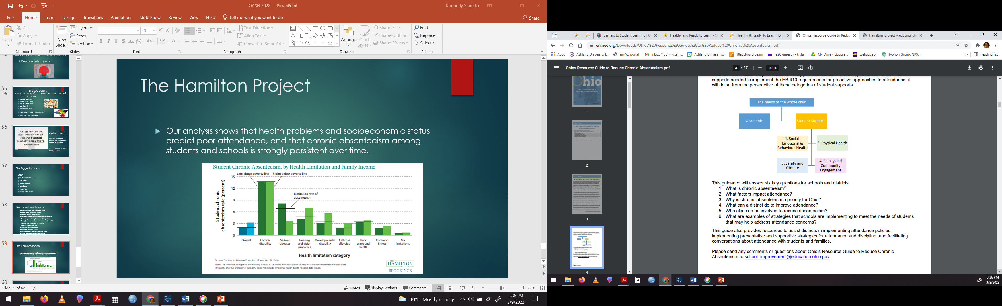
Non-Academic Barriers
Ohio Department of Education (2017)
ODE (2017) https://eric.ed.gov/?q=source%3A%22Ohio+Department+of+Education%22&id=ED580128

Slide 30
Non-Academic Barriers
• Physical health (health conditions, food
security)
• Mental health (depression, anxiety)
• Violence (bullying, gang activity)
• Abuse/neglect (physical, emotional, sexual
abuse)
• Trauma (repeated, long-term traumatic
experiences)
• Family (homelessness, domestic violence, family
conflict)
• Negative peer influences (rule breaking)
• Alcohol, tobacco, drug use
• Difficulties with concentration
• Behavioral (disruptive, unruly)
• Social-emotional (poor impulse control, anger)
• Lack of social/emotional relationships
Allen et al. (2016)

Slide 31
Top Health Barriers to Learning:
Mental health and behavioral problems
Vision problem
Hearing problems
Uncontrolled asthma
Dental pain
Lead exposure
Hunger
Medical home
(lack of access)
Children’s Health Fund (2022) Health barriers to learning. Educators. https://hrl.nyc/node/hbl-links

Slide 32

Role of Standardized Data

Slide 33
National school health data set to influence local, state, and national student health policy
Goals:
Identify best practices in school health
Support data driven policies to advocate for:
Needs of students
Evidence-based school nursing practice
Improve student health outcomes
Notes:
This is an overall data initiative. Not just about data points.
Building local school nurse capacity
KNOWLEDGE of school nurses
USE data locally
Building Partnerships
State Office of Education and/or Health
State affiliates
University researchers

Slide 34
Standardized data
Common Language
Notes:
We hear data every day…but what does it mean and why do we need to collect it? Uniform data points and standardized data provides us with a common language. School nursing practice is very different from state to state and sometimes district to district within a state. Having a common language provides the opportunity to have conversations using the same vocabulary…consistency in the message or story. We can make comparisons and utilize the power of aggregate data to tell a story. If we are all talking the same language, we offer the opportunity for those “Oh, wait a minute, I’ve heard this before” moments when talking to fellow school nurses or those outside of school nursing.

Slide 35
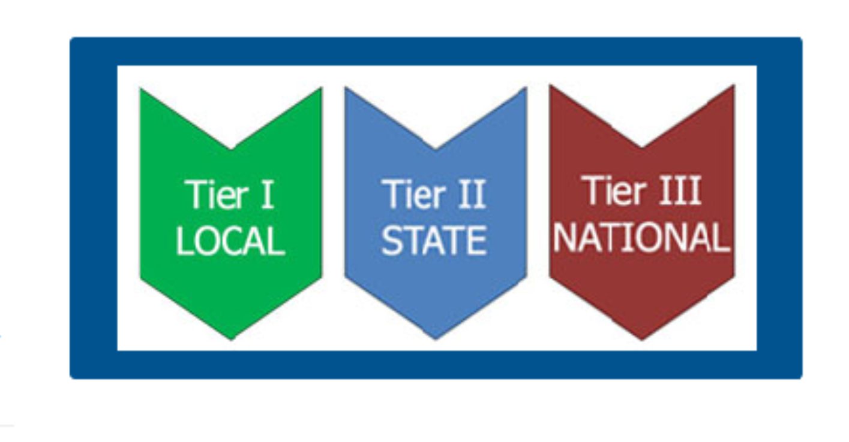
Tiered Programming
Notes:
As a review of the foundational components of ESC, we’re going to look at the 3 tiered programming model that supports efforts at the local, state, and national levels. ESC is built on a 3 tiered programming model. There is engagement at he local, state, and national levels to support school nursing practice, data collection, and advocacy efforts. Each level is integral to the success of the program and the program’s strength rests in the connections in synergy of the efforts at each level.
For example: school nursing practice at the local level is dependent upon state and national level standards, but the local school nursing practice also informs practice at the state and national level. The data is true for data collection, for state data to have value, the data collect at the local level needs to support the creation of state data. Each and every voice is essential. The same goes for the national data, each state that is represented in the national data enriches the meaning and useability of the data to advocate and inform practice overall and school nurses are implementing the national standards at the local level.

Slide 36
Three-Pronged Approach

Slide 37
School Demographics and Workforce Capacity
Total # students
Total # chronically absent
% Free/reduced lunch
% English Language Learners
Highest level of education for Health Staff
State-specific SN credentials
Model of practice

Slide 38
School Health Staffing
Total FTE by provider
(RN, LPN/LVN, Health Aide/UAP)
  Direct services
  Supplemental/float
  Special assignment
  Administrative/supervisory

Slide 39
Chronic Conditions
Total # students
# students chronically absent (total)
# of students with a current diagnosis from a health care provider of:
  Asthma
  Type 1 Diabetes
  Type 2 Diabetes
  Seizure disorder
  Life threatening allergy
  ME/CFS
# students chronically absent for each dx
Notes:
These would be students with a current diagnosis from a health care provider.
Just the ones listed here. You will note this is not all of them-just the most common chronic conditions:
Asthma,
Type I and Type 2 Diabetes,
Seizures,
Life-threatening Allergies.
Recently added was ME/CFS (Myalgic encephalomyelitis/chronic fatigue syndrome (ME/​CFS) .This is due to a contract that NASN received in order to build the platform. (For ore information on ME/CFS: https://www.cdc.gov/me-cfs/about/index.html)
We also added chronic absenteeism to this data set in addition to the school demographics, as many school, district, states may only be submitting certain data points. This is a data point that is valuable. The submission of the total number of students is also repeated to allow for more consistent analysis of the chronic conditions and helps control for the denominator of only those who have submitted this data set.
As we build upon our other projects that address chronic absenteeism, we are including the number of students with each diagnosis that is identified as chronically absent.
Again-this is a beginning point. We know there are other important conditions such as mental health. We are starting slow-in building the culture of data and use of data-work continues on creating the data points.

Slide 40
Health Office Disposition
Total # students
#student encounters/health office visits by provider (RN, LPN/LVN, UAP/Health Aide) resulting in the student:
  Returning to class/staying in school
  911 being called (or regional equivalent)
  Being sent home
Notes:
Health Office Visit Disposition or what is the outcome of a student visiting the health office.
Categorized in just these 3 categories. Return to class, sent home, or activation of 911/emergency services
It is broken down by school health providers (RN, LPN/LVN, and UAP/Health aide. It is important to track them separately, especially for advocacy efforts. We will see these data points in action later in the presentation.

Slide 41
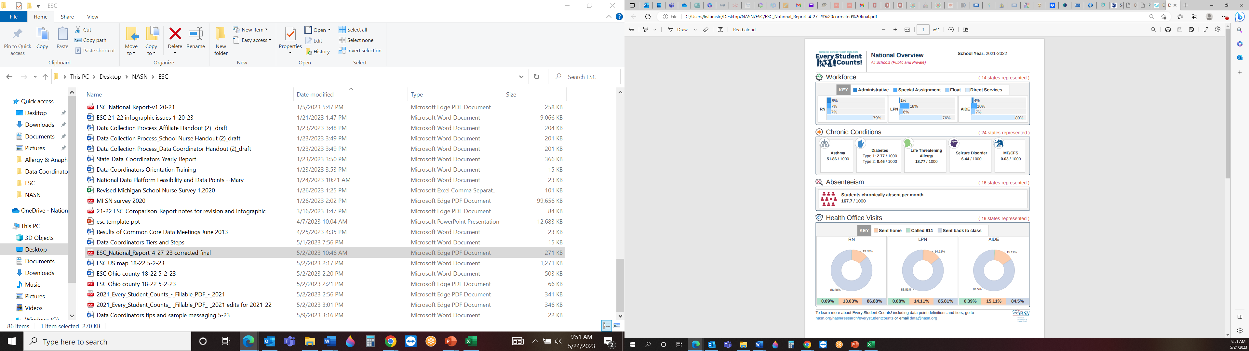

Slide 42

Role of Standardized Data in School Nursing
General awareness
Value/efficiency to student outcomes
Acuity level
Staffing needs/models
Notes:
How can data help you…help you save time, help practice more efficiently and effectively, communicate with educators/administrators/legislators/fellow school health professionals, share your experience and the experience/needs of your students
Let’s take a close look at how the ESC data points support these stories…

Slide 43
Poor health not only results from lower educational attainment, it can also cause educational setbacks and interfere with schooling
- Center on Society and Health, VCU (2015)
Notes:
Looking at the bigger picture of Public Health and its intersection with School Nursing… we share goals and purpose. Consider how data collaboration can be useful in your community.

Slide 44
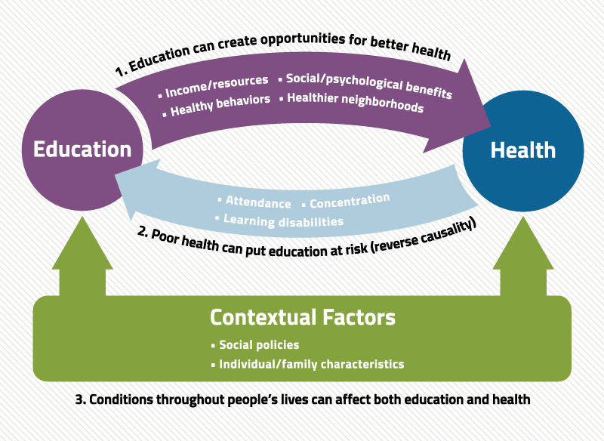
Center on Society and Health, VCU (2015)
Notes:
Looking at the bigger picture of Public Health and its intersection with School Nursing… we share goals and purpose. Consider how data collaboration can be useful in your community. We are partners in population health and need your support in addressing the practice complexities and utilization of school health data to better support our communities.

Slide 45

Thank you!
Kimberly Stanislo DNP, APRN-CNP, LSN, CPNP-PC
kstanislo@nasn.org
NASN Research Education Practice Director

Slide 46

References
Allen, B., Allen, T., Devine-Kepner, C. G., Goldberg, E., Riley, R., & Weems, J. (2016, May 5). Non-academic barriers to learning [presentation]. The Education Policy and Leadership Center (EPLC). https://www.eplc.org/wp-content/uploads/2016/12/Non-Academic-Barriers-Presentation-revised-5-5-16.pdf
Children’s Health Fund. (2022). Health barriers to learning. Educators. https://hrl.nyc/node/hbl-links
Center on Society and Health, VCU. (2015) Why education matters to Health: Exploring the causes. Work. https://societyhealth.vcu.edu/work/the-projects/why-education-matters-to-health-exploring-the-causes.html#gsc.tab=0
NASN. (2017). Definition of School Nursing. About NASN. https://www.nasn.org/about-nasn/about
Ohio Department of Education (ODE). (2017). Ohio’s resource guide to reduce chronic absenteeism. ODE. https://eric.ed.gov/?q=source%3A%22Ohio+Department+of+Education%22&id=ED580128
Notes:
Notes: To change slide background navigate to Design > Format Background and use the dropdown to choose your new color.

Slide 47
Cannabis Legalization: Medical Cannabis Access at School
Mathew Swinburne, J.D.
Associate Director
The Network for Public Health Law-Eastern Region
5/25/2023

Slide 48
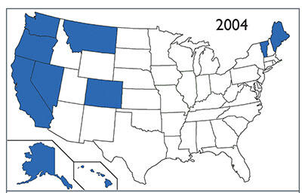
2004: 10 States Allow Medical Cannabis

Slide 49
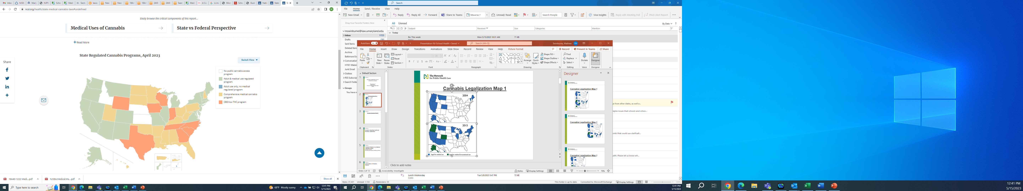
Cannabis Landscape 2023
2023
Medical States: 38 states and D.C.
Adult-use: 22 states and D.C.

Slide 50
Pediatric Patients: Qualifying Medical Conditions (Example New Jersey)
means seizure disorder, including epilepsy;
intractable skeletal muscular spasticity;
post-traumatic stress disorder; glaucoma;
positive status for human immunodeficiency virus;
acquired immune deficiency syndrome;
cancer;
amyotrophic lateral sclerosis;
multiple sclerosis;
muscular dystrophy;
inflammatory bowel disease, including Crohn's disease;
terminal illness, if the patient has a prognosis of less than 12 months of life;
anxiety;
migraine;
Tourette's syndrome;
dysmenorrhea;
chronic pain;
opioid use disorder;
or any other medical condition or its treatment that is approved by the commission.

Slide 51

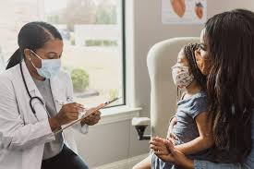
Pediatric Patients: Physician Authorization
(Example-New Jersey)
A doctor of medicine, doctor of osteopathic medicine, physician assistant, or nurse practitioner in good standing may enroll with the state to certify patients for medical cannabis.
The healthcare provider must have a bona fide relationship with any patient (ongoing assessment, care, and treatment)
To register a patient one of the following must be met
  Provider-patient relationship must have existed for at least one year
  Seen and/or assessed the patient for the medical condition on at least four visits.
  Provider assumes responsibility for providing management and care of the patient’s medical condition after conducting a comprehensive review and evaluation.
For pediatric patients must have pediatric specialist support the certification of the patient.

Slide 52
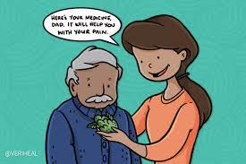

Pediatric Patient: Care Givers
(Example-New Jersey)
Acquire and administer medical cannabis for the patient.
Each qualifying patient younger than 18 years of age may concurrently have up to four designated caregivers,
May petition the commission for approval to concurrently have more than four designated caregivers
Additional designated caregivers are necessary to meet the patient's treatment needs.
Caregivers who are not immediate family members are required to submit fingerprints for a criminal background investigation.

Slide 53


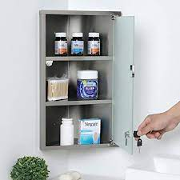
Policy Variables for Medical Cannabis in Schools
Is this a permissive or mandatory policy?
What is the patient and caregiver verification process?
What type of cannabis products will be allowed?
Where can the cannabis be administered?
Who can administer the medical cannabis?
Can the medical cannabis be stored at the school?
Can the medical cannabis be stored at the school over night?
What are the security protocols related to cannabis storage?
What is the protocol for adverse reactions?

Slide 54


Medical Cannabis at School: New Jersey
To help ensure that pediatric medical cannabis can fully engage in their educational opportunities, New Jersey passed Bill A4587 in 2015.
Public and private schools are required to have policies that authorizes parents, guardians, and primary caregivers to administer medical cannabis to a student will on school grounds, aboard a school bus, or attending a school-sponsored event.
Policy to be developed by the board of education or the chief school administrator of the private school.

Slide 55
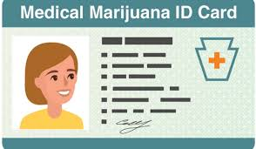
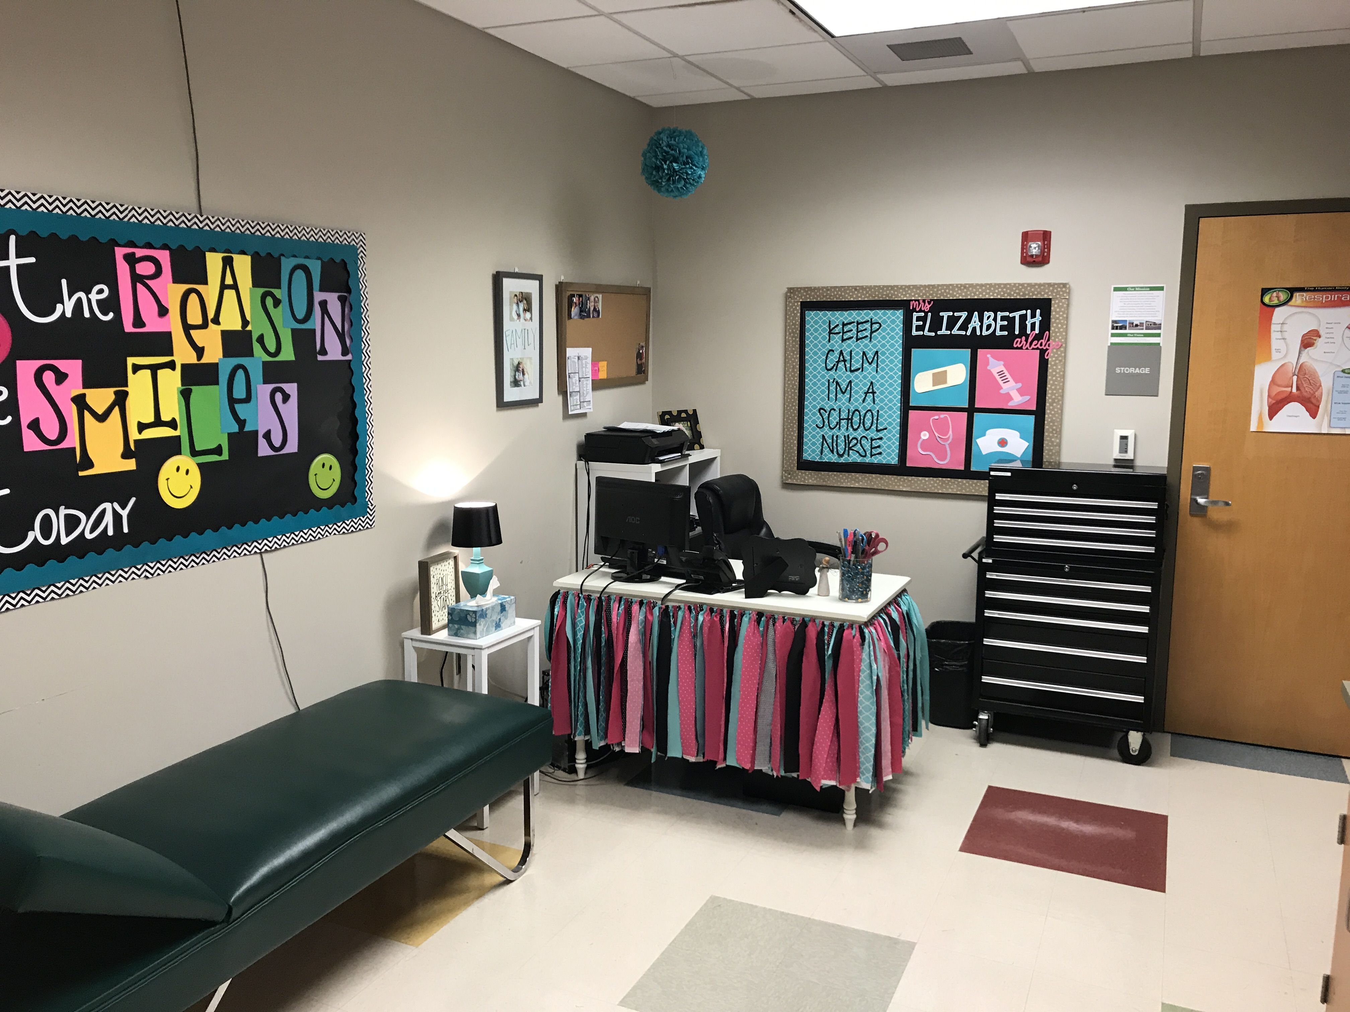

Policy Requirements
Student must be a registered medical cannabis patient
Parent guardian, or designated care giver must be authorized to assist the student with their medical cannabis.
Expressly authorize parents, guardians, and designated caregiver to administer medical cannabis to the student on school grounds, school bus, and attending a school sponsored event.
Identify locations on school grounds where medical cannabis may be administered
Prohibit the smoking or other inhaled forms of medical cannabis.

Slide 56
Resources for Policy Development
New Jersey School Boards Association -Sample Policy
  Identification of location for administration (Nurse’s office).
  Explicitly prohibits student self-administration.
  Prohibits students from carrying the medical cannabis.
  Prohibits the storage of medical cannabis on school grounds.
  Marijuana Legalization and School Policy: Public Health Approach (NJPSA, NJPN,. . . .)
  Discusses medical cannabis policies and need for interactive process.
  Discusses non-medical cannabis use at schools and response protocols.

Slide 57


Alternative Approaches: MD
Maryland passed a law in 2020 that requires all public schools to allow access to medical cannabis at school, school events, and on the school bus.
Private schools are not required but may develop policies for medical cannabis access
The Maryland Medical Cannabis Commission and the Maryland Department of Education developed guidelines for public schools allowing the administration of medical cannabis.
Local school systems need to develop policies based on these guidelines.

Slide 58

Maryland School Health Guideline Requirements
Requires schools to designate personnel authorized to administer medical cannabis during school hours, at school-sponsored activities, and while on the school bus.
Specific locations where medical cannabis may be administered to students (nurse’s office is a required location)
Procedures for educating any designated school personnel on safety considerations for patient use of medical cannabis as it relates to a school setting.
Protocols to ensure students who are qualifying patients receive care during school hours and school-sponsored activities and while on a school bus.
Security protocols for the possession, storage, and loss or theft of medical cannabis on school property.
A plan for the administration of medical cannabis: first dose, student medical record, and administration instructions
A clear prohibition on any method of administration of medical cannabis that includes smoking or vaping.
Liability waivers
Verification of patient authorization and caregiver authorization.

Slide 59
Mathew Swinburne
Associate Director
The Network for Public Health Law-Eastern Region mswinburne@law.umaryland.edu
Thank you.

Slide 60

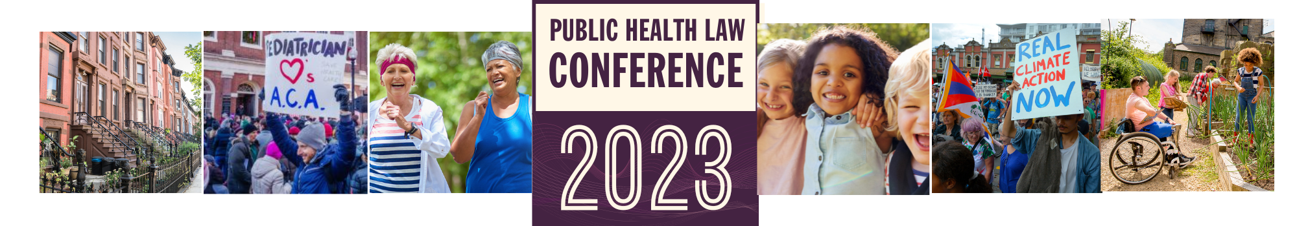
People. Policy. Progress.
More than 40 sessions examining core issues for healthier, stronger, and more equitable communities.
networkforphl.org/2023conference | #phlc2023

