Slide 1
Public Health’s Preemption Problem: Key Health Justice Impacts and Updates
April 12, 2023

Slide 2
Moderator
Amy Cook, J.D., Senior Law and Policy Analyst, Center for Public Health Law Research, Temple University Beasley School of Law

Slide 3
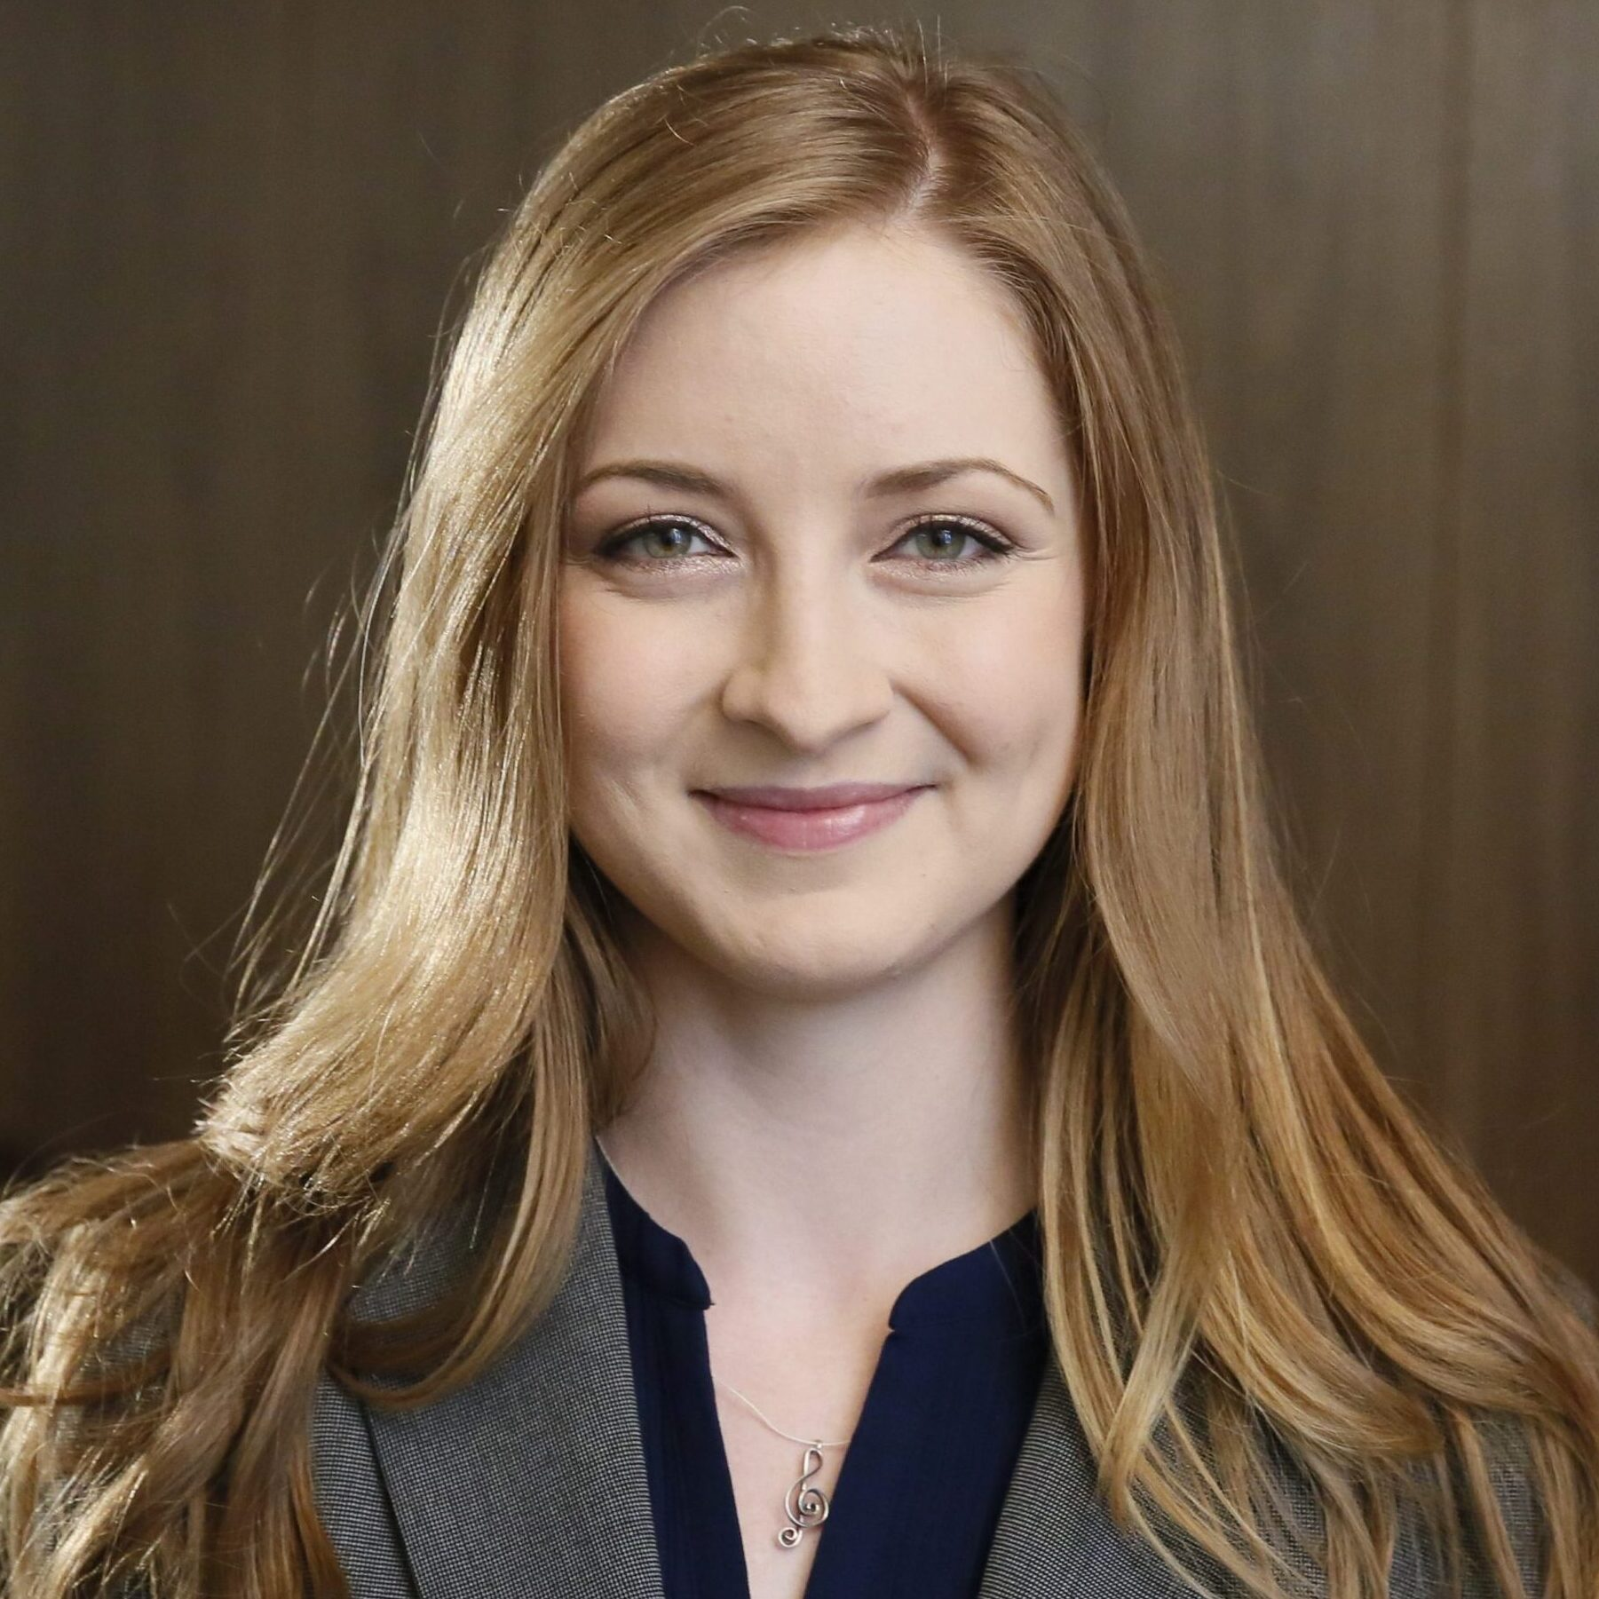
Presenter
Jennifer L. Piatt, J.D., Deputy Director, Network for Public Health Law—Western Region Office

Slide 4
Presenter
Sabrina Ruchelli, J.D., Law and Policy Analyst, Center for Public Health Law Research, Temple University Beasley School of Law

Slide 5
Presenter
Sterling Johnson, J.D., Center for Public Health Law Research, Temple University Beasley School of Law; Ph.D. Student, Geography & Urban Studies, Temple University

Slide 6
Presenter
Adam Herpolsheimer, J.D., Law and Policy Analyst, Center for Public Health Law Research, Temple University Beasley School of Law

Slide 7
State Preemption Laws
Sabrina Ruchelli, JD
CENTER FOR PUBLIC HEALTH LAW RESEARCH
April 12, 2023

Slide 8
Law is a social determinant of health.
Law shapes behaviors and environments, but the effects of laws are not equitably distributed among our communities.

Slide 9
The Center for Public Health Law Research supports the widespread adoption of scientific tools and methods for mapping and evaluating the impact of law on health.

Slide 10
Legal epidemiology
The scientific study and deployment of law as a factor in the cause, distribution, and prevention of disease and injury in a population.

Slide 11
Policy surveillance
The systematic collection, analysis, and dissemination of laws and policies across jurisdictions or institutions, and over time.

Slide 12
The Policy Surveillance Process
Defining the Project Scope
Background Research
Developing Coding Questions
Coding the Law
Collecting Law & Creating Legal Text
Publication & Dissemination
Tracking & Updating the Law
Quality Control

Slide 13
What is Preemption?
Legal doctrine permitting higher levels of government to usurp lawmaking authority from lower levels
E.g., minimum wage laws
Federal
State
Local

Slide 14
State Authority to Preempt
Dillon’s Rule
Narrowly defines local authority
Local governments only possess authority delegated by the state
Home Rule
Generally, more permissive than Dillon’s rule

Slide 15
Forms of Preemption
States can preempt local governments by:
Setting a minimum or maximum legal standard
Preempting local control in an entire area of law
CEILING
FIELD
FLOOR

Slide 16
Punitive Preemption
Imposes civil and criminal penalties or removal from public office when public officials propose or enact legislation that exceeds local lawmaking authority

Slide 17
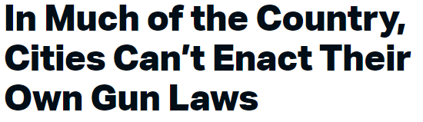
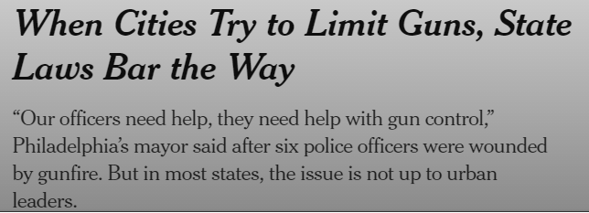
Preemption and Firearms

Slide 18
The State Preemption Project was a collaboration between the Center for Public Health Law Research and the National League of Cities. Support was provided by the Robert Wood Johnson Foundation. The views expressed here do not necessarily reflect the views of the Foundation.

Slide 19
Preemption Project
Longitudinal dataset (August 1, 2019 to November 1, 2022) analyzing and tracking preemption laws in 15 domains across the country
Updated annually, next update coming in late 2023
National League of Cities uses legal data to shape discussion and increase awareness of state preemption and provides supports to thwart state preemptive activity
Housed with free, open-access on Lawatlas.org

Slide 20
Preemption Domains
Ban the Box
Firearms
Mandatory inclusionary zoning
Municipal broadband
Mandatory paid leave
Rent control
Full disclosure tax requirements
General revenue limits
General expenditure limits
Property tax rate limits
Tax assessment limits
Tax levy limits
Transgender rights
Local law enforcement budgets
Race and racism in school curriculum

Slide 21
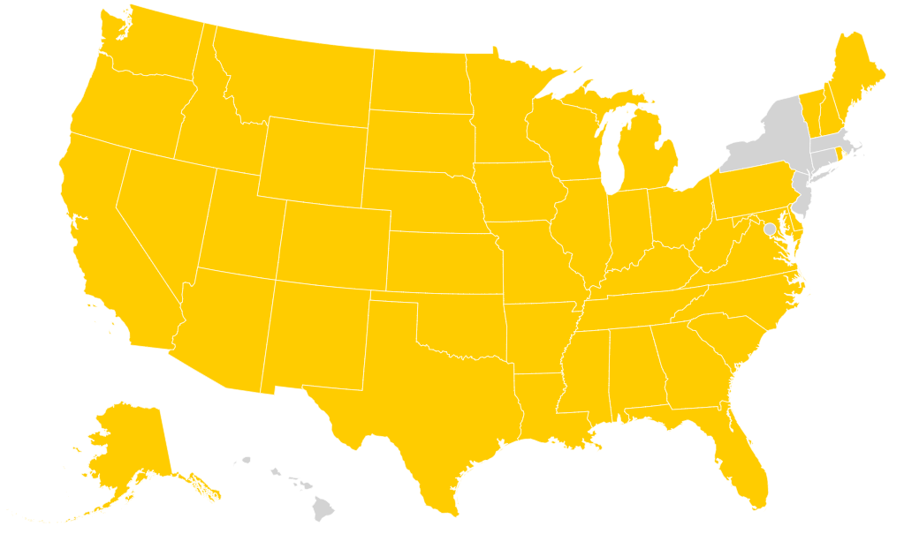
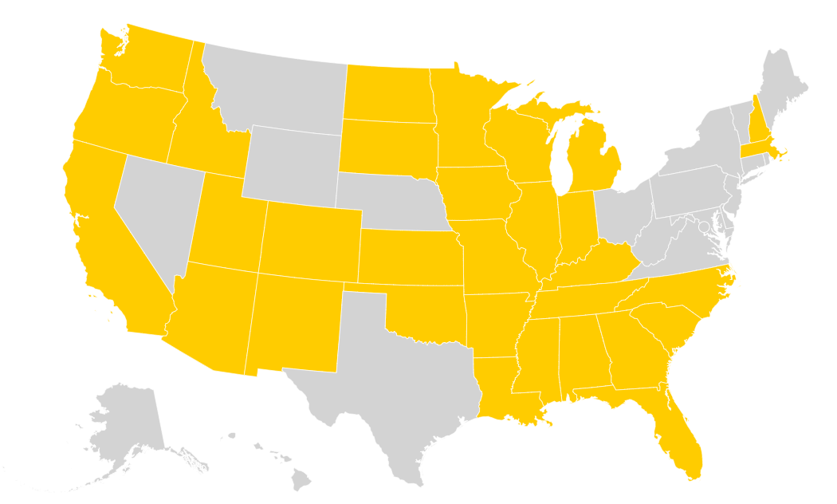
2022 Updates
Four states (Florida, Georgia, Missouri, and Texas) passed laws preempting local control over police budgets
Three states (Alabama, New Hampshire, and Utah) added new preemptive elements to their laws related to local regulation of firearms
One state (Ohio) passed a new law prohibiting local governments from passing any laws imposing rent control or rent stabilization on private landlords
Figure 1. Firearms Preemption as of November 1, 2022
Figure 2. Rent Control Preemption as of November 1, 2022

Slide 22
Race and Racism in the Classroom
Sterling Johnson JD, MA
CENTER FOR PUBLIC HEALTH LAW RESEARCH
April 12, 2023

Slide 23
Race and Racism in the Classroom
Preemption Context

Slide 24
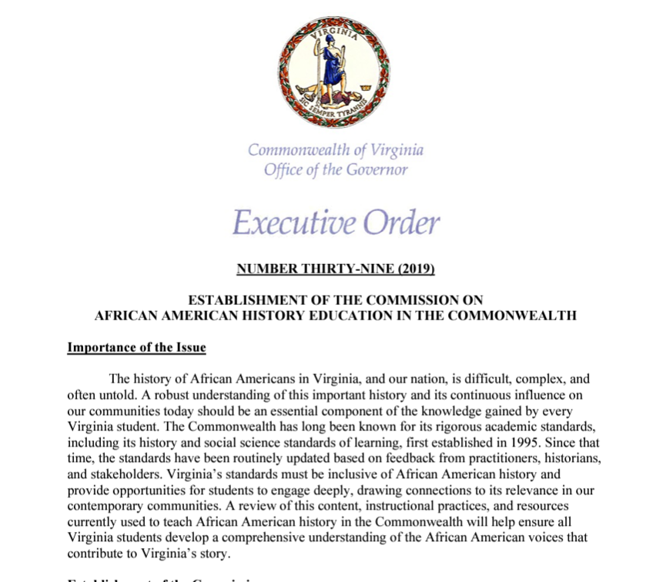

Slide 25
Race and Racism in the Classroom
Black History as U.S. History

Slide 26
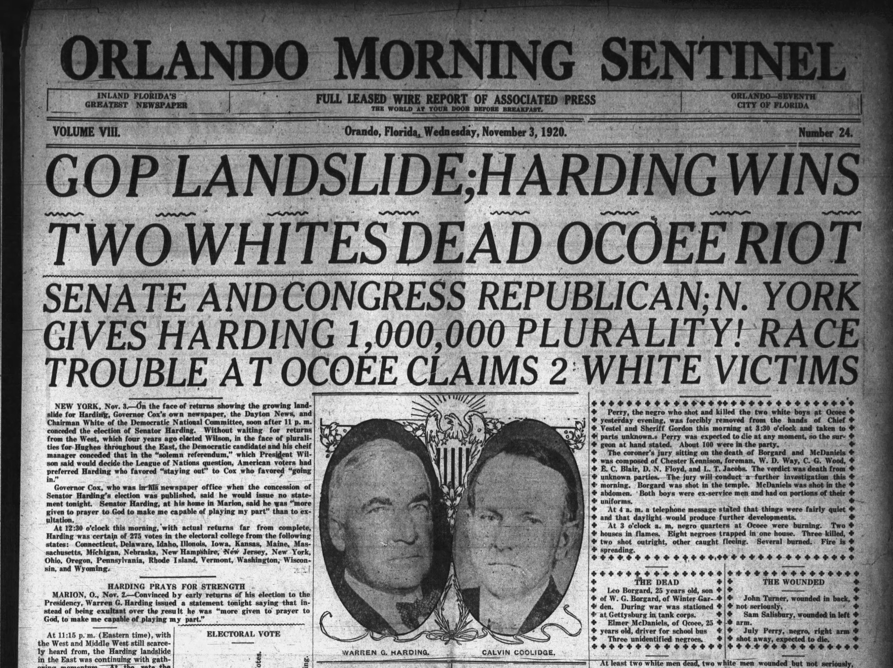
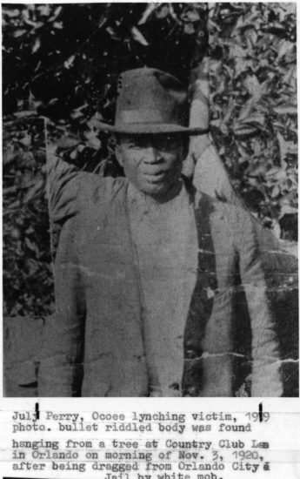
Source: Orange County Regional History Center
Source: University of Florida

Slide 28
Race and Racism in the Classroom
Anti-“Critical Race Theory” Laws

Slide 29
Black History Education as Critical Race Theory

Slide 30
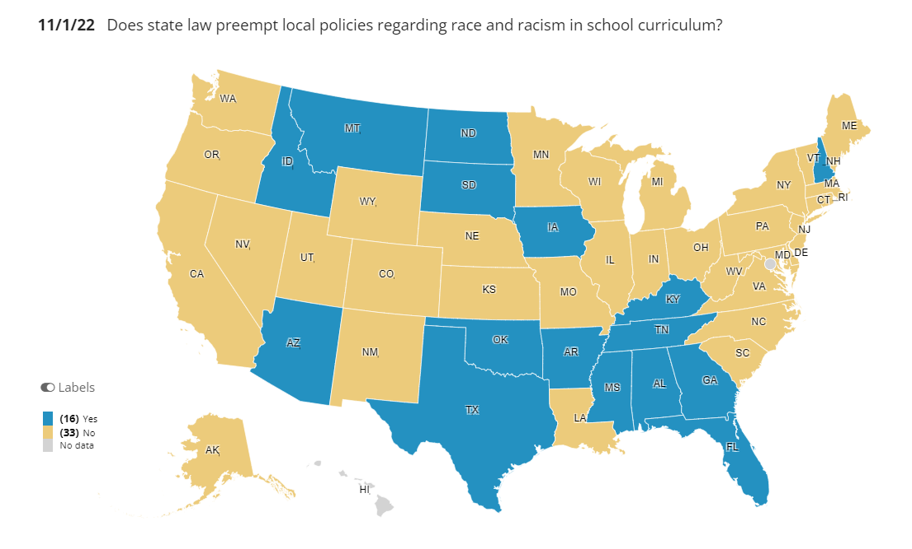

Slide 31
Broad Categories Prohibited from Being Taught in Classrooms
The U.S. is fundamentally racist or sexist
Meritocracy or traits such as a hard work ethic are racist or sexist or were created by a particular race to oppress another race
Any individual should feel discomfort, guilt, anguish, or any other form of psychological distress on account of his or her race or sex
An individual, by virtue of his or her race or sex, bears responsibility for actions committed in the past by other members of the same race or sex
"Divisive concepts" or "controversial issues“
Racial scapegoating

Slide 32
“CRT” Book Bans

Slide 33
Race and Racism in the Classroom
Real-world Impact

Slide 34
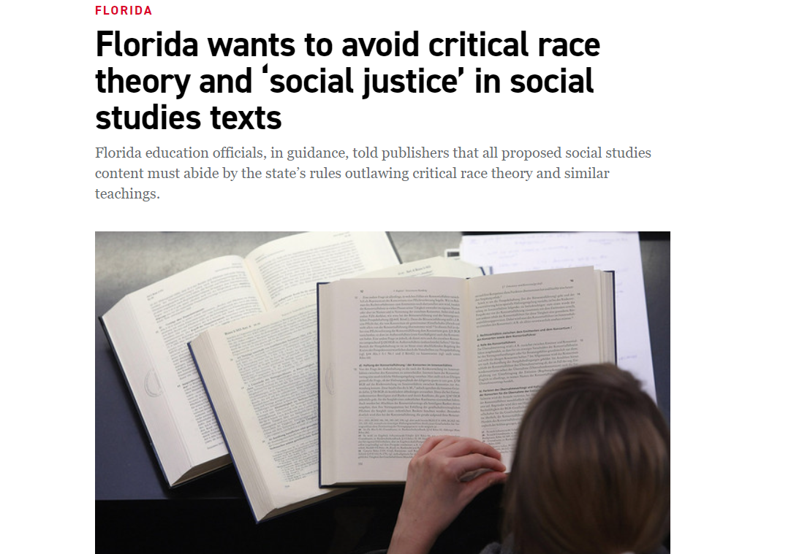
Florida Education Guidelines
Source: Getty Images

Slide 35
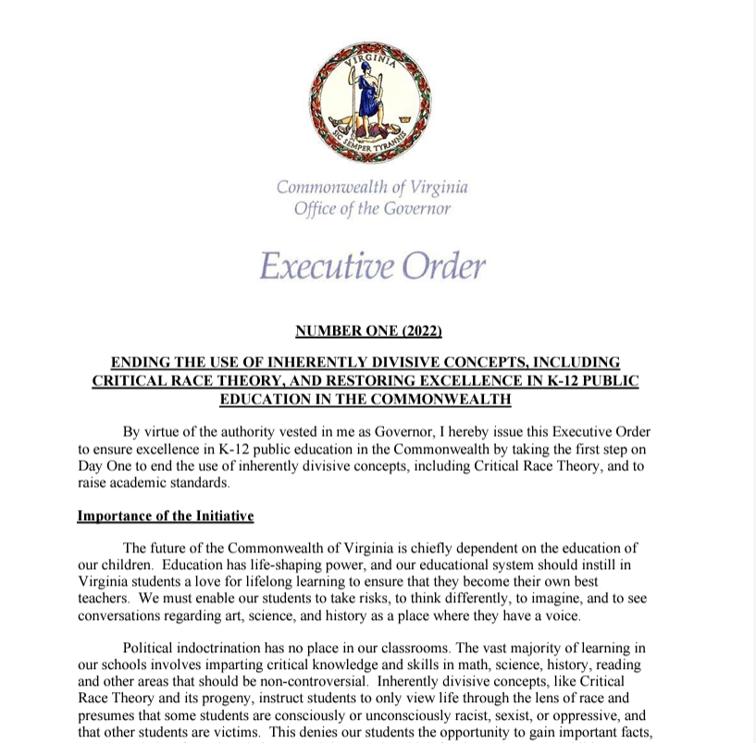

Slide 36
Transgender Rights
and Preemption
CENTER FOR PUBLIC HEALTH LAW RESEARCH
APR 12, 2023

Slide 37
For the last couple of decades, transgender rights have been ostensibly under attack. The rise in laws and regulations infringing on these rights have grown exponentially in the last few years. Not all anti-trans laws are preemptive, but the usage of preemption as an anti-trans tactic is prevalent and especially worrying.

Slide 38
Types of anti-trans preemption laws

Slide 39
Anti-Discrimination Protections
These bills are especially sinister as they prevent localities from protecting a vulnerable population. North Carolina’s HB2 is the most prominent example, even though the “Bathroom Bill” section stole all the headlines.
as of November 1, 2022.

Slide 40
Prohibiting adding gender identity as a protected class
Two states currently
Arkansas
Tennessee
North Carolina (HB2) – finally and completely repealed in 2019.
Attempts to safeguard: Michigan Ballot initiative – court case (https://ballotpedia.org).
Five more states have introduced bills since 2021 (https://www.tracktranslegislation.com/).

Slide 41
Rights in the School Setting
As is often the case with moral panics, the alleged corrupted youth is the target. And given the state’s control over education, this is the avenue for which most preemption related anti-trans legislation are occurring. This is occurring both in and out of the classroom.
as of November 1, 2022.

Slide 42
Inclusive School Curriculum and Parental Bills of Rights*
Four States - Curriculum
Texas
Arkansas
Alabama
Florida
Three states – Parental Bills of Rights
Arizona
Alabama
Florida
Altogether 87 bills involving education have been so far introduced in 2023 (https://www.tracktranslegislation.com/).
*other states have also enacted parental bills of rights, but these three states’ laws specifically invovle mental health and the ability for children to socially transition

Slide 43
Participation in Sports
Nineteen states
(AL, AZ, AR, FL, GA, ID, IA, IN, KY, LA, MS, MT, OK, SC, SD, TX, TN, UT, WV)
Eleven states passed bills in 2022 alone
Three states had bills fail in 2022 (KS, WI, WY)
According to other sources, four more bills have passed in 2023 (both Kansas and Wyoming overcoming previous failure) (https://www.tracktranslegislation.com/)

Slide 44
Single-Sex or Sex-Segregated Spaces (Bathroom Bills)
Oklahoma, North Carolina (HB2), Alabama
The bills in Oklahoma and Alabama apply in the school setting whereas North Carolina’s law applied in any public facility
Since our research, Arkansas and Idaho have both passed school bathroom bill.
HB2 represents how far these types of bans can be taken.

Slide 45
Gender-Affirming Care
Restrictions are not limited to schools and anti-discrimination protections. The most worrisome trend we are seeing are states prohibiting gender-affirming care in its entirety for transgender youth.
as of November 1, 2022.

Slide 46
Prohibitions of Gender-Affirming Care for Trans Youth (and sometimes adults…)
Only Arkansas preempted as of November 1.
In lieu of an outright ban, Arkansas banned using public funds for gender-affirming care and anyone in state or county-owned facilities from providing care.
Two states have followed suit (AZ and MS) while nine states have passed non-preemptive bans (AL, FL, GA, ID, IN, SD, TN, UT, and WV) (https://blog.petrieflom.law.harvard.edu/2023/03/22/trans-antagonism-creates-space-for-the-worst-side-of-the-law/ GA, ID, and IN all enacting bills in the three weeks since I wrote that blogpost https://www.tracktranslegislation.com/).

Slide 47
How We Can Move Forward

Slide 48
490+
Anti-Trans Bills in 2023 Source: https://translegislation.com/

Slide 49
Activism and Advocacy
Reactive: Each time a law is passed, organizations like the ACLU, National Center for Transgender Equality, Lambda Legal, Transgender Legal Defense & Education Fund, National Center for Lesbian Rights and others have lawsuits ready to go challenging the constitutionality of these laws.
Proactive: Organizers across the country attend and broadcast committee hearings and legislative sessions when proposed bills are on the docket. Giving testimony, raising community concerns, and even protesting state legislatures themselves is proving invaluable to this fight.

Slide 50
Resources
Law and Bill Tracking
https://lawatlas.org/datasets/preemption-project
https://www.tracktranslegislation.com/
https://translegislation.com/
https://www.aclu.org/legislative-attacks-on-lgbtq-rights
Organizers and Commentators
Erin Reed (Activist following state legislature movement) – https://twitter.com/ErinInTheMorn
Alejandra Caraballo (Lawyer and clinical instructor) - https://twitter.com/Esqueer_
Ari Drennen (Media Matters journalist) – https://twitter.com/AriDrennen
Allison Chapman (Legislative researcher) - https://twitter.com/AlliRaine22

Slide 51
Thank You!

Slide 53
Preemption and Abortion Access Post-Dobbs
Jennifer L. Piatt, J.D. Research Scholar Deputy Director, Western Region
Network for Public Health Law Sandra Day O’Connor College of Law Arizona State University Jennifer.Piatt@asu.edu

Slide 54
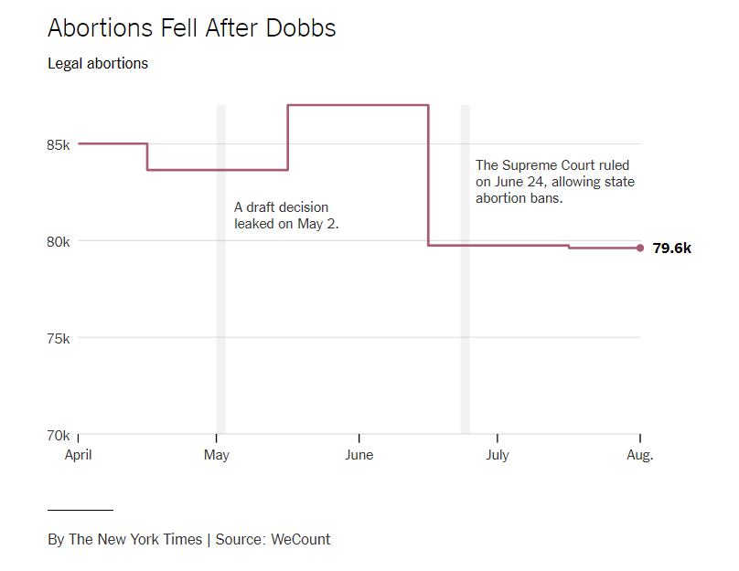
Abortion Post-Dobbs
Legal Abortions Fell Around
6 Percent In Two Months
After End of Roe
New York Times (Oct. 30, 2022)

Slide 55
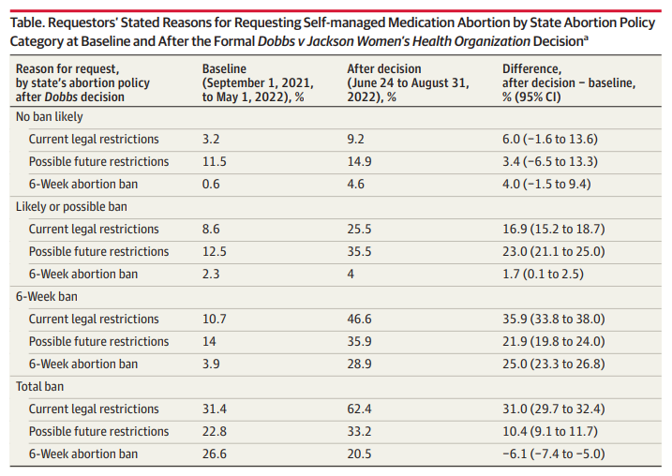
Requests for Self-managed Medication Abortion Before and After Dobbs, JAMA (Nov. 1, 2022)

Slide 56
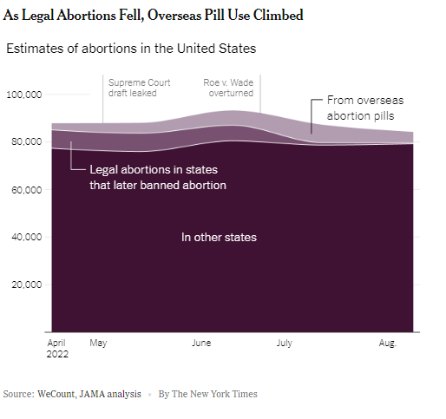
Abortion Post-Dobbs
“Putting both studies together, there were about 2,000 fewer abortions per month, compared with April, when abortion was legal in every state.”
New York Times (Nov. 1, 2022)

Slide 57
Federal Preemption

Slide 58
FDA Preemption
PATHWAY:
FDA’s authority to approve safe & effective drugs for circulation in interstate commerce may preempt contradictory state laws seeking to
limit or restrict medication abortion access, enabling access to
medication abortion nationally.
COVERAGE:
Pregnant individuals seeking abortion up to 10 weeks gestation.
CAVEATS:
Litigation has emerged regarding the extent of FDA authority and preemption vis-à-vis state authority over the practice of medicine.

Slide 59
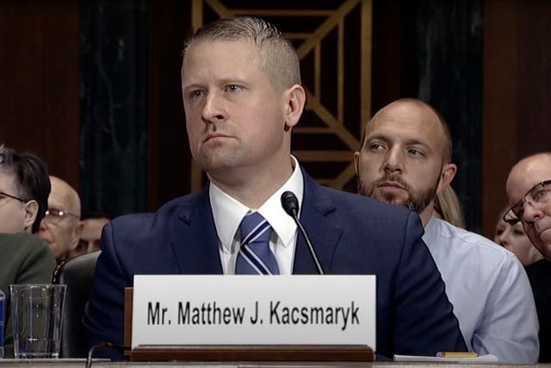
Alliance for Hippocratic Medicine v. FDA (N.D. Tex., Apr. 7, 2023)
In a challenge by anti-abortion medical associations, Judge Matthew Kacsmaryk, an appointee of President Donald Trump, stayed FDA’s approval of medication abortion drug mifepristone in an attempt to remove it from the U.S. marketplace.

Slide 60
Alliance for Hippocratic Medicine v. FDA (N.D. Tex., Apr. 7, 2023)
FDA originally approved mifepristone in 2020 under an approval pathway aimed at providing more stringent control of the drug (“subpart H”).
Subpart H
REMS
According to Judge Kacsmaryk, the Subpart H approval was unlawful because:
Pregnancy is not an “illness,” and
Drugs for medication abortion “do not provide a ‘meaningful therapeutic benefit’” above surgical abortion.

Slide 61
Alliance for Hippocratic Medicine v. FDA (N.D. Tex., Apr. 7, 2023)
Standing
Plaintiffs need to initially prove a concrete and particularized injury has occurred, or imminently will occur, that is traceable back to the defendant.
Judge Kacsmaryk: Plaintiffs have standing
Numerous Other Legal Analysts:
Plaintiffs do not have standing

Slide 62
Alliance for Hippocratic Medicine v. FDA (N.D. Tex., Apr. 7, 2023)
Federal Comstock Act (1873):
“Every article or thing designed, adapted, or intended for producing abortion, or for any indecent or immoral use; and . . .
Every article, instrument, substance, drug, medicine, or thing which is advertised or described in a manner calculated to lead another to use or apply it for producing abortion, or for any indecent or immoral purpose; . . .
Is declared to be nonmailable matter and shall not be conveyed in the mails or delivered from any post office or by any letter carrier.”
18 U.S.C. §1461.

Slide 63
Alliance for Hippocratic Medicine v. FDA (N.D. Tex., Apr. 7, 2023)
DOJ: Courts read an “unlawful” requirement into the Comstock Act, and mailing mifepristone does not necessarily mean an unlawful abortion is going to occur.
Judge Kacsmaryk: Mifepristone approval enables violation of the Comstock Act

Slide 64
Washington v. FDA (E.D. Wash., Apr. 7, 2023)
The court preliminarily enjoined FDA from “altering the status quo and rights as it relates to the availability of Mifepristone” in the 17 challenging states and Washington, D.C.

Slide 65
Where does mifepristone stand, legally?

Slide 66
Emergency Medical Treatment & Active Labor Act (EMTALA)
PATHWAY:
EMTALA requires most U.S. hospitals to provide screening & stabilizing emergency care. On July 11, 2022, HHS confirmed that physicians may conclude life-saving abortion care is necessary under EMTALA when pregnant patients present with an “emergency medical condition” (EMC). EMTALA expressly preempts conflicting state laws.
COVERAGE:
Pregnant patients with an EMC necessitating abortion as treatment at most hospitals.
CAVEATS:
Litigation may determine what is considered an EMC or how state & federal laws intersect. In select challenges (TX, ID), federal courts have issued contradictory opinions.

Slide 67
State Preemption of Local Authorities

Slide 68
PATHWAY: Prosecutors have near-absolute discretion over when to prosecute individuals for abortion-related crimes. Post-Dobbs, 90+ elected state prosecutors have pledged not to enforce their states’ abortion bans or restrictions. Some police chiefs & city councils have also issued memos providing for the de-prioritization of police enforcement of abortion bans.
Enforcement Discretion
COVERAGE:
Highly variable & dependent on jurisdiction.
CAVEATS:
Governors can suspend prosecutors for refusing to prosecute abortions. Prosecutors are elected officials with fixed or limited terms—newly elected prosecutors may take different stances from their predecessors.

Slide 69
Texas S.B. 20
“A prosecuting attorney may not adopt or enforce a policy under which the prosecuting attorney refuses to prosecute a class or type of criminal offense for any reason other than to comply with an injunction, judgment, or order issued by a court.”
Makes such action “official misconduct” justifying removal.
Passed Texas Senate on April 5, 2023.

Slide 70
New Mexico
Prohibits public bodies (e.g., localities) from “deny[ing], restrict[ing] or interfer[ing] with a person’s ability to access or provide reproductive health care or gender-affirming health care”
New Mexico H.B. 7 (2023)
N.M. Supreme Court
Suspended Eastern New Mexico ordinances restricting access to abortion

Slide 71
Acknowledgments
Ask the Network regarding questions or comments:
Jennifer L. Piatt, J.D., jpiatt@networkforphl.org
Special thanks to Summer Ghaith, Cleo Goeckner, Lauren Krumholz, Madisyn Puchebner & C. McKenna Sauer at ASU’s Sandra Day O’Connor College of Law for their research, drafting & formatting assistance.

Slide 72
People. Policy. Progress.
More than 40 sessions examining core issues for healthier, stronger, and more equitable communities.
networkforphl.org/2023conference | #phlc2023

Slide 73
Thank you for attending.
Webinar attendees who requested CLE credits at the time of registration will receive an email from ASLME, an approved provider of continuing legal education credits, with information on applying for CLE credit for this webinar.
73

