Slide 1
The Prevention Measures Law Project
A Tool for Assessing Legal Preparedness for Emergencies

Slide 2


Denise Chrysler, JD
Senior Advisor, Mid-States Region
Network for Public Health Law
Stacie Kershner, JD
Consultant
Network for Public Health Law
Notes:
Bios
Denise Chrysler is a Senior Advisor at the Network’s Mid-States Region Office. She served as the Mid-States Office’s director from the time the Network was launched in September 2010 until she retired from the position in February 2023. Before joining the Network, for 27 years, Denise provided legal services to Michigan’s state health department. She served as the state health department’s public health legal director, privacy officer, freedom of information coordinator, regulatory affairs officer, and member of the Institutional Review Board. She also represented the health department as an assistant attorney general. Denise earned her JD at the University of Michigan Law School.
Stacie Kershner is a Senior Academic Professional and Deputy Director for the Center for Law, Health and Society at Georgia State University College of Law, where manages new and ongoing health law education, research and community outreach initiatives. She teaches public health law to law and graduate students. Stacie is also a legal consultant with the Network for Public Health. Prior to Georgia State Law, Stacie served as an ORISE fellow with the Centers for Disease Control and Prevention Public Health Law Program. Kershner earned her J.D. from Georgia State University College of Law and she holds a graduate certificate in public health from Georgia State University School of Public Health.

Slide 3



Agenda
I. Introduction to the Tool
1. Partners
2. History: Social Distancing Law Project (Round 1 – 2007; Round 2 – 2009-2010)
II. What’s New and Improved
III. Tool Components
1. The Law Assessment and Template Questionnaire
2. The Legal Consultation Meeting with Tabletop Exercise
IV. Next Steps
Notes:
The Prevention Measures Law Project is a tool that jurisdictions may use to assess the sufficiency of their legal authority to implement communicable disease prevention measures including both non-pharmaceutical measures and measures to increase access to pharmaceuticals.
The tool was originally developed and implemented by the Centers for Disease Control and Prevention Public Health Law Program and the Association of State and Territorial Health Officials. Last year, the CDC awarded funds to ASTHO to update the tool, and they brought the Network for Public Health Law into this third round as well, because two of the Network attorneys were involved with the implementing the tool in their jurisdiction in their positions as state public health attorneys prior to joining the Network: Denise Chrysler in Michigan and Donna Levin in Massachusetts. Denise was the Mid-States Region Co-Director. Donna was the Network Director and both are recently retired but still working with the Network. I had worked on the early versions of the Social Distancing Project while with the CDC’s Public Health Law Program and was excited to come back on board as a consultant for this project. Our team also includes ASTHO’s Andy Baker White and CDC’s Greg Sunshine.
The tool was originally called the Social Distancing Law Project or SDLP for short. The original tool examined measures such as quarantine and isolation, school dismissal, business closures, and cancellation of mass gatherings. These are all measures that we know have been important to some degree at various times throughout the COVID response. But we also know that there are many other measures to prevent disease control that have been important as well, so we knew the tool needed to be updated. We also recognize the importance of having both non-pharmaceutical measures alongside the pharmaceutical measures, so we have expanded the tool to encompass a broader range of measures. And we have also realized that these non-pharmaceutical measures are really designed to keep people physically distanced but that there are a lot of ways in our world right now to continue to be socially together even when apart. So the updated tool has a new name, “The Prevention Measures Law Project” or PMLP.

Slide 4
Which of the following best represents your employment? a. Federal govt. b. State govt. c. Local govt. d. Tribal govt. e. Territorial govt. f. Research/Academic g. Other (share in the chat)
Who’s attending?
Polling Question #1

Slide 5
Which of the following best represents your role? a. Attorney b. Public health professional c. Emergency management professional d. Researcher / Academic e. Other (share in the chat)
Who’s attending?
Polling Question #2

Slide 6
Past Participation
  Michigan’s Experience
WASHINGTON
MONTANA
NORTH
DAKOTA
MAINE
OREGON
MINNESOTA
VERMONT
NEW HAMPSHIRE
IDAHO
SOUTH DAKOTA
WISCONSIN
WYOMING
NEW YORK
MASSACHUSETTS
MICHIGAN
RHODE ISLAND
NEVADA
NEBRASKA
IOWA
PENNSYLVANIA
CONNECTICUT
INDIANA
NEW JERSEY
UTAH
ILLINOIS
OHIO
DELAWARE
COLORADO
WEST
VIRGINIA
MARYLAND
CALIFORNIA
KANSAS
MISSOURI
KENTUCKY
VIRGINIA
TENNESSEE
NORTH
CAROLINA
ARIZONA
NEW
MEXICO
OKLAHOMA
ARKANSAS
SOUTH
CAROLINA
ALABAMA
GEORGIA
MISSISSIPPI
Round 1
(+ Washington DC and Puerto Rico)
Round 2
TEXAS
LOUISIANA
FLORIDA
HAWAII
ALASKA
Notes:
The tool was first developed and launched in 2007. The 17 Round I participating jurisdictions were Alaska, California, Connecticut, Washington, D.C., Florida, Georgia, Hawaii, Illinois, Maryland, Massachusetts, Michigan, New Jersey, New York, Puerto Rico, Texas, Virginia, and Washington state.
The tool was again implemented in 2009-2010. The 9 Round II states were Alabama, Missouri, Nebraska, New Hampshire, North Dakota, Ohio, Oregon, Pennsylvania, and Utah.

Slide 7
Based on this map, do you live in a jurisdiction that participated in Rounds I or II of the Social Distancing Law Project? a. Yes b. No
Who’s attending?
Polling Question #3

Slide 8
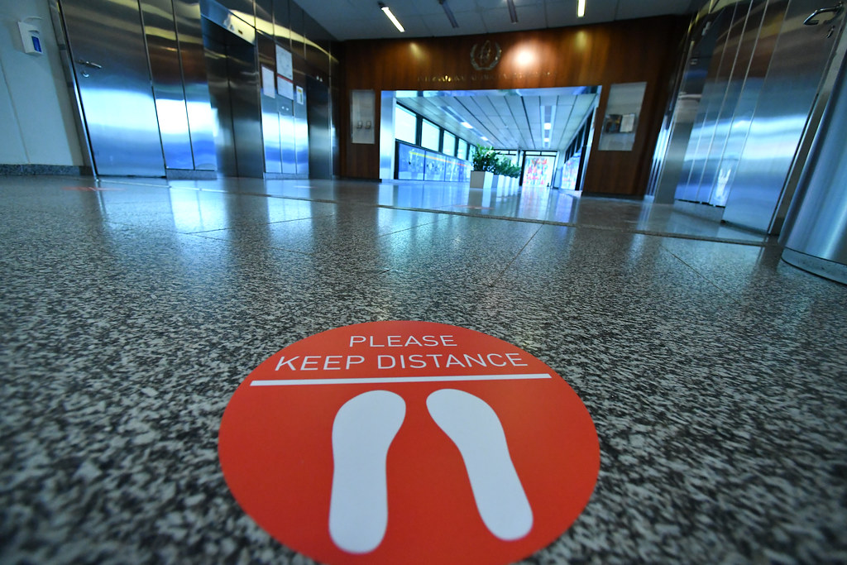
The Update: PMLP (AKA SDLP Round 3)
  Name
  Communicable Diseases
  Audience
  Themes
    Legal Authority
    Implementation
    Equity
    Communication
    Continuity
  Components
  Disease Control Measures
  Flexibility/Scalability/Customization
Image: Reminder to physically distance in orange circle on ground..
Notes:
So what makes this tool new and improved, aside from the new name?
The original Social Distancing Law Project and in fact much of our emergency preparedness efforts were directed to influenza specifically. Based on the experience of the past decade, we know we need to be prepared for a variety of different possible communicable disease outbreaks. Ebola, Measles, Tuberculosis, COVID, and Monkeypox are all threats we have faced in the past ten years. Our updated tool allows jurisdictions to examine sufficiency of legal authority for various diseases and also unknown threats.
While the original SDLP was directed toward state public health officials and attorneys, the updated PMLP is designed to be used by state, local, territorial and Tribal health department officials and public health attorneys, as well as public health practitioners, and alongside partners in other departments or agencies, such as education, transportation, law enforcement, etc. who are charged with understanding, implementing and enforcing laws authorizing social distancing measures in order to prevent and control communicable diseases.
To identify additional areas where the tool needed revision or enhancement, we convened a workgroup in early spring of 2022. Some of the workgroup members were leads or participants in their state’s SDLP in Rounds I or II. Others are the successors to those who may have participated. We asked the workgroup a series of questions about the tool, the pros/cons, how the information gathered may have been used in their jurisdiction and what improvements should be made. These are the themes that arose from that conversation
Legal Authority – some of the jurisdictions who participated found the tool valuable because is served as the basis for developing guidance and template orders, some of which was useful during COVID-19. However better understanding is needed of authority at each level of government as well as across agencies in order to have a cohesive response. Questions were added to this version to address the interaction between jurisdictions, including possible preemption, and in cooperation with neighboring jurisdictions.
Implementation – some jurisdictions felt it would be helpful to learn what different approaches other jurisdictions might have for the same problem in order to potentially improve response. They also felt that more attention needs to be paid to compliance and enforcement. There was also recognition that if enforcement is to be handled by a third party, they need to have input, be on board as much as possible, and be compensated if possible. There was also consensus that the bandwidth of health care entities and law enforcement agencies in particular need to be considered, so this was added.
Equity – equity arose as a very serious theme throughout the discussion. Many jurisdictions felt that little legal preparedness efforts had considered the disparate impact on communities of color or low-income communities during prior planning. Equitable enforcement – ensuring that measures were applied consistently and with intent to reduce potential burden on already burdened communities is also important.
Communication – building relationships the community on mutual respect and trust is important so that the first communication isn’t during an emergency. Understanding best practices in communicating complex legal language for lay understanding is critical to getting the message out efficiently and effectively.
And finally,
Continuity – Workgroup attendees emphasized the importance of putting systems in place to maintain the information and practice response regularly, as well as to pass along the information to any successors new to their positions who will have a role in the response.
So what is included in the tool now?

Slide 9
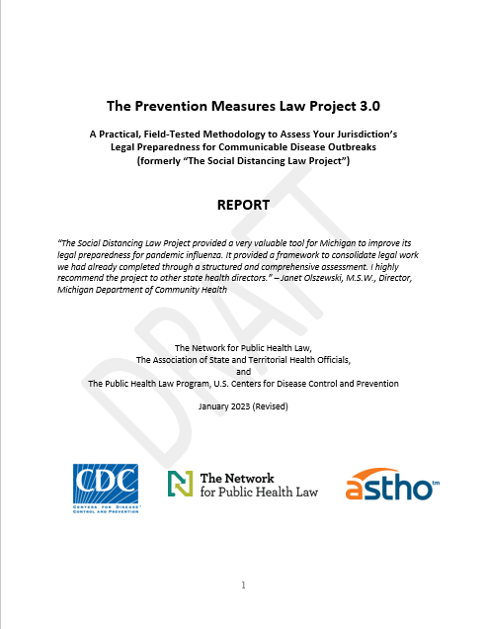
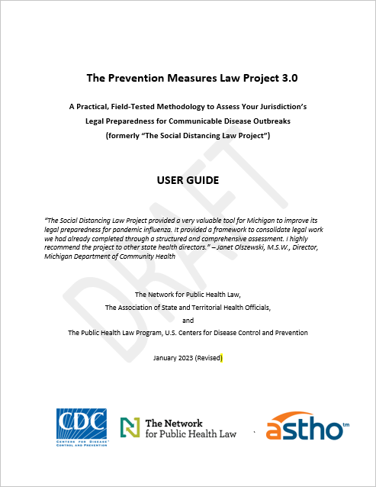
Included in the Tool
Report
User Guide
  Legal Assessment and Template Questionnaire
  Legal Consultation Meeting and Tabletop Exercise
  Report and Action Steps
Notes:
The new updated PMLP allows jurisdictions to assess their legal sufficiency to respond with various prevention measures.
First, there is a a report providing background information and describing in detail how a jurisdiction may implement the too.
Then there is a user guide which includes: The Legal Assessment with a template questionnaire to complete about your jurisdiction’s laws and the Legal Consultation Meeting, with a Tabletop Exercise to test those laws. The resulting product from these two components is a Report with action steps to take in your jurisdiction. Let’s take a deeper look at each of these.

Slide 10

Legal Assessment
  Compile the relevant legal authority supporting implementation and enforcement of disease control measures.
  Identify any gaps, uncertainties, or ambiguities in those authorities.
  Examine interjurisdictional cooperation.
  Can I? Must I? Should I?
Image: Diverse group of professionals seated at an office table, with the group focused on one woman who is speaking..
Notes:
The first component of the tool is an analysis of the prevention measures and preparation of a report detailing the sufficiency of those laws both prior to or in the absence of a declared public health emergency and after an emergency is declared. The jurisdiction’s legal counsel will likely complete this tool or at least oversee and review its completion.
The purpose of the legal assessment is to: 1) Compile the relevant legal authority supporting implementation and enforcement of disease control measures, and 2) Identify any gaps, uncertainties, or ambiguities in those authorities.
The assessment includes a section for each of the disease control measures on the next slide. The questions are designed to be asked twice. The first is for what legal authorities exist to support that measure when there isn’t an emergency order. So this would be the measures that the jurisdiction can take generally under their everyday legal authorities. The questions are then repeated for when there is an emergency order in place. The type of order depends on the jurisdiction. It might be an emergency order issued by the governor or it could be a public health emergency order specifically. These orders tend to expand the options of what is available to prevent or control a disease.
The questions then continue by analyzing whether these legal authorities are sufficient to implement and enforce the measure. The jurisdiction would want to consider how best to address potential gaps identified before needing to use those measures during an outbreak.

Slide 11

Disease Control Measures
  Restriction on the Movement of Individual Persons
  Restriction on the Movement of Communities or Groups within or into the Jurisdiction
  Exclusion of Students, Cancellation or Altered Practices of Schools
  Closure or Altered Practices of Public Places
  Cancellation or Altered Practices of Mass Gatherings
  Mandates for Masks, Gloves, and Other PPE
  Contact Tracing
  Requirement for a Health Screening or Proof of Negative Test
  Vaccine Mandates and Proof of Vaccine Requirements
  Distribution of Mass Prophylaxis
Image: Empty school classroom with chalkboards, smartboards, desks and chairs.
Notes:
The updated version of the tool contains these disease prevention measures. Do you know what laws authorize these measures in your jurisdiction? Do you know the details of those laws? Who is allowed to order these measures? How are they funded and implemented? What means are there to increase compliance? Who is responsible for enforcement? Are there penalties for non-compliance?
The first category includes restriction of movement of individuals, such as isolation of individuals who are sick or quarantine of individuals who have been exposed. This could also include quarantine of a group of people who can be specifically defined, like all of the passengers on a certain flight.
But as we know from COVID, we might need to restrict large groups of people. So the second category is for restriction of movement of all people within a community, rather than identified individuals. This includes things like restricting travel into a state or implementing a stay-at-home order. It also includes measures like a cordon sanitaire, or quarantine of a geographic area.
The category for schools includes excluding individual students, such as those who are not vaccinated against a disease threat when one is available. Closure is a shut down. But altered practices may be more common in the future – that would include going to virtual or hybrid schooling or alternating days or running double buses to reduce the number of students in each seat.
Closure of public places includes businesses open to the public like restaurants or stores. Mass gatherings could be large sporting events, parades, concerts, or even things like weddings or funerals.
The altered practices may include things like reducing the total capacity by 50 or 25%. Or capping total attendance. It might also include things like only allowing outdoor dining or requiring building alterations to HVAC or having windows open, etc.
We have added mandates for PPE, like masks, or screenings like temperature checks or negative tests. We have also included vaccine mandates and distribution of mass prophylaxis.

Slide 12
Sample Assessment Questions:
Exclusion of Students, Cancellation or Altered Practices of Schools
Part A
What are the powers and authorities authorizing the closure of schools, exclusion of students, or altering of practices or operations of schools?
What are the powers and authorities prohibiting this measure?
Who is authorized to determine if this measure is needed?
…
Are there plans in place to continue reduced and free lunches to students who receive those services while schools are open?
Are there plans in place to consider continuity of services for students with disabilities served under IDEA?
Are there plans in place for communicating with families for whom English is a second language?
…
How can this measure be ended? Who has the authority to end this measure, what is the process, is a notice required, and what criteria should be considered?
Can anyone be held liable, or can liability be waived for anyone ordering, implementing, enforcing, or ending this measure?
Notes:
Here is an excerpt from the 3rd disease prevention measure: Exclusion of students and Closure or Altered Practices of Schools.
Each section opens with similar instructions for each of three parts. Part A is legal authority.
For the following questions, respond first in the absence of or prior to a declaration of an emergency, then repeat for during a declared emergency.
Legal powers/authorities and procedures to close schools, exclude students, or otherwise alter practices or operations of schools
If it becomes necessary for officials to close schools, exclude students, or otherwise alter practices or operations of schools (including public, private, K-12, preschool, childcare, colleges and universities, etc.), what legal authorities and procedures would enable, support, authorize, or otherwise provide a legal basis for doing so? List all legal powers, authorities, and procedures including, but not limited to, police powers of health, safety and welfare; general public health powers; or emergency powers or authorities that could be used to authorize, prohibit, or limit closure of schools, exclusion of students, or alteration of practices or operations. (If there are multiple powers or authorities that can be used to support this same measure, be sure to include the responses for each.)
Then the template goes on to say, For each of the identified powers and authorities, determine:
What are the powers and authorities authorizing closure of schools, exclusion of students, or altering of practices or operations of schools?
What are the powers and authorities prohibiting this measure?
Who is authorized to determine if this measure is needed?
Several of the questions are the same in every section. But each section also includes some that are specific to that disease control measure.
Are there plans in place to continue reduced and free lunches to students who receive those services while schools are open?
Are there plans in place to consider continuity of services for students with disabilities served under IDEA?
Are there plans in place for communicating with families for whom English is a second language?
And then the questions look at how the measure can be ended.
How can this measure be ended? Who has authority to end this measure, what is the process, is notice required, and what criteria should be considered?
Can anyone be held liable or can liability be waived for anyone ordering, implementing, enforcing, or ending this measure?

Slide 13
Sample Assessment Questions:
Exclusion of Students and Closure or Altered Practices of Schools
Part B
Are there potential gaps in those legal authorities?
Are there potential uncertainties about those legal authorities?
Are there any legal provisions that could inhibit, limit, or modify the jurisdiction’s legal authority to close schools, exclude individual students, or otherwise alter practices or operations of schools not otherwise listed above?
Part C
Do any higher levels of government have additional or concurrent authority? Are any of this jurisdiction’s measures preempted by a higher level of government, limiting this jurisdiction’s ability to respond?
…
What agreements are in place for inter-jurisdictional cooperation between this jurisdiction and neighboring or other jurisdictions?
…
Notes:
The questions go on to examine interjurisdictional cooperation. What other jurisdictions may also have concurrent or conflicting authority. Are any measures preempted? Also neighboring jurisdictions may want to examine participation in EMAC, or other mutual aid or agreements.
Part B asks about the sufficiency of these authorities and whether there are any gaps that should be addressed.
Part C looks at overlapping authority, such as when the state and locality each are potentially able to act on the same issue, such as if this were a local jurisdiction who could close schools, could the state also close the schools or demand they stay open? It also looks at jurisdictional cooperation. For example, where I live there is a city school district for the largest city in the county and a county school district for the other smaller cities and unincorporated areas. They try to collaborate on decisions to close and on messaging to avoid confusion. It may also be that neighboring jurisdictions have agreements for providing mutual aid that might be important.

Slide 14
Sample Assessment Questions:
Exclusion of Students and Closure or Altered Practices of Schools
Part D
What characteristics of the disease should be considered before triggering this measure?
…
Might the action exacerbate existing health disparities of certain communities, and can these burdens be mitigated in some way?
...
Is the action in the best interest of other individuals, businesses, and communities? Are the social and economic costs of this measure greater than the costs of unchecked disease spread on individuals and businesses?
…
What challenges might there be to compliance and enforcement?
…
Will this measure support the jurisdiction’s values and advance the jurisdiction’s goals as determined through community participation and input?
Notes:
Part D gets into decision making once authority is established. Public health laws establish the legal authority to act, but rarely provide a clear course of action about whether, when, and how to act. Most decisions are discretionary, relying on professional judgment, subject-matter expertise, and the best currently available information. Decision makers must balance competing interests to avoid acting prematurely without sufficient information or exposing the public to potential harm while obtaining and evaluating evidence that supports a particular course of action. So this section of the template includes questions to help guide discretionary decision making, derived from another Network Tool on decision making, “Can I? Must I? Should I?”
The Lead Agency Attorney should be at the table with other senior leadership when discussing information important to making discretionary decisions, as there can be legal and ethical implications. Attorneys are not only needed to explain the legal authority on the front end or to bat clean up if there is litigation on the back end. Instead, attorneys should be involved with public health leadership along the way as part of the team.
There may also be legal alternatives with less risk that attorneys may be aware of to help public health achieve its goals. If the measure is discretionary, the jurisdiction also needs to consider legal and other consequences of action or inaction, ethical implications, whether there is disparate impact on certain populations, the best interest of community partners, finances, politics, and other factors. The jurisdiction also needs to examine potential challenges in compliance and enforcement, as well as how to communicate decisions to the public. These factors all must figure into decision-making by public health officials with guidance from their attorneys.

Slide 15
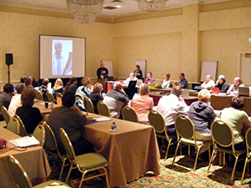
Legal Consultation Meeting with Tabletop Exercise
  Convene a meeting to be sure that participants are aware of and understand the legal authorities in the completed assessment report.
  Use a tabletop exercise to test the legal assessment.
  Incorporate lessons learned from COVID or other debriefs or reports.
  Capture any issues or concerns that arise.
  Plan for next steps – what are the action items?
  Plan for sustainability – how will the information be kept fresh?
Image: Centers for Disease Control and Prevention Pan Flu Scramble Exercise.
Notes:
Once the Legal Assessment is completed, it is time to organize the Legal Consultation Meeting.
The Legal Consultation Meeting is an opportunity to bring together public health officials and attorneys, along with representatives from other relevant agencies, or jurisdictions that may also have authorities, as well as private sector businesses and community organizations.
With all of these people in the room, the time is ripe to have a training on the information compiled in the legal assessment, to level-set and be sure that everyone has the same information. This is also an opportunity to ask questions and gain clarity or raise concerns.
Then the tabletop exercise provides a hypothetical scenario to test the sufficiency of the laws against, to consider what factors would be important in whether to act or not and how to act, and to determine what might be needed for compliance and enforcement.
This is also an opportunity to incorporate lessons learned from COVID after-action reports or other assessments that may be going on in your jurisdiction.
And the reality is that there likely are gaps that need to be addressed – testing against a hypothetical scenario offers a chance to identify any issues or concerns that arise and make plans to address them. What next steps are needed?

Slide 16
Legal Consultation Meeting Attendees
  State, tribal, territorial, and local health and emergency management officials, including representatives from public health preparedness
  and infectious disease control;
  Legal counsel for the public health and emergency management offices;
  Counterparts with emergency preparedness roles
  from other agencies such as law enforcement, homeland security, education, transportation, and corrections, etc.;
  Judges and court administrators;
  Elected officials from the executive and legislative branches, department leads, and their legal counsel;
  Representatives from the private sector, including businesses and non-profit organizations;
  Legal counsel and other leaders of hospitals and other healthcare facilities;
  Representatives of community organizations;
  Representatives of other entities critical to the successful implementation of prevention measures in the jurisdiction;
  Representatives from higher or lower-level jurisdictions with additional or concurrent authority for public health emergency response, and from neighboring jurisdictions with cooperative authority (such as through agreements);
  Public health and/or risk management communicators; and
  Others?
Notes:
This is a list of some of the attendees who may have a role to play in a disease outbreak and thus in the legal table top exercise. Are there others in your jurisdiction who should be invited and included?

Slide 17
Sample Tabletop Exercise
Facilitator: Over the past thirty days, the World Health Organization (WHO), the U.S. Centers for Disease Control and Prevention (CDC), and other agencies have confirmed the isolation of a novel and highly virulent and more deadly strain of [Disease]….
[Jurisdiction’s Health Department Official]: Our surveillance systems have identified the following…
The other suspected cases of [Disease] are four members of the same family. They may live near the first individual and may have crossed paths at the corner store or park or other public places in the neighborhood over the last few days. Two of the family members are children who attend the local elementary school…
Chief Executive Officer: What measures are available to restrict the movement of these individuals to prevent the spread of the [Disease] in [Jurisdiction]? Who is needed and what is involved in determining which measures to order and how to implement and enforce them? Can the children and their classmates be excluded from school? Can the neighborhood be placed under area quarantine (cordon sanitaire)?
Notes:
This is an excerpt from the tabletop exercise, around the section that addresses school exclusion, among other measures. These can be tailored to the specific disease that the jurisdiction would like to practice.

Slide 18
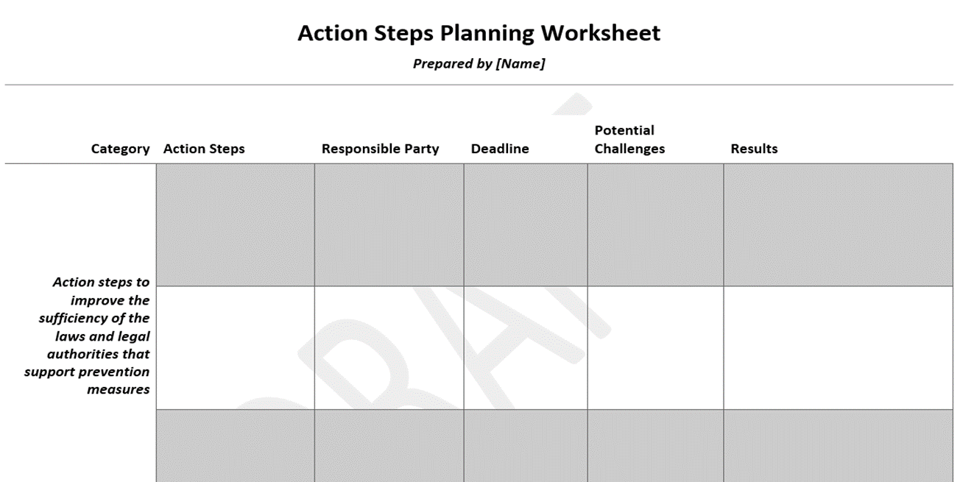
Sample Action Steps Report
Notes:
This is a screen shot of the action steps planning worksheet to track any gaps or inconsistencies that arise during the tabletop and need to be addressed after the meeting.

Slide 19
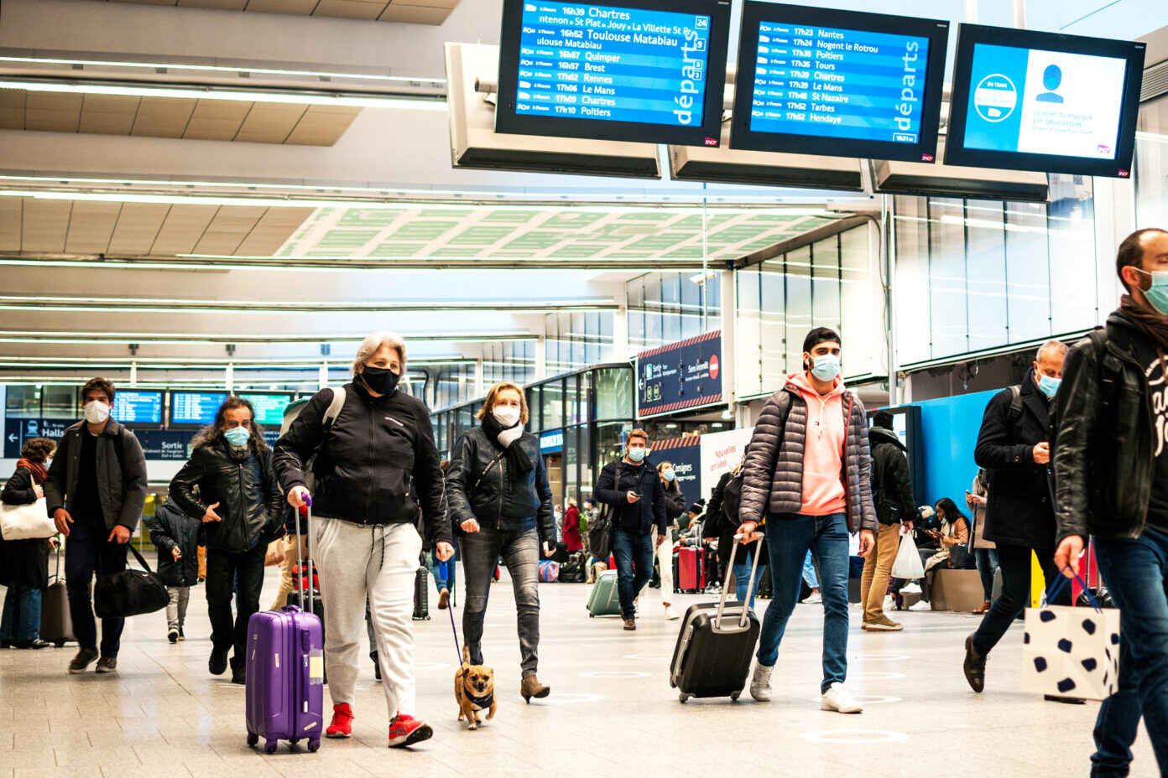
Pilot Sites
Next Steps
  Before the update is finalized, we would like jurisdictions to test the Prevention Measures Law Assessment Project
  3 Pilots before July 31
  For more information, contact Stacie at
  spkershner@networkforphl.org
Incorporate Feedback
Timeline to Launch
Image: People wearing masks walking through an airport.

Slide 20
COVID-19 After-Action Debriefs
Polling Question #4
Is your jurisdiction doing an after-action debrief on the COVID-19 response?
a. Yes
b. No

Slide 21
COVID-19 After-Action Debriefs
Polling Question #5
If your jurisdiction is doing a COVID-19 after-action debrief, does it include assessing legal authorities for disease control and response?
a. Yes
b. No

Slide 22
COVID-19 After-Action Debriefs
Polling Question #6
If your jurisdiction is doing an after-action debrief, is the attorney responsible for public health in your jurisdiction involved in the after-action debrief?
a. Yes
b. No

Slide 23
COVID-19 After-Action Debriefs
Polling Question #7
Has your jurisdiction participated in a training or tabletop exercise on public health emergency legal authority
a. Yes, training
b. Yes, tabletop
c. Yes, both training and tabletop
No
I don’t know / Not applicable

Slide 24
Disease Control Measures
Chat Discussion Question #1
Which of these disease prevention measures did your jurisdiction implement during the COVID-19 response?
  Restriction on the Movement of Individual Persons
  Restriction on the Movement of Communities or Groups
  within or into the Jurisdiction
  Exclusion of Students, Cancellation or Altered Practices of Schools
  Closure or Altered Practices of Public Places
  Cancellation or Altered Practices of Mass Gatherings
  Mandates for Masks, Gloves, and Other PPE
  Contact Tracing
  Requirement for a Health Screening or Proof of Negative Test
  Vaccine Mandates and Proof of Vaccine Requirements
  Distribution of Mass Prophylaxis

Slide 25
What challenges did your jurisdiction face when implementing these measures?
How could this PMLP help your jurisdiction to address challenges with implementing disease control measures before the next disease outbreak?
Disease Control Measures
Chat Discussion Question #2

Slide 26
Who do you think should be included at the Legal Consultation Meeting and Tabletop Exercise in your jurisdiction?
Legal Consultation Meeting Attendees
Chat Discussion Question #3
  State, tribal, territorial, and local health and emergency management officials, including representatives from public health preparedness
  and infectious disease control;
  Legal counsel for the public health and emergency management offices;
  Counterparts with emergency preparedness roles
  from other agencies such as law enforcement, homeland security, education, transportation, and corrections, etc.;
  Judges and court administrators;
  Elected officials from the executive and legislative branches, department leads, and their legal counsel;
  Representatives from the private sector, including businesses and non-profit organizations;
  Legal counsel and other leaders of hospitals and other healthcare facilities;
  Representatives of community organizations;
  Representatives of other entities critical to the successful implementation of prevention measures in the jurisdiction;
  Representatives from higher or lower-level jurisdictions with additional or concurrent authority for public health emergency response, and from neighboring jurisdictions with cooperative authority (such as through agreements);
  Public health and/or risk management communicators; and
  Others?
Notes:
This is a list of some of the attendees who may have a role to play in a disease outbreak and thus in the legal tabletop exercise. Are there others in your jurisdiction who should be invited and included?

Slide 27
What challenges might your jurisdiction face with implementing the Prevention Measures Law Project Toolkit? What would help you to address these challenges?
Implementing PMLP
Chat Discussion Question #4

Slide 28
How can a tool such as the PMLP help your jurisdiction to consider health equity when implementing disease control measures?
Implementing PMLP
Chat Discussion Question #5

Slide 29
Questions?

Slide 30
Resources
  Social Distancing Law Assessment Project 2007, 2009-10
  https://www.cdc.gov/phlp/publications/social_distancing.html
  Leeb, K., Chrysler, D., Goodman. R. (2013). The Social Distancing Law Project Template: A Method for Jurisdictions to Assess Understanding of Relevant Legal Authorities, Disaster Medicine.
  https://www.cambridge.org/core/journals/disaster-medicine-and-public-health-preparedness/article/abs/social-distancing-law-project-template-a-method-for-jurisdictions-to-assess-understanding-of-relevant-legal-authorities/58D235557DD2CAEEFB71B9299A78144#
  Chrysler, D. Public health decision-making tool. Network for Public Health Law.
  https://www.networkforphl.org/resources/public-health-decision-making-tool
Notes:
But first, we’d like to get your feedback.
Divide room into groups – try to split up any individuals from others in their same jurisdiction. If possible try to have different level of jurisdictions at the table (state, local, Tribal, territorial).

Slide 31
Thank you!
Denise Chrysler dchrysler@networkforphl.org
Stacie Kershner spkershner@networkforphl.org
Notes:
Does anyone have any questions or suggestions? We appreciate any feedback that you might have!

